Slide 1
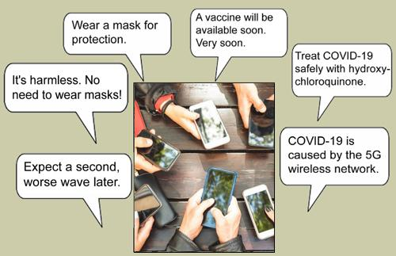
The COVID Conundrum:
An Inquiry into Credibility
© 2022. Douglas Allchin
http://shipseducation.net/covid

Slide 2
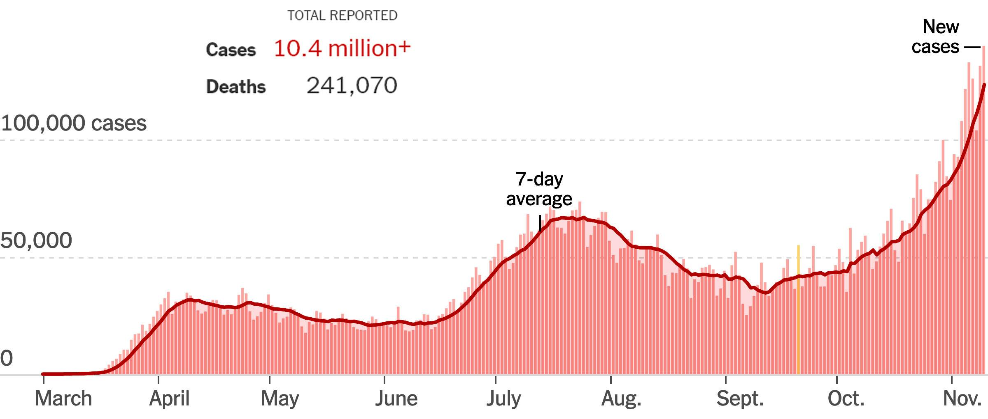
Help label the axes?
What does this graph convey?
New York Times, Nov. 11, 2020

Slide 3
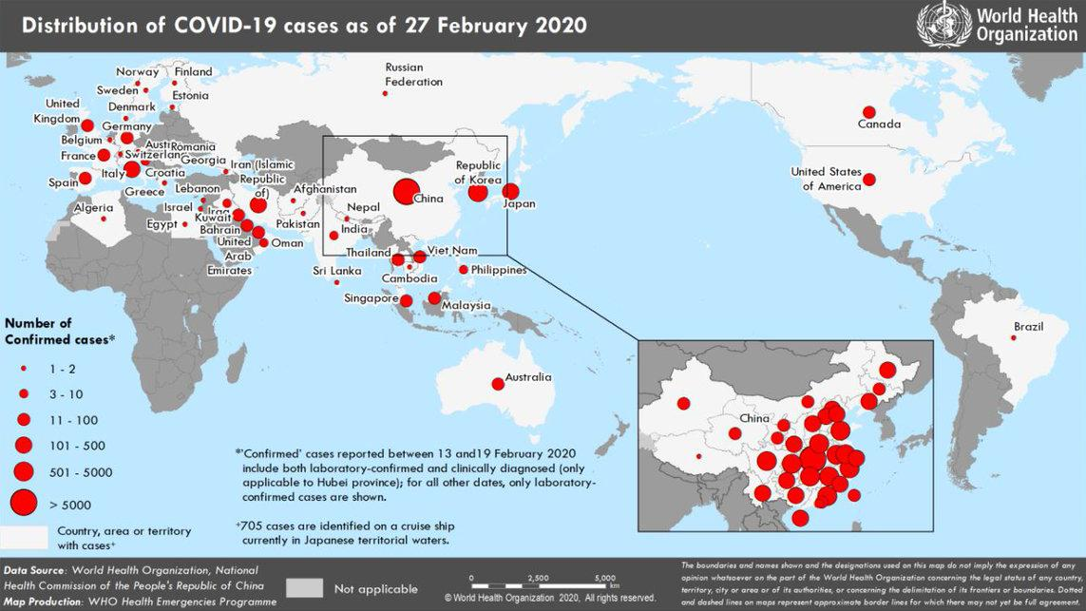
Do you recall when you first heard about the coronavirus?
What were your initial impressions?

Slide 4
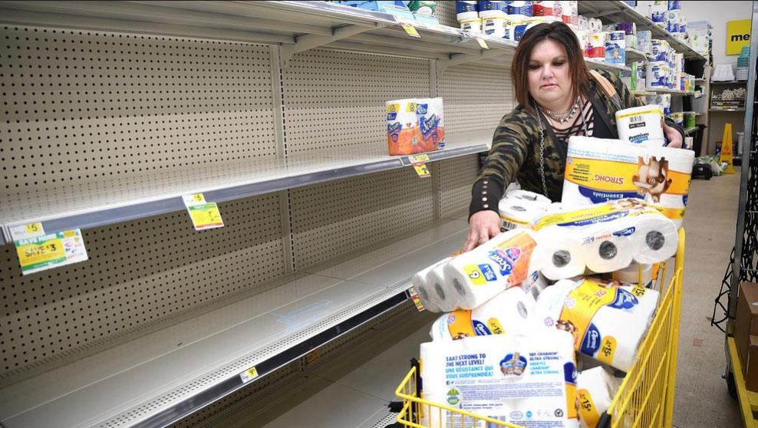
hoarding of toilet paper, sanitizer, face masks, grocery staples

Slide 5
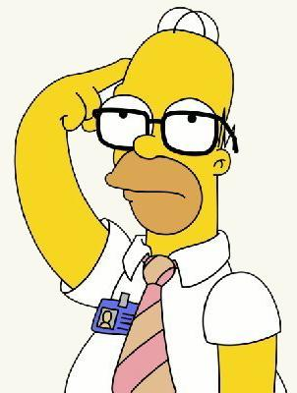
Our challenge:
Which scientific
claims should
you have trusted?

Slide 6
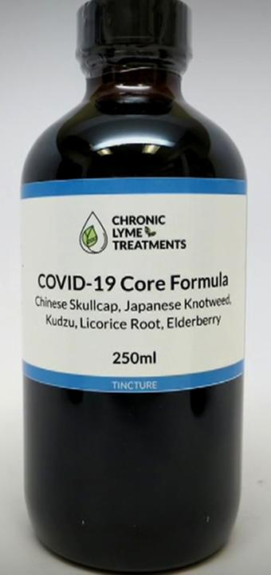
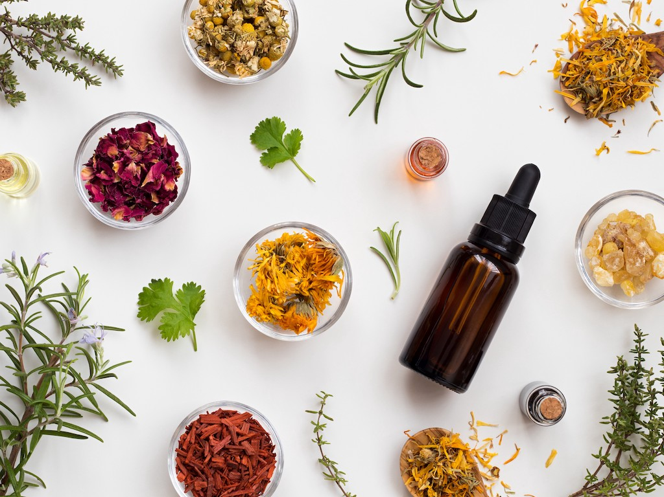
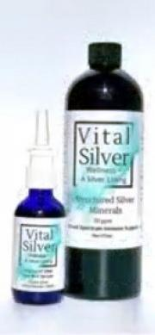
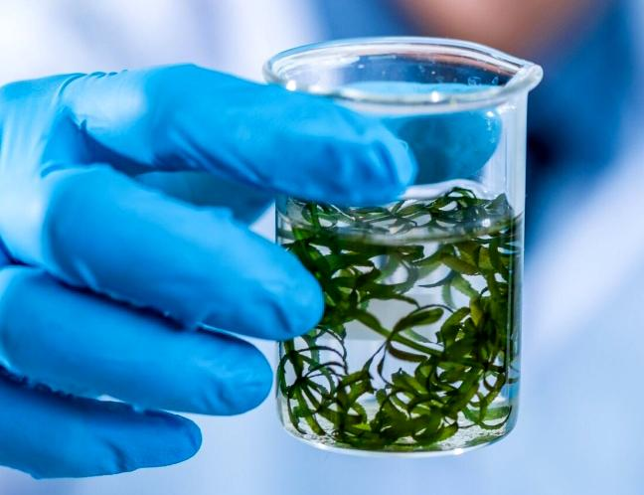
Remedies for sale: elderberry tincture, anti-viral aromatherapy,
oregano oil, colloidal VitalSilver, boneset tea, frankincense
Are any of these effective? How would you know?

Slide 7
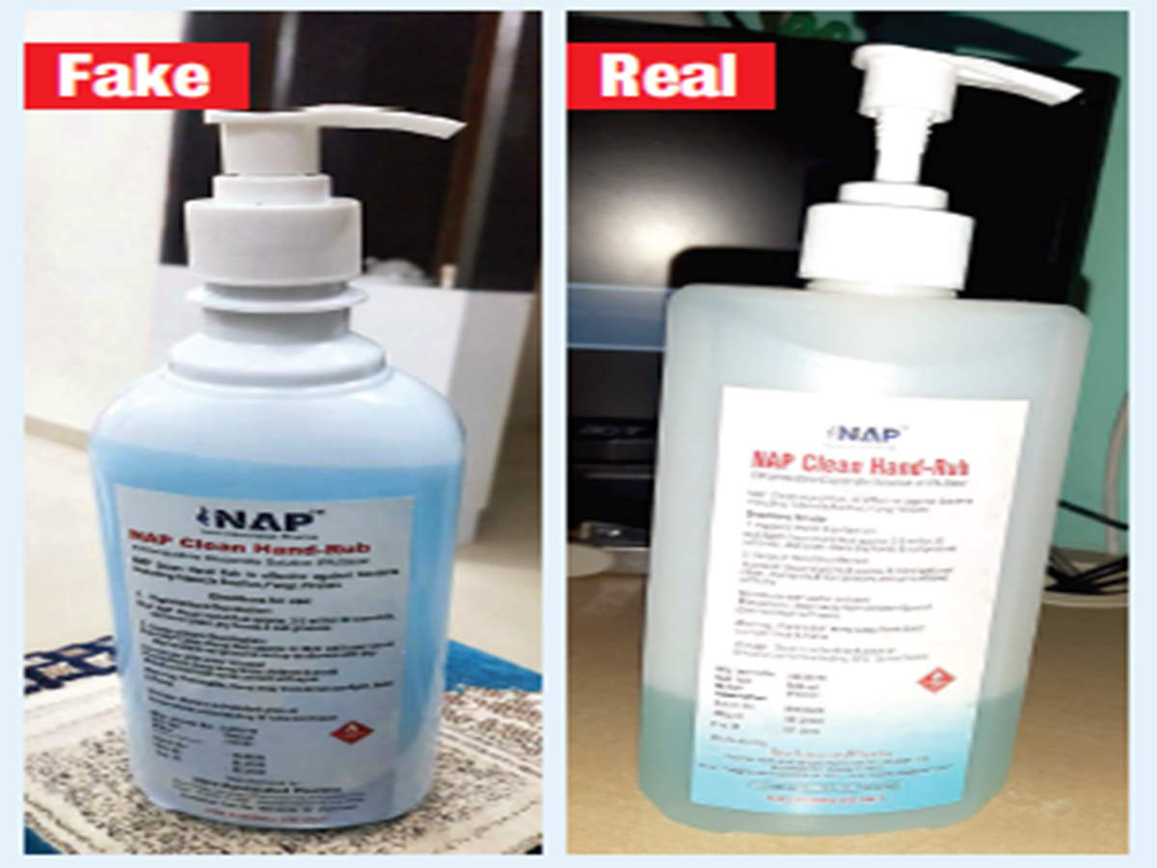
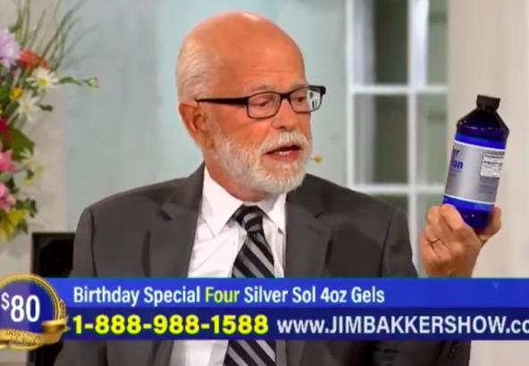
fake hand sanitizer (India)
U.S. Food & Drug Administration stops fraudulent sales
How do you detect fraud?

Slide 8
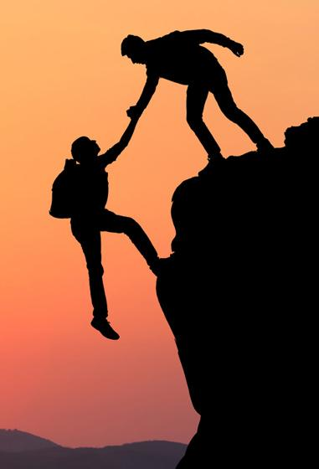
Why--or when--do we trust others?
How is trust about scientific information different from trust about moral guidance or personal loyalty?

Slide 9
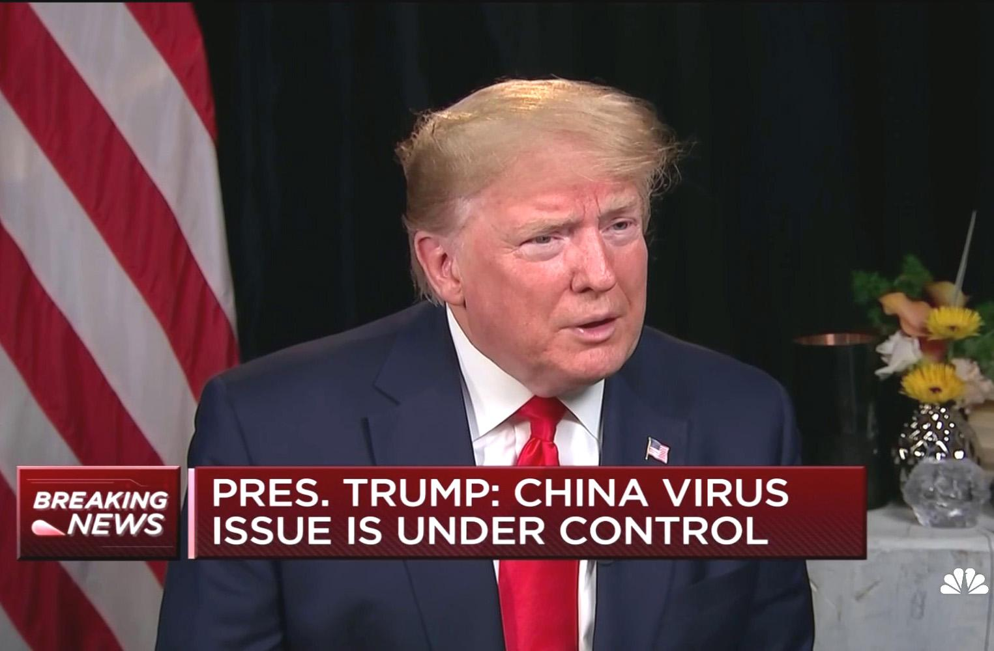
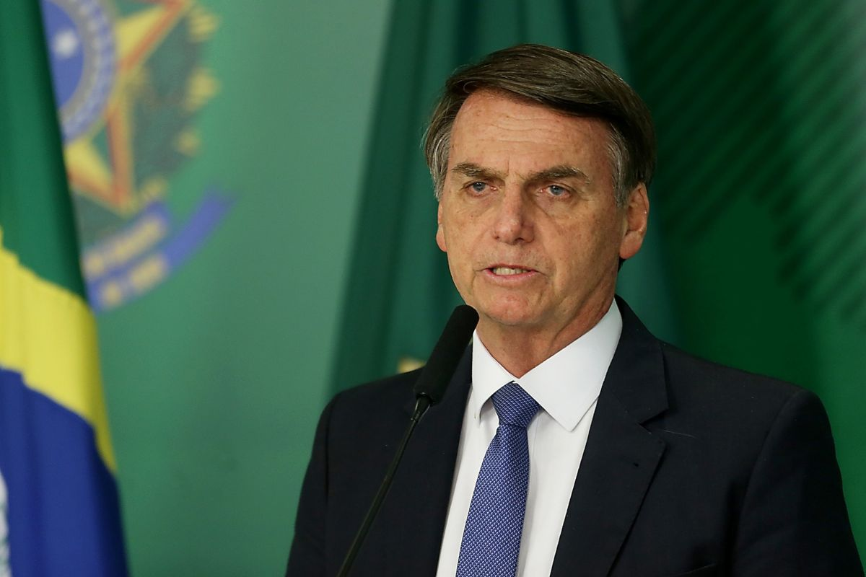
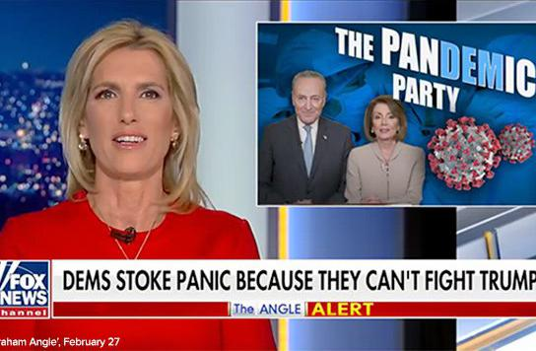
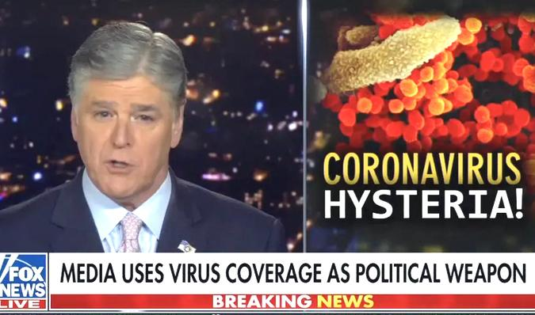
How serious was the threat? From a historically situated perspective, how should you have assessed different claims?

Slide 10
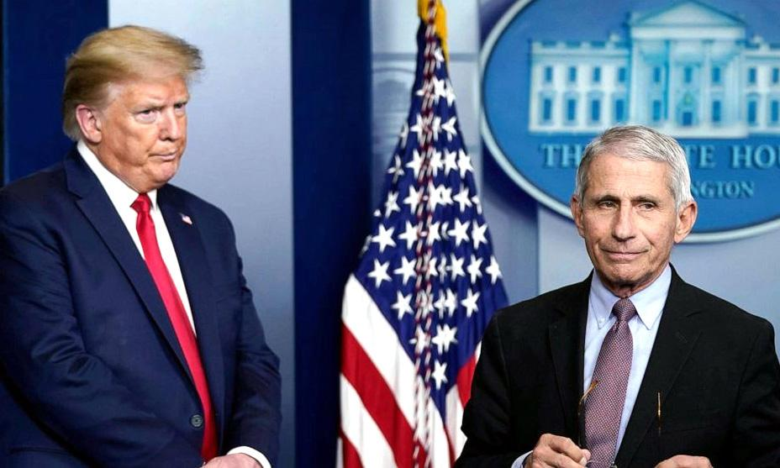
Assessments by Donald Trump (U.S. President) and Dr. Anthony Fauci (Director of the National Inst. of Allergy and Infectious Diseases) differ.
Who is qualified to know? What is expertise?

Slide 11
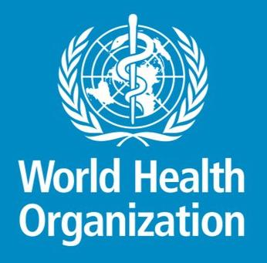
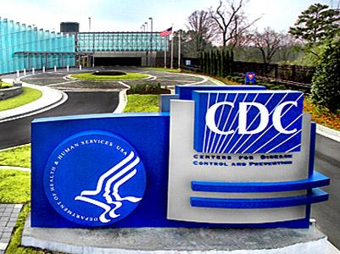
How do scientific institutions achieve their credibility?

Slide 12
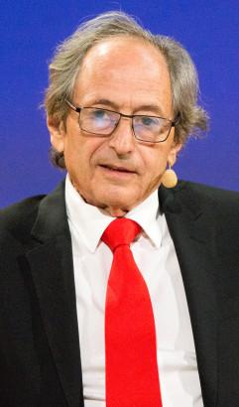
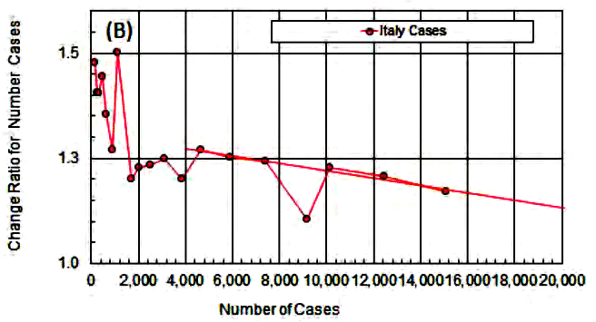
March 24, 2020 -- Nobel Prize-winner Michael Levitt declares peak and predicts decline of cases in Italy, the U.S. and elsewhere.
Were Levitt's claims credible? On what basis?

Slide 13
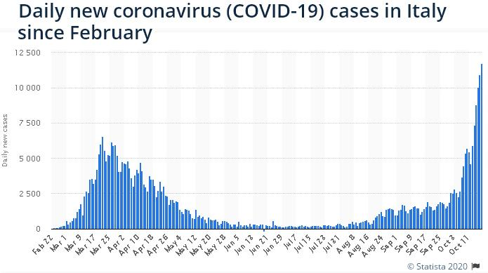
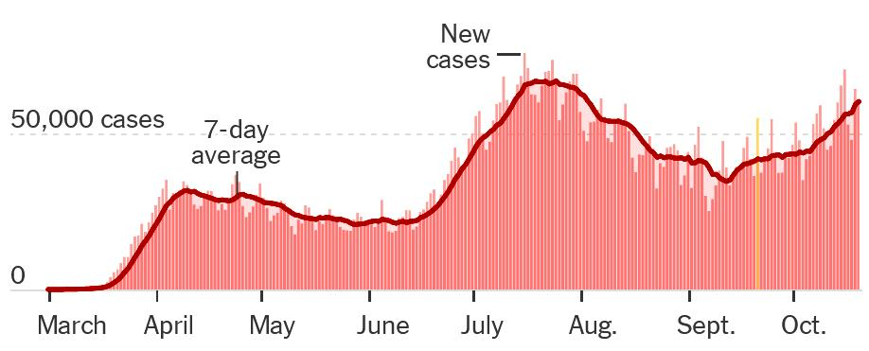
Levitt's claims were wrong.
Why was he not credible?

Slide 14
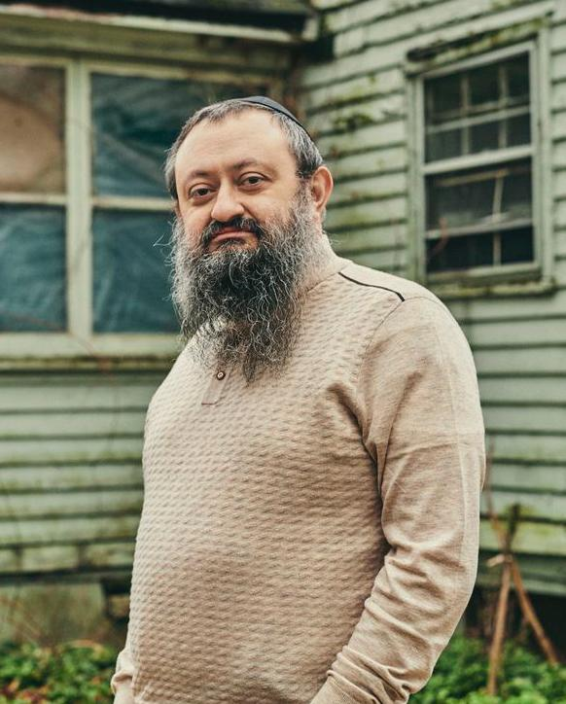
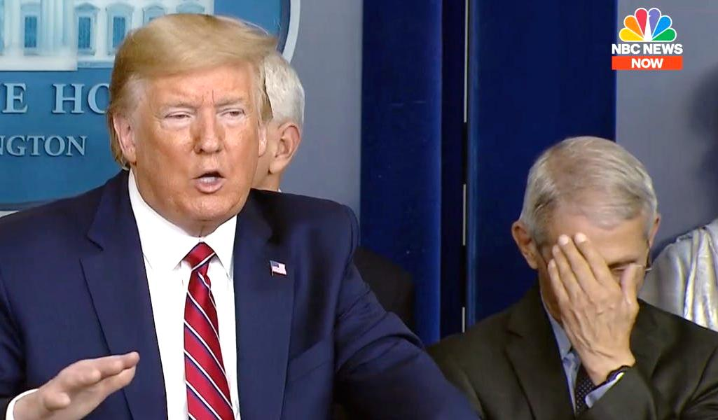
March 21, 2020--A rural doctor reports 100% cure with HCQ.
President Trump calls it a "game changer." Dr. Fauci says the evidence is "anecdotal."
Miracle cure or tantalizing hype? What should be the basis for your belief -- reported evidence or expertise?

Slide 15
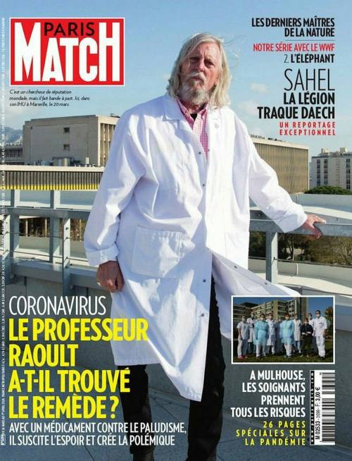
April 12, 2020 -- The publication of the original study on HCQ is questioned by fellow French scientists.
How would you learn about criticism in the scientific journals?

Slide 16
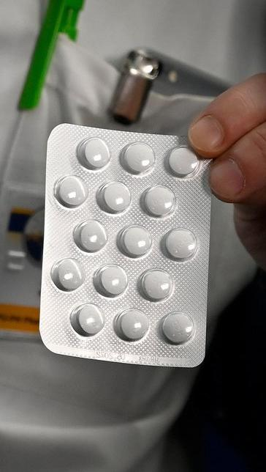
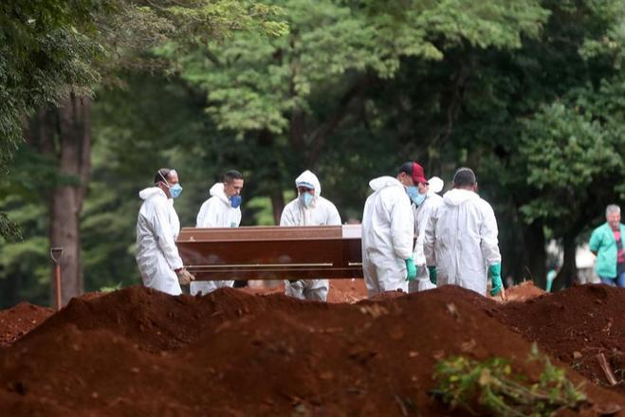
April 12, 2020 -- A small Brazilian study of HCQ is halted when many participants die.
Verdict?: oversold false hype.

Slide 17
REVIEW:
We should not have trusted these three "experts." Why not?

Slide 18
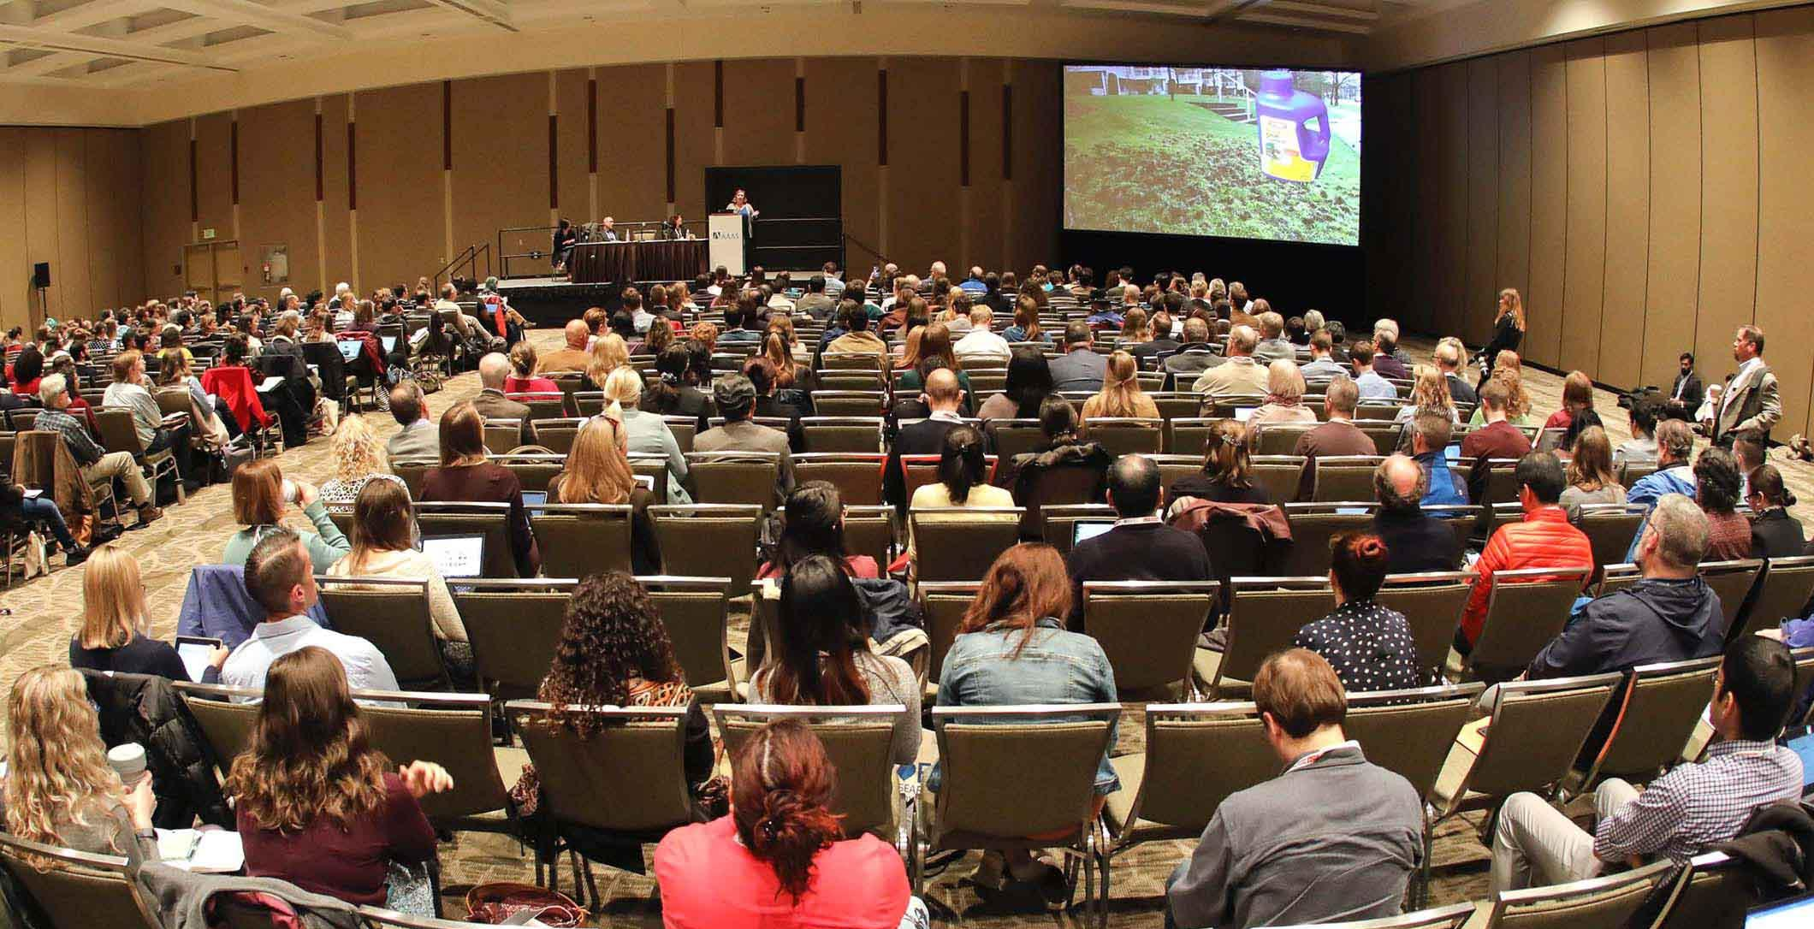
Science depends on a consensus of qualified experts.

Slide 19
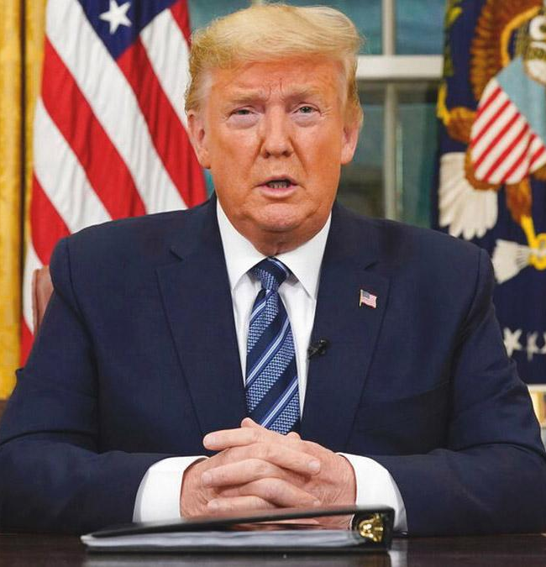
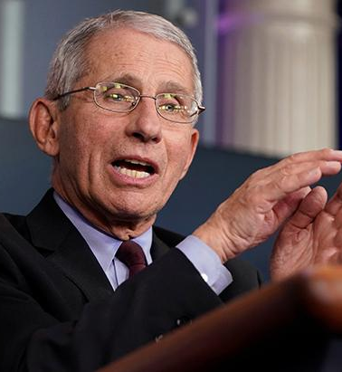
March 11, 2020 -- Trump: "We will have a vaccine very soon."
March 31, 2020 -- Fauci: Expect a "second wave" in the fall
April 3, 2020 -- CDC: Wear a mask in public.
Thinking historically, what should have been the consumer's basis for the most trustworthy claims?
Evidence, arguments, or expertise?
Personal judgment or reliance on experts?

Slide 20
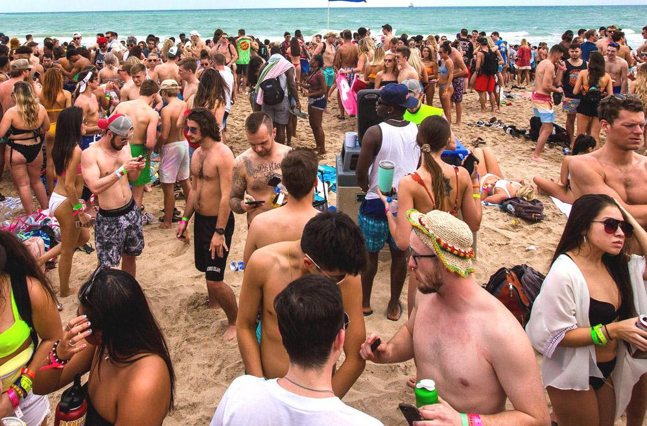
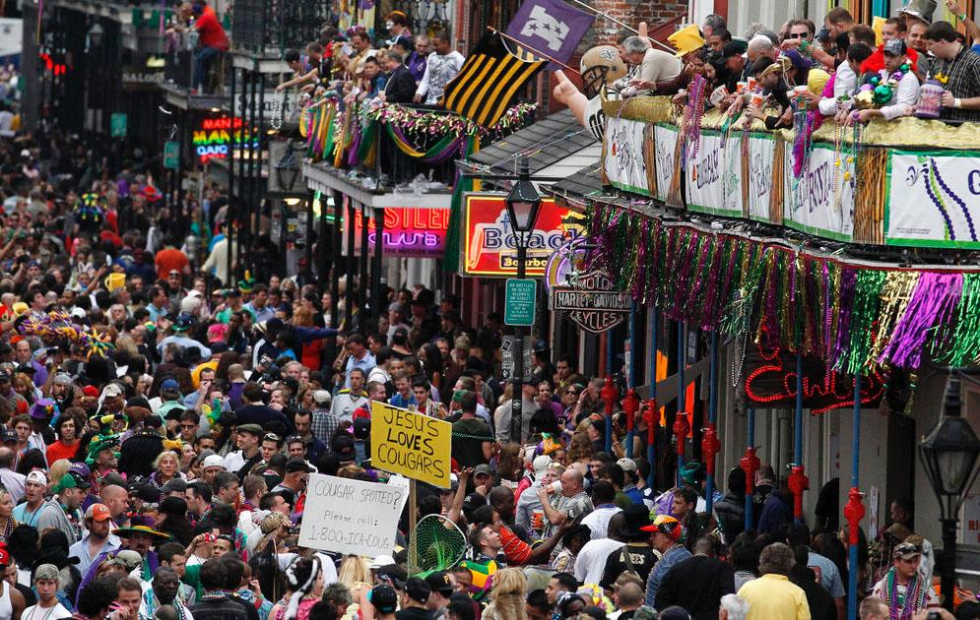
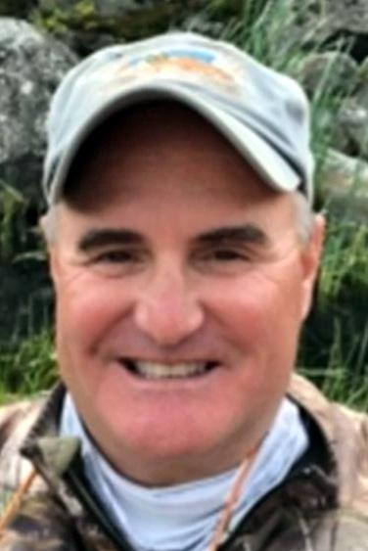
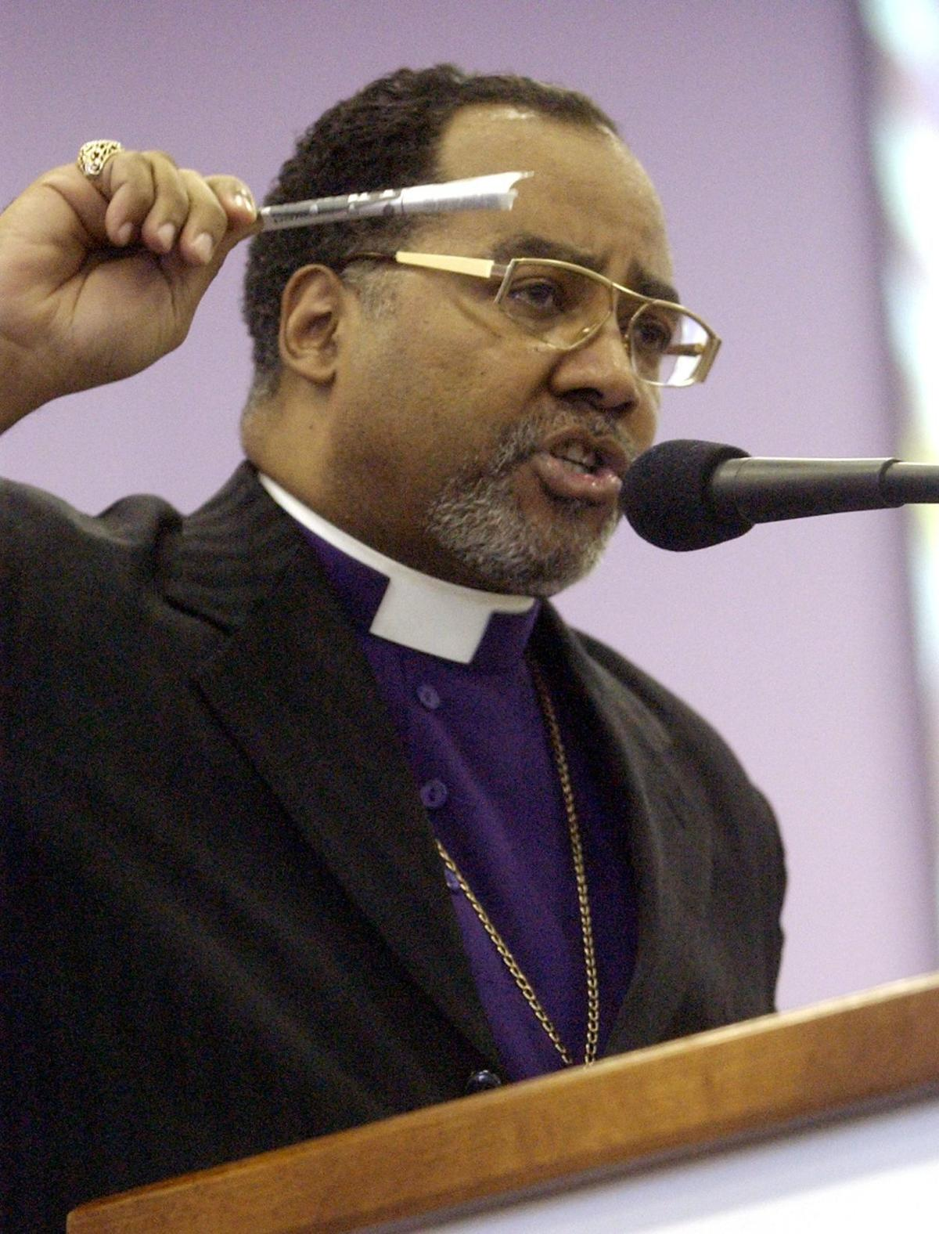
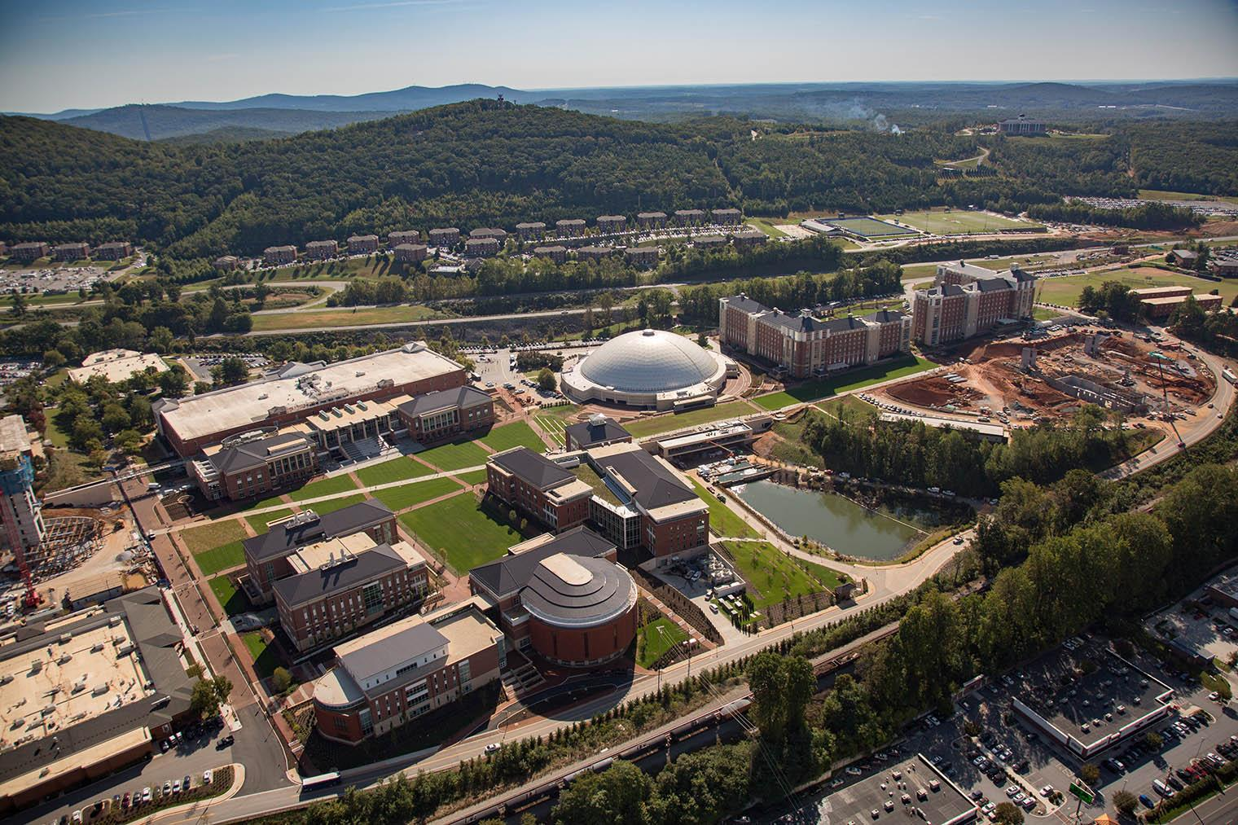
The costs of disregarding expertise: college students partying on beach and Mardi Gras celebrants spread covid to family and friends; two vocal covid-critics died of covid; a university in Virginia re-opened and spread covid to local town residents

Slide 21
How could you have tried to persuade someone who did not view covid as a risk to respect the scientific expertise and consensus?

Slide 22
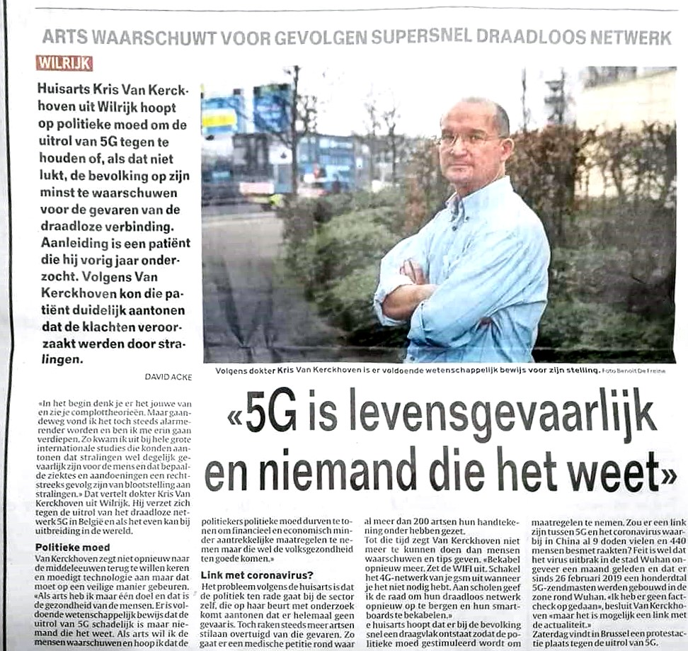
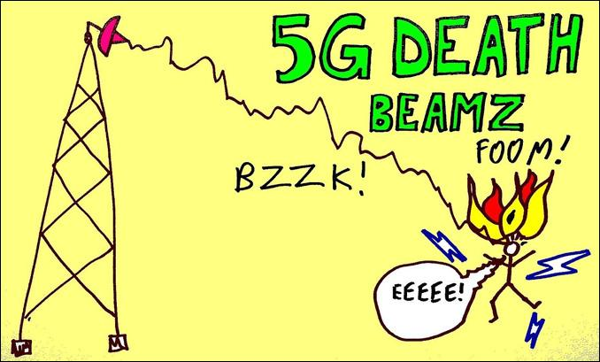
Jan. 22, 2020 -- Belgian doctor claims "5G is life-threatening, and no one knows it” — and it caused the covid pandemic in China
… Just compare the maps!

Slide 23
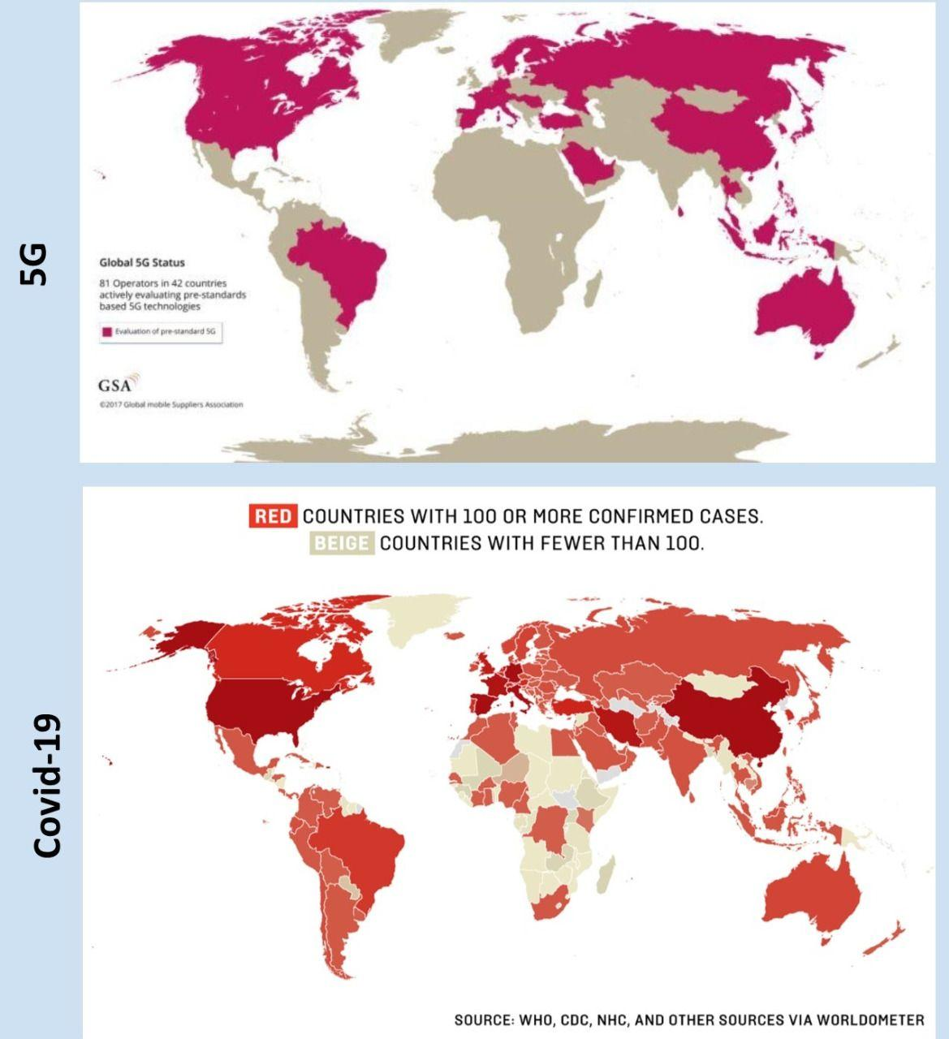
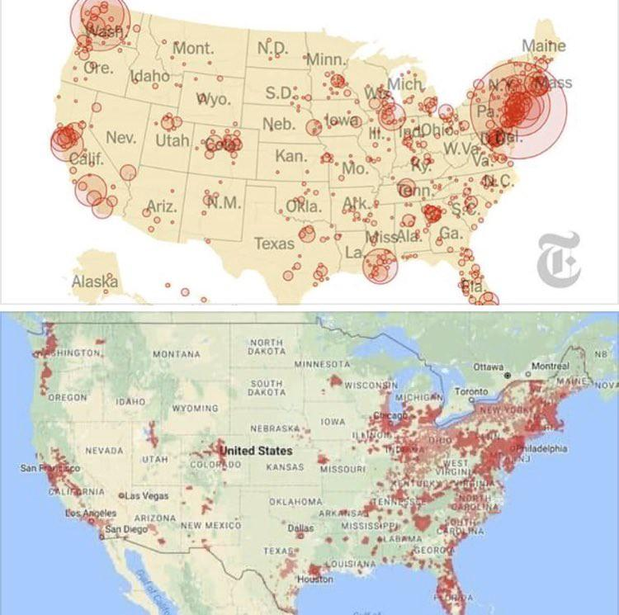

Slide 24
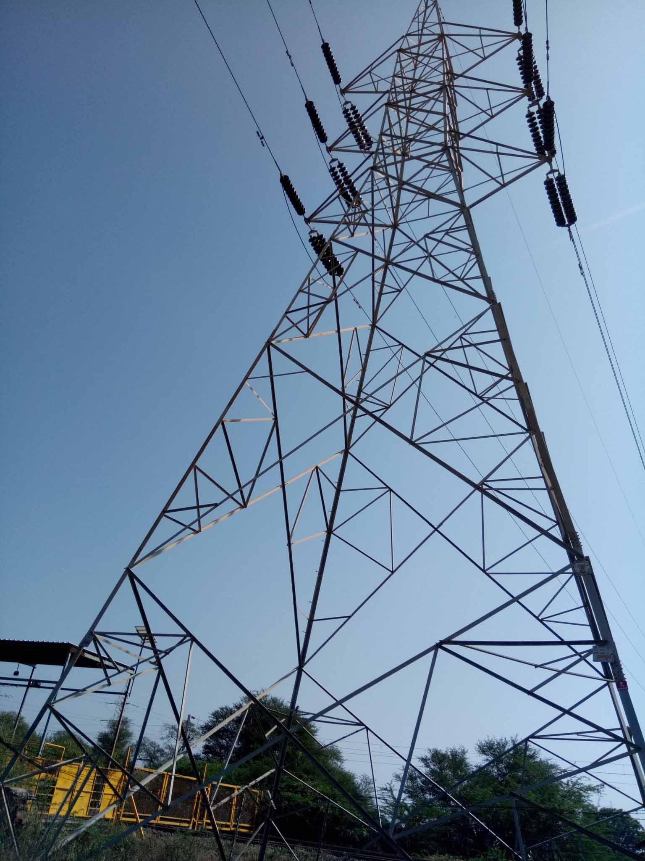
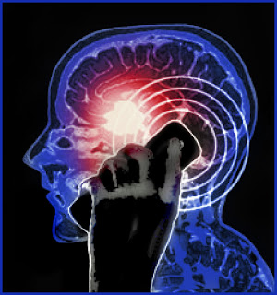
online evidence for cell phones causing cancer, including an Italian Supreme Court ruling
online evidence for cancer
from high voltage power lines

Slide 25
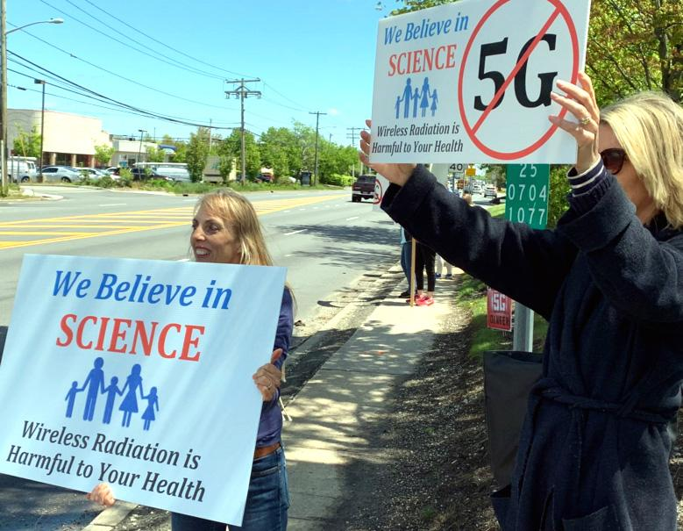
Explain whether these maps, theories and supplemental evidence are sufficient for believing the 5G theory of covid.

Slide 26
Correlation is not causation.

Slide 27
Correlation evidence from 1980s-90s was attributed to confounders. Earlier published studies were invalidated.

Slide 28
Systematic studies, repeated many times, have failed to establish a relationship between cell phone radiation and any adverse health effect. Online information is hearsay only.

Slide 29
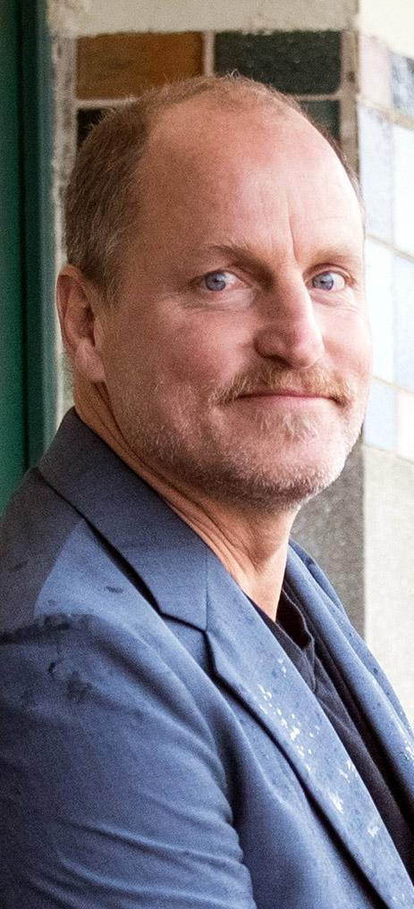
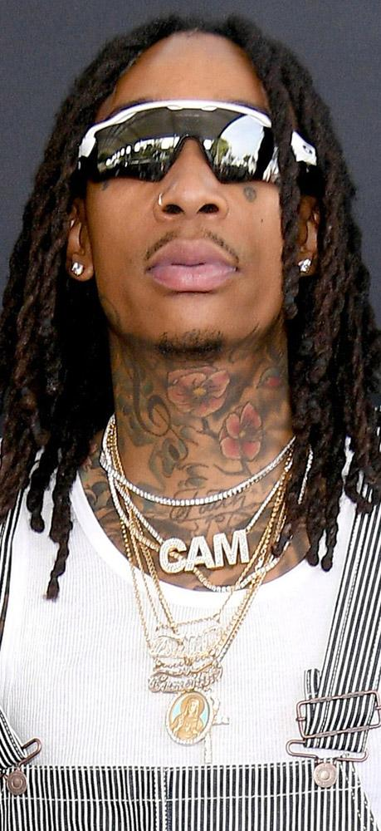
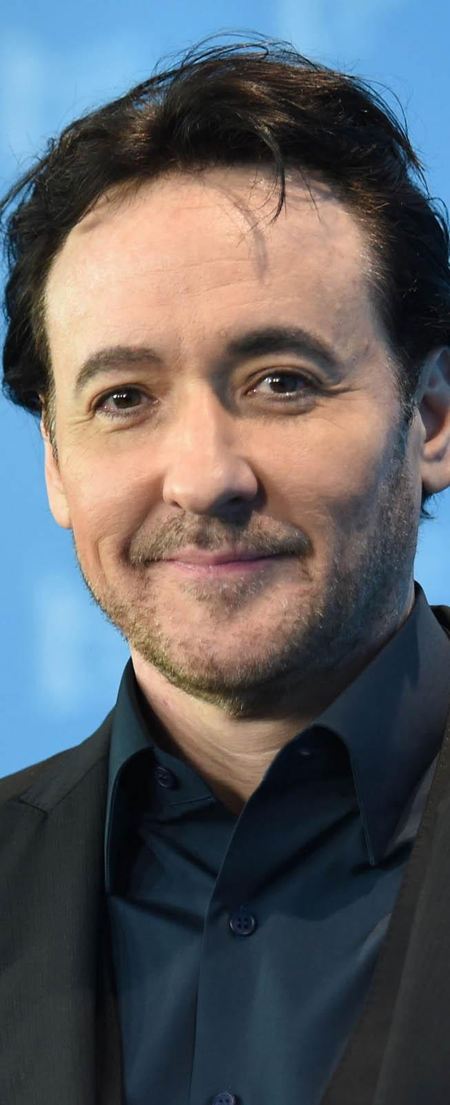
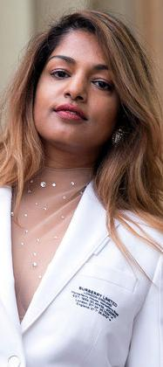
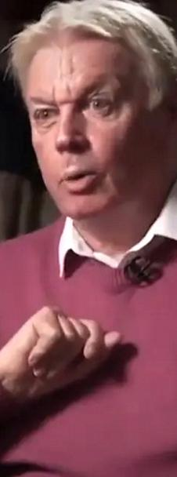
Many celebrities have promoted the 5G theory.
How should we regard their testimony?

Slide 30
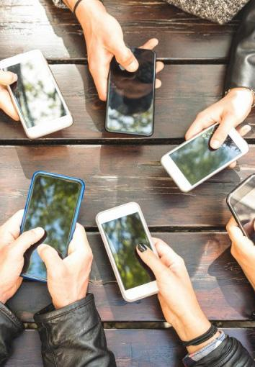
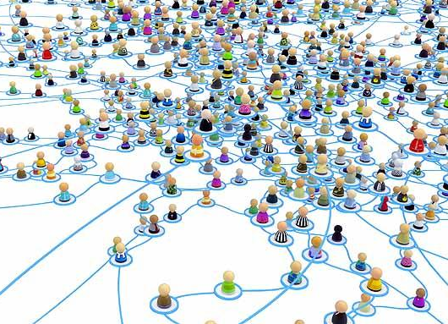
False information can spread rapidly and widely through social media, unchecked.

Slide 31
Communication within "bubbles" can create false consensus effects.

Slide 32
5G cell towers were widely vandalized in Europe.

Slide 33
U.S. blames China.
China. blames U.S.
May 16 – Eric Trump calls virus a hoax to impede his father's election.
April 24 –Donald Trump suggests drinking bleach.
Many false theories circulated widely, believed by many.
How might you escape believing such false theories?
How would you argue to someone else who did believe them?

Slide 34
In reviewing the history of covid, what have you learned about how to know which scientific claims are trustworthy, and which are not?

Slide 35
REAL-WORLD TEST: A new scientific study claims that mouthwash will kill the coronavirus.
https://onlinelibrary.wiley.com/doi/10.1002/jmv.26514
How should you decide if this can keep you safe?

Slide 36
COVID: An Inquiry into Credibility
© 2022. Douglas Allchin
http://shipseducation.net/covid

