Slide 1
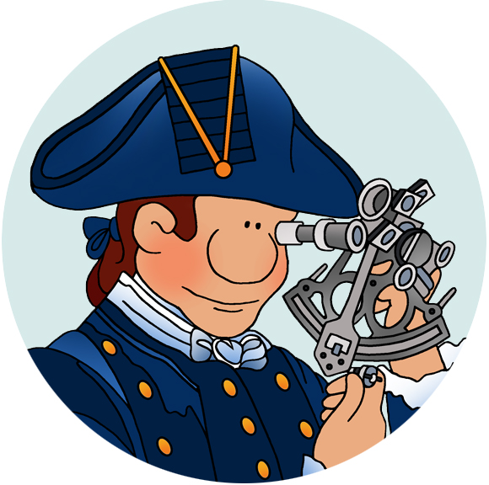
Fact-Checking 102
The Concepts behind Reliability
© 2024 Douglas Allchin http://shipseducation.net/misinfo

Slide 2
In Fact Checking 101, you learned to:
Stop, take your bearings, and find out who is making a claim, and why
Investigate the credibility of the source online
Find multiple sources or Trace the origin of information to confirm simple facts
Establish a source’s expertise
Determine the consensus of the relevant scientific experts
Now it's time to explore the concepts in more detail.

Slide 3
Fact-Checking 102
Who is making the claim and why?

Slide 4
If misinformation is a concern,
why should we care about an author’s motivation (or implicit purpose)?
Why might someone try to mislead you?

Slide 5
Why might someone try to mislead you?
a salesperson?
a CEO deciding their own salary?
an investment advisor?
a candidate for political office?
a public policy that benefits the decision-maker’s business or family?
compensation for supporting a political position (like a bribe or kickback)

Slide 6
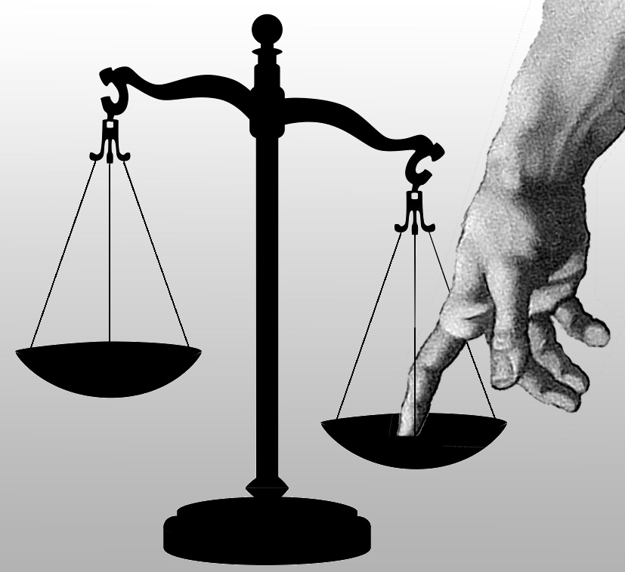
Summary: Having a stake in the outcome (profit, power, privilege) defines an interest.
A conflict of interest exists when someone who serves you is at odds with your welfare.

Slide 7
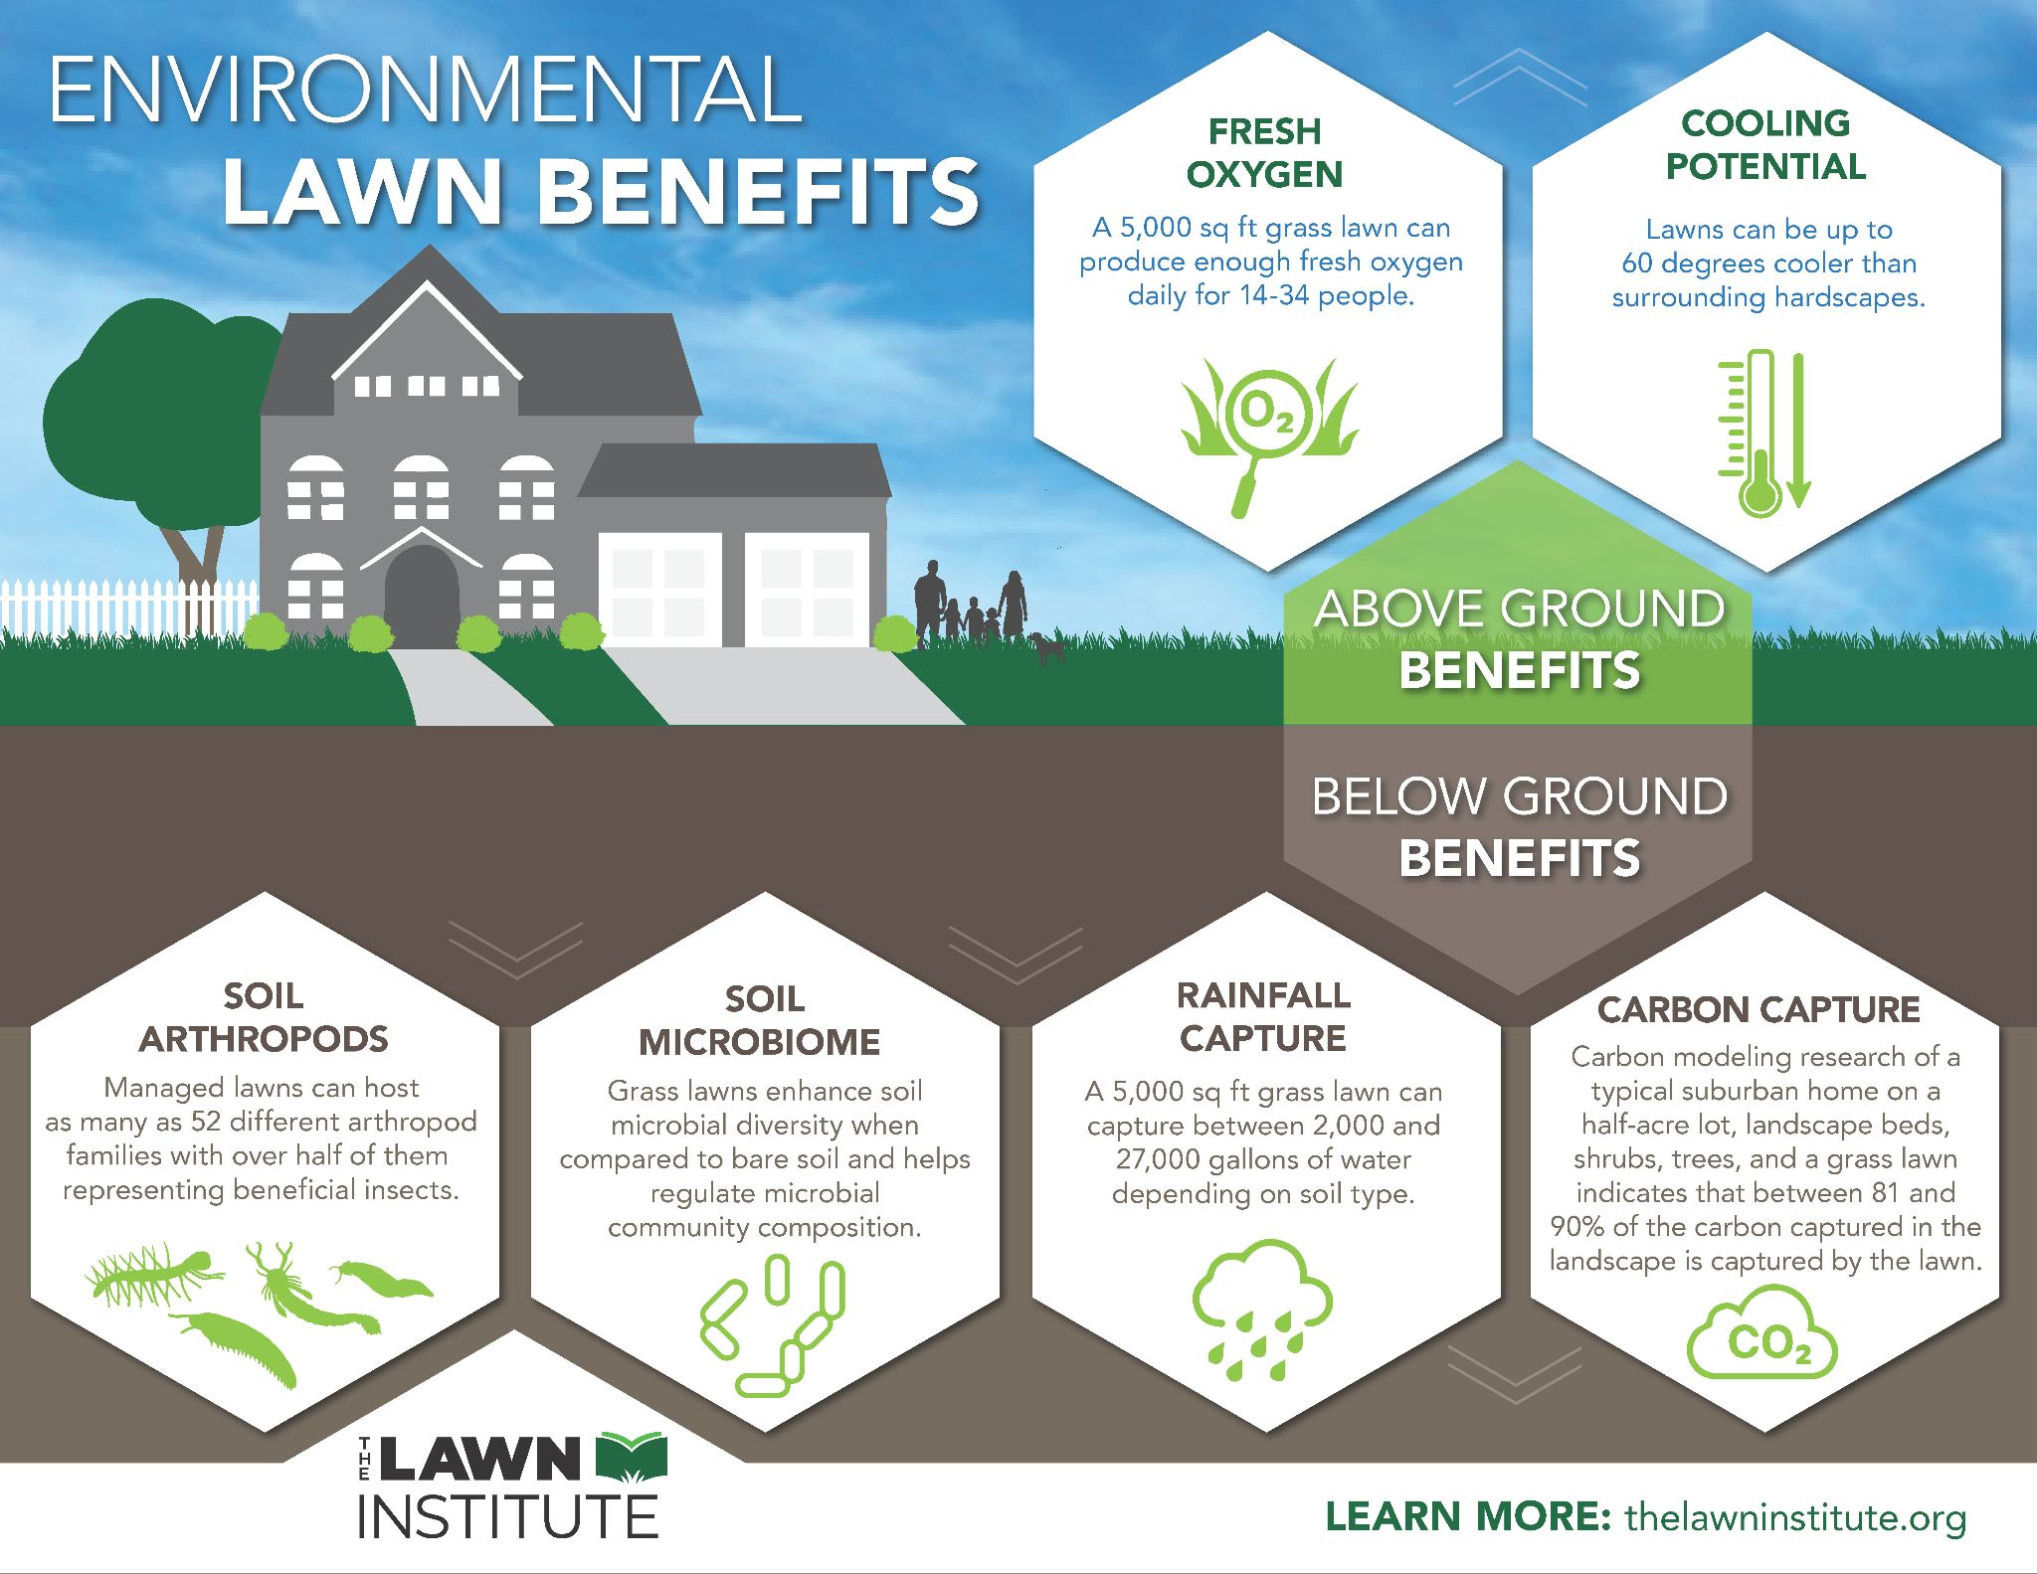
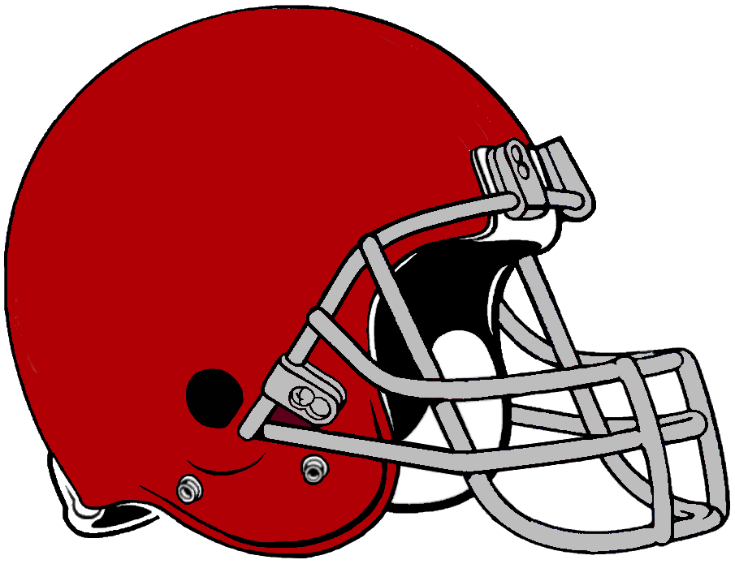
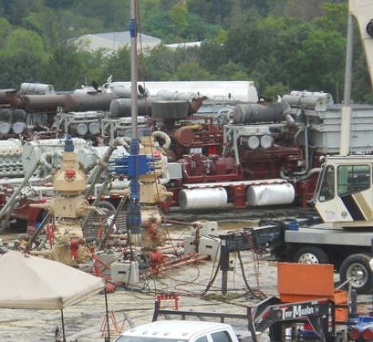
Drug research
paid for by the manufacturer,
without appropriate critical checks.
The "benefits" of lawns, presented by the turf industry, without considering the environmental harm or alternative.
Research on football helmet safety,
sponsored by the National Football League.
Claims about the safety of hydraulic fracking waste disposal, from a "dot.org" website funded by the oil industry.

Slide 8
Do you know or can you find other cases?

Slide 9
Do you know or can you find other cases?
dietary advice, from the sugared beverage industry?
exceptional health effects of vitamins, from a vitamin store?
criticism from a bitter mother of an autistic child who blames a vaccine?
denial of climate change, from the oil industry?
low heart disease risks, from the meat industry?

Slide 10
How will you identify a conflict of interest
and assess its significance?

Slide 11
How will you identify a conflict of interest
and assess its significance?
Look for signs of bias—commercial, ideological, religious? Race, class, gender?
Consider the source of funding? (Is it presented openly?)
Who is the publisher, the host website, or social media feed?
Is the author's affiliation hidden or obscured?
(Apply lateral reading?!)
Check sources with alternate interests.

Slide 12
Fact-Checking 102
Review (1): Summarize the concept of conflict of interest and describe 2 examples involving public scientific claims.

Slide 13
Fact-Checking 102
2) Investigate credibility.

Slide 14
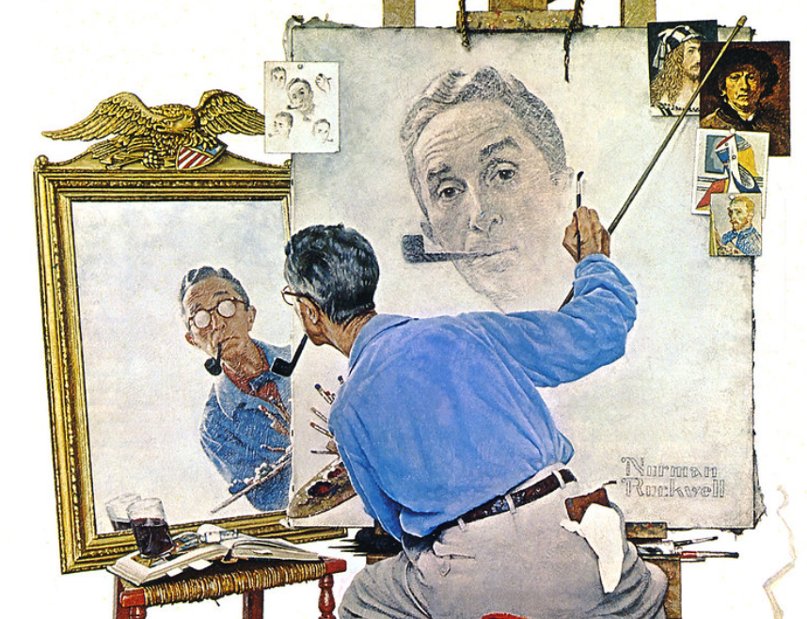
What do we mean by “credibility”?

Slide 15
What do we mean by “credibility”?
trust ?
trust with respect to truth and accuracy?
quality of information?
completeness of information?
transparency?
openness about sources & interests?

Slide 16
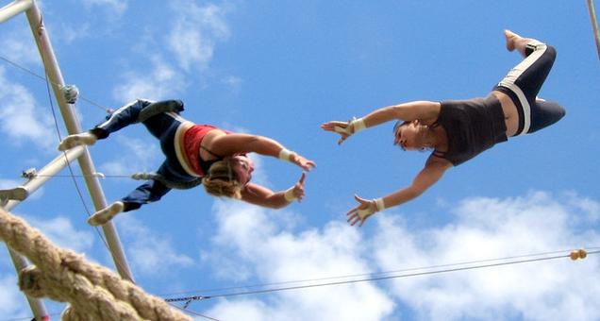
What kinds of trust are there?

Slide 17
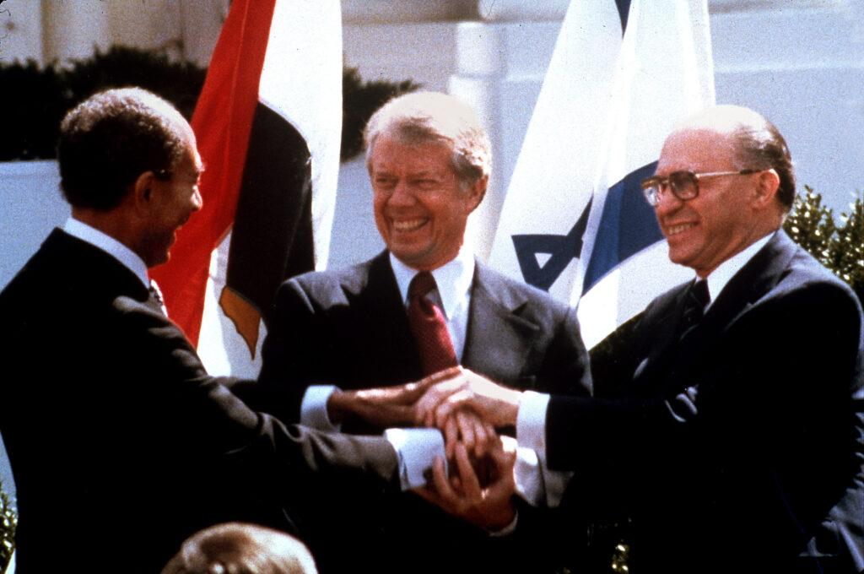
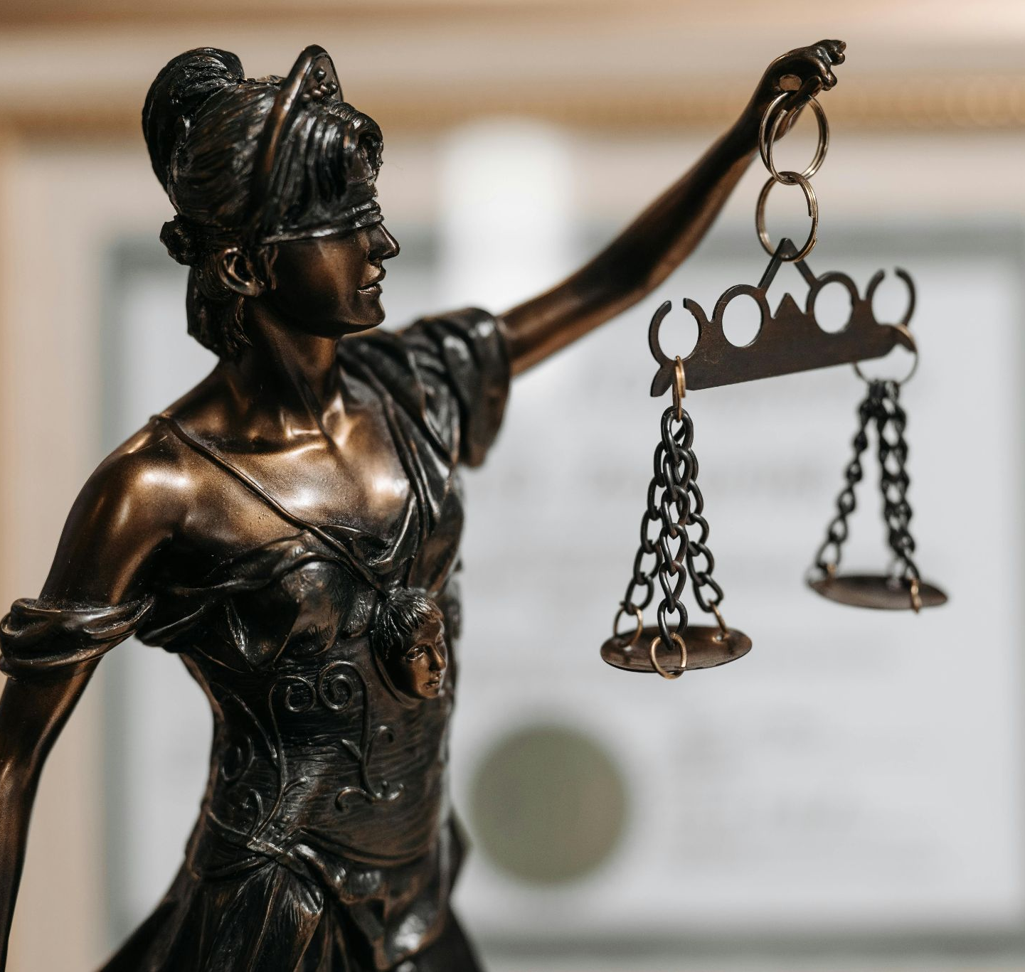
What kinds of trust are there?
promise-keeping?
loyalty?
contractual?
moral judgment?
fairness?
leadership?
knowledge & objectivity?

Slide 18
Yes, there are many kinds of trust.
One kind of trust does not imply another.
promise-keeping | loyalty | contractual
moral | fairness | leadership | knowledge

Slide 19
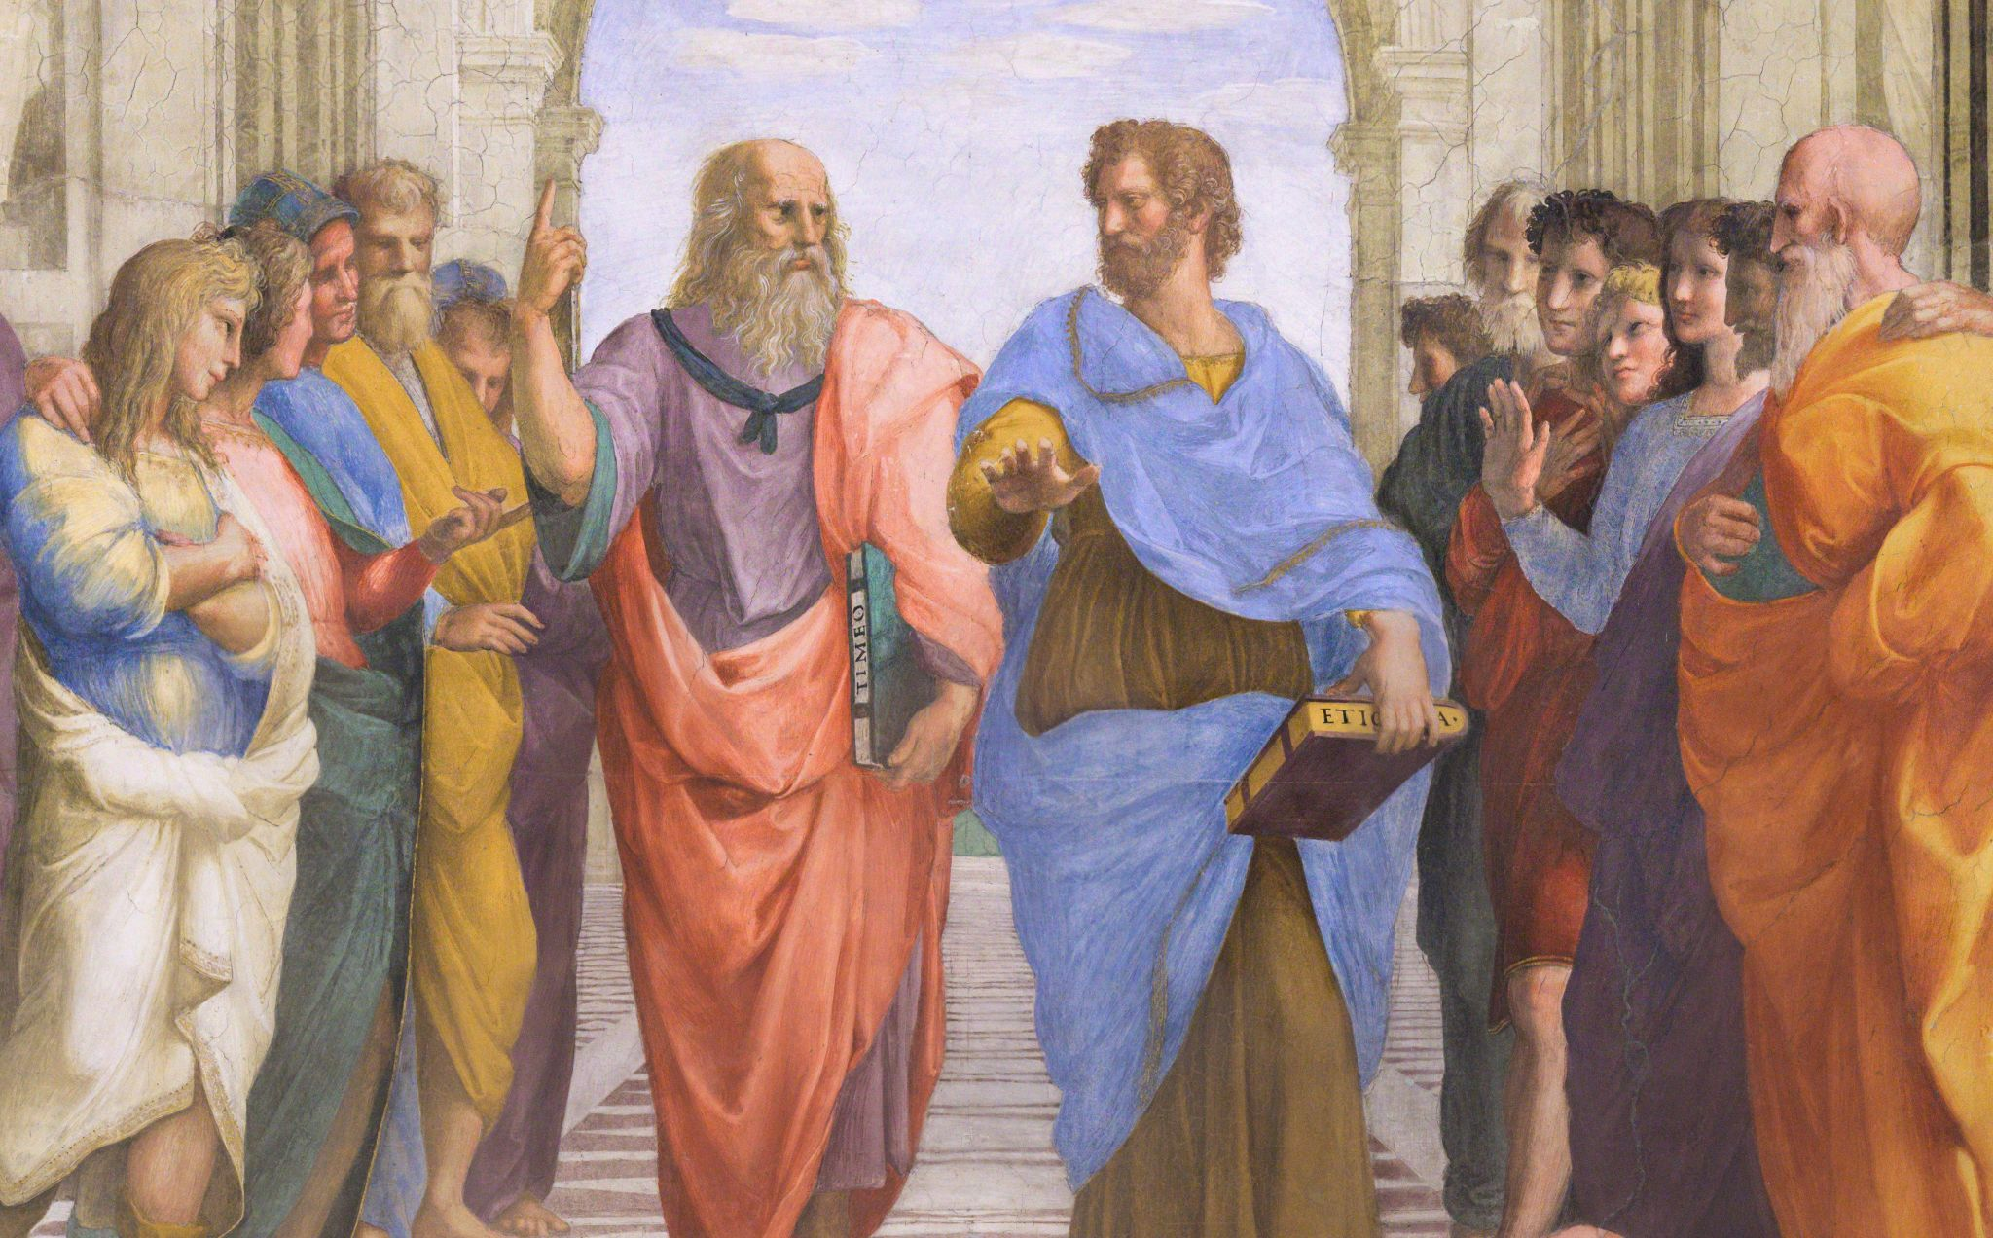
How does trust about knowledge differ from other forms of trust?

Slide 20
How does trust about knowledge differ from other forms of trust?
based on expertise (depth of knowledge, awareness of possible errors & pitfalls) that can be documented publicly
NOT based on personal relationships or social group (or political affiliation)
NOT based on personal values or personality
NOT based on moral virtues (other than respect for truth maybe)
NOT based on prestige or social status

Slide 21
What is the relationship of trust and expectation?
Similarities? Differences?

Slide 22
When might you be justified in expecting ("trusting") someone’s testimony or statements to be truthful, or credible?

Slide 23
When might you be justified in expecting (trusting) someone’s testimony or statements to be truthful, or credible?
track record; or a documented history or pattern of truth-telling (by inductive reasoning)
system of accountability (negative sanctions for lying or misleading) (by context)
checking (“calibrating”) sources against other sources you know (by analogy)
recommendations from other trusted sources

Slide 24
Is trust (or “trustworthiness”) a personal judgment, or one that can be assessed objectively, through observable behaviors accessible to all?

Slide 25
Ideally, trustworthiness should be
justified publicly,
transparent, and
accountable

Slide 26
Fact-Checking 102
Review (2): Summarize the concepts of trust and credibility. Name several core criteria that justify when you can expect reliable scientific claims.

Slide 27
Fact-Checking 102
3) Find multiple sources.

Slide 28
Why would consulting only one source leave us vulnerable to misleading information?

Slide 29
So how do multiple sources help? (Why is that valuable?)

Slide 30
So how do multiple sources help? (Why is that valuable?)
Information is more likely to be complete – fewer "blind spots" or errors.
Less likely to rely on "cherry-picked" evidence.
The sampling of views will be more diverse.
Easier to spot individual biases.
Independent confirmation adds to reliability.
Shared conclusions from contrasting positions are more "objective."
More likely to detect uncertainties, disagreement.

Slide 31
How should you manage multiple sources?

Slide 32
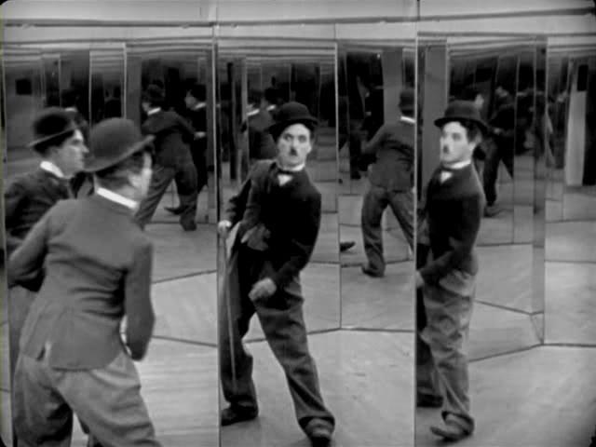
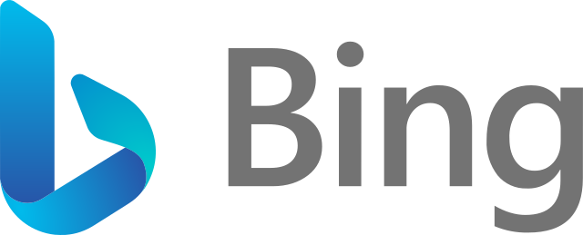
Internet search engines often foster confirmation bias.
They may reflect your prior views – giving what you want to find (what your keywords "asked" for), not objective information.

Slide 33
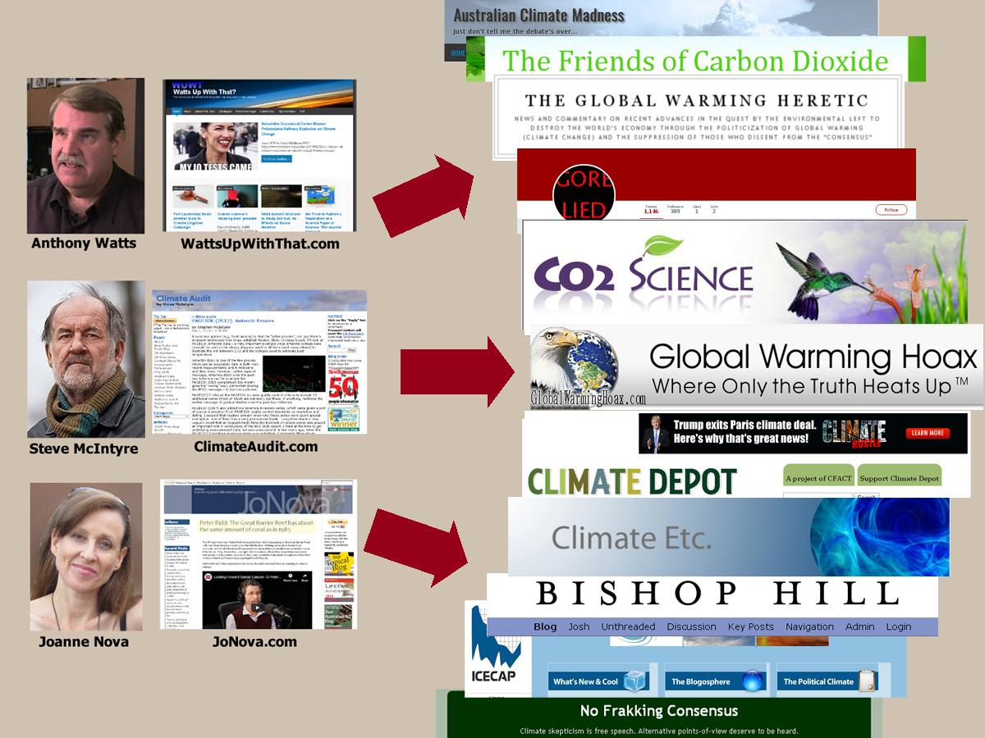
You may find dozens of websites critical of climate change.
However, most of the information comes from just 3 sources.
They give a false impression of agreement among "multiple" sources.

Slide 34
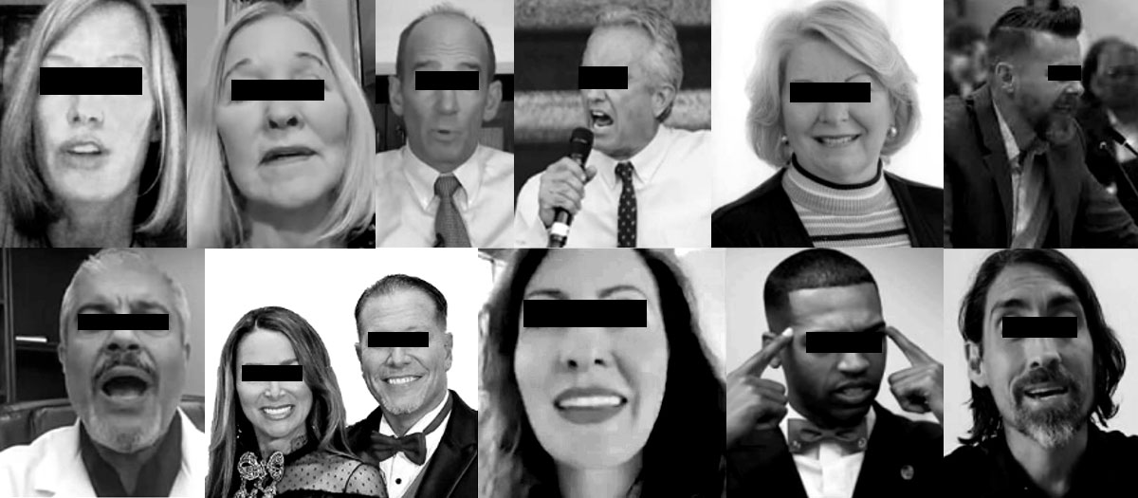
Two-thirds of the social media disinformation on COVID in early 2021 originated from just 12 individuals.
(After they were identified publicly in a research report in May 2021, the social media platform quickly closed the accounts.)

Slide 35
How should you manage multiple sources?
Seek relatively neutral or “disinterested” or “third-party” perspectives.
Seek a diversity of perspectives.
Seek complementary perspectives, or those that balance each other’s biases.
Seek independent perspectives.

Slide 36
Fact-Checking 102
Review (3): Describe the value of using multiple sources. Explain the importance of independent sources and of comparing complementary perspectives.

Slide 37
Fact-Checking 102
4) Establish expertise.

Slide 38
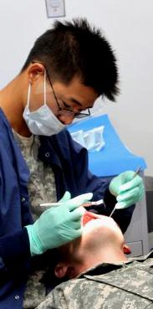
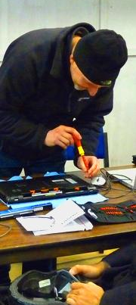
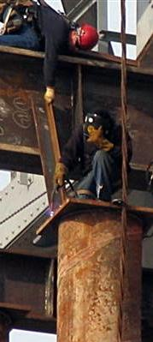
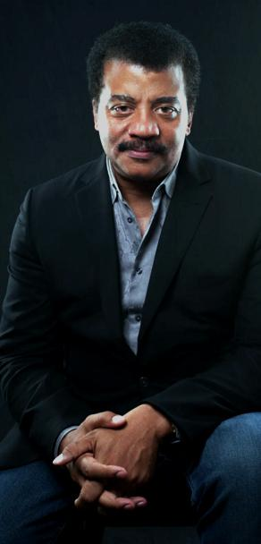
What is expertise?
dentist | lawyer | tech repair | bridge welder | scientist | pilot | accountant | military intel

Slide 39
What criteria should you use to identify experts, or someone with specialized knowledge?

Slide 40
What criteria should you use to identify experts, or someone with specialized knowledge?
a documented track record, or portfolio
advanced degree/training
certification (testing)
licensing (accountability)
credentials
peer recommendations
professional awards or prizes
positions of leadership
(valid) user reviews
relevant experience

Slide 41
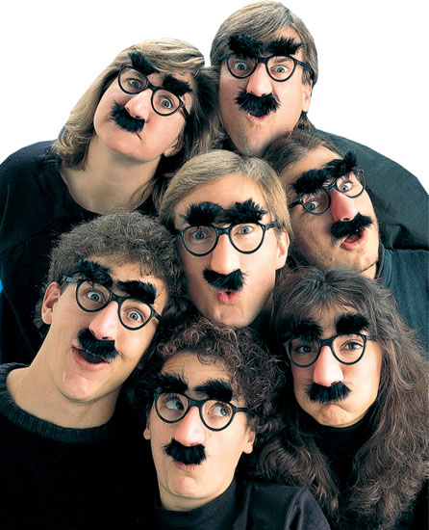
How might someone imitate scientific expertise when they have none?

Slide 42
How might someone imitate scientific expertise when they have none?
present fake credentials?
invent bogus institutions with impressive names?
create journals where “peer review” is done by like-minded reviewers?
others?

Slide 43
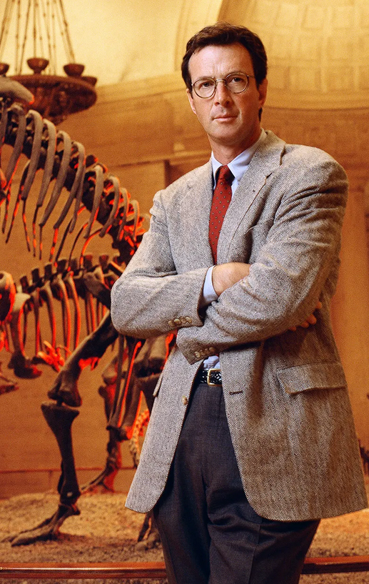
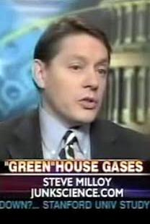
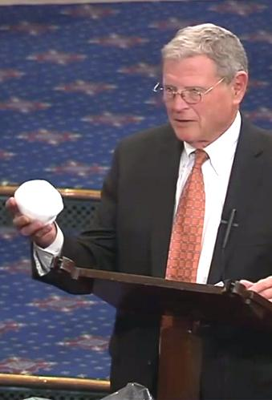
Who is an expert?
"Credentials" are not enough.
They must be scientific experts...
Vocal
climate change
"naysayers"
Michael Crichton,
renowned science fiction writer – not a scientist
Steve Milloy, founder of junkscience.com – paid for by a libertarian group
James Inhofe, U.S. senator – but not a scientist

Slide 44
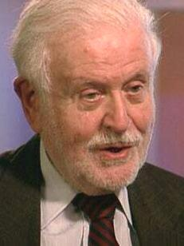
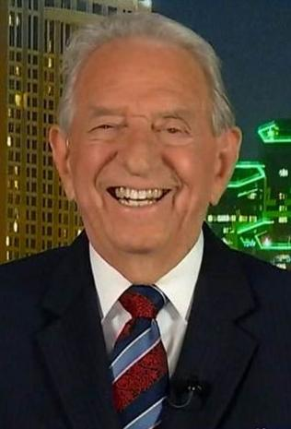
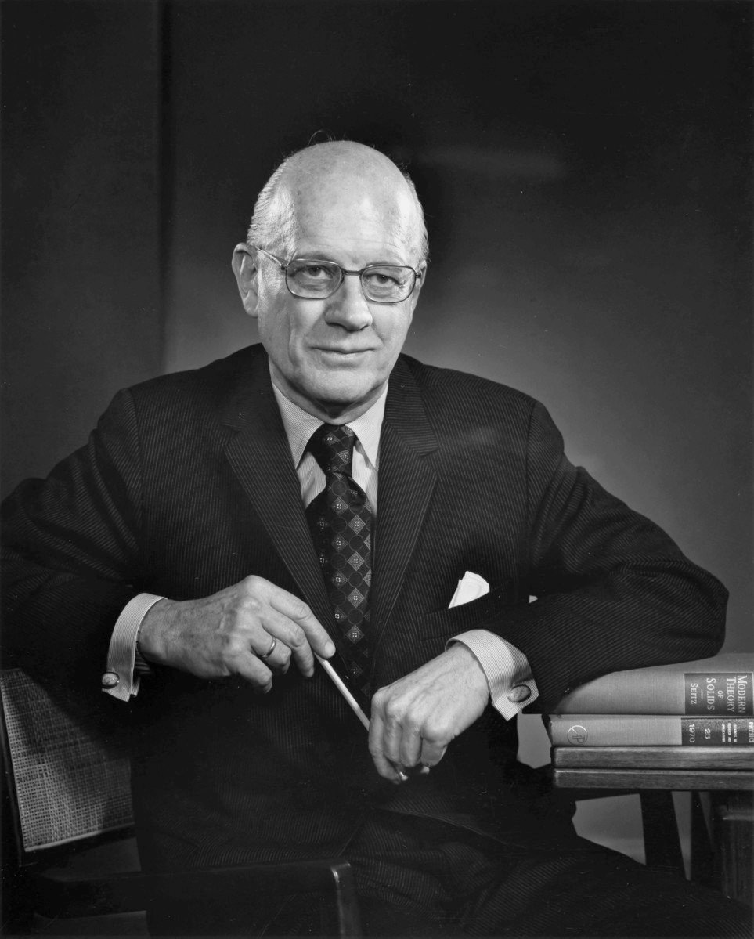
Relevant expertise matters.
More prominent climate change
"naysayers"
Fred Singer–an expert on atmospheric physics, but not climate
John Coleman–founder of the Weather Channel, but not a climatologist
Fred Seitz
solid-state physicist, defender of tobacco industry

Slide 45
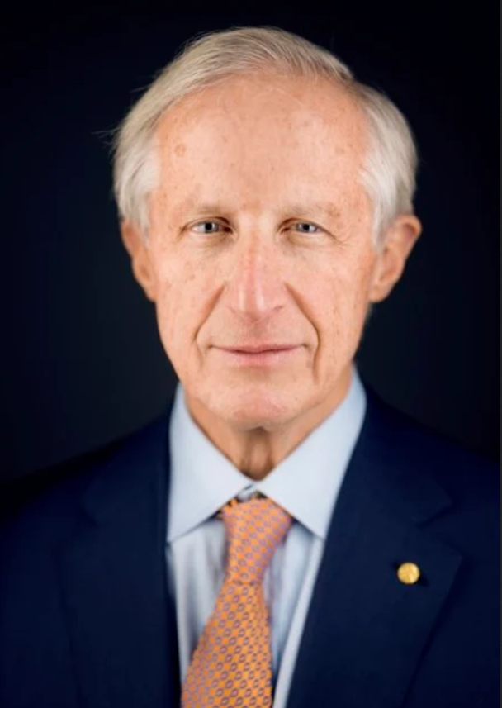
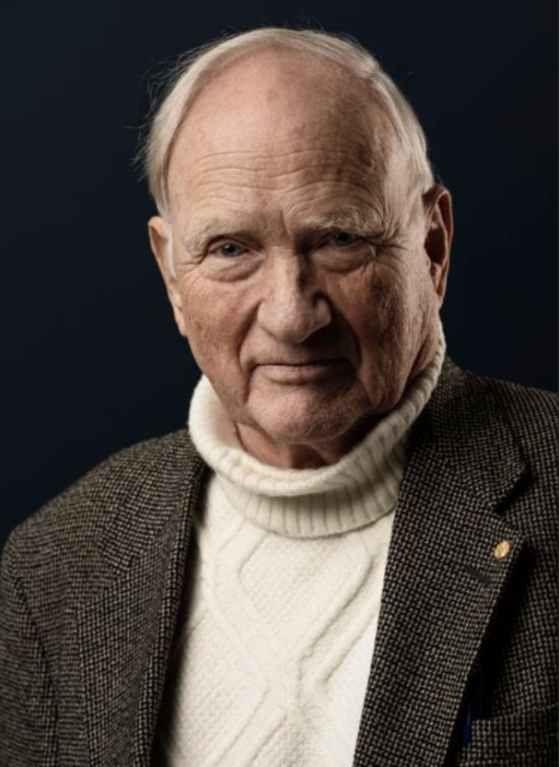
Climate-naysaying Nobel scientists?
Ivar Giaever
William Nordhaus
John Clauser
Even a Nobel Prize does not confer universal scientific expertise.
An expert must have the relevant expertise.

Slide 46
Fact-Checking 102
Review (4): Explain what constitutes expertise and how non-experts find and validate experts.

Slide 47
Fact-Checking 102
5) Determine the consensus of the relevant scientific experts.

Slide 48
Why might consulting only one expert – even if they have credentials, experience, and so on – leave us vulnerable to misleading information?

Slide 49
Scientists seek consensus.
One isolated study, one sample, one expert judgment is not enough.

Slide 50
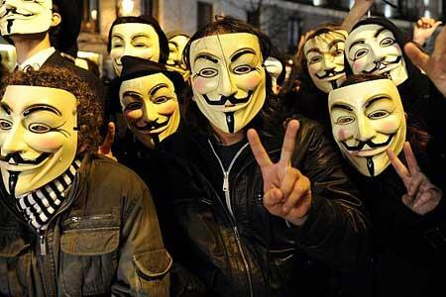
If there is uniform agreement among a certain group of people, is that a consensus?

Slide 51
Expertise matters.
A genuine consensus depends on the relevant experts.
An imitation, by the self-named "Nongovernmental International Panel on Climate Change" (NIPCC) -- created by a political think-tank
The International Panel on Climate Change (IPCC)--
written by and vetted by experts

Slide 52
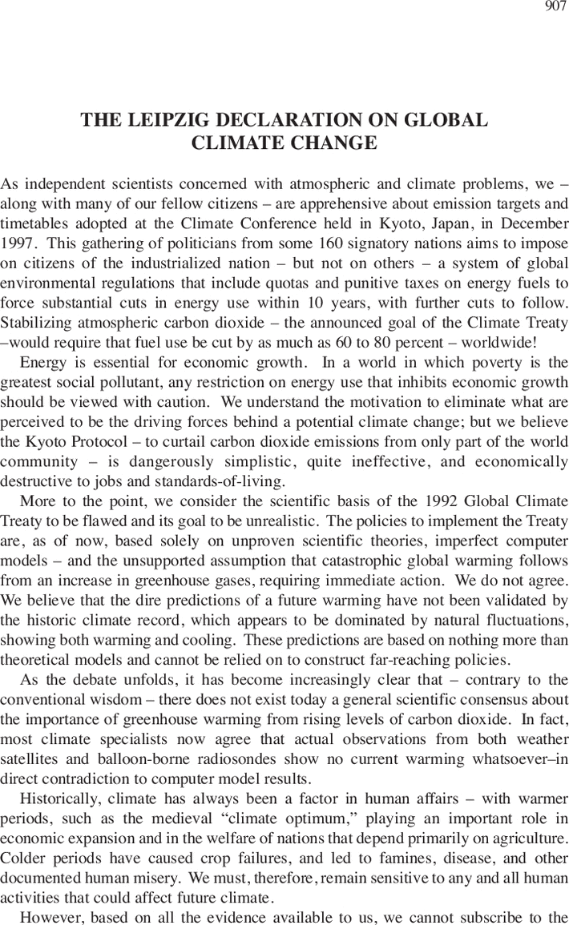
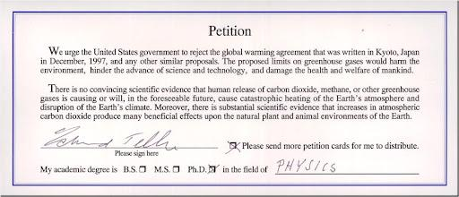
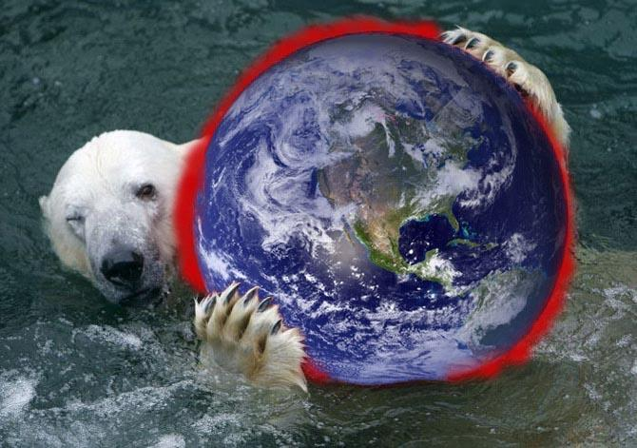
Oregon Petition (1998, 2007)–
over 30,000 signatures
Leipzig Declaration (1995)--
an "agreement" on climate change by weathermen, dentists and oil company employees?
Beware of bogus "consensus" statements, signed by non-experts – no matter how many people signed it.

Slide 53
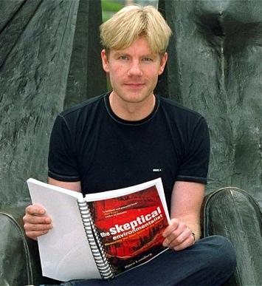
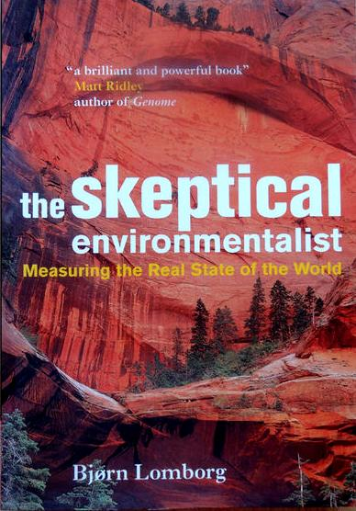
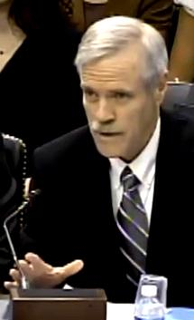
Bjorn Lomborg
John Christy
Individual scientists, even if they are experts,
are not a consensus.

Slide 54
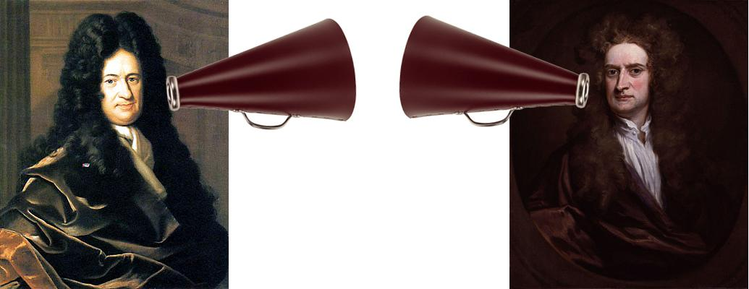
Science also seeks a critical consensus.
A reliable claim must withstand scrutiny by considering contrasting views of the evidence.
Gottfried Leibniz
Isaac Newton

Slide 55
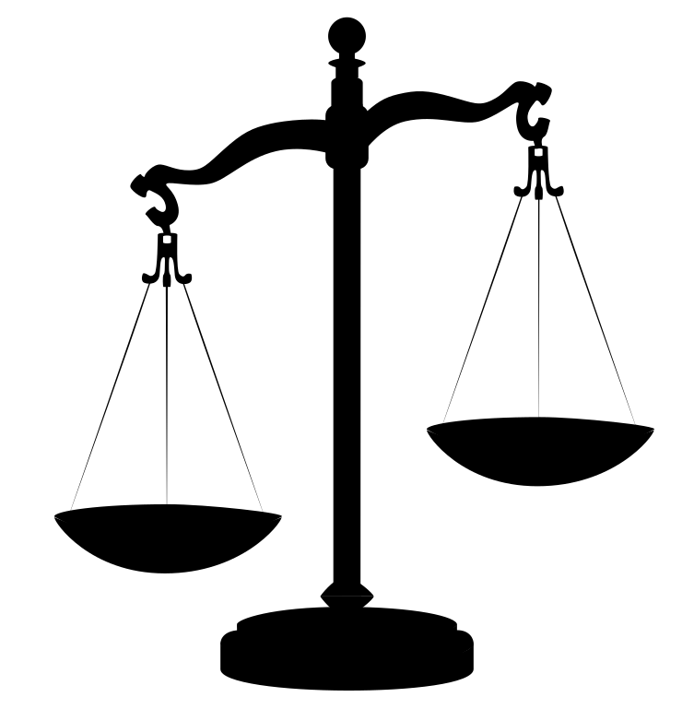
Is a simple majority a consensus?

Slide 56
Is a simple majority a consensus?
(NO – it does not necessarily reflect a critical consensus of the relevant experts.)

Slide 57
How would you go about finding the scientific consensus – a critical consensus of the scientific experts?

Slide 58
Major U.S. scientific institutions that embody consensus

Slide 59
Fact-Checking 102
Review (5): Describe the role of consensus in science. Explain what reflects a critical consensus.

Slide 60
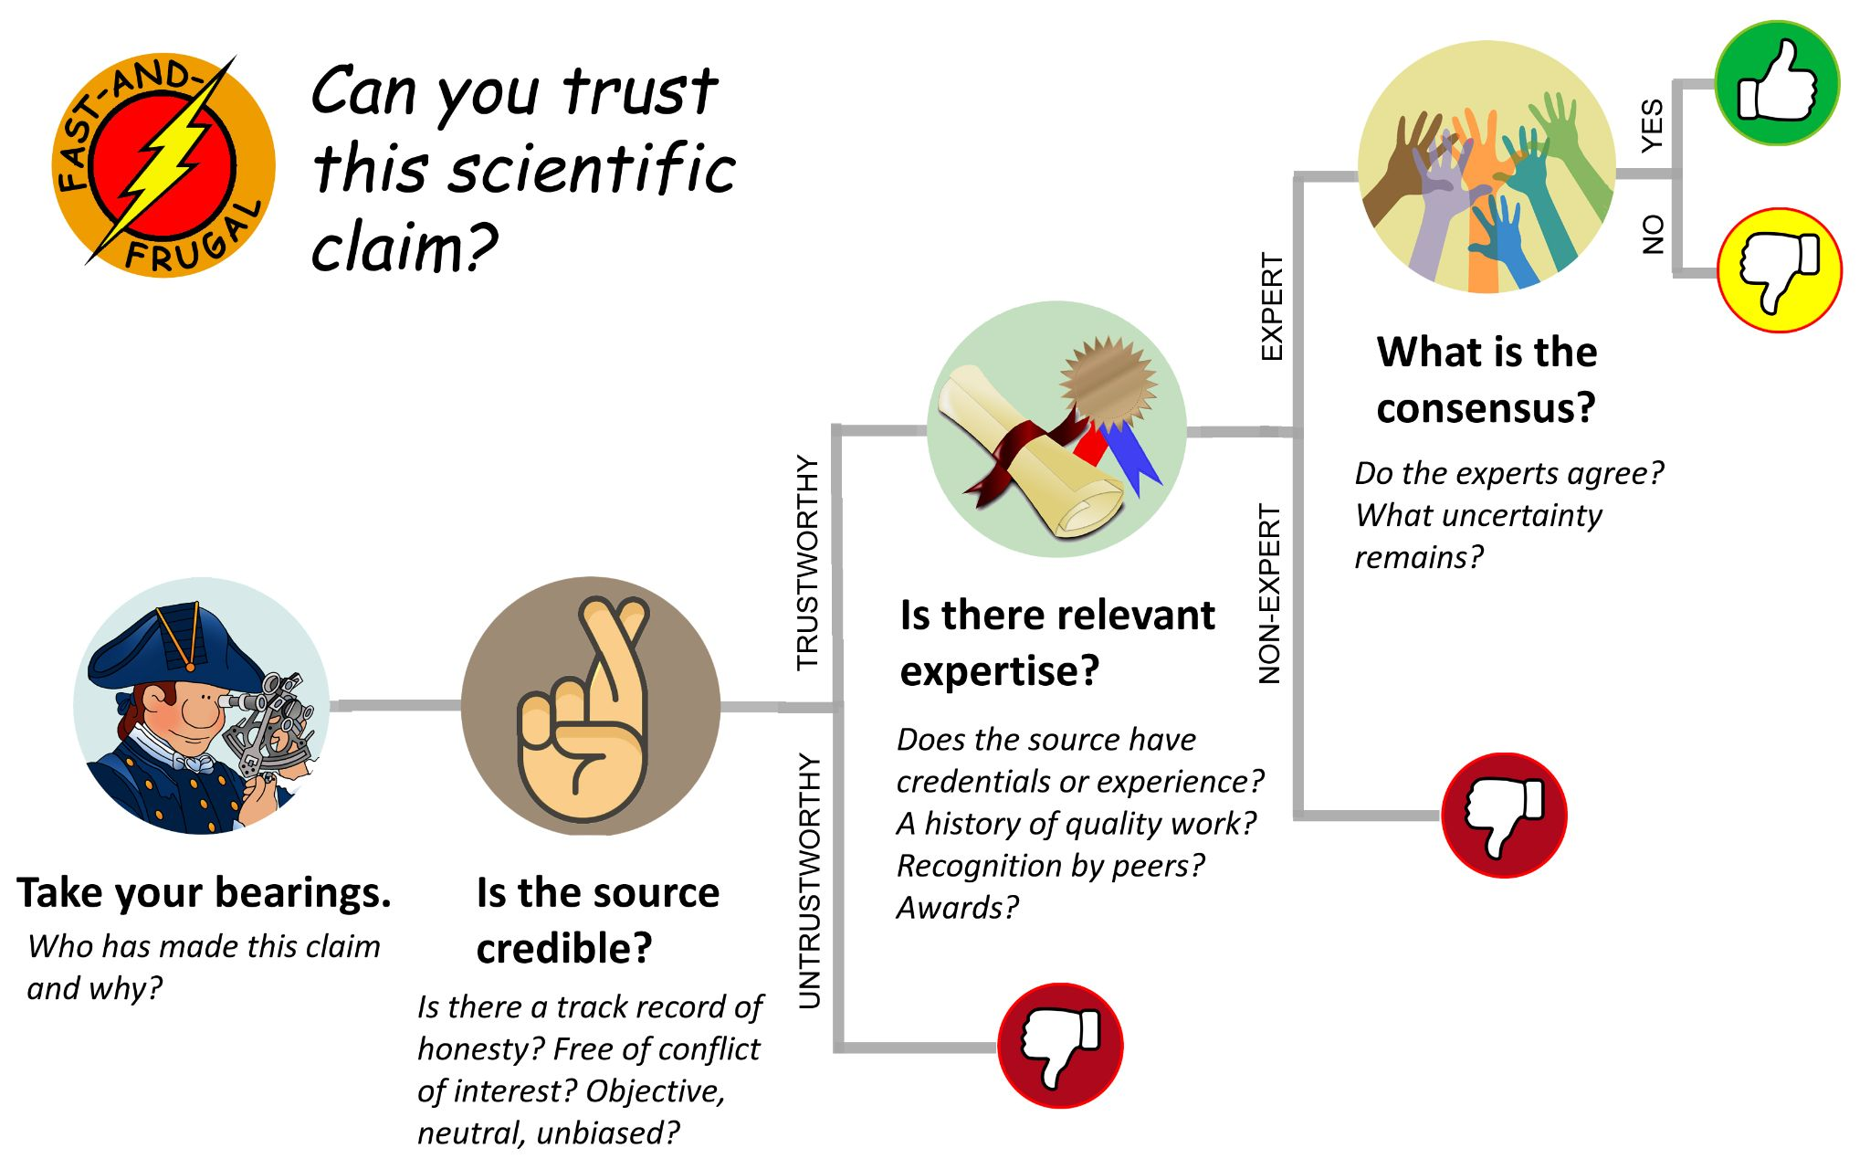
In Fact-Checking 101, you encountered a "fast-and- frugal" guide. How might you improve that now?

Slide 61
Fact-Checking 102
Conflict of Interest
Credibility
& Trust
Multiple Sources
Expertise
Consensus
Review:
What have you learned about the reliability of sources?

