Slide 1
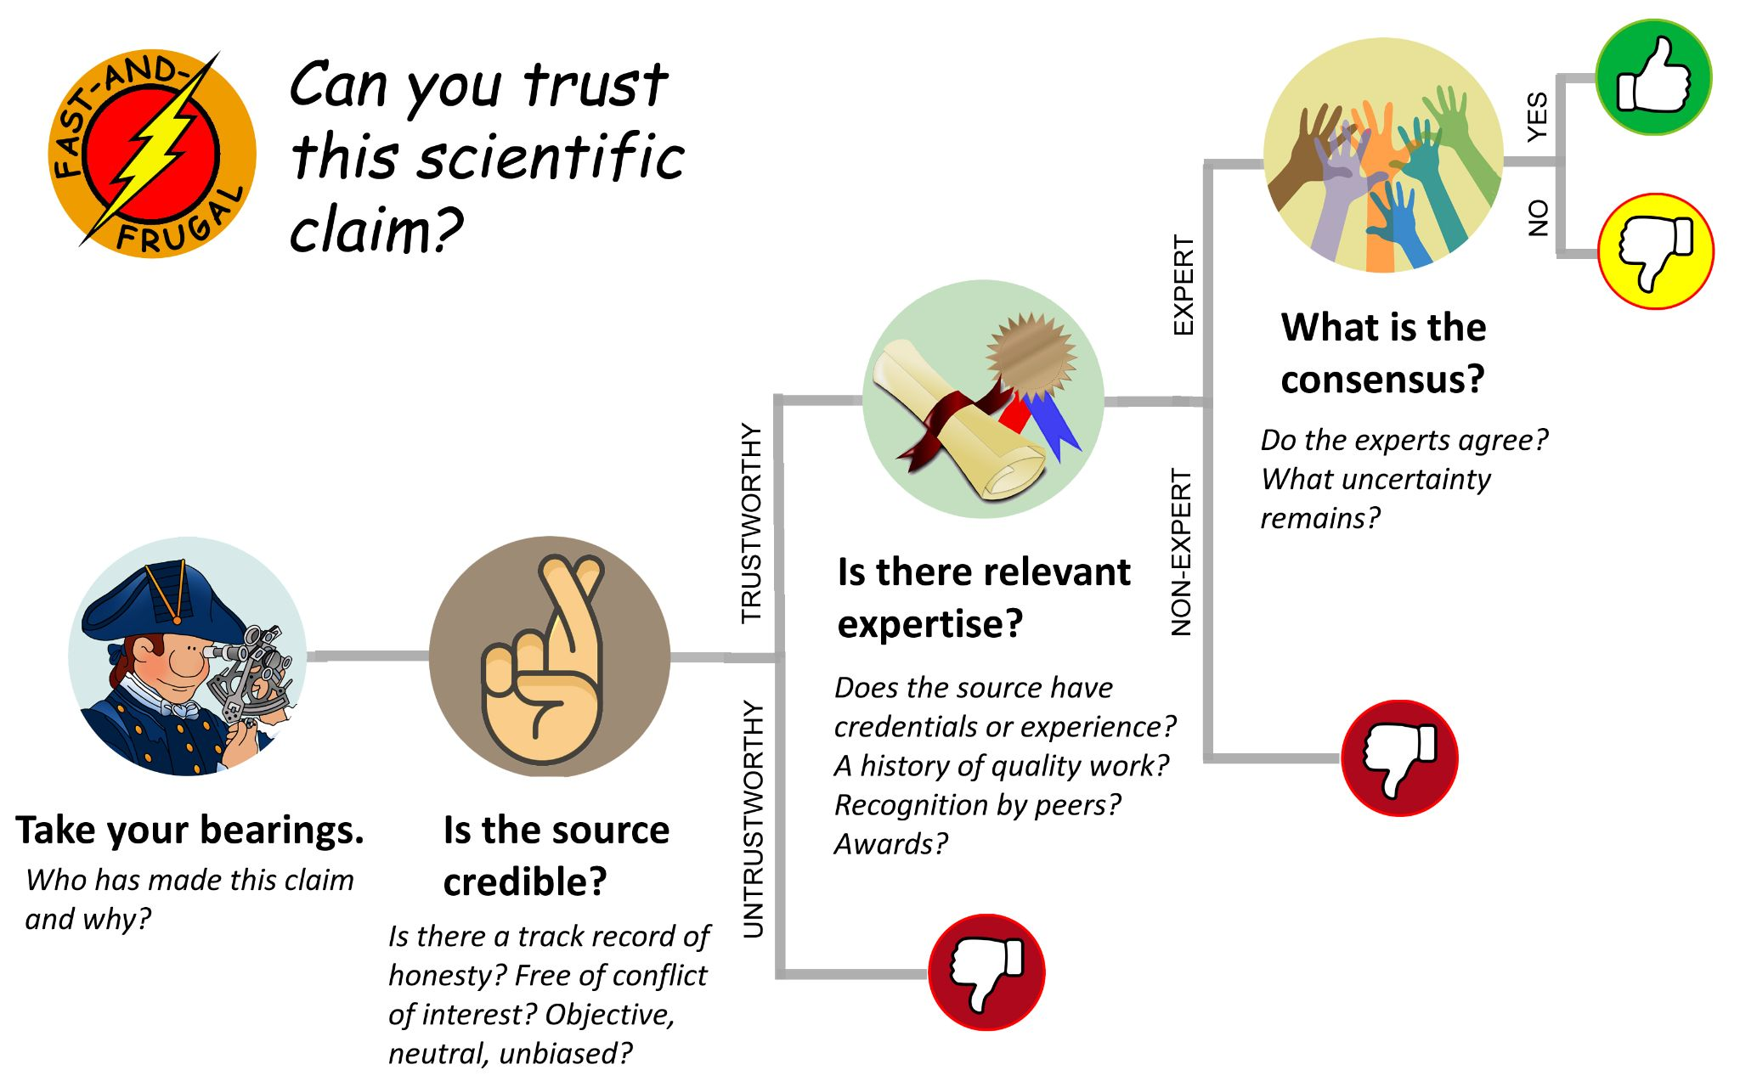
Fact-Checking 101
© 2024 Douglas Allchin http://shipseducation.net/misinfo

Slide 2
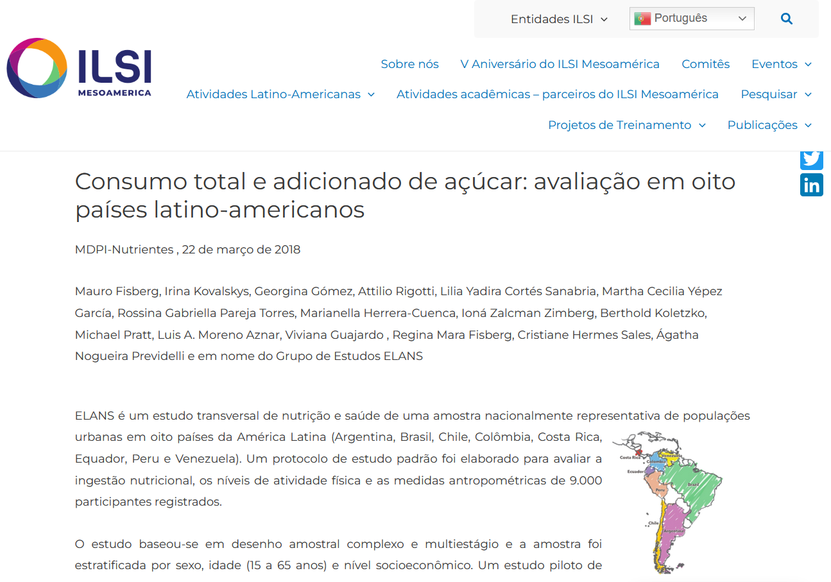
You encounter a webpage about sugar consumption in Latin American countries. Should you believe it?
???

Slide 3
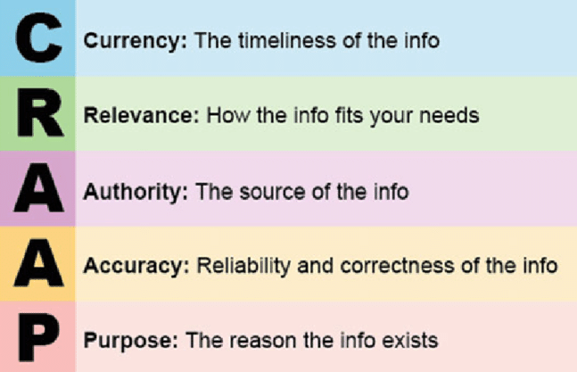
You could use conventional "critical thinking" skills
— analyzing the argument and the evidence
?
?
Blakeslee, Sarah (2004). The CRAAP test. LOEX Quarterly. 31 (3).

Slide 4
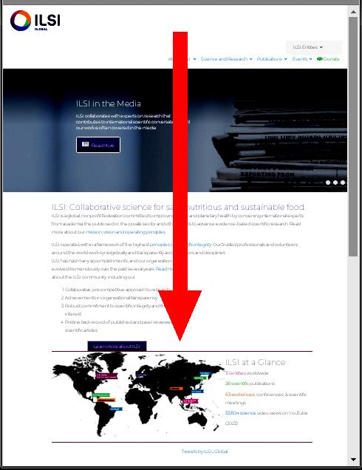
That's how most people approach the problem.
They read vertically.
They:
consider the overall impression
check the URL ( .org, .com ? )
check the Author's byline
consult the "About" page
read the claims & identify the evidence and the reasoning

Slide 5
But such analysis will not tell you
who is behind these claims
—or why.
?
Who is this and what is their purpose?
How might they want to mislead you?
Do they have a conflict of interest?

Slide 6
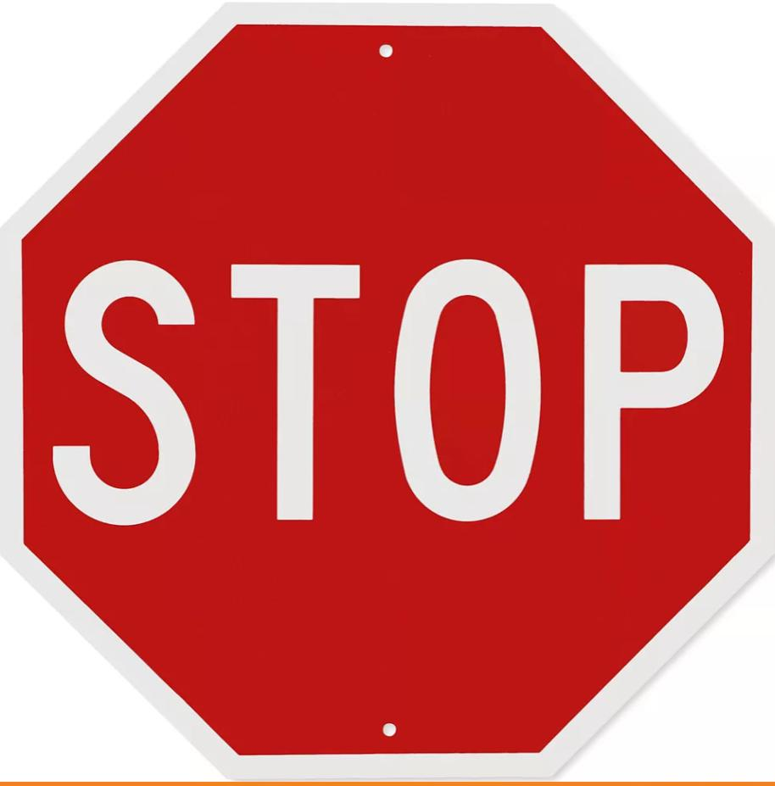
For a more effective method,
do what professional fact-checkers do:
First:
ASK yourself:
Do you even know what you are looking at?
Why dive into something deeply before even knowing what it is?

Slide 7
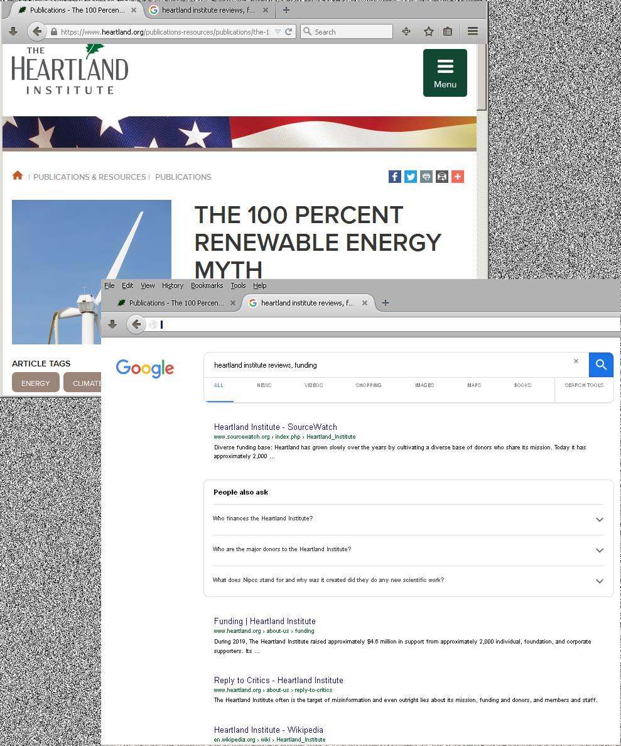
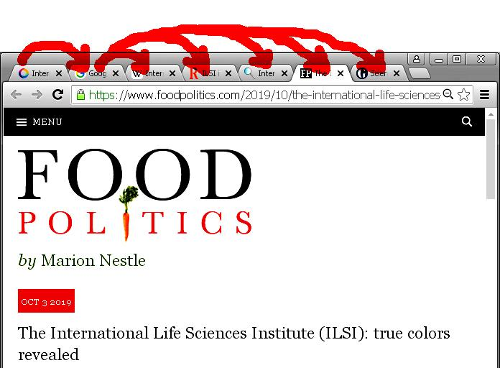
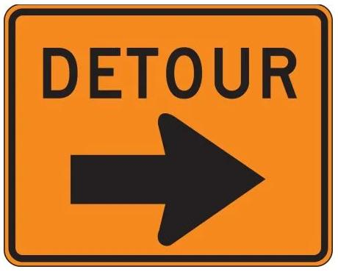
Step 2. Investigate the source.
Open a new tab and
read laterally.

Slide 8
Do not just follow the first result.
Exercise click restraint.
SLOW
Review
your search results and
choose the most informative
links mindfully.

Slide 9
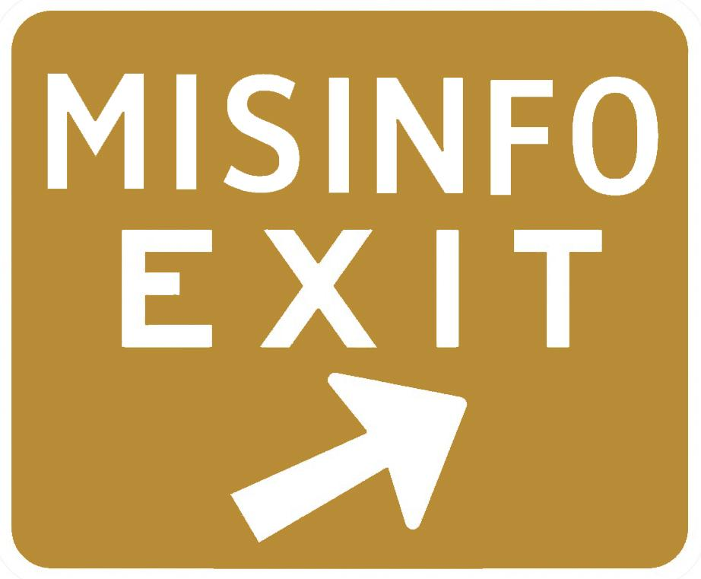
Investigate:
Is there a track record of honesty?
Any bias from conflict of interest?
Objective, neutral, balanced?
Practice
critical ignoring.

Slide 10
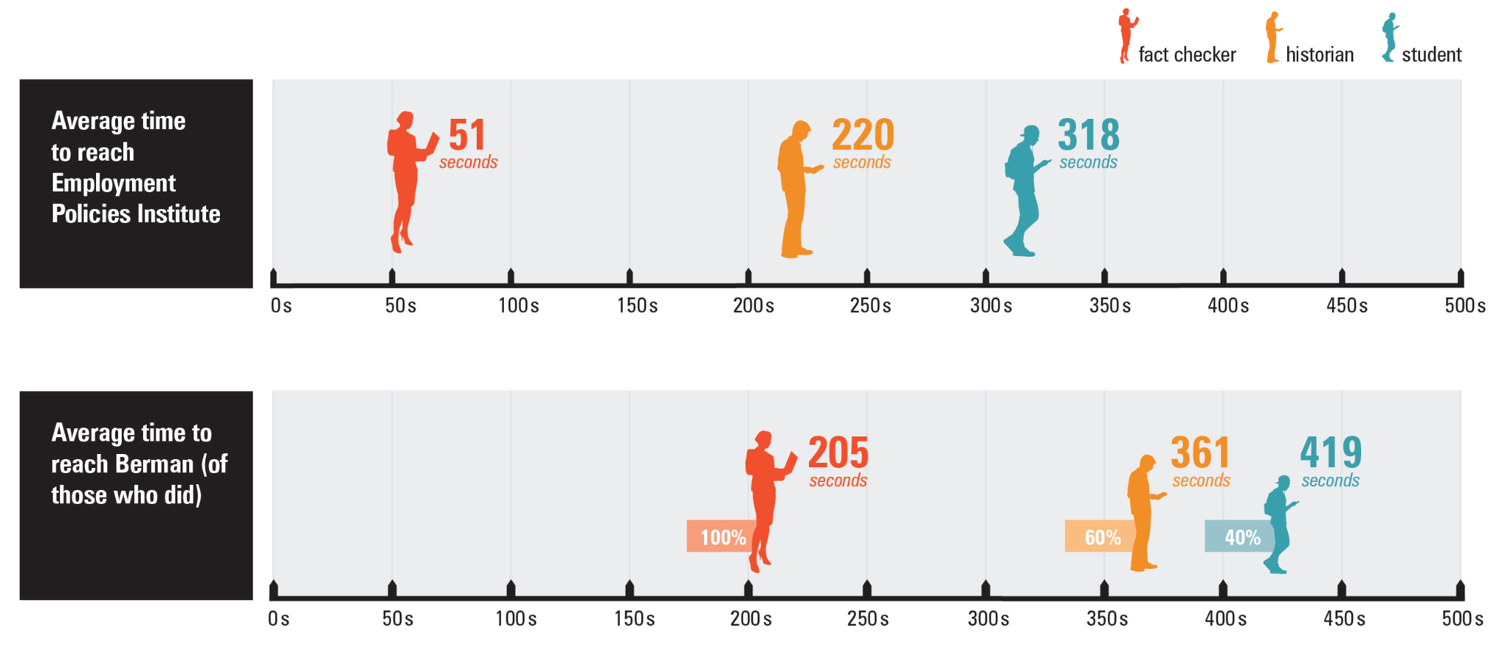
Lateral reading reduces the time needed to identify a source's credibility.
from Wineburg & McGrew, (2019). Lateral reading: Reading less and learning more when evaluating digital information. Teachers College Record, 121(#11), https://www.tcrecord.org/?contentid=22806

Slide 11
Continue the fact-checkers' routine:
Step 3.
Find other coverage.
Step 4.
Trace the claims to their origin.
2 ways to confirm facts

Slide 12
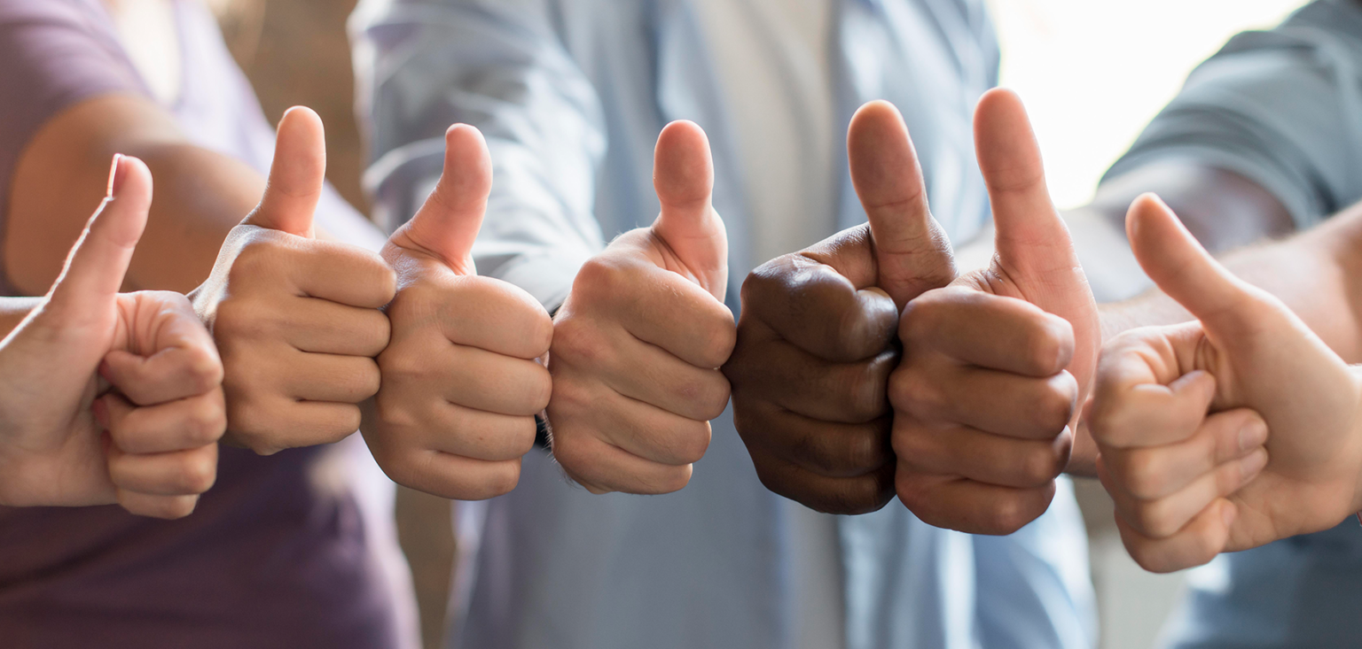
But…
scientific claims are a special challenge.
You do not want just to confirm an event or quote
or find one isolated study
or sample one expert opinion.
You want to know if the claims are reliable —
vetted by a community of experts.
Your target benchmark is thus
the consensus of
the relevant experts

Slide 13
Next ask:
Does the source have the relevant credentials or experience ?
A history of quality work?
Recognition by peers? Awards?

Slide 14
Do the experts agree?
What uncertainty remains?
Where is there disagreement, and why?
OR

Slide 15
REVIEW
The SIFT Method*
STOP.
Investigate the source.
Find other coverage.
Trace the claim to its origin.
*Caulfield & Wineburg, Verified (University of Chicago Press, 2024)

Slide 16
REVIEW
A fast-and-frugal
decision tree for
scientific claims*
*Allchin, "Marginalizing Misinformation – the Fast and Frugal Way. The Science Teacher (2023)

Slide 17
Misinformation problem – solved!!

Slide 18
Solved …Almost!
What will motivate you to STOP & fact-check?
Will you notice when you need to find the consensus?
Do you know where to find it?

Slide 19
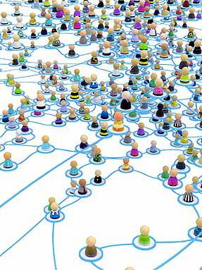
Beyond
fact-checking skills,
we should understand:
how scientific consensus forms
the social structure of trust in knowing
basics of credibility
nature of expertise
media transparency
deceptive tactics
search biases

Slide 20
Fact-Checking 101
S.I.F.T.
Review:
What have you learned?
What do you have yet to learn?

