Slide 1
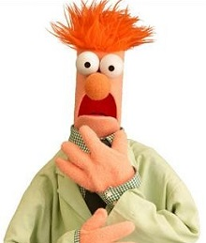
The Plausibility Trap
© 2024 Douglas Allchin & Jonathan Osborne
http://shipseducation.net/misinfo/plausibility.htm

Slide 2
How well can you evaluate
expert scientific claims
on the internet
or social media?
Test yourself !
…Ready?

Slide 3
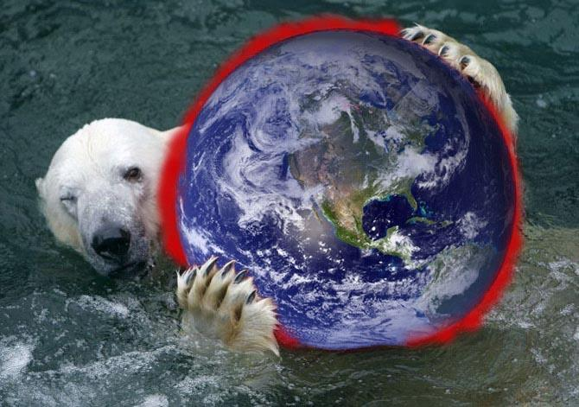
Question #1: Is global warming real?
What about contradictory (or "falsifying") evidence?

Slide 4
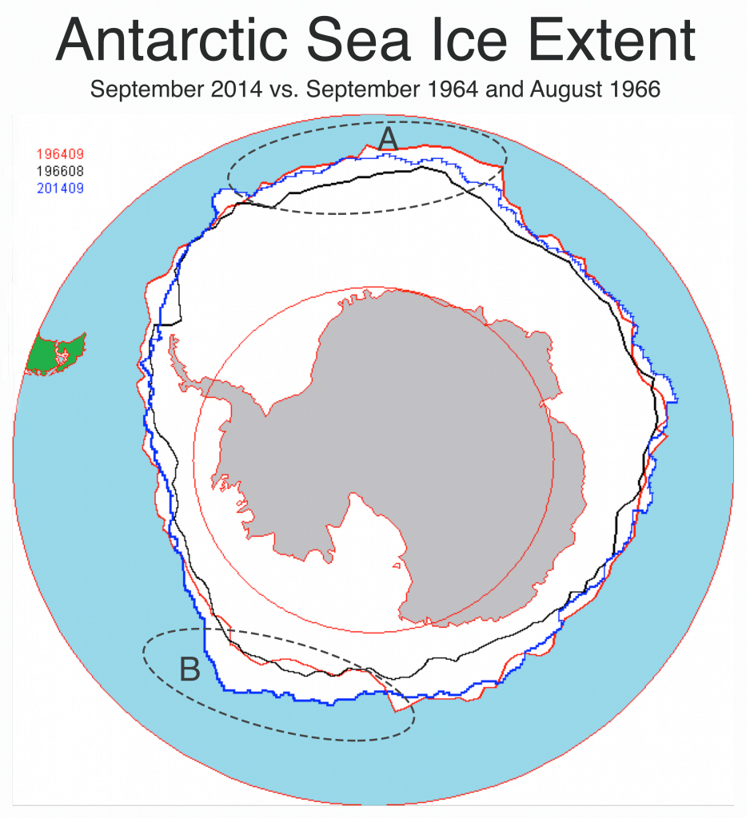
Comparison of historic maps shows that the extent of sea ice has grown in some cases (A and B in figure).
The planet can't really be warming if sea ice is increasing!
Discuss?

Slide 5
Share your thoughts.

Slide 6
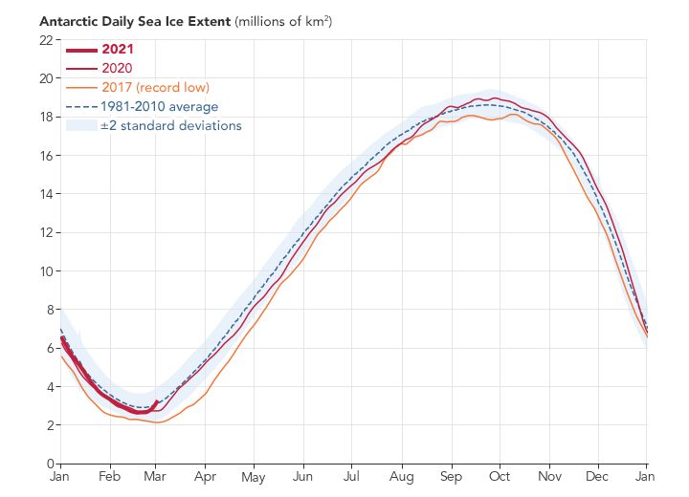
Here's what the expert climatologists say.
They do not rely on a few isolated comparisons. They look at the overall pattern of the data.
Looking across many years, the recent years show record lows in the extent of sea ice.
multi-year data: record lows

Slide 7
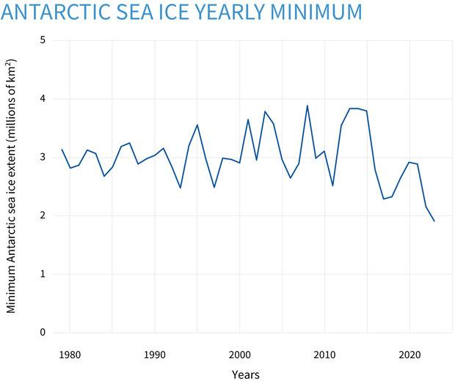
long-term trends
Nor do the experts compare only two different points in time. They analyze trends.
While the yearly minimum of sea ice varies from year to year, the overall trend is a decrease.

Slide 8
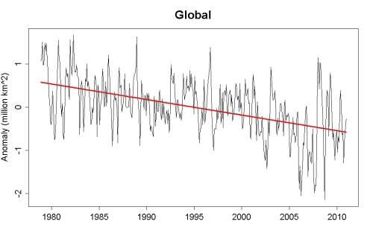
Climatologists do not limit themselves to observations from a few isolated locations.
They consider more complete, global data.
The trend of sea ice coverage around the world is decreasing.
more complete (global) data

Slide 9
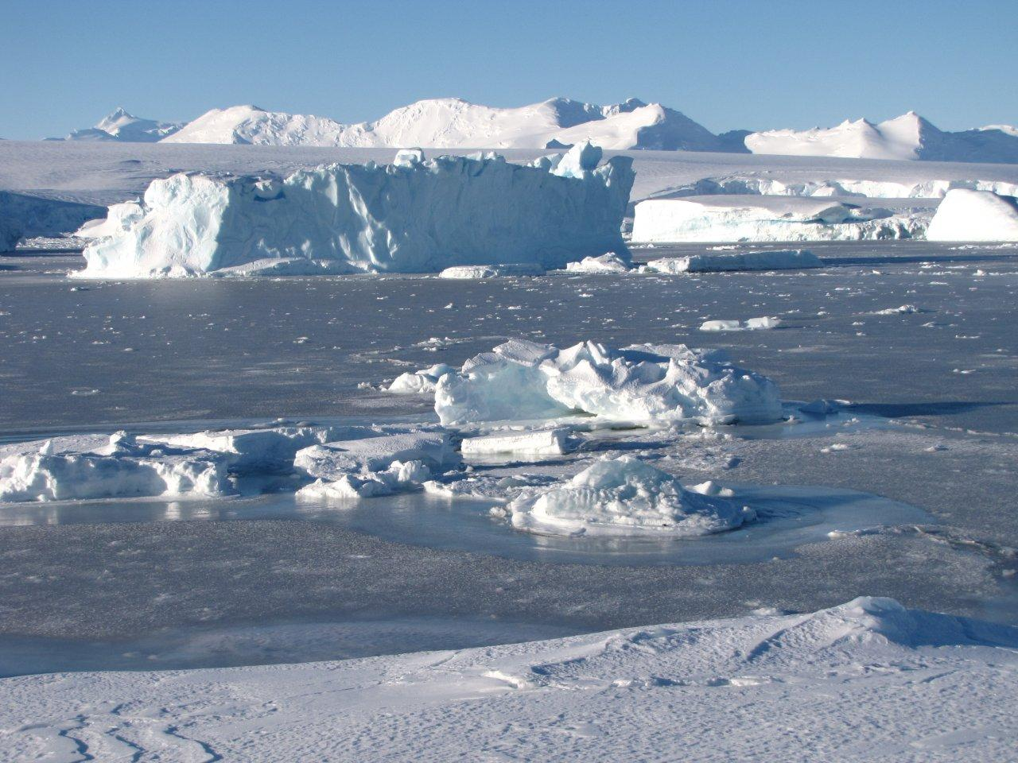
Experts were curious about the puzzling increase in sea ice in particular years.
They considered alternative explanations.
Sea ice floats, and they learned that this can sometimes lead to more sea ice in some locations.
sea ice floats–feedback loops

Slide 10
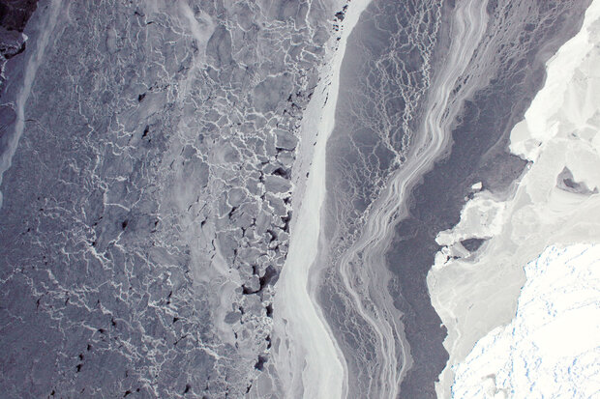
Most importantly, scientists realized that surface coverage only allowed them to approximate the total sea ice (and thus of the true effects of temperature).
By studying volume (not area), they found loss of sea ice was more consistent.
varied thickness (volume, not area)

Slide 11
multi-year data: record lows
long-term trends
more complete (global) data
All this
diverse
evidence concurs.
Experts
agree.
sea ice floats–feedback loops
varied thickness (volume, not area)

Slide 12
Global warming is indeed real,
based on multiple forms of evidence,
as reflected in the consensus of the relevant experts.

Slide 13
But you are not an expert climatologist.
When presented with the initial evidence about sea ice,
how would you know to question it?

Slide 14
What do we learn from this case
about plausibility, evidence, and expertise?

Slide 15
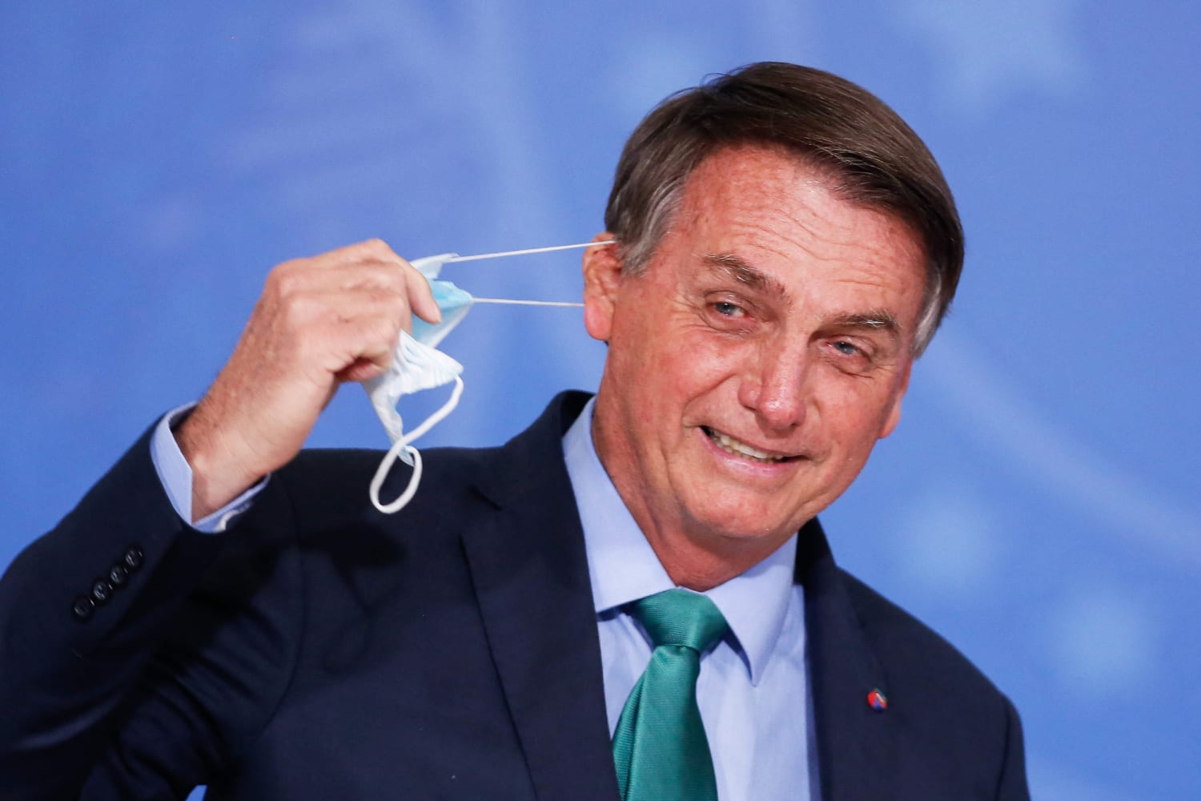
Question #2:
Are masks effective protection against the covid virus?

Slide 16
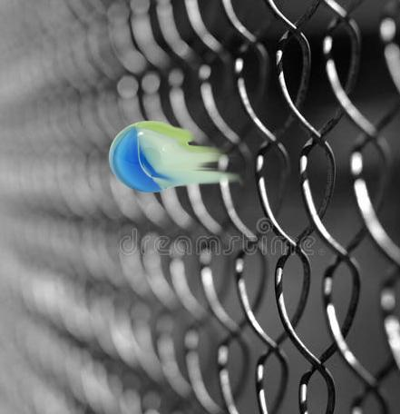
The virus size is <0.1 micron.
The holes in an N95 mask are ~0.3 microns.
Therefore, the virus "will sail through the mask like a marble through a chain-link fence."
Safety claims by health officials are bogus, false reassurance!
Discuss.

Slide 17
Share your thoughts.

Slide 18
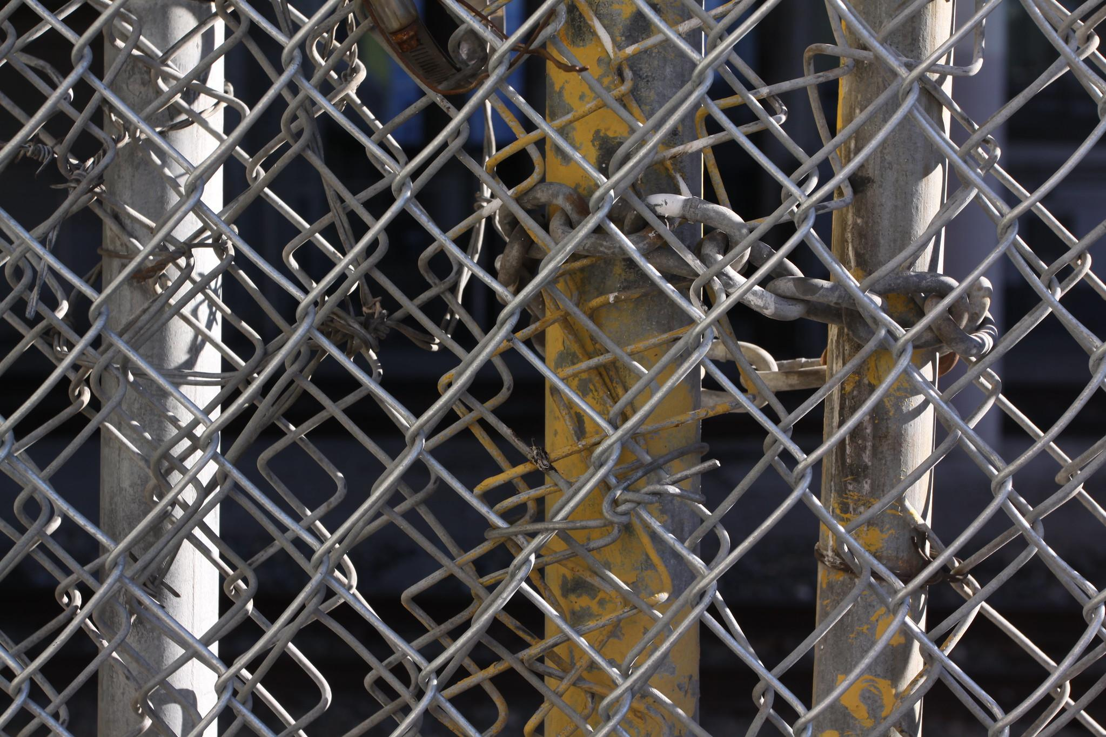
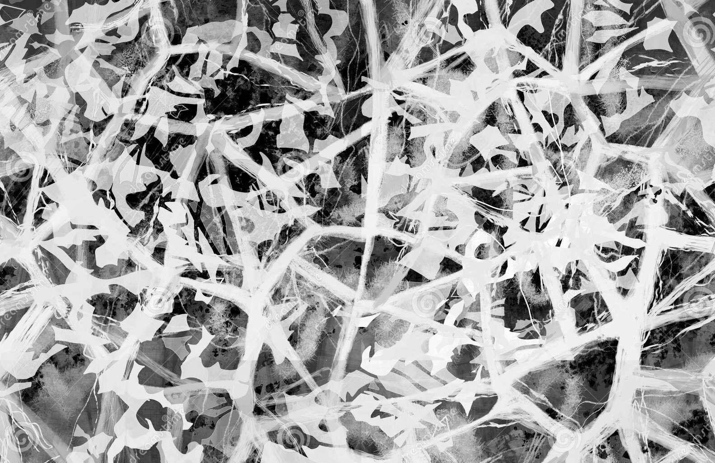
Experts, however, note that:
The mask is a mesh, not a flat filter.
N95 masks have electrostatic charge that attracts virus particles.
There is turbulence.
The virus is carried on (larger) fluid particles.

Slide 19
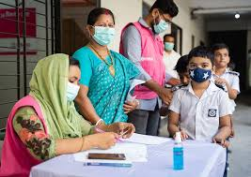
Yes, masks are effective protection against the covid virus,
as reflected in the recommendations of health experts.

Slide 20
But you are not an expert in microphysics.
When presented with the plausible argument,
how can you even suspect that it is wrong?

Slide 21
What do we learn from this case
about plausibility and expertise?

Slide 22
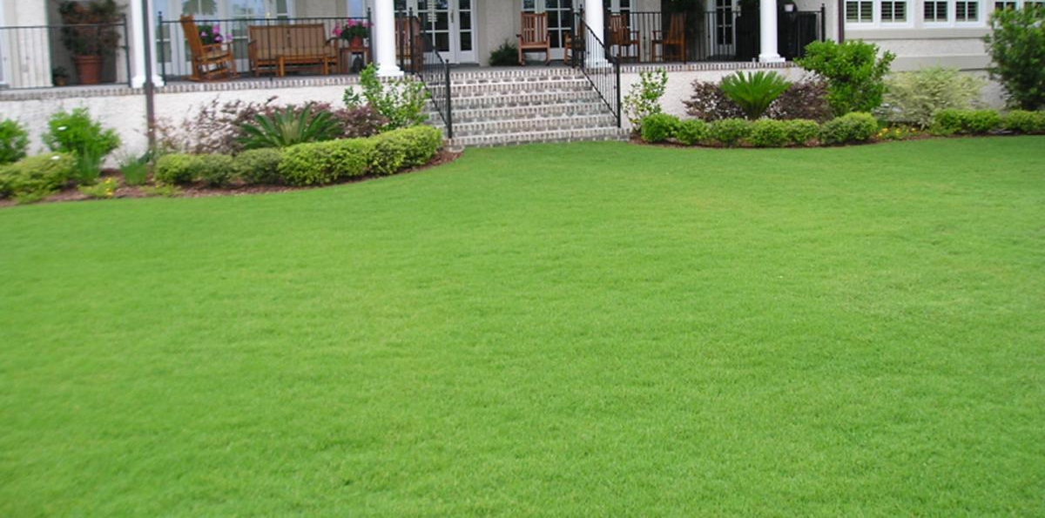
Question #3: How "green" are lawns?
How do they contribute to the environment?

Slide 23
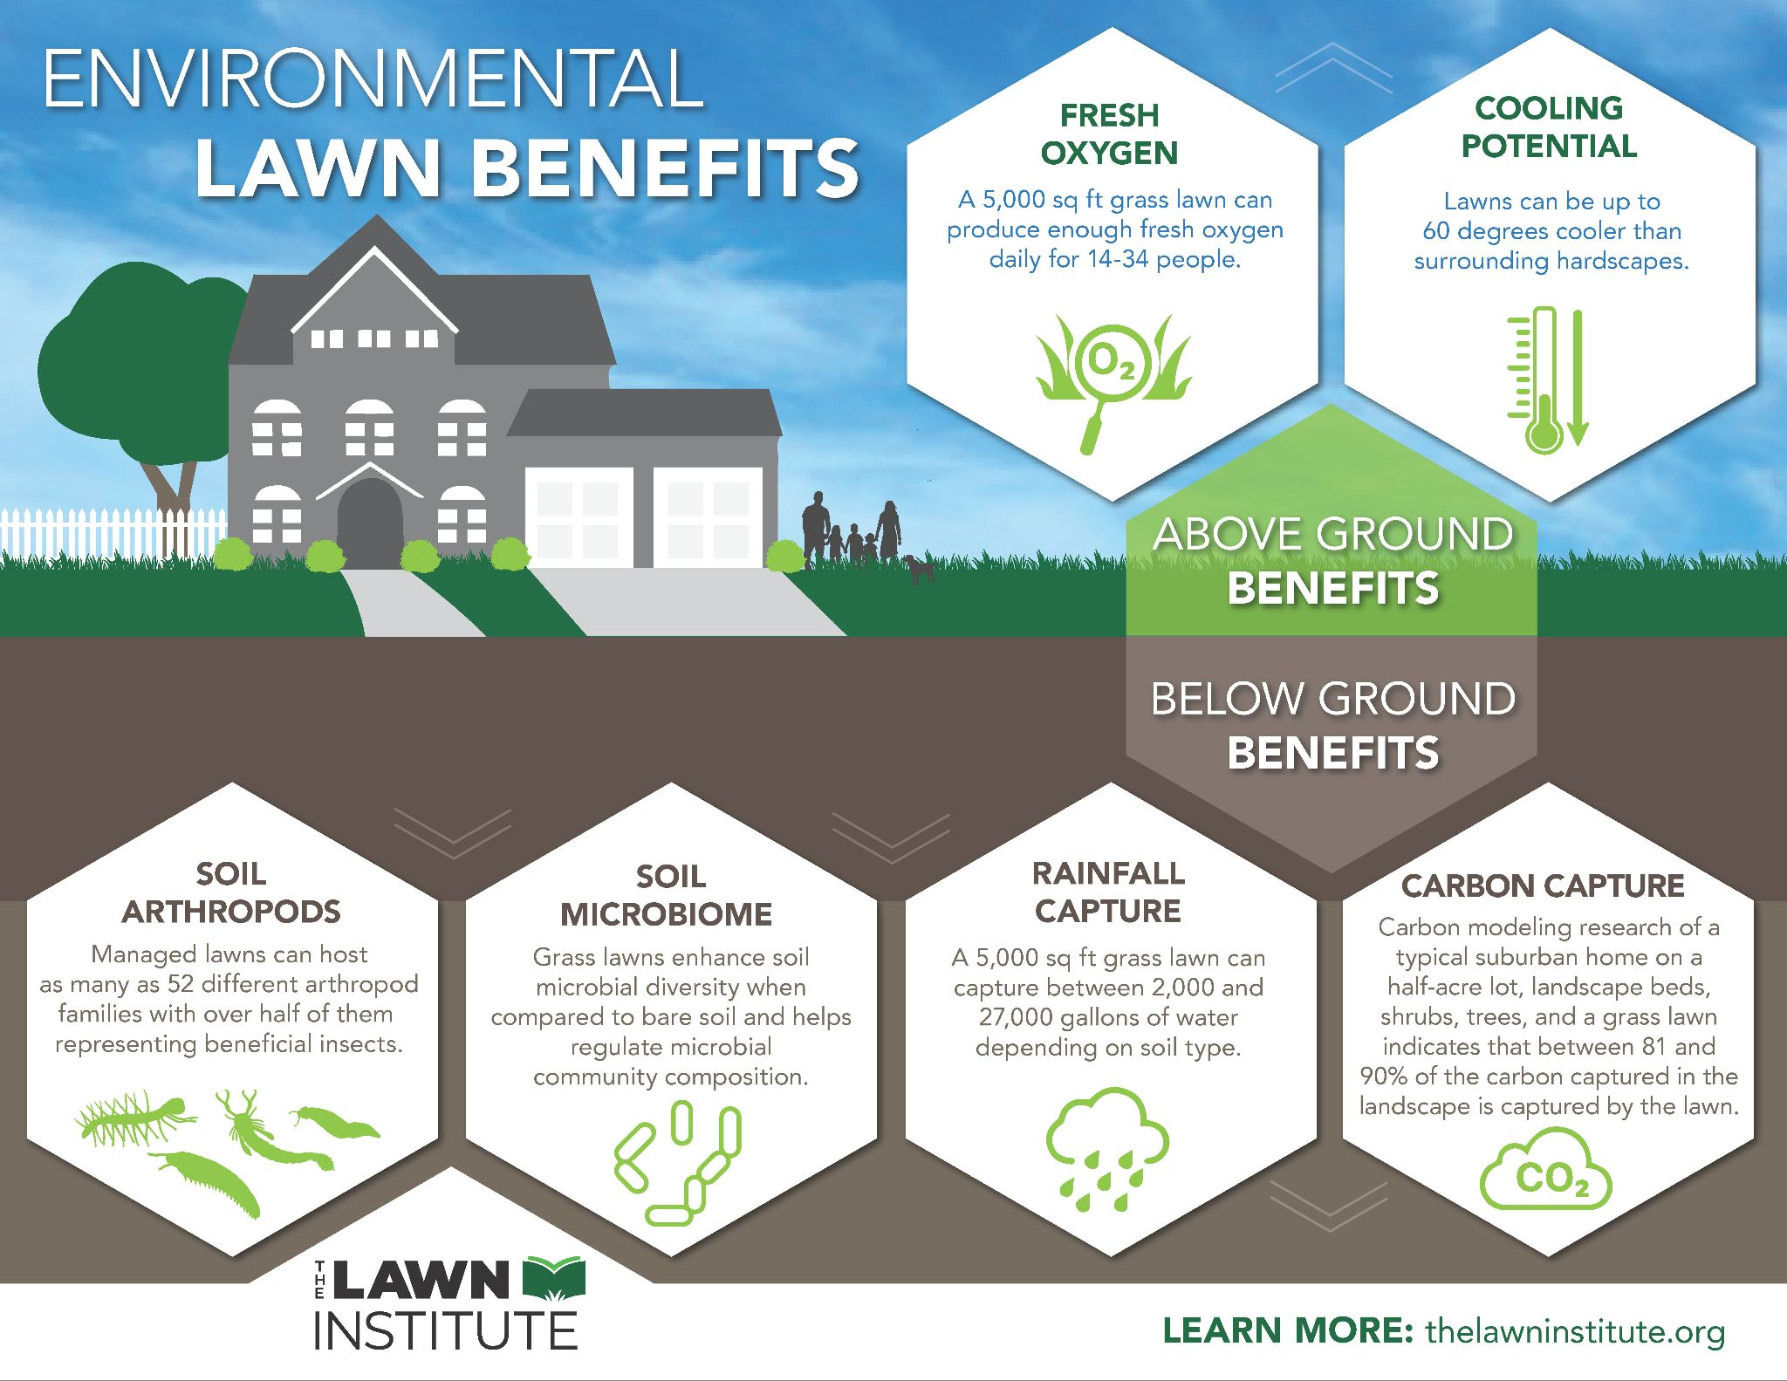
Discuss.

Slide 24
Were you persuaded?
Did you also consider possible harms (unstated)?
– pesticides? weed-killers? lawn waste?
Did you consider other landscaping alternatives?
Did you consider asking "who is the Lawn Institute"?

Slide 25
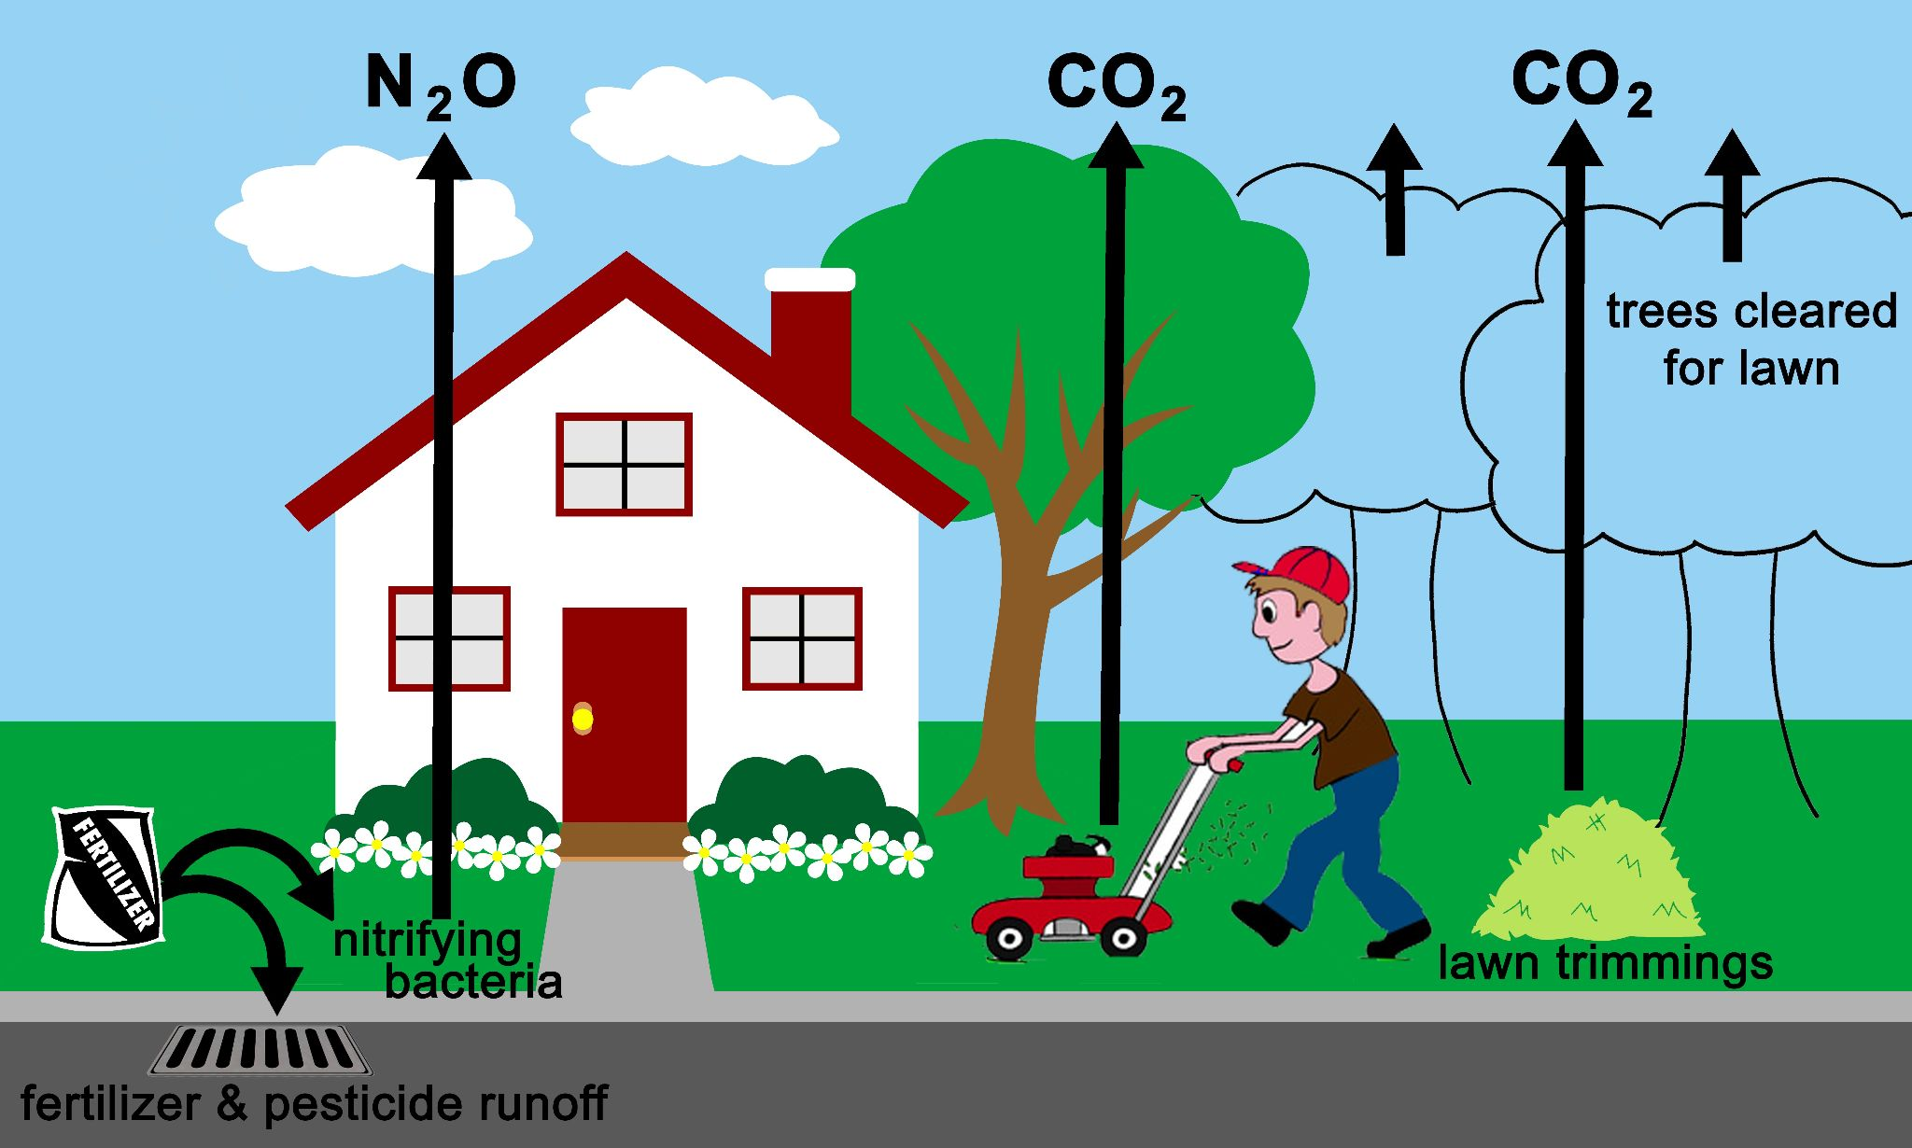
Experts note that greenhouse gases are produced by:
rotting of lawn clippings & thatch
loss of trees/shrubs cleared for the lawn
lawn mower & other power equipment
nitrifying bacteria from excess fertilizer (300X)

Slide 26
Grass lawns actually contribute to climate change.
(They are not very "green," ecologists would say.)
But if you are not an expert, how would you know that?
Allchin, D. 2023. How green are lawns? American BIology Teacher. 85(April): 237-239.

Slide 27
Who is the Lawn Institute? — an organization funded by the turfgrass industry. The "research" they fund is typically about marketing or turf production, not ecology. All the claims they presented here were selected from research by others.

Slide 28
What do we learn from this case
about plausibility, evidence, and expertise?

Slide 29
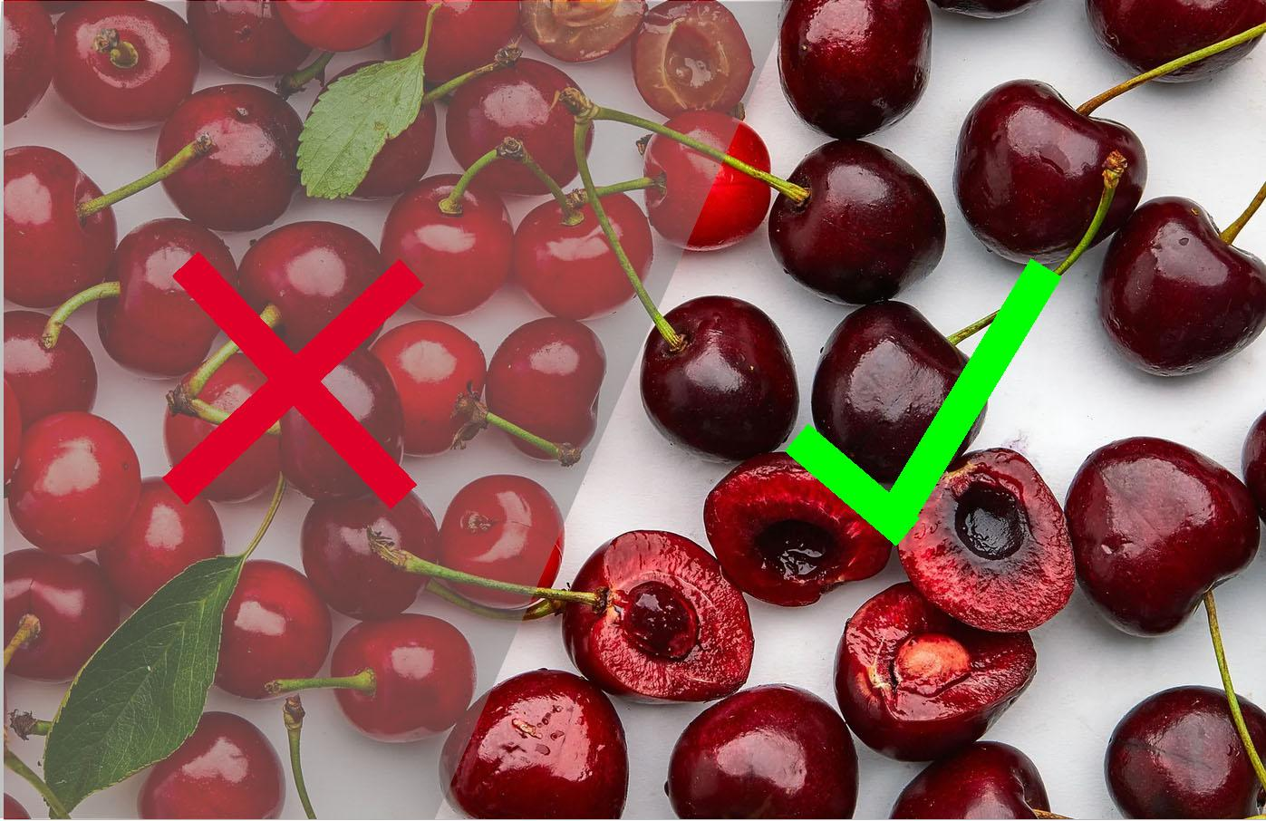
Data can be "cherry-picked"
– and thus incomplete
and misleading.
*But only experts know about the missing evidence and can detect its absence.
image from the Food Geek

Slide 30
Our brains are not ideal.
One thinking tendency is:
WYSIATI
"What You See Is All There Is"
(Namely, we tend to only think about what is currently presented to us.
We don't look for exceptions or
imagine contrary examples.)
Image:: Andreas Weigand CC2
Daniel Kahneman
2002 Nobel Prize winner

Slide 31
If we are not experts,
we are vulnerable to plausible arguments and cherry-picked evidence.

Slide 32
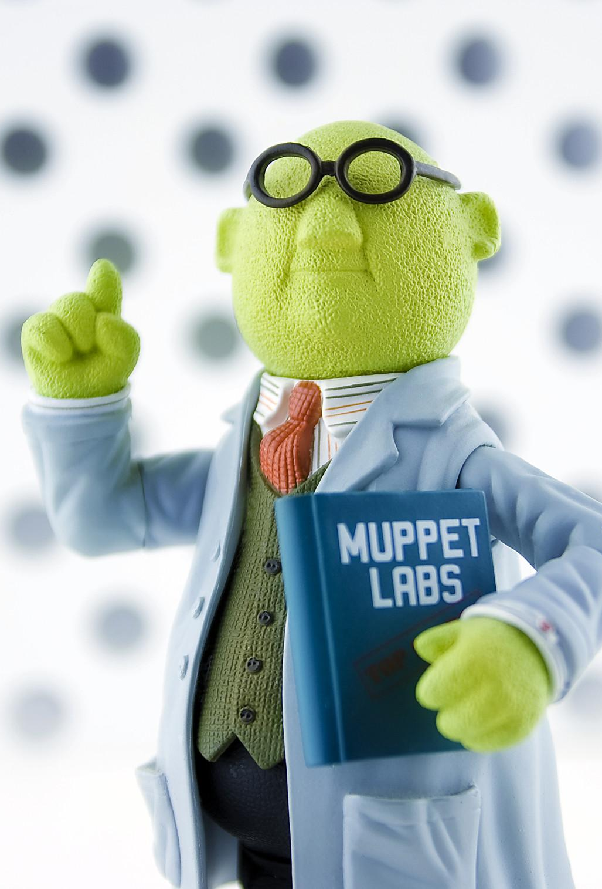
Just because it's plausible,
doesn't mean it's true.
That's:
The Plausibility Trap
Image: Andy Moore cc2

Slide 33
What strategies can you imagine to defend against
The Plausibility Trap?
Image: Andy Moore cc2

Slide 34
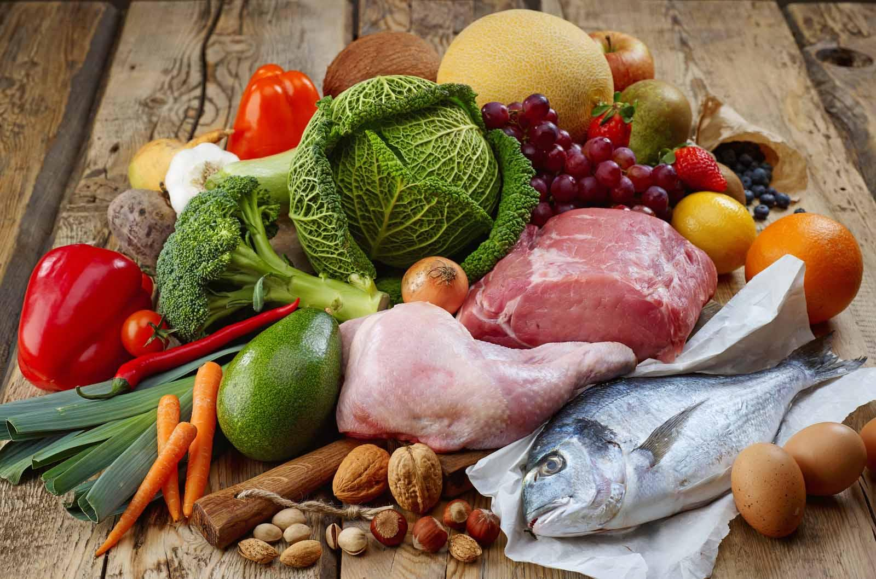
Question #4: What is the healthiest diet?

Slide 35
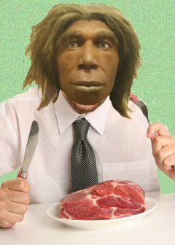
Reasons for the "Paleo Diet"
Our Paleolithic (Stone Age) ancestors were adapted to their environment – eating meat and fresh fruits and vegetables.
Our enzymes have not had time to adapt to modern diets – based on cultivated grains and dairy products.
We suffer from gluten & lactose intolerances and obesity, for example.
Thus, an ancient diet is most "natural."
Discuss.

Slide 36
Take some time:
Imagine alternative explanations?
Suggest how the evidence might be misleading?

Slide 37
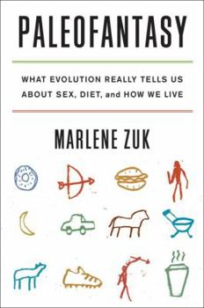
What the expert researchers say:
Ancestral diets varied.
Each reflected the local environment.
Enzyme regulation can evolve rapidly.
Meat diets foster heart disease.
Meat diets also contribute to climate change.

Slide 38
Verdict?: The Paleo Diet is an example of the naturalizing error – an effort to make a cultural value look "natural" and endorsed by science.
But you need expertise to detect that.

Slide 39
To defend yourself against
the Plausibility Trap,
you need expertise!
Image: Andy Moore cc2

Slide 40
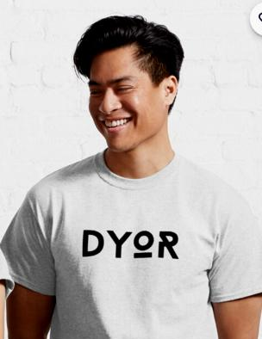
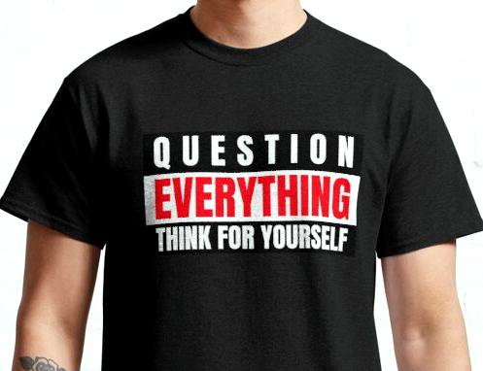
Should you "Do Your Own Research" (DYOR) of scientific claims?

Slide 41
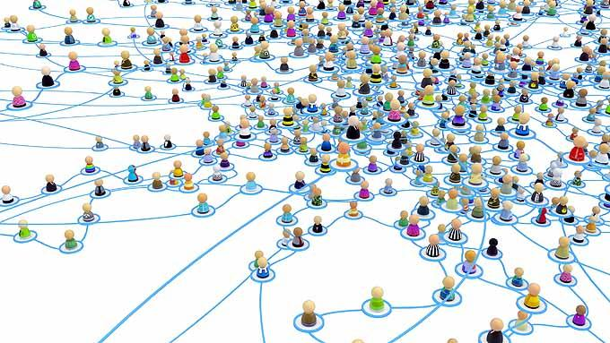
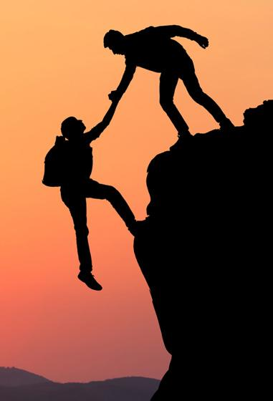
Discuss how each case shows that expertise is more important than stray bits of evidence or plausible arguments.

Slide 42
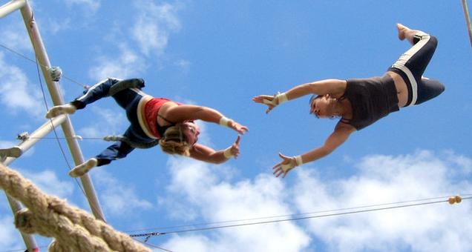
Who then should you trust, if not yourself?

Slide 43
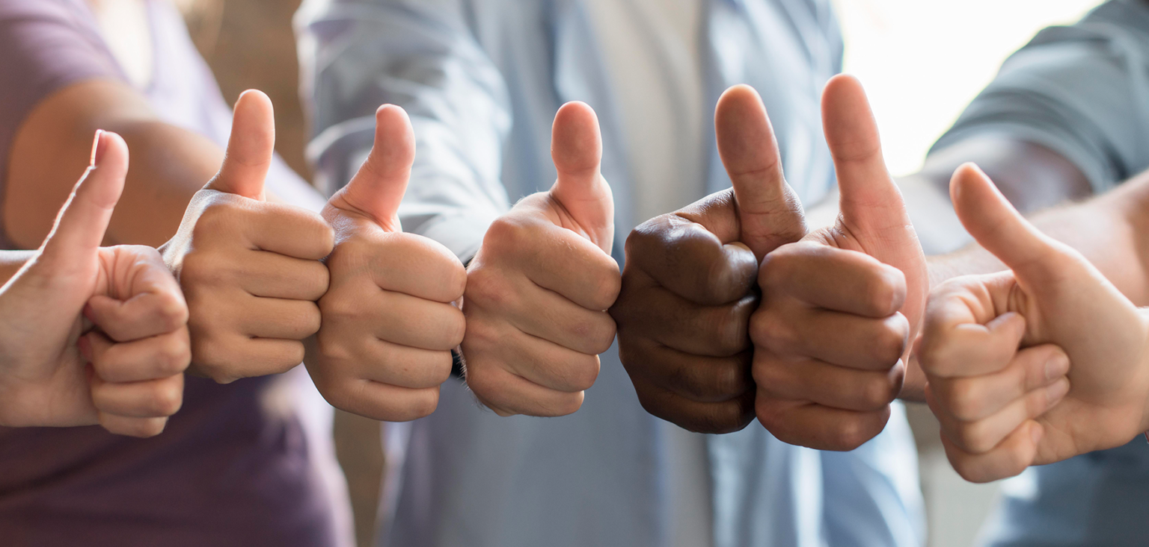
the consensus of
the relevant experts

Slide 44
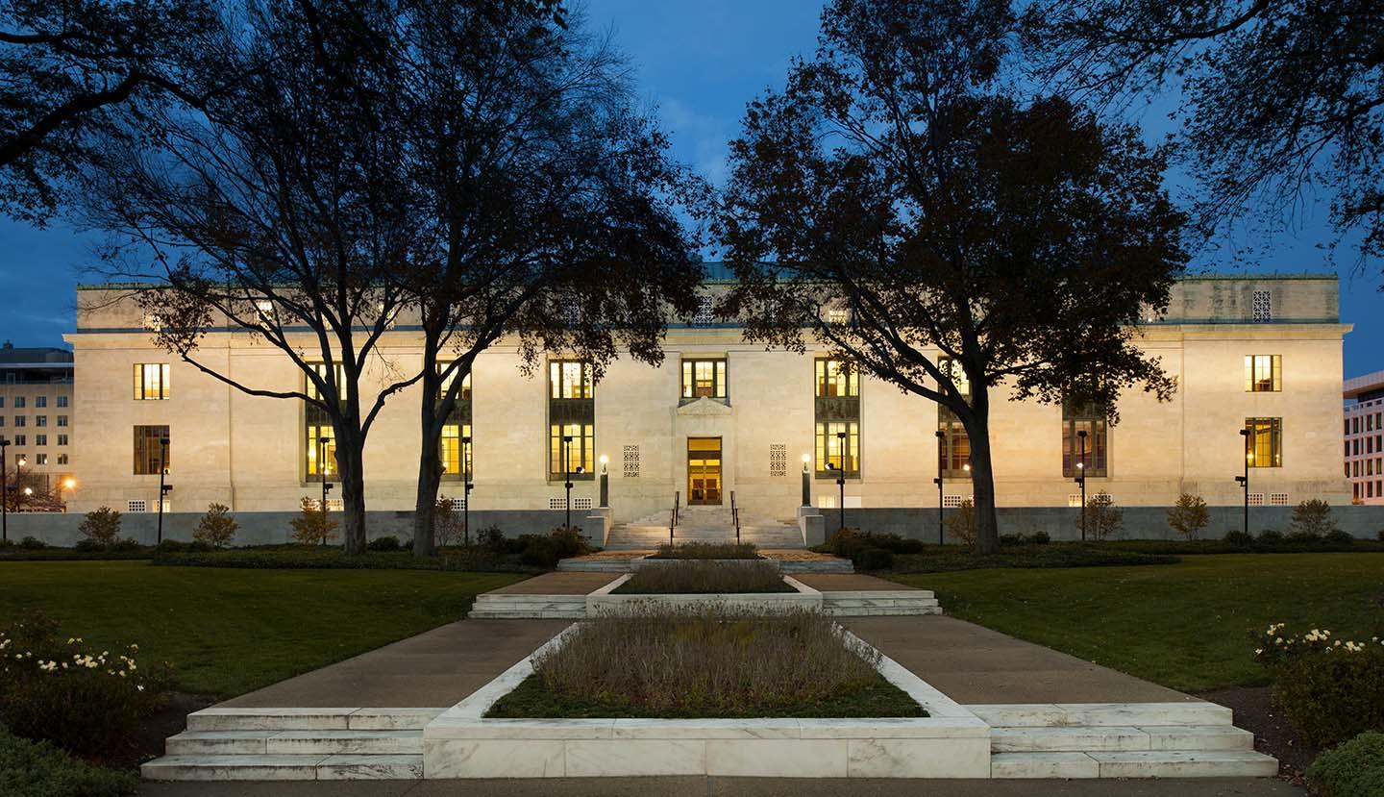
scientific institutions that embody consensus

Slide 45
Which scientific institutions do you know?

Slide 46
What have you learned about
the Plausibility Trap?
Image: Andy Moore cc2

Slide 47
Escape the Plausibility Trap
Find the trustworthy
scientific institutions,
and
trust the consensus
of the relevant experts.
Image: Andy Moore cc2

