Slide 1
Science LIARS
© 2022. Douglas Allchin
http://shipseducation.net/misinfo/liars.htm

Slide 2
Form a team of 3.
Find an incredible science news story.
Identify the theme. Each person writes a fake story based on the same theme.
Present the real story and best 2 fake stories to the class.
The class (and teacher!) votes. Then you reveal the real story.
Science LIARS
Afterwards, you discuss the most effective persuasive tactics.

Slide 3
Survival Strategies

Slide 4
Survival Strategies
Subglacial Lake
Extremophiles

Slide 5
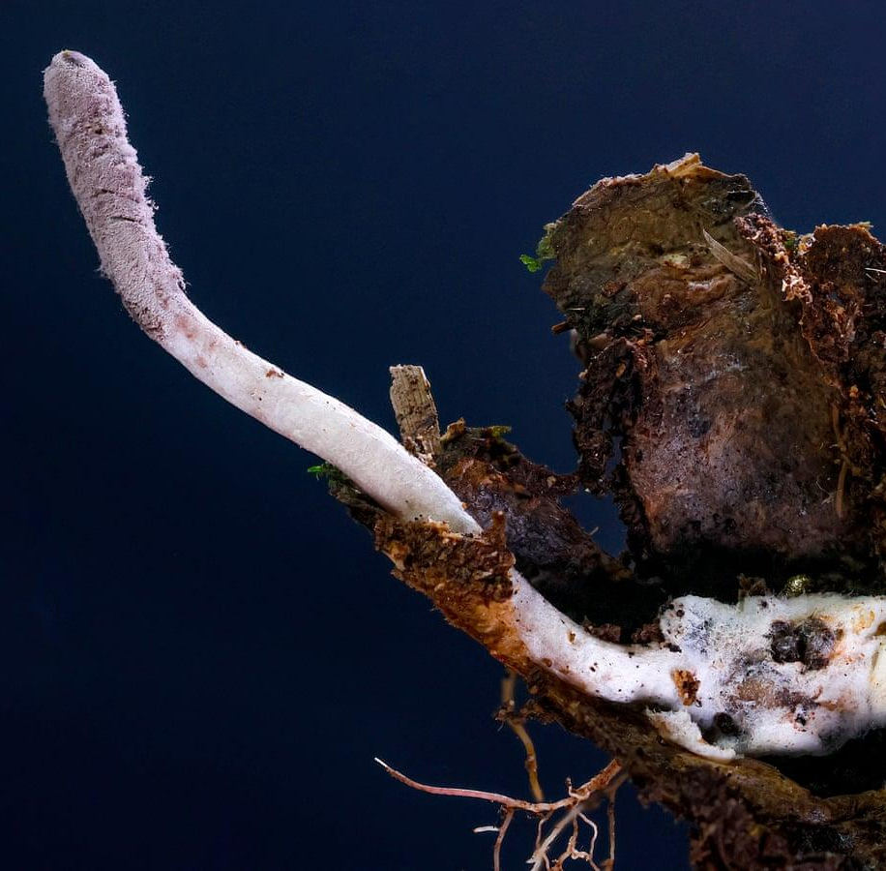
Survival Strategies
"Zombie" Fungus Paralyzes Spiders

Slide 6
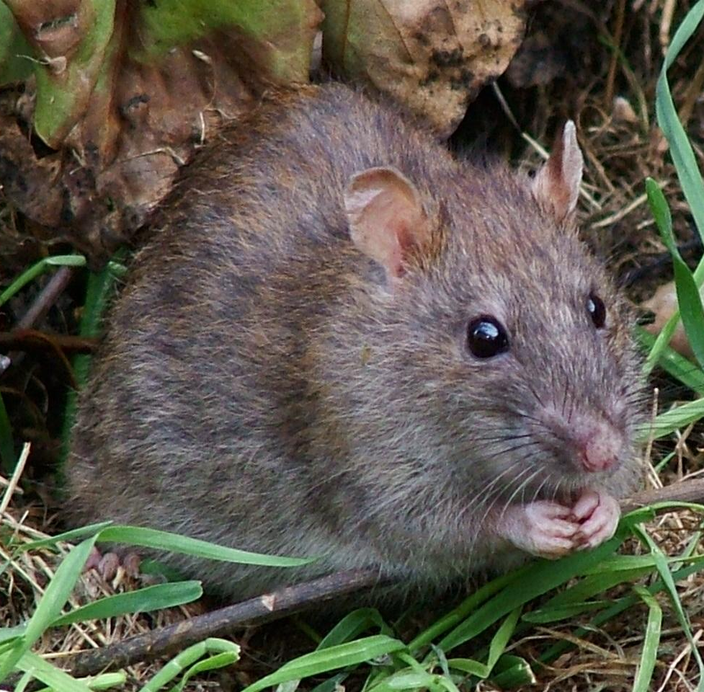
Survival Strategies
Acoustic Mimicry in Himalayan Rats

Slide 7
Survival Strategies
Subglacial Lake
Extremophiles
"Zombie" Fungus Paralyzes Spiders
Acoustic Mimicry in Himalayan Rats

Slide 8
Survival Strategies
Subglacial Lake
Extremophiles
"Zombie" Fungus Paralyzes Spiders
Acoustic Mimicry in Himalayan Rats

Slide 9
"Criminal" Behavior in Wild Animals

Slide 10
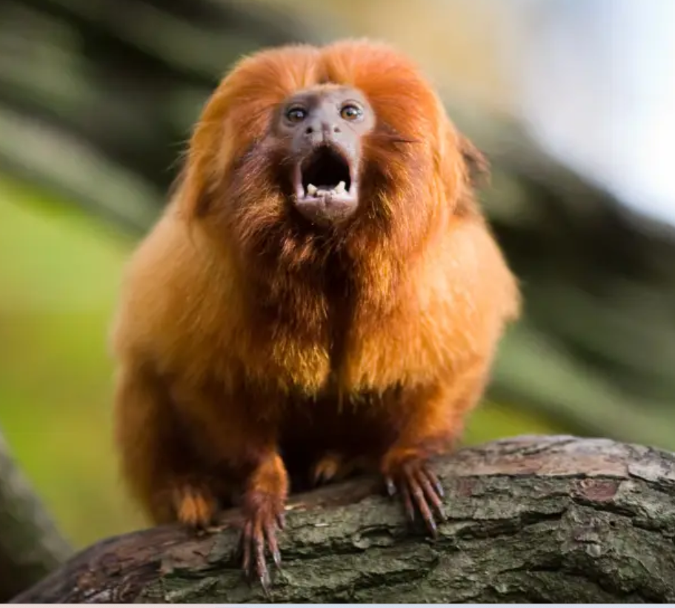
"Criminal" Behavior in Wild Animals
"Enslavement" by
Golden Lion Tamarins

Slide 11
"Criminal" Behavior in Wild Animals
"Terrorism" by Peregrine Falcons

Slide 12
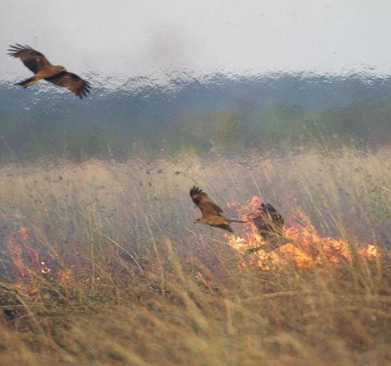
"Criminal" Behavior in Wild Animals
"Arson" by Australian Raptors

Slide 13
"Criminal" Behavior in Wild Animals
"Enslavement" by
Golden Lion Tamarins
"Terrorism" by Peregrine Falcons
"Arson" by Australian Raptors

Slide 14
"Criminal" Behavior in Wild Animals
"Enslavement" by
Golden Lion Tamarins
"Terrorism" by Peregrine Falcons
"Arson" by Australian Raptors

Slide 15
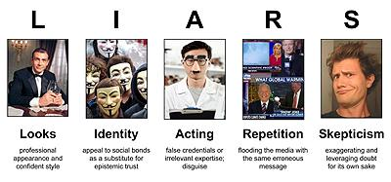
Some common persuasive tactics (and a handy acronym to remember them).

Slide 16
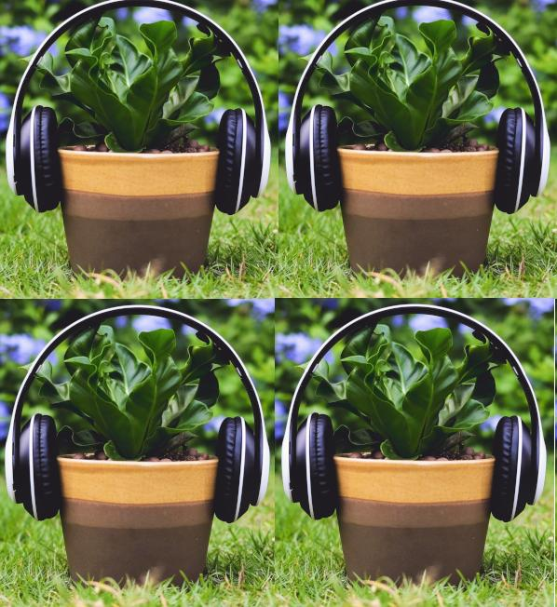
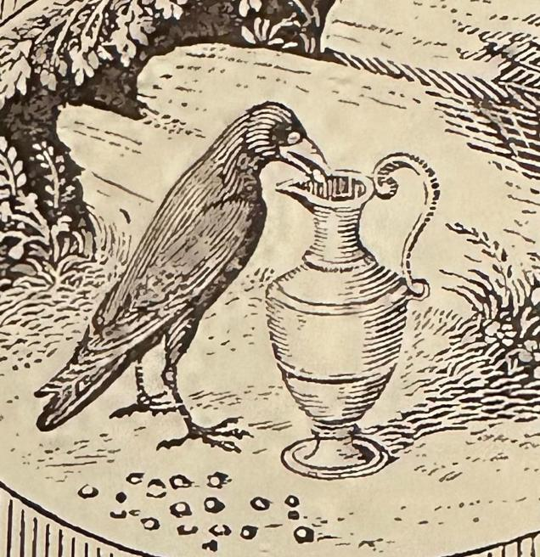
Innovative Scientific Methods
New Manuscript:
Spallanzani Tested Bird Intelligence
CRISPR meets AI
to Address Climate Change
NASA Equips Seals
with Tin Hats
Music Applied
to Plants Retested

Slide 17
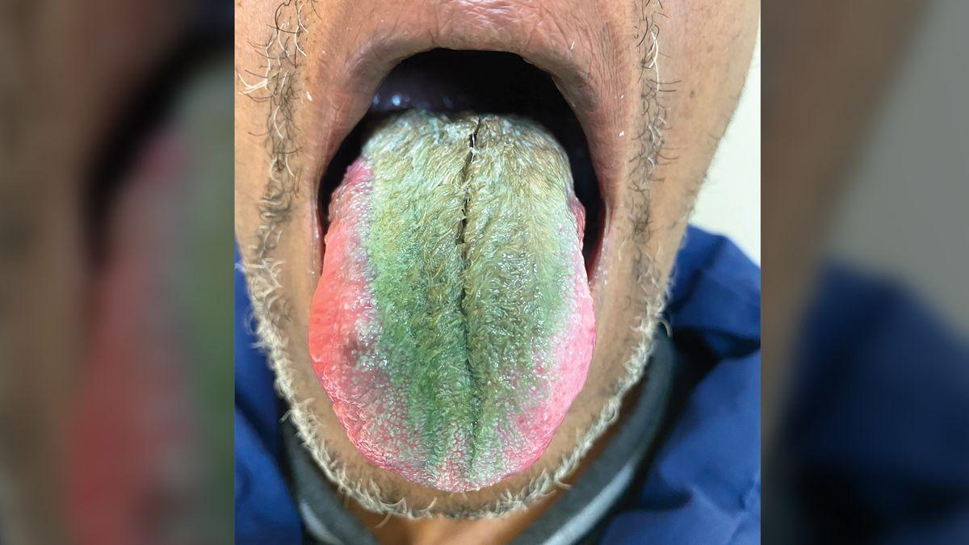
Startling Medical Diagnoses

Slide 18
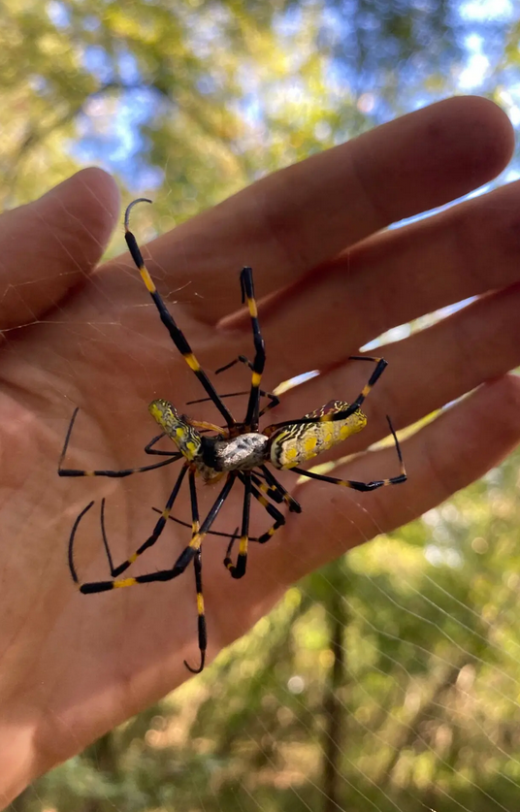
Hand-Sized Spiders Spread across U.S.
Whale Capsizes Boat–
Just Trying to Fish
Insights on Blushing
from Karaoke Study

Slide 19
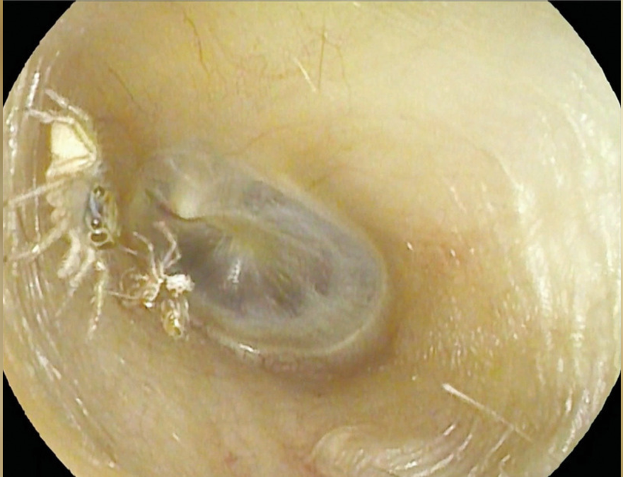
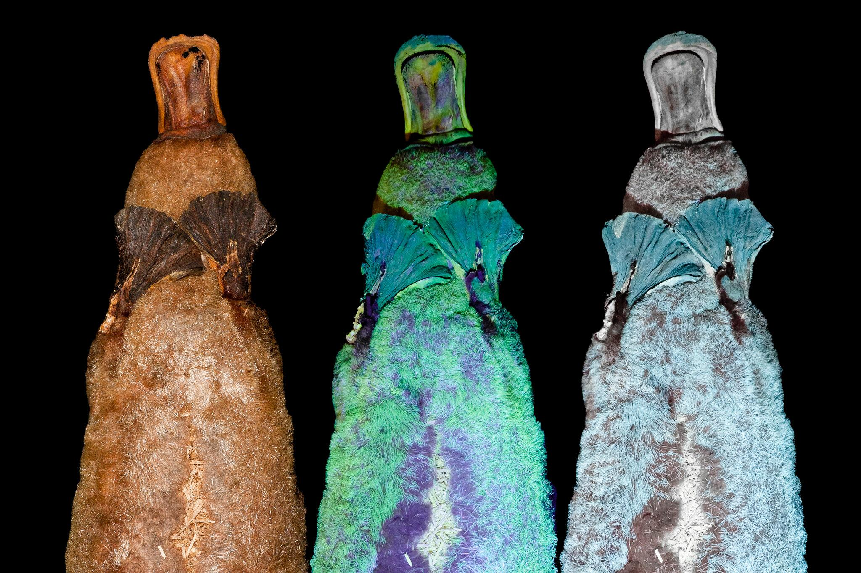
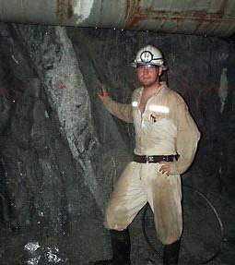
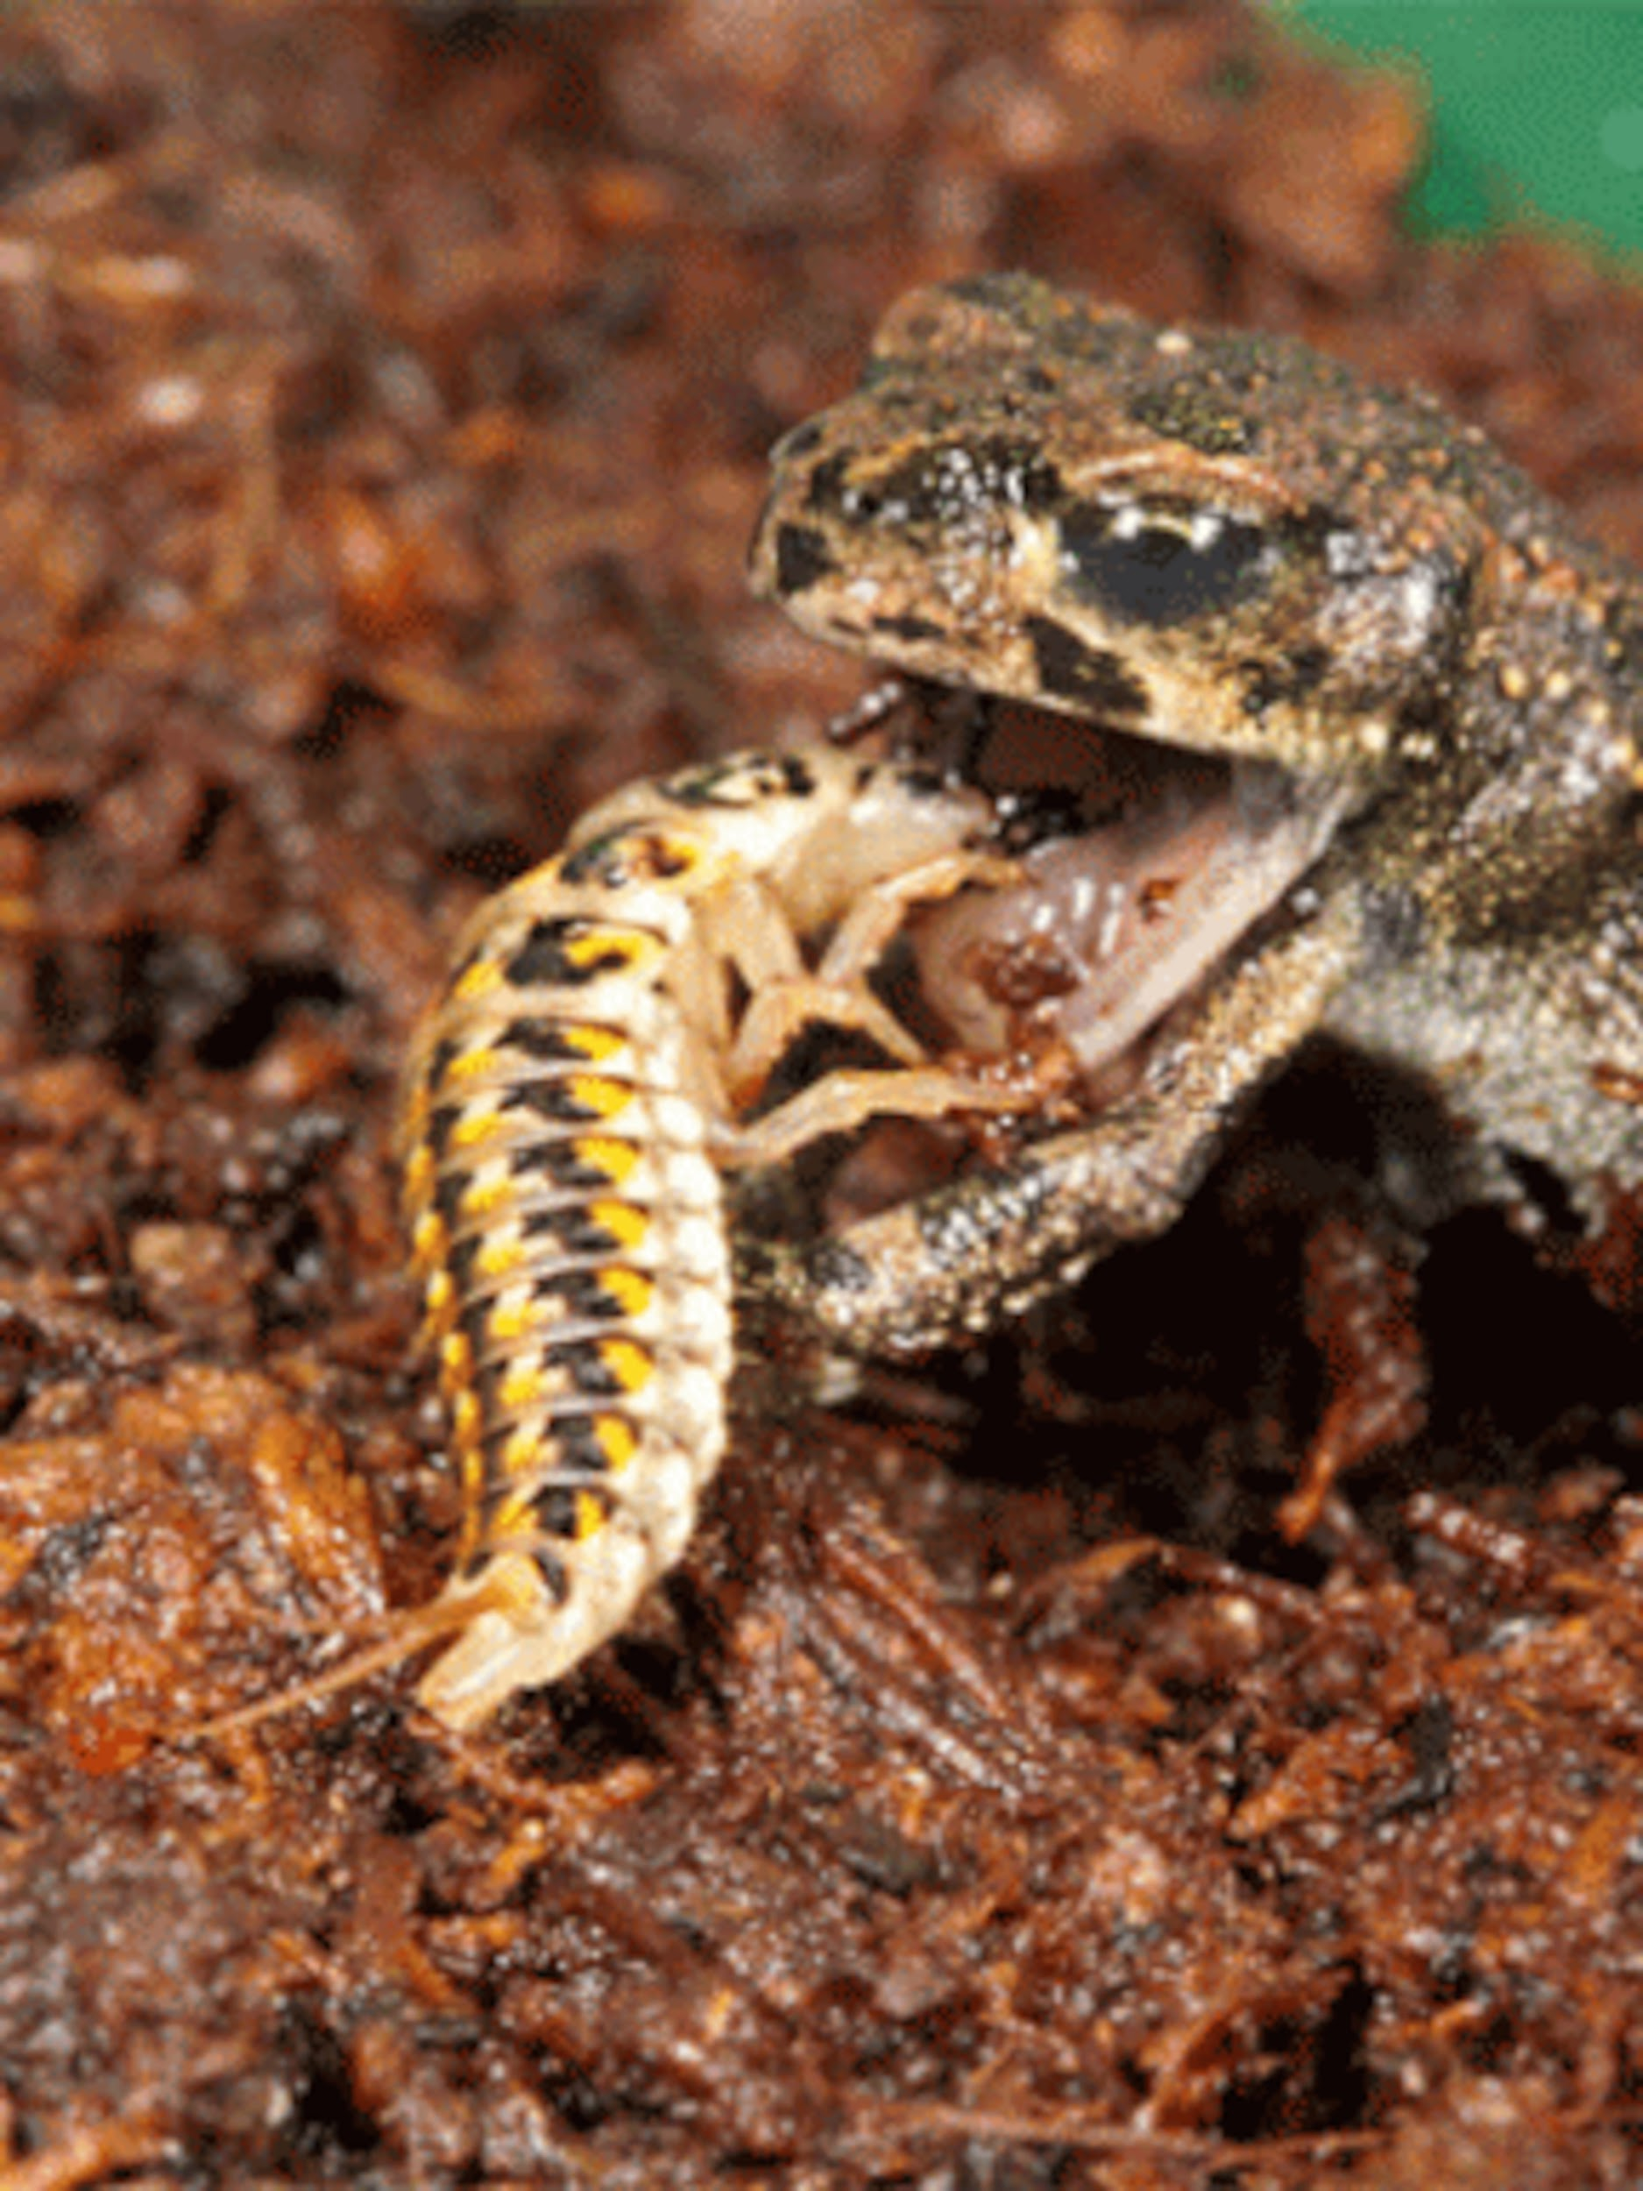
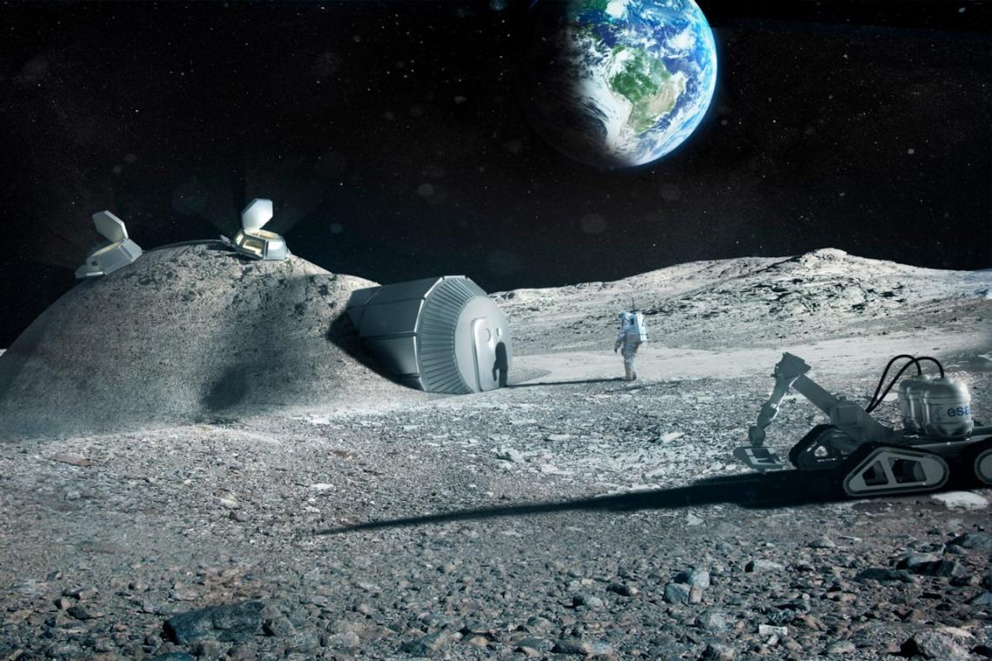
Annoying Noise Traced
to Spider in Ear
Platypuses Fluoresce: Why?
Bacterium in 3-km-deep Cave Lives on Radioactivity
Up-ended
Food Chain:
Beetle Larva
Eats Frog
Astronauts Could Use Urine and Moon Dust
for Cement Houses

