Slide 1
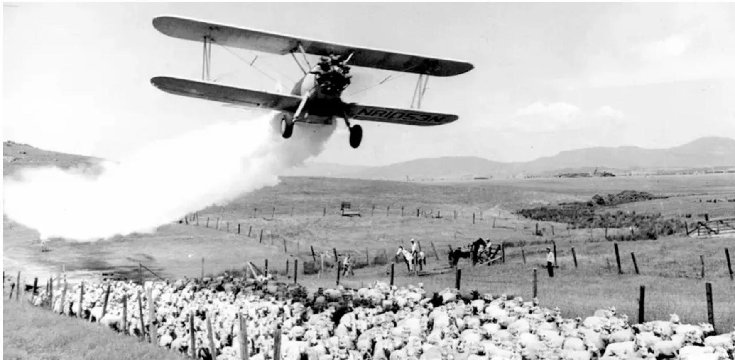
AP Photo
The Noisy Response to Silent Spring, 1963
© 2025 Douglas Allchin
http://shipseducation.net/misinfo/silentspring.htm

Slide 2
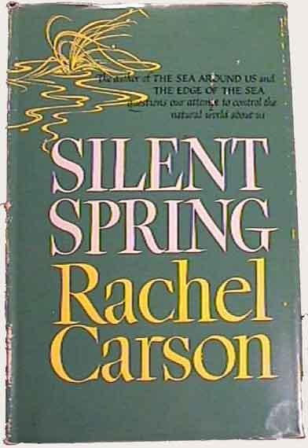
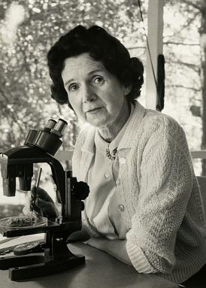
In 1962 nature writer Rachel Carson published Silent Spring, a powerful indictment on the dangers of the excessive use of pesticides.
Her work helped ignite an emerging environmental movement.

Slide 3
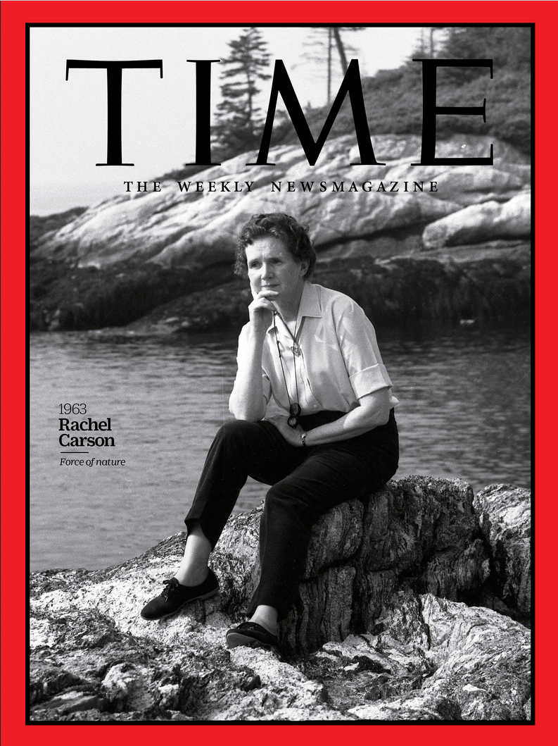
Carson would later be named as one of the most influential "Persons of the Century" by TIME magazine:
"Nearly 40 years later, [Silent Spring] is still regarded as the cornerstone of the new environmentalism. Carson was not a born crusader but an intelligent and dedicated woman who rose heroically to the occasion. She was rightly confident about her facts as well as her ability to present them. Secure in the approval of her peers, she remained remarkably serene in the face of her accusers."
In 2020, Time reimagined its annual iconic cover image for 1963, supposing Carson had been named "Woman of the Year."

Slide 4
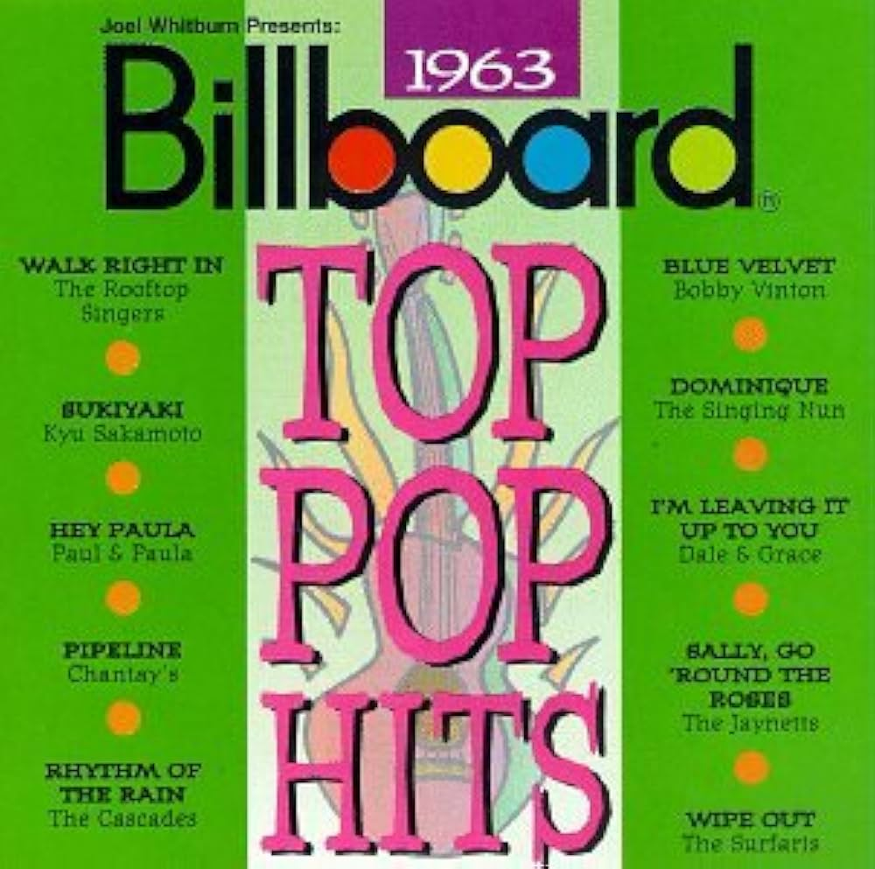
Let's step back in time to 1963…
Click on any title to listen
on YouTube
Walk Right In
Blue Velvet
Sukiyaki
Dominique
I'm Leaving It
Up to You
Hey Paula
Sally, Go 'Round
the Roses
Pipeline
Rhythm of
the Rain
Wipe Out

Slide 5
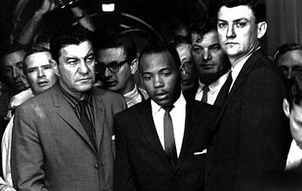
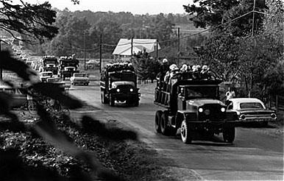
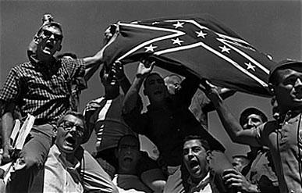
In the news…
Sept. 30, 1962 — Chief U.S. Marshal James McShane and Assistant Attorney General for Civil Rights John Doar guard James Meredith from harm, as Federal marshals under direction of President John F. Kennedy, arrive at the University of Mississippi ("Ole Miss") to allow Meredith admission, against actions by the University and governor, and with much student protest.

Slide 6
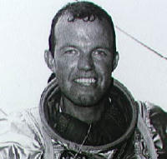
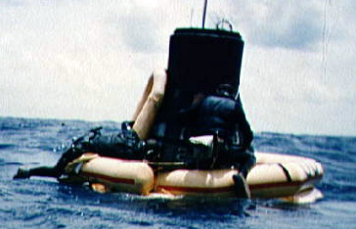
May 16, 1963 — Gordon Cooper completes the longest manned Mercury spaceflight: 34 hrs, 40 mins.

Slide 7
June 19, 1963 — Russian Valentina Tereshkova is the first woman in space, doubling Cooper's time. The space race is emblematic of political tensions between the U.S. and the U.S.S.R.

Slide 8
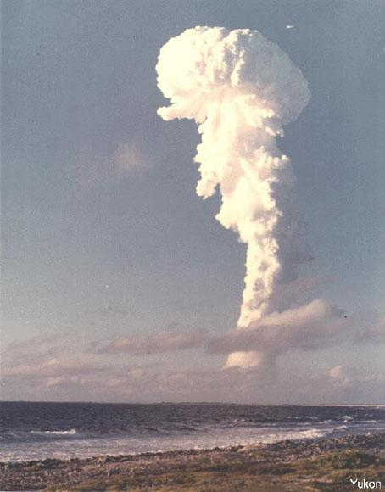
July 25, 1963 — The United States, United Kingdom, and the U.S.S.R. sign a Nuclear Test Ban Treaty -- outlawing atmospheric testing. The fifteenth and last nuclear test occurred last year.

Slide 9
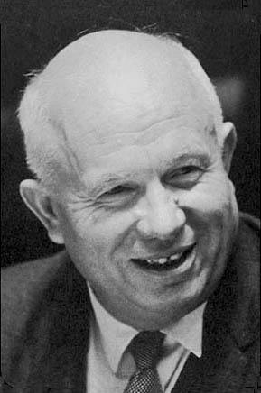
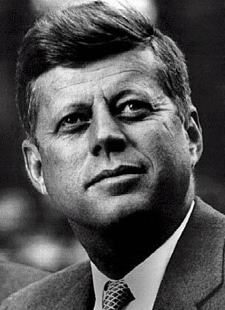
Aug 30, 1963 — Following the Cuban missile crisis last year, a new Washington-Moscow hotline opens to reduce the risk of unintended war between the two superpowers.

Slide 10
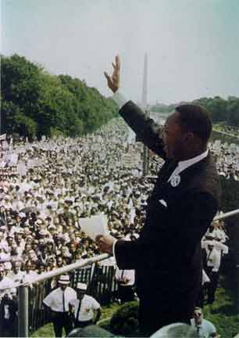
Aug 28, 1963 — A civil rights march in Washington DC. draws 200,000 participants. The Reverend Martin Luther King, Jr. speaks, "I Have a Dream."

Slide 11
September, 1963 — It has been a year since nature writer Rachel Carson published her book Silent Spring on the dangers of the excessive use of pesticides. Controversy fills the media. What scientific claims should we accept?

Slide 12
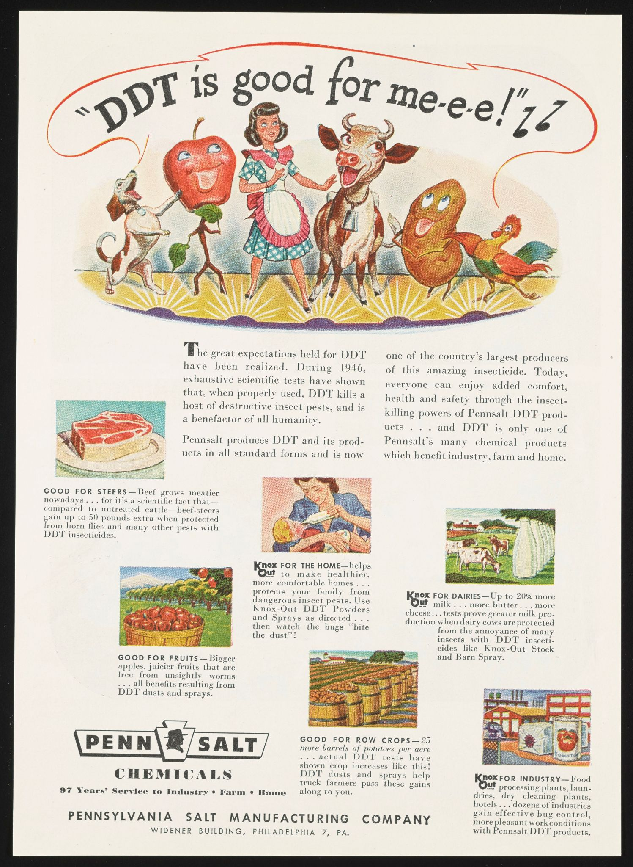
The chemical industry has for many years been promoting the value and safety of pesticides, such as DDT.

Slide 13
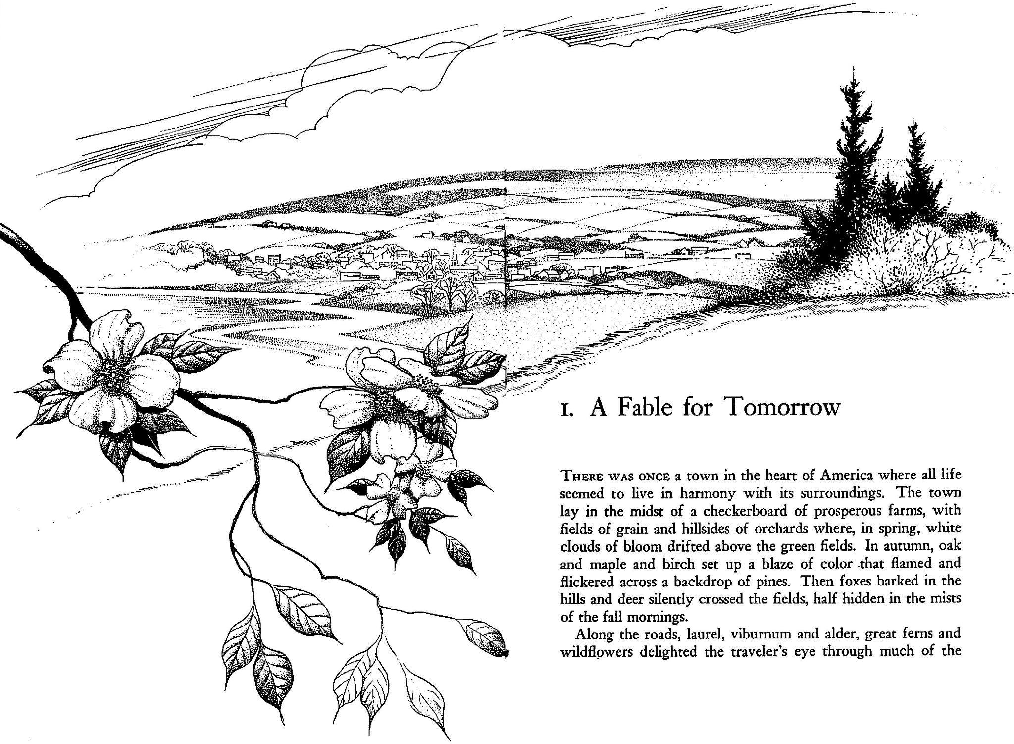
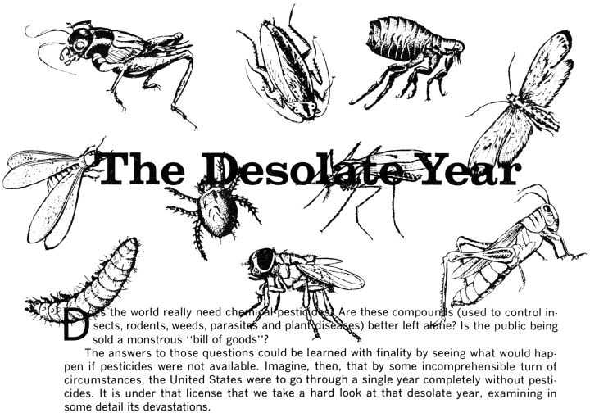
Consumers are now presented with two contrasting views. On the one hand, Carson describes the threats to wildlife and human health. On the other, the chemical industry warns against loss of crops and the rise of insect-borne diseases. Both claim to speak for science.
Whose claims should we accept?

Slide 14
The National Resarch Council has convened a panel on pesticides and wildlife relationships. And President Kennedy has asked his Science Advisory Committee to issue a report.
But let's consider various book reviews that you could easily find in the media.
Make a short list of things you might be looking for in these reviews.

Slide 15
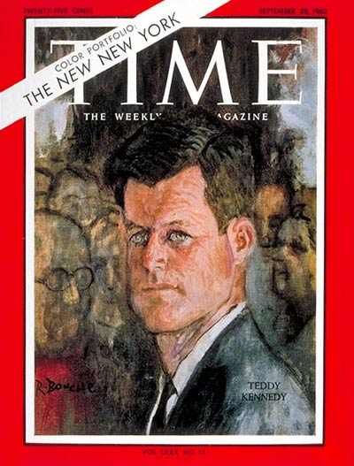
TIME magazine presents an assessment (that will contrast starkly with their judgment 40 years later):
“Many scientists sympathize with Miss Carson's love of wildlife, and even with her mystical attachment to the balance of nature. But they fear that her emotional and inaccurate outburst in Silent Spring may do harm by alarming the nontechnical public, while doing no good for the things that she loves.”
The book contains many “oversimplifications and downright errors.” Carson's claims are “unfair, one-sided, and hysterically overemphatic.”

Slide 16
Letters: Silent Spring?
Oct. 5, 1962
Sir: Granted Rachel Carson, in her new book Silent Spring, presents only one side of the chemical poison use controversy.
Need TIME [Sept. 28] belittle her efforts on behalf of mankind? The chemical manufacturers have presented the "other side" of the controversy to the public so effectively that highly toxic pesticides are now used as carelessly as foot powder.
TIME should have cheered Miss Carson's efforts to alert the public to pesticide dangers, and seconded her motion to step up research to discover target-specific, short-life pesticides and non-chemical pest controls, the use of which would assure that America will never have a "silent spring."
THOMAS L. KIMBALL Executive Director National Wildlife Federation Washington, D. C.
Sir: Thank you for allaying the fears of at least one member of the nontechnical and impressionable public. After reading installments of Miss Carson's book in a magazine last June, I was so struck with horror that I threw out all my insecticides and sprays. All summer long I had thrips on the grapevine, ants in the kitchen, and bugs at my barbecues.
(MRS.) VICKI PATTERSON West Newton, Mass.
Sir: As a California citrus grower, I am in a position to know that nowhere in the world is the consumer so thoroughly protected from harmful residual chemicals as in the U.S. A pox on authors who will pervert the truth for a few lousy bucks.
GEORGE BROOMELL Tustin, Calif.
Sir: Most scientists with whom I have spoken are of the opinion that Miss Carson used facts in her book, although they undoubtedly were carefully selected to promote her point of view. Apparently it was her candid opinion that the pesticide situation would never reach the public unless she used Madison Avenue tactics.
No clear-thinking scientist is going to suggest eliminating the use of pesticides. However, they are going to pay more attention to weighing the pros and cons of elm v. robin type questions. Miss Carson has done her job well--stimulating thought, discussion and controversy.
PATRICK R. DUGAN Microbiological and Biochemical
Center. Syracuse University
Research Corp. Syracuse, N.Y.

Slide 17
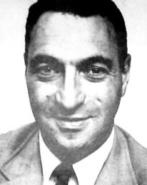
Review for The Saturday Evening Post
“The Myth of the Pesticide Menace.”
Neil Diamond, science writer

Slide 18
Review for The Saturday Evening Post
“The Myth of the 'Pesticide Menace' ”
“An emotional, alarmist book”
"Thanks to a woman named Rachel Carson, a big fuss has been stirred up to scare the American public out its wits."
"the attention-getting quality inherent in any exaggeration"
"It was just what the American public wanted to hear. No matter that Miss Carson's conclusions were preconceived, no matter that her arguments were more emotional than accurate. Silent Spring became a bestseller and conversational fad."
________
In the byline, Diamond is profiled as an original collaborator with “Miss Carson." but apparently having disagreed with her approach, discontinued. In fact, Diamond declined to complete the research that Carson planned, and he was asked to withdraw.
Neil Diamond
(science writer)

Slide 19
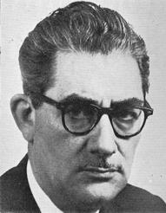
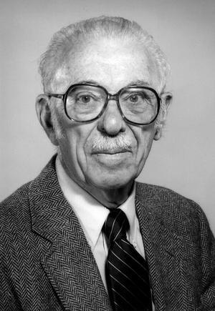
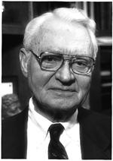
Robert White-Stevens
(chemist)
Thomas Jukes
(biochemist)
William Darby
(nutritionist)
representatives of the chemical industry
writing in Chemical Week and Chemical and Engineering News

Slide 20
"Miss Carson maintains that the balance of nature is a major force in the survival of man, whereas the modern chemist, the modern biologist, the modern scientist believes that man is steadily controlling nature."
"The major claims in Miss Rachel Carson's book, Silent Spring, are gross distortions of the actual facts, completely unsupported by scientific experimental evidence, and general practical experience in the field."
"The real threat then to the survival of man is not chemical but biological, in the shape of hordes of insects that can denude our forests, sweep over our crop lands, ravage our food supply and leave in their wake a train of destitution and hunger, conveying to an undernourished population the major diseases and scourges of mankind. If man were to follow the teachings of Miss Carson, we would return to the Dark Ages, and the insects and diseases and vermin would once again inherit the earth."
Robert White-Stevens
(chemist, American Cyanamid Corp.)
comments on CBS Reports documentary

Slide 21
1963 article in American Scientist
DDT is able control many diseases, including malaria, typhus, dengue, plague, and cholera. The harms are negligible. People who worry about pesticides in their food and the environment are “alarmist.”
"Progress in American agriculture must not become … hamstrung by legislation resulting from inaccurate statements regarding the dangers of pesticides. The right to publish confers the obligation to tell the story without distortion, omission, misquotation, or innuendo. … At stake is no less than the protection of the free world from hunger and disease,”
Thomas Jukes
(biochemist, American Cyanamid Corp.)

Slide 22
review for Chemical and Engineering News
"Silence, Miss Carson"
"The public may be misled by this book." It will appeal to "those readers who are as uncritical as the author," such as "organic gardeners, the antiflouride leaguers, the worshipers of 'natural foods,' those who cling to the philosophy of a vital principal, and pseudo-scientists and faddists."
Miss Carson's "ignorance or biases on some of the considera- tions throws doubt on her competence to judge policy."
Banning pesticides would mean “disease, epidemics, starvation, misery and suffering incomparable and intolerable to modern man.”
"The responsible scientist should read this book to understand the ignorance of those writing on the subject and the educational task which lies ahead."
William Darby
(nutritionist, Vanderbilt School of Medicine)

Slide 23
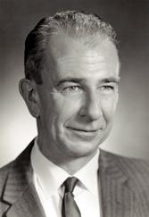
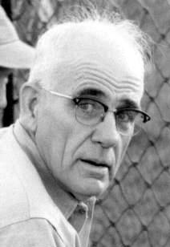
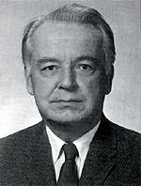
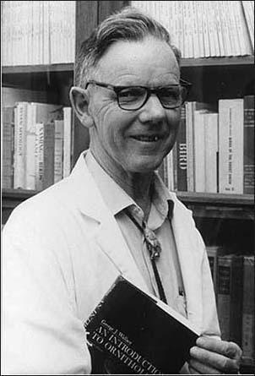
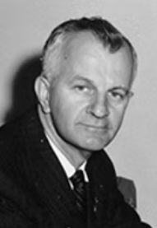
Lamont Cole
(ecologist)
Scientific American
Clarence Cottam
(wildlife biologist)
Sierra Club Bulletin
Robert Rudd
(entomologist & textbook author)
Pacific Discovery
George Wallace
(zoologist)
Cranbrook Inst. of Science Bulletin
Roland Clement
(naturalist)
Audubon
biologists
reviewing Silent Spring for a popular audience

Slide 24
review for Scientific American
"Rachel Carson's indictment of the wide use of pesticides"
“As an ecologist, I am glad this provocative book has been written. That is not to say I consider it a fair and impartial appraisal of all the evidence." However, "the extreme opposite has been impressed on the public by skilled professional molders of public opinion.” … “Errors of fact are so infrequent, trivial and irrelevant to the main themes that it would be ungallant to dwell on then.”
"Anyone will recognize this is an argument that is bound to arouse the ire of powerful elements in our society." … "Where does the truth lie? It lies in part with Miss Carson, who presents enough solidly established facts to justify some alarm."
Lamont Cole
(ecologist)

Slide 25
review for Sierra Club Bulletin"
"A Noisy Reaction to Silent Spring"
"No book since Harriet Beecher Stowe's Uncle Tom's Cabin has stirred the American public or Washington officialdom as this beautifully written and well documented appraisal of the pesticide problem."
"It is not surprising that the most extreme reactions against this skillfully and effectively written document have come from those whose purse strings and employment are threatened." … "Some in the field of economic entomology, particularly those who receive financial support directly, or for their laboratories, have been violent in their opposition to the book." …
"In the vigorous campaign against Silent Spring, the philosophy seems to exist that it makes little difference what line of attack is followed if only the book is condemned."
Clarence Cottam
(wildlife biologist)

Slide 26
review for Pacific Discovery
"The Chemical Countryside"
"We have cause to suspect that the products of our technology may be unwisely applied, and in the long run harm us more than help us."
"Silent Spring is a credit to its writer. But while conceding her literary abilities, her critics challenge her technical competence. … Are the correct?" … "In my opinion she is eminently qualified to present the facts, synthesis and argument."
"Silent Spring is not just another fine literary work of the sort we expect from Miss Carson. It is, as well, biological warning, social commentary, and moral reminder. Insistently, she calls upon technological man to pause and take stock."
Robert Rudd
(entomologist & author of the textbook Pesticides and the Living Landscape)

Slide 27
Cranbrook Institute Bulletin #41
"Bird Mortality in the Dutch Elm Disease Program in Michigan"
"From the evidence submitted in this report it should be clear that mortality to birds has been high in many of the control programs designed to protect Dutch elms from disease."
"Though it is not within the scope of this report to criticize or evaluate the earnest efforts of operators or administrators to try to save the valuable elm trees, we are inclined to question the whole program … on ecological grounds. Any program which destroys 80 or more species of birds and unknown numbers of beneficial predatory and parasitic insects needs further study."
George Wallace
(zoologist)

Slide 28
review (and related commentaries) for Audubon magazine
"This disarmingly eloquent book by one of America's favorite science writers is a two-fisted indictment of our modern devotion to the technological solution of man's problem in pushing nature to yield him more and more and more."
"Miss Carson's book is more than a compilation of facts and figures, the blunders and the near misses involved in the use of pesticides these past 15 years and more. It is a thoughtful questioning of the impact of these poisonous materials on the fabric--that web of life–which has to this day made our earth productive."
Roland Clement
(naturalist)

Slide 29
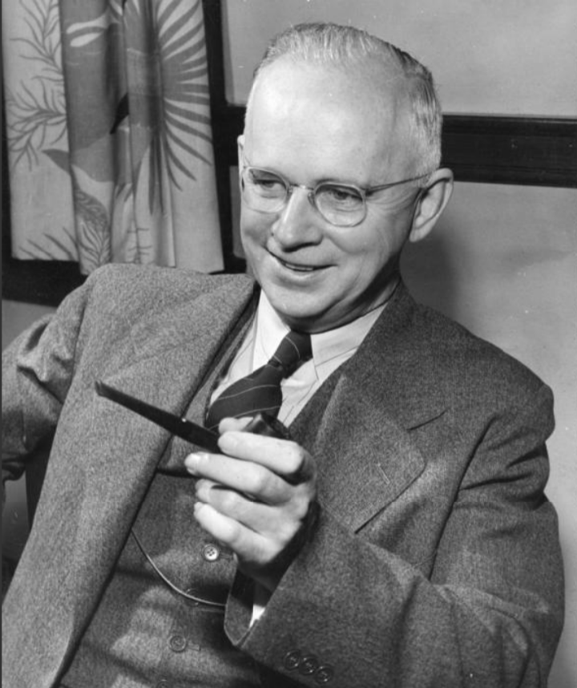
Ira Baldwin
(agricultural bacteriologist),
reviewed Carson's book for the prestigious research journal, Science
Chair of the National Research Council Committee
on Pest Control and Wildlife Relationships

Slide 30
review for the research journal, Science
"Chemicals and Pests"
"Silent Spring is superbly written and beautifully illustrated with line drawings. The author has made an exhaustive study of the facts bearing on the problem [of pesticides]. It is not, however, a judicial review or a balancing of the gains and losses; rather, it is the prosecuting attorney’s impassioned plea for action against the use of these new materials which have received such widespread acceptance, acceptance accorded because of the obvious benefits their use has conferred.”
"The story of Silent Spring, so well told by Rachel Carson, even though it presents only one side of a very complex problem, will serve a useful purpose, if research on better methods of pest control are stimulated and if all concerned with the production, control and use of pesticides are stimulated to exercise greater care in the protection of the public welfare."
Ira Baldwin
(agricultural bacteriologist)
Chair of the National Research Council Committee on Pest Control and Wildlife Relationships

Slide 31
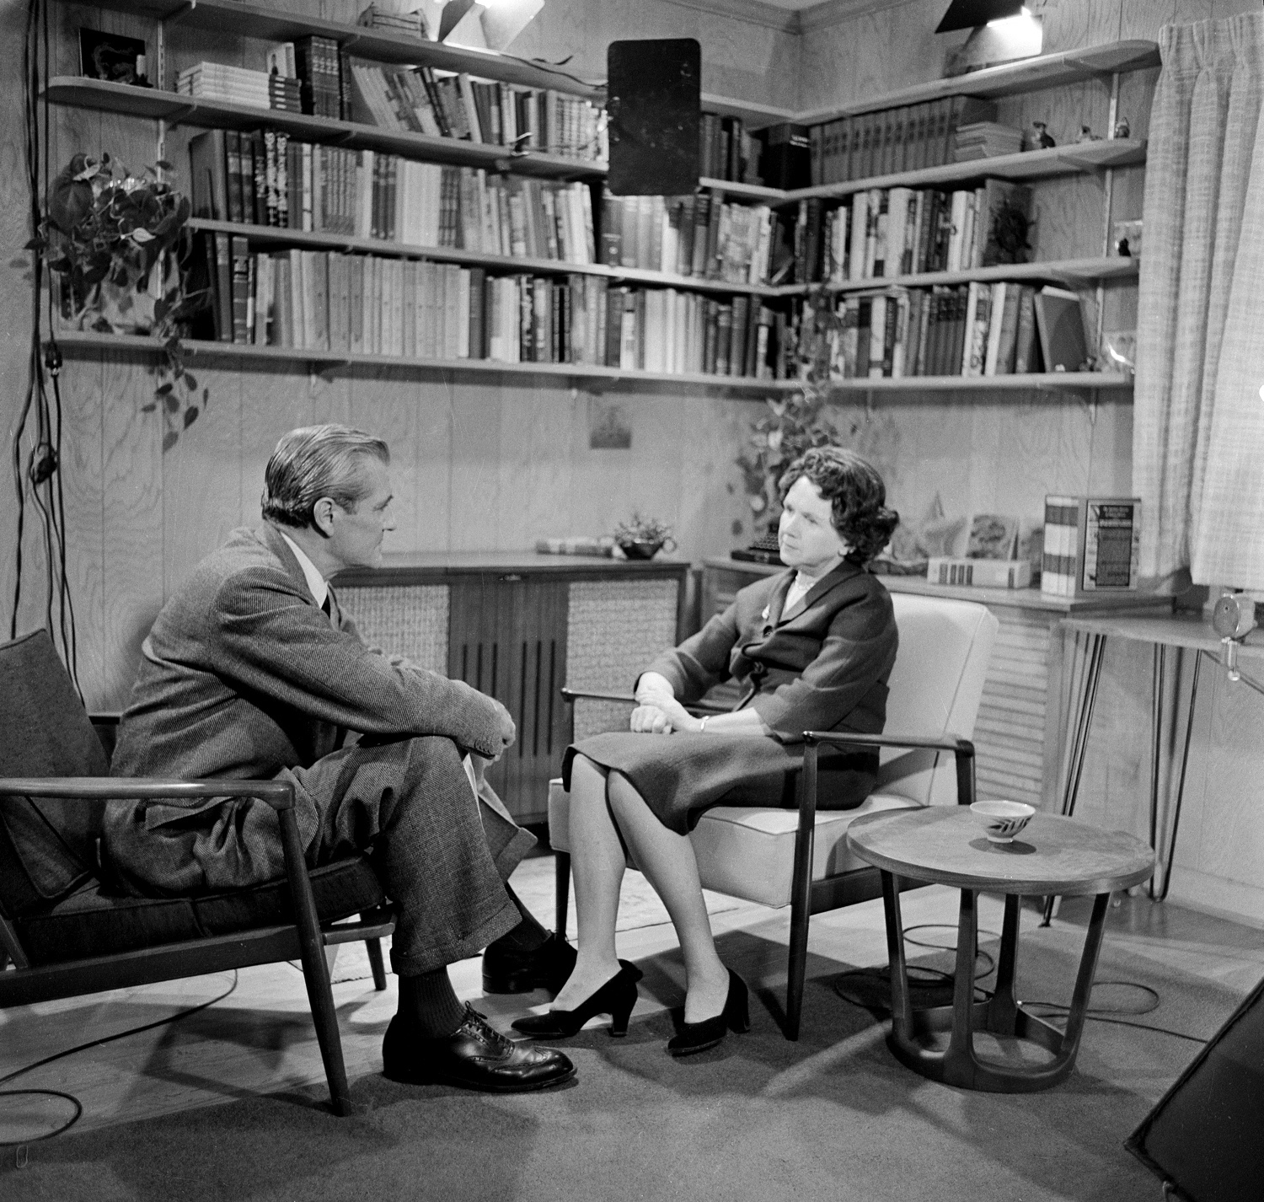
CBS Reports
investigative TV journalism
interviews with:
White-Stevens (speaking on behalf the chemical industry)
Luther Terry (Surgeon General)
George Larrick (Food and Drug Adminstration)
Orville Freeman (Secretary of Agriculture)
others from the Public Health Service and the U.S. Fish and Wildlife Research Center
Rachel Carson
aired April 3, 1963
Available on YouTube

Slide 32
The program begins by reviewing the various uses and the obvious benefits of synthetic pesticides, and the general safety of crop foods (under allowable residue limits) sold at grocers.
Carson then presents her concerns about: agricultural workers and consumers exposed the chemicals without proper cautions; the cumulative effect of repeated exposure; the detrimental effect on beneficial insects, such as pollinators; the poisoning of aquatic life and, through the food chain, birds. She also draws attention to the development of pesticide-resistant insects through natural selection.
The program tries to assess the scale of the problem. They note annual deaths attributed to pesticide poisoning, and the 137 insects know to be resistant to some pesticide. At the same time, they dispel the nightmarish images sometimes associated with Carson's claims.
In general, they confirm Carson's basic cautionary message and emphasize the need for more research and better government regulation.
CBS Reports
"The Silent Spring of Rachel Carson"

Slide 33
Robert White-Stevens (quoted earlier, for the chemical industry)
George Larrick (Food and Drug Administration)
The book "causes all of us to take a new look at our responsibilities."
He acknowledges that current controls are not "truly sufficient."
Orville Freeman (Secretary of Agriculture)
acknowledges that prior to the book, the public had not been adequately alerted to the various dangers of pesticides.
John Buckley (U.S. Fish & Wildlife Research Center"
"There is no doubt that the use of pesticides has resulted in extensive damage to wildlife." Harms to birds are well documented.
Page Nicholson (U.S. Public Health Service)
admits lack of knowledge about the contamination of ground water and its consequent effects.
Luther Terry (Surgeon General)
expresses concern about not knowing about the low-level, long-range effects of exposure.
CBS Reports
"The Silent Spring of Rachel Carson"

Slide 34
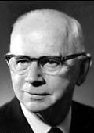
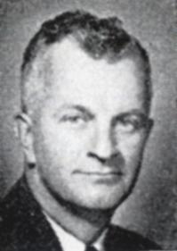
In retrospect, what were the roles of each of these voices in the media?
Which were ultimately most reliable?

Slide 35
Review:
What have you learned about …
credibility and relevant expertise?
conflict of interest?
scientific consensus?
media gatekeepers (journalists)?
disinformation & persuasive tactics?

Slide 36
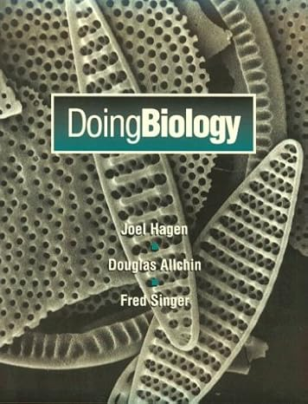
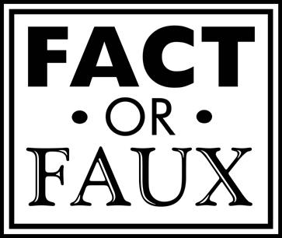
Sources & Additional Reading/Activities
http://shipseducation.net/misinfo/library.htm
http://pesticides1963.net
http://doingbiology.net/carson.htm
http://shipseducagtion.net/misinfo

