Slide 1
When Experts Disagree
— Coping with Uncertainty —
©2025 Douglas Allchin
http://shipseducation.net/misinfo/disagreement.htm

Slide 2
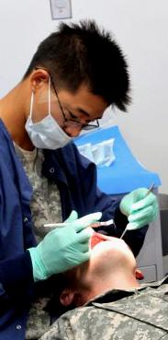
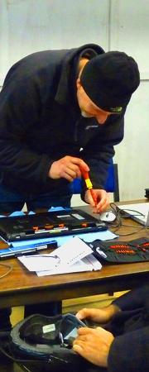
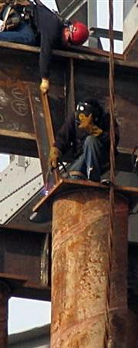
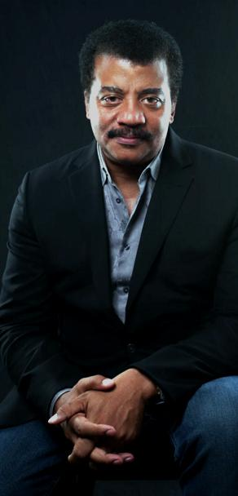
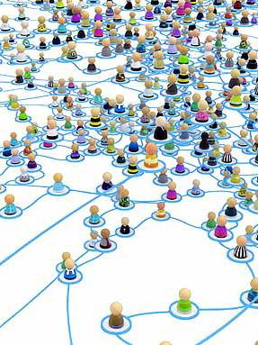
Inquiry Into Expertise
Recall the lessons from your "Inquiry Into Expertise" and "Fact
Checking 102."
We need to respect when others know more than we do.
In science, reliable knowledge is indicated by the consensus of the relevant experts.
Fact Checking 102

Slide 3
"Respect the consensus of the relevant scientific experts."
That’s what counts as “settled” science.

Slide 4
But what if … the scientific experts disagree?

Slide 5
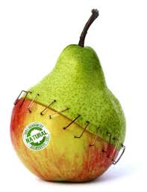
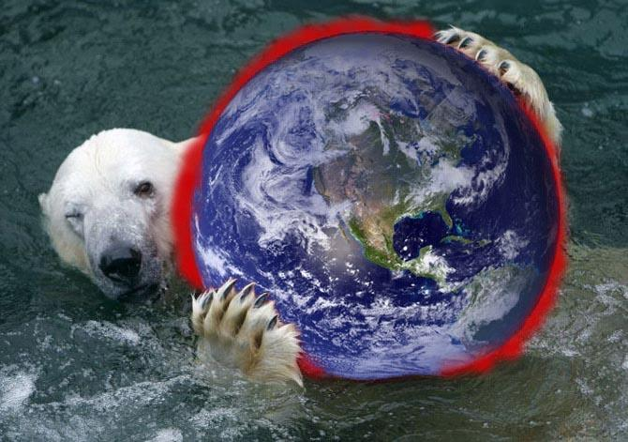
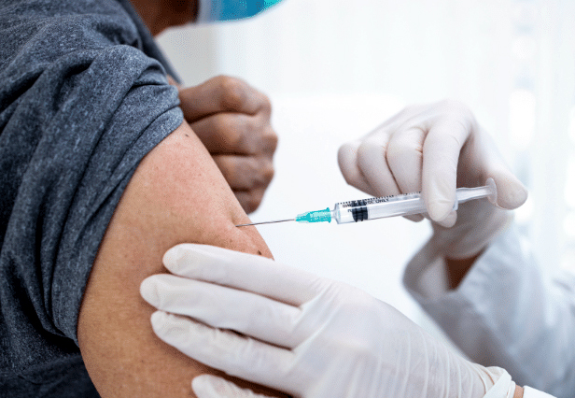
Are you familiar with any cases in the media reporting that scientific experts disagree?
covid pandemic?
climate change?
vaccine safety?
GMOs?
teenage pregnancies? | health effects of vaping? local waste incinerators? | cell phones & cancer?
Keep that list handy!

Slide 6
Consider the options.
Identify several possible responses
when scientific experts disagree.

Slide 7
Some possible responses when experts disagree:

Slide 8
Some possible responses when experts disagree:
Dismiss science as unhelpful?
Wait for more research?
Follow your own intuitions?
Examine the evidence and decide for yourself?
Pick an expert who agrees with you, and ignore the others?
Investigate the experts' interests.
Ask why the experts disagree?
Establish where they do agree?
Accept uncertainty as the relevant status of knowledge?
Find some alternative way to make decisions?
Identify if each response seems appropriate,
when and why.

Slide 9
Some possible responses when experts disagree:
Dismiss science as unhelpful?
Wait for more research?
Follow your own intuitions?
Examine the evidence and decide for yourself?
Pick an expert who agrees with you, and ignore the others?
Investigate the experts' interests.
Ask why the experts disagree?
Establish where they do agree?
Accept uncertainty as the relevant status of knowledge?
Find some alternative way to make decisions?
Let's explore 3 dimensions in more detail:
Why do experts disagree?
How can we make decisions if there is uncertainty?
How do we know what the consensus is, or if experts really do disagree?

Slide 10
Some imagine that disagreement means science is "broken."
( Isn't the very purpose of science to find definite answers? )
Let's examine that view.

Slide 11
Explore (1):
Why might experts
disagree?
Imagine some occasions when disagreement in science
would seem reasonable.

Slide 12
Some occasions when scientific disagreement seems reasonable:

Slide 13
Some occasions when scientific disagreement seems reasonable:
Not enough evidence
Research is incomplete
Evidence conflicts
Different views about which evidence is most important
Different areas of expertise
Different levels of expertise
Alternate theories may explain the same results
Different theoretical preferences
Different personal biases
Conflict of interest is hidden
Scientists are still working on it
How do these occasions reflect on the goal of science?

Slide 14
Scientific disagreement may very well indicate active science-in-the-making,
not "broken" science.
The status of
expert scientific
knowledge is
uncertainty.

Slide 15
Recalling the nature of expertise…
If the scientific experts disagree,
does that mean non-experts should try to find the solution themselves?
Give reasons for and against this strategy.
Inquiry Into
Expertise

Slide 16
When Experts Disagree
If the experts cannot agree,
we non-experts really can't do any better.
That's the dilemma of expertise.
If experts disagree, we should accept that
the very status of current knowledge is
(justified) uncertainty.
How might we address the emotions associated with uncertainty?

Slide 17
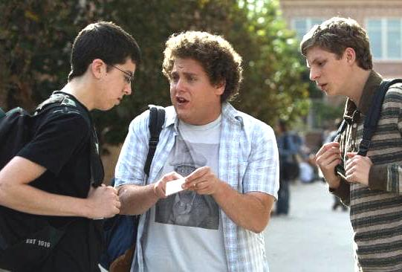
Explore (2):
How can we make decisions if there is uncertainty?
How do you decide when advice from friends conflicts?

Slide 18
Making decisions when advice from friends conflicts:

Slide 19
Making decisions when advice from friends conflicts:
Ignore all of it? (probably not!)
Consider the range of views?
Look for overlap?
Follow the majority view?
"Measure" each comment?
Give more weight to quality?
Use context to interpret each?
Consider each person's "track record" in previous advice?
Consider the consequences of adopting (or disregarding) each?
Play it safe? Hedge your bets?
How can you apply this to the case of scientific disagreement?

Slide 20
Explore (2):
So, how might we cope with scientific uncertainty?

Slide 21
How to cope with genuine scientific uncertainty:

Slide 22
How to cope with genuine scientific uncertainty:
Prepare for multiple possibilities?
Take precautionary action?
Consider the "worst case scenario"?
Protect vulnerable stakeholders?
Consider the possible extremes?
"Cover all your bases"?
Assess the degree of uncertainty?
Trust the "most probable" outcome?
Trust the overall weight of opinion?
Let each person decide separately?
Invest in more research?
Other?
What context would be appropriate for each strategy?

Slide 23
When Experts Disagree: Coping with Uncertainty
Accommodate the uncertainty.
Be flexible.
Apply precautionary principles.
Prepare for alternative outcomes.
Use available knowledge.

Slide 24
Explore (3):
How do we know the views of the experts,
whether consensus or disagreement?

Slide 25
Social Media?
Contrarian claims about covid vaccines were 11 times more frequent on Twitter than those of the corresponding consensus.
Claudio schwartz ON UNSPLASH
Efstratiou, A. , Efstratiou, M., Yudhoatmojo, S., Blackburn, J. & De Cristofaro, E. (2024). “Here’s your evidence”: False consensus in public Twitter discussions of COVID-19 science. Proceedings of the ACM on Human-Computer Interaction, 8(CSCW2), #471. https://dl.acm.org/doi/pdf/10.1145/3687010

Slide 26
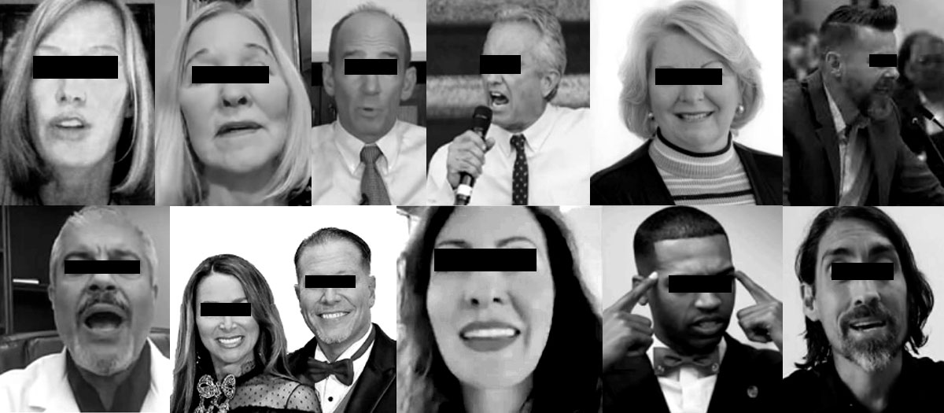
Two-thirds of the social media information on COVID contrary to expert consensus in early 2021 originated from just 12 individuals.
Center for Countering Digital Hate. (2020). The Disinformation Dozen. https://counterhate.com/research/the-disinformation-dozen/

Slide 27
Lies on social media spread more rapidly, more broadly, and farther than facts.
Vosoughi, S., Roy, D., & Aral, S. (2018). The spread of true and false news online. Science, 359, 1146–1151.

Slide 28
Internet?
There are dozens of websites denying global warming and man-made climate change.
Does that reflect a consensus?

Slide 29
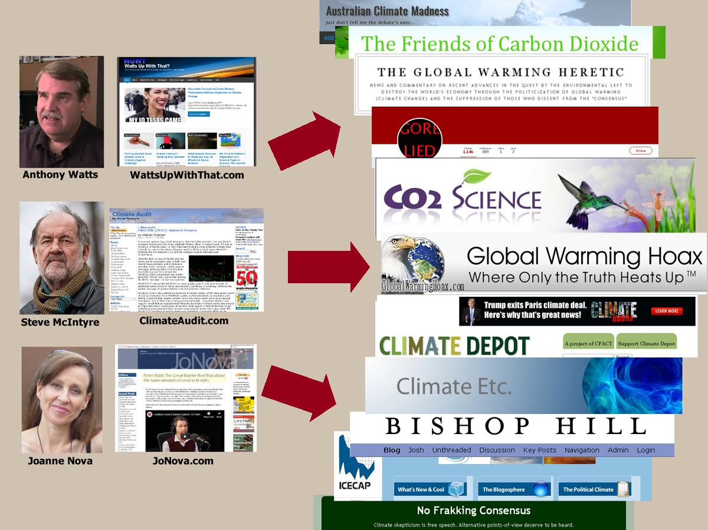
Most of those websites get their information from just 3 sources.
An illusion of "agreement" is fostered merely by a biased media presence.
Sharman, A (2014) Mapping the climate sceptical blogosphere. Global Environmental Change, 26, 159-170.

Slide 30
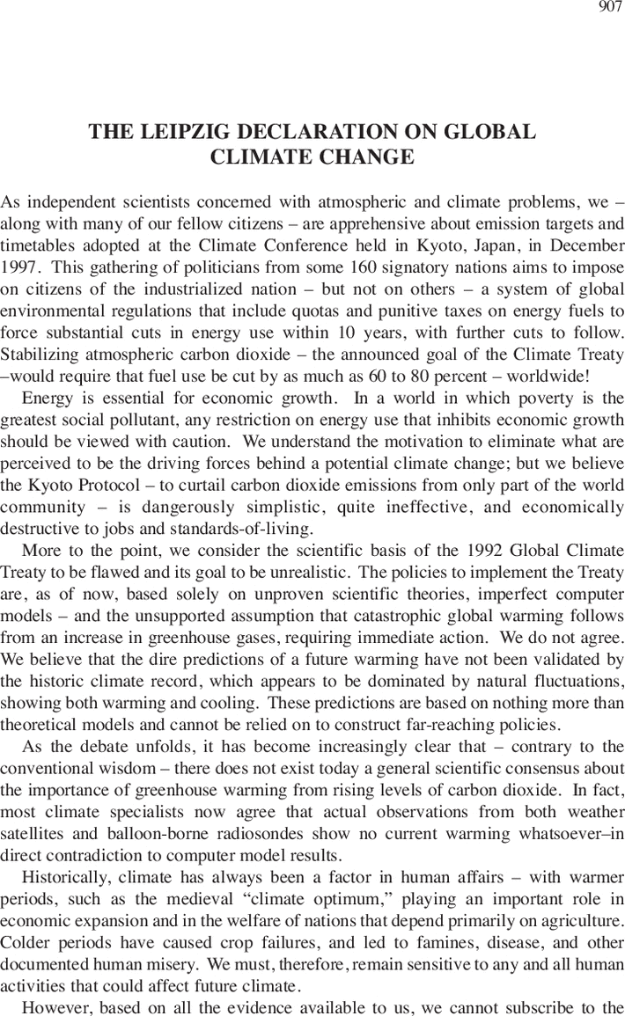
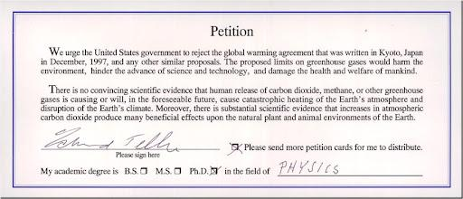
Organizational "consensus" statements?
Bogus petitions have tried to convey an impression that the experts do not agree – but the signers are almost entirely non-experts.
Leipzig Declaration (1995)--
an "agreement" on climate change by weathermen, dentists and oil company employees?
Oregon Petition (1998, 2007)–
over 30,000 signatures

Slide 31
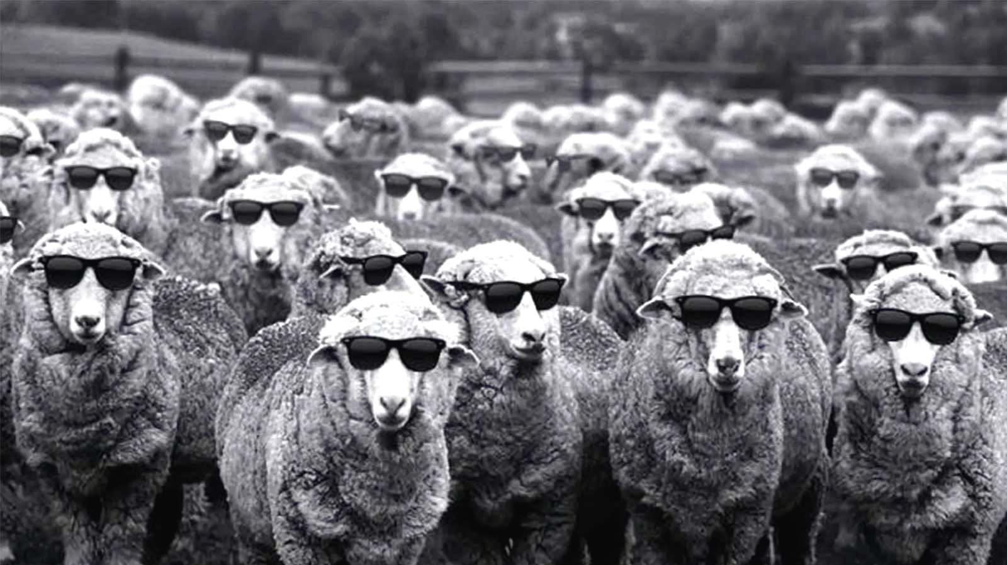
Explore (4).
Identify several possible reasons why someone might want to create a counterfeit image of scientific experts disagreeing.

Slide 32
Reasons someone might try to create a counterfeit image of scientific disagreement:

Slide 33
Reasons someone might try to create a counterfeit image of scientific disagreement:
The settled science threatens their interests?
Controversy fosters delay?
Confusion promotes relying on quick emotion rather than slow reason?
General erosion of trust in science?
Profit?
Power?
Privilege, prestige?
Science
Liars Game

Slide 34
second-hand cigarette smoke
climate change
safety of vaccines
acid rain
environmental harms of pesticides
toxicity of hexavalent chromium
toxicity of formaldehyde
toxicity of vinyl chloride
toxicity of lead
ephedra
effectiveness of statins in controlling cardiovascular disease
health effects of burning diesel fuel
severity of the covid pandemic
significance of masking in reducing viral transmission
origins of the covid-19 virus
On many occasions, special interests have tried to create an image that experts disagree
–– when there was a scientific consensus.
Michaels, D. (2020). The Triumph of Doubt.
Oreskes, N., & Conway, E. M. (2010). Merchants of Doub

Slide 35
Explore (3):
How do we know the views of the experts,
whether consensus or disagreement?

Slide 36
Discuss how to use your fact checking skills?
Look for any conflict of interest
Separate credibility from "trust"
Assess the expertise to speak for science

Slide 37
Major established scientific institutions embody consensus.
Institutional
Tour

Slide 38
2024 Kavli science Journalism Award WInners (AAAS)
Veteran science journalists may also be credible sources for ascertaining and reporting the scientific consensus
(based on their professional expertise – built on a track record, rather than casual impressions of "trust").

Slide 39
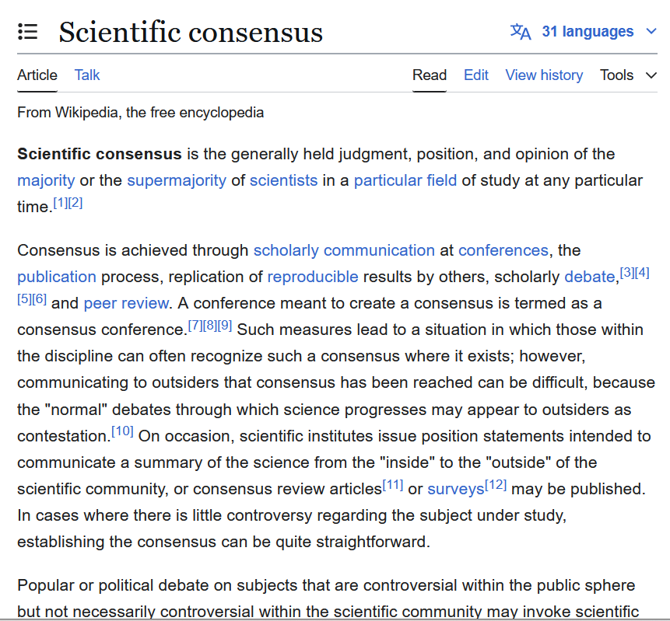
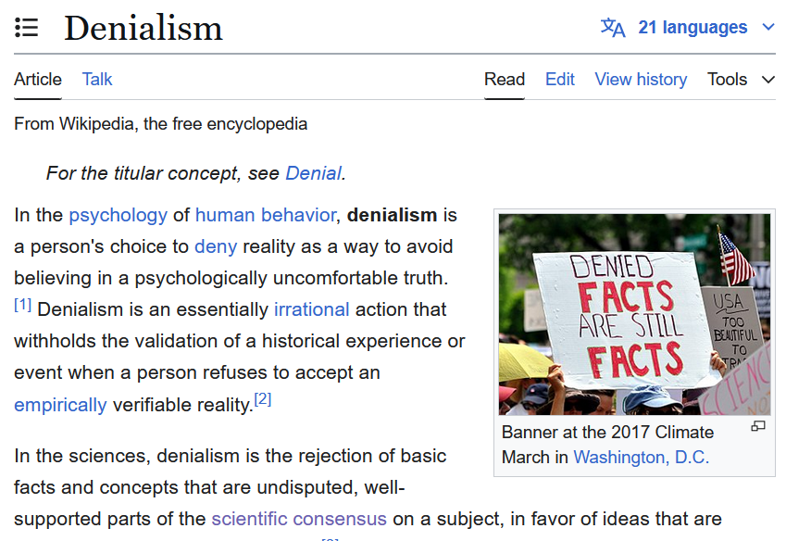
Even Wikipedia – now edited for accuracy – may be informative.
(Be sure to check what sources they rely on!)

Slide 40
When Experts Disagree
Summarize what you have learned about when scientific experts disagree.

Slide 41
When Experts Disagree

Slide 42
When Experts Disagree
First, check whether the disagreement is genuine. Was it created artificially in the media by those hoping to escape settled science?
If experts do disagree, admit your own limits. Simply accept the undertainty for what it is. (Do not try to override it!)
Explore the disagreement itself. Why do the experts disagree? What is the degree of uncertainty, the range of alternatives, and the views of the leading experts? Use help from veteran science journalists, scientific institutions, and even Wikipedia.
Adapt your style of decision-making. Adopt the Precautionary Principle and rely on other guiding concepts.

Slide 43
http://shipseducation.net/misinfo
Related Lessons
Inquiry Into
Expertise
Institutional
Tour
Science
Liars Game
©2025 Douglas Allchin
http://shipseducation.net/misinfo/disagreement.htm

