Slide 1
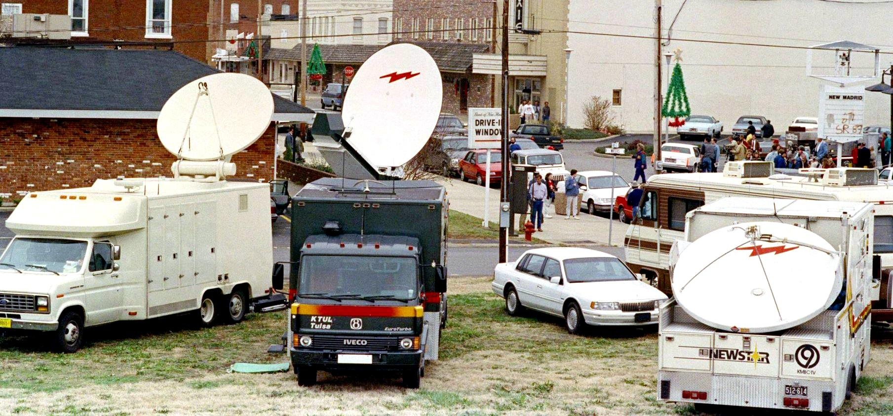
The New Madrid Earthquake, 1990
© 2024 Douglas Allchin
http://shipseducation.net/newmadrid1990

Slide 2
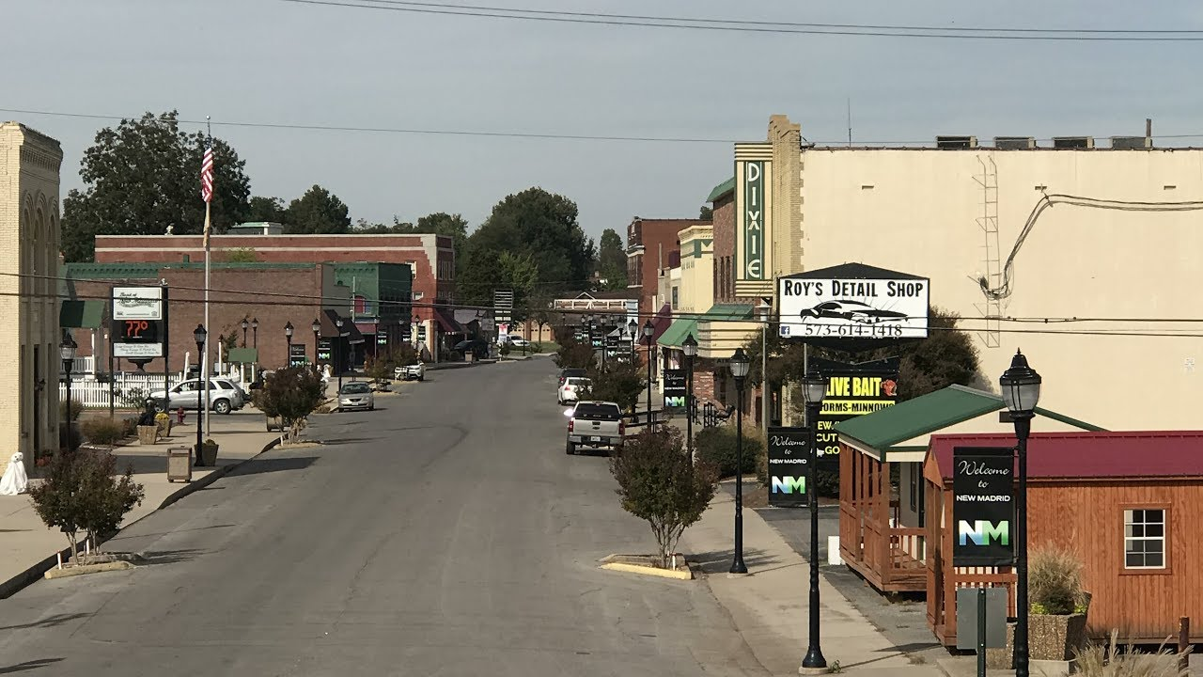
New Madrid, Missouri

Slide 3
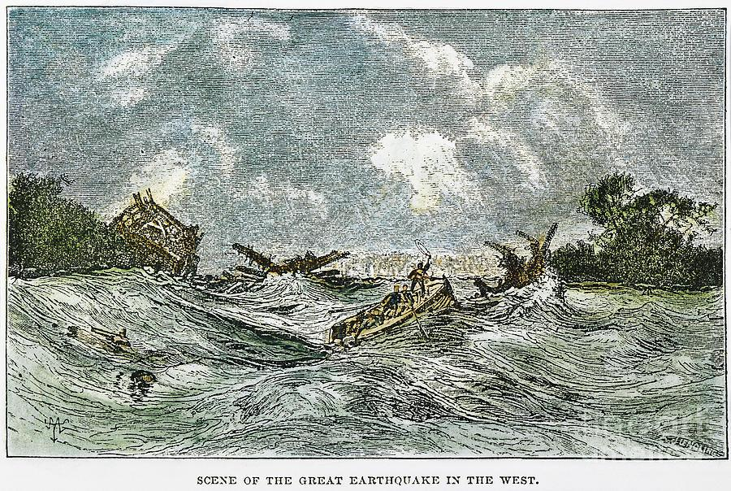
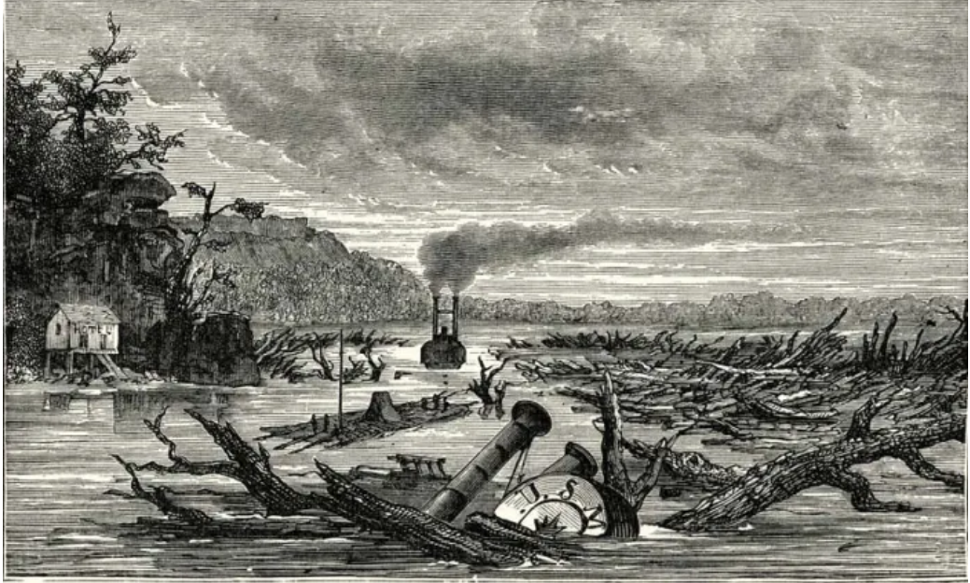
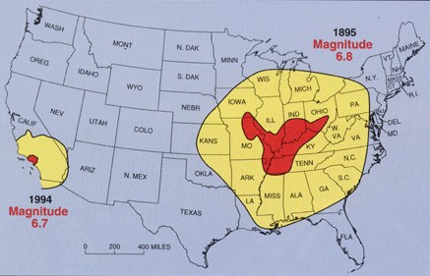
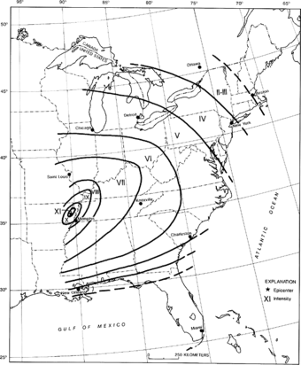
1811-1812
Earthquakes
-–the strongest in US history

Slide 4
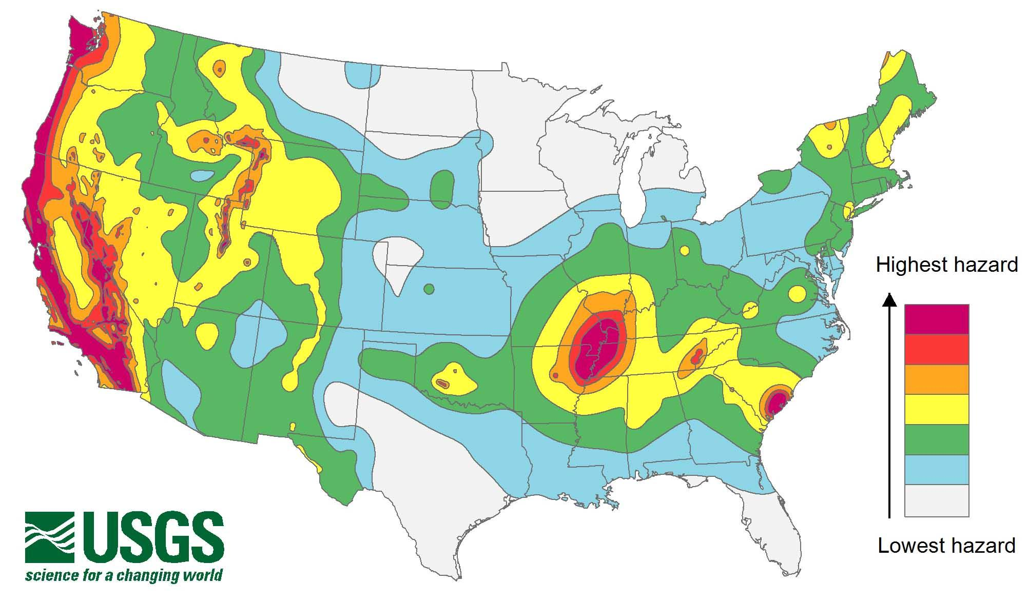
Earthquake risks remain today

Slide 5
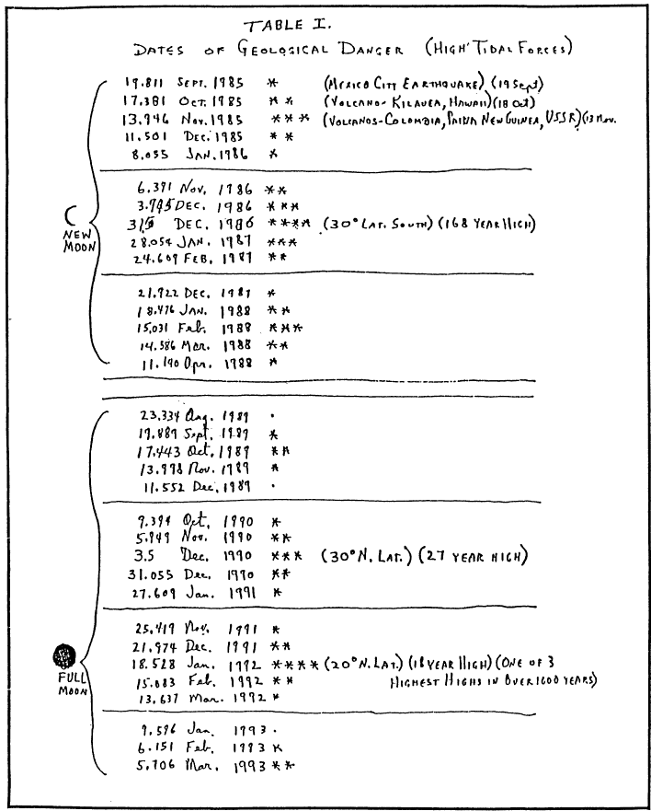
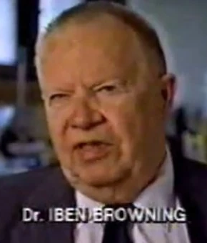
November, 1989. The Memphis Commercial Appeal reports on a lecture by Iben Browning, who has analyzed the geological conditions of the famous 1811-1812 earthquakes and finds that similar conditions will occur again next year, on December 3, 1990. Browning is a business consultant on meteorological and geological issues and publishes a newsletter on these topics. His reasoning is based on modeling the geological forces of excess tidal loading which will increase the likelihood of an earthquake at a similar scale. He repeats his projection a few weeks later in an invited speech at the Missouri Governor’s Conference on Agriculture.
▶ What is your response at this stage?

Slide 6
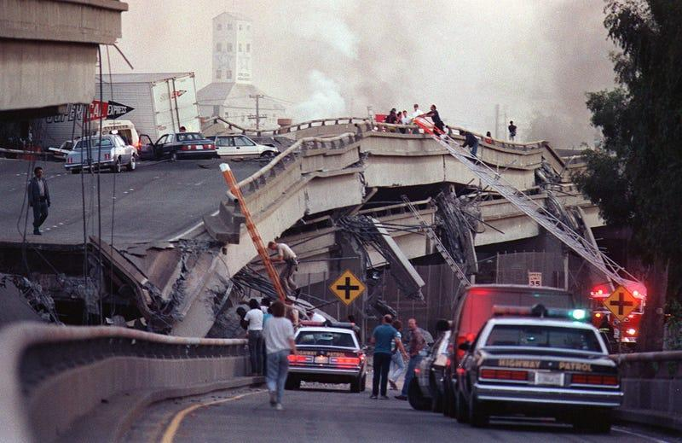
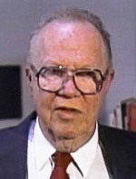
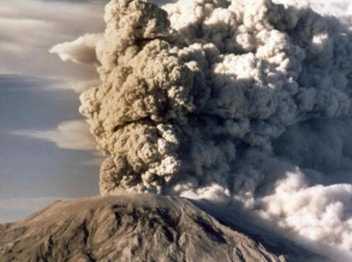
As a measure of his credibility, Dr. Browning claims to have correctly projected the earthquake in Loma Prieta, California, earlier this year, and also the devastating eruption of the Mount St. Helens volcano in Washington in 1980.
▶ Does this information alter your view?

Slide 7
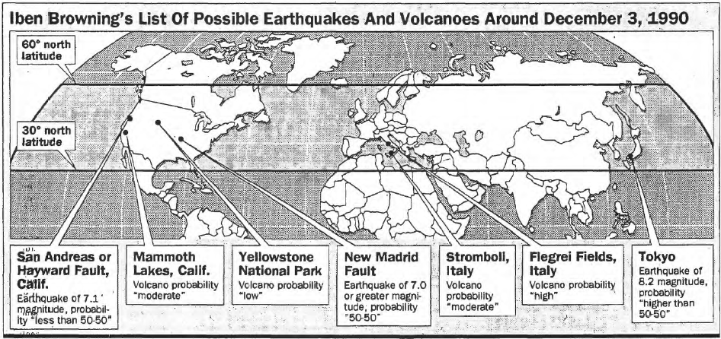
June 26, 1990. Dr. Browning has continued his lecture circuit and now the St. Louis Post Dispatch has begun to cover the story. Today, it publishes a map of the seven global locations implicated in Browning’s projections.
▶ Your view?

Slide 8
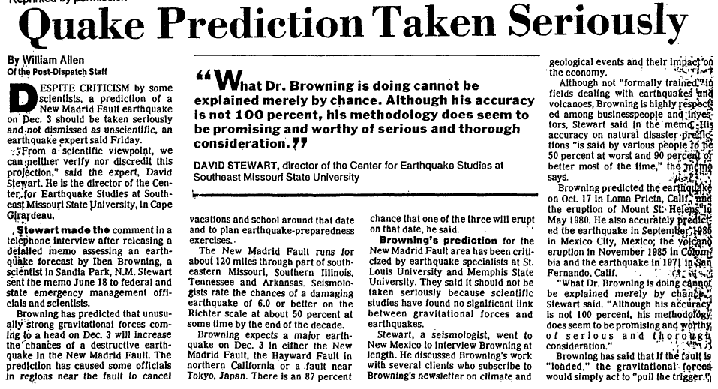
July 21. A Post-Dispatch headline reports, “Quake Prediction Taken Seriously.” The article cites David Stewart, Director of the Earthquake Research Center at Southeast Missouri State University, who has vouched for Browning’s expertise to his colleagues. In a separate comment he said, “Here’s a man who verifiably has hit several home runs, and he’s up to bat … you can’t ignore the batting record.”
▶ status update?

Slide 9
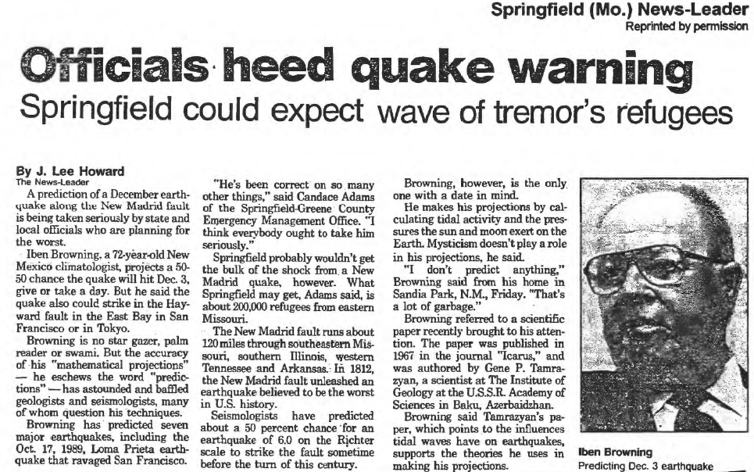
August 5. The Office of Emergency Management in Springfield-Greene County, Missouri, notes that Browning has “been correct on so many things. I think that everybody ought to take him seriously.”

Slide 10
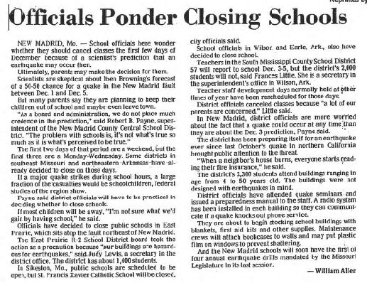
September 9. The Superintendent of the New Madrid Country Central School District announces that schools will be closed on December 3, still months away. “The problem with schools,” he says, “is it’s not what’s true so much as it is what’s perceived to be true.”

Slide 11
September 26. Southeast Missouri experiences an earthquake: enough to rattle dishware—and a sense of complacency. About 200 minor quakes occur annually in the region, most too small to notice. Various government agencies have been arguing for years that residents should be prepared for any major quake, although the timing cannot be predicted.
▶ updated view?

Slide 12
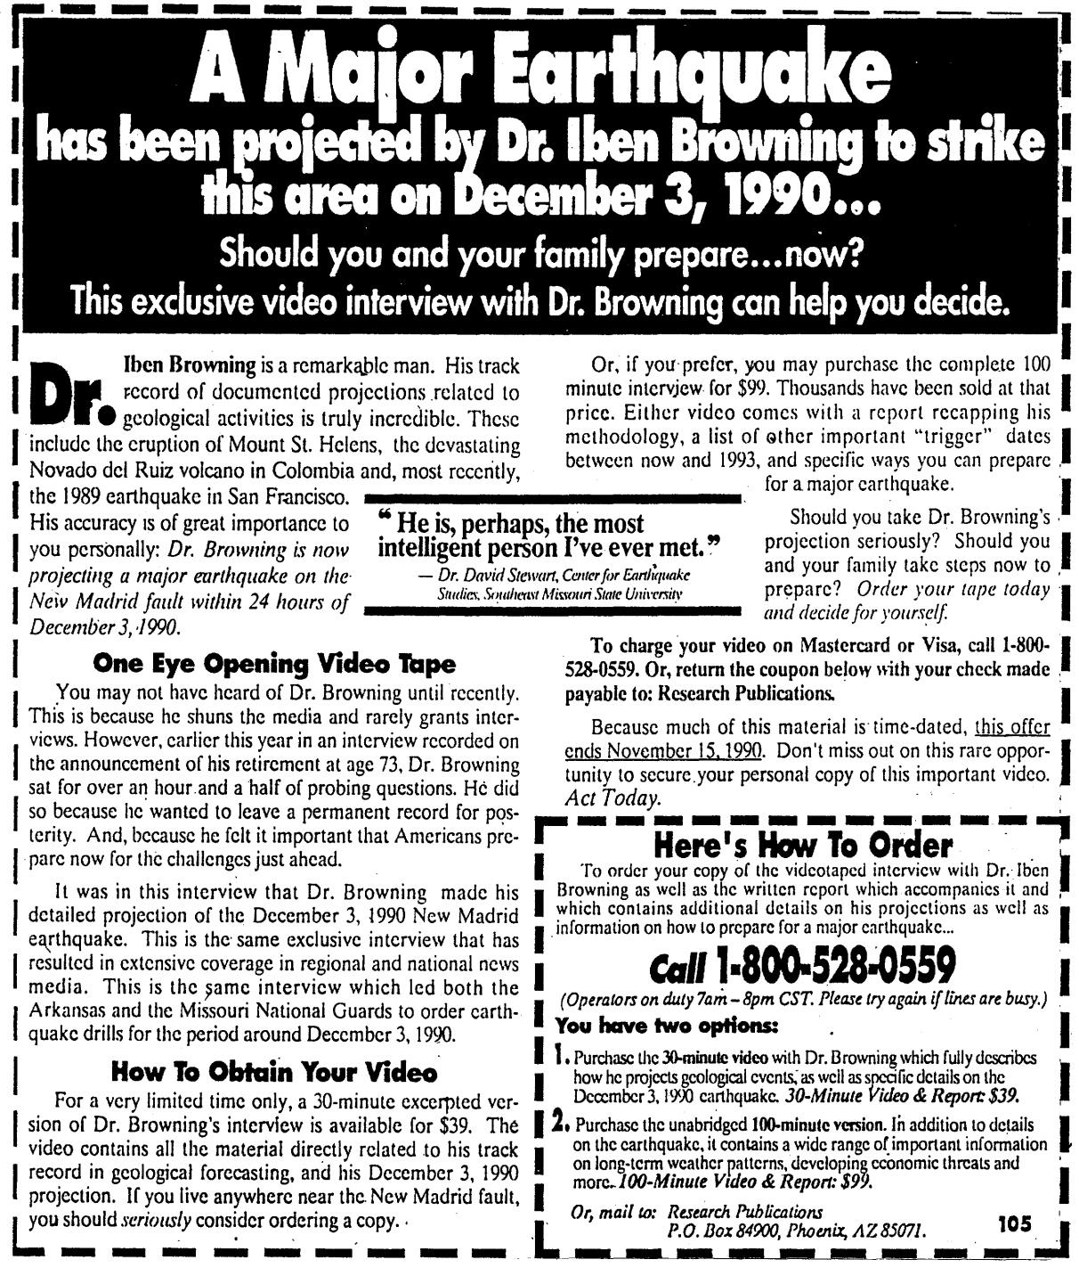
September 26. Full-page ads appear in the local newspapers selling a 1.5-hour videotape interview of Iben Browning. They sell for $99 each (or $39 for a 3-minute excerpt)

Slide 13
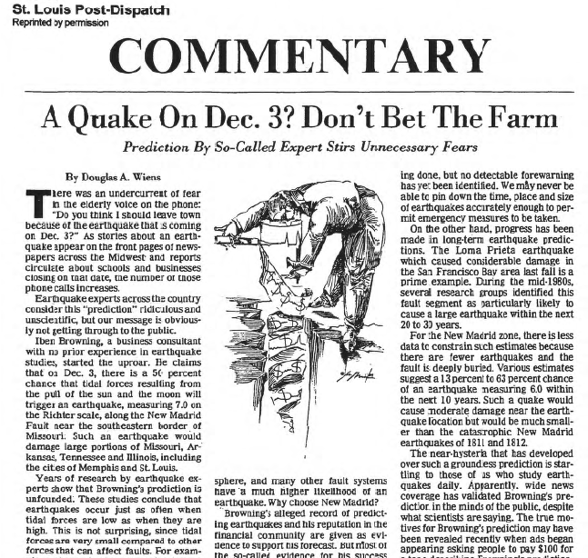
September 29. The Director of the Missouri Department of Natural Resources releases a statement that, contrary to Browning, “the probability of a significant quake occurring on Dec. 3 is not greater than any other day.”

Slide 14
Early-October. Browning is interviewed on ABC’s Good Morning America. Other TV talk shows soon feature discussion of a projected earthquake in New Madrid.

Slide 15
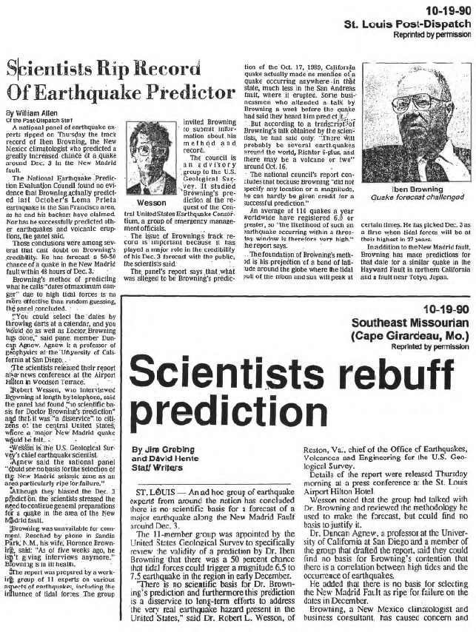
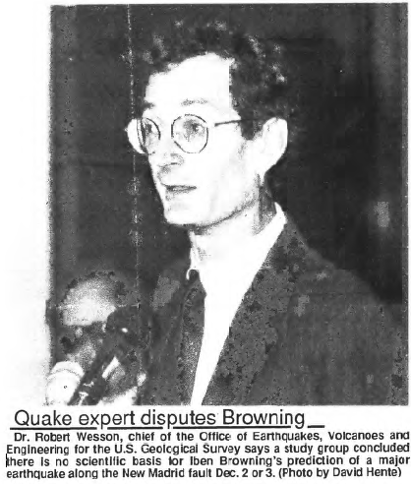
October 18. The United States Geological Survey (USGS) responds to public concerns and issues a report that Browning’s geological model is scientifically unsound, and that his “predictions” of earlier events had been so vague as to be meaningless, and thus were not validated.

Slide 16
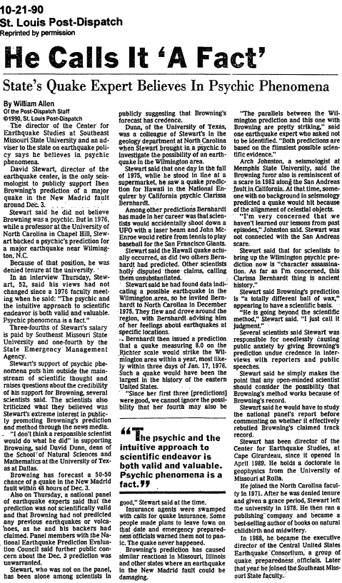
October 21. David Stewart defends Browning. Meanwhile, William Allen, science reporter for the Post-Dispatch has done further digging. He now reports that 15 years earlier Stewart lost his previous position at the University of North Carolina for inviting a psychic to speak on earthquake predictions and endorsing her approach as “valid and valuable.”

Slide 17
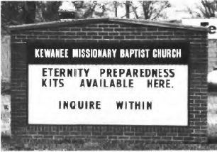
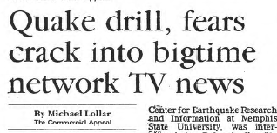
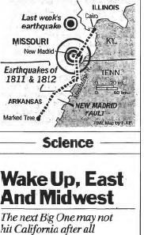
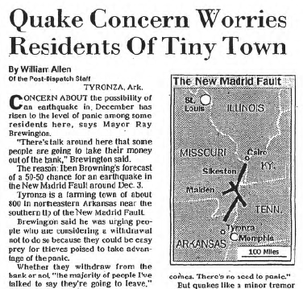
Mid-November. The National Earthquake Information Service (part of the USGS) is fielding 100 calls a day related to the prediction. The St. Louis County emergency management office has been similarly swamped with inquiries.

Slide 18
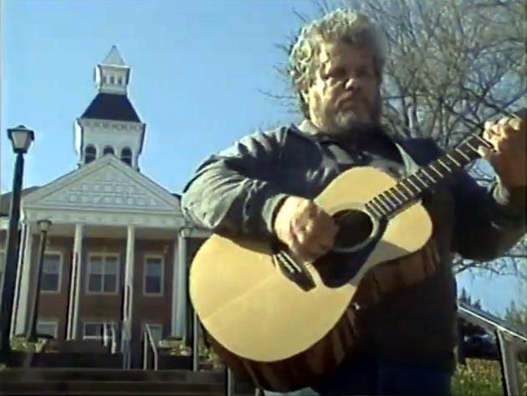
Late November. Country music singer Lou Hobbs releases his song, “Living on the New Madrid Fault Line”:
Lately I feel a little nervous about my section of the land of the free,
Living on the New Madrid fault line, something’s shakin’, Lord, I hope it’s just me.
Over the next few days he is invited to sing it on Good Morning America and dozens of other television and radio shows.
https://www.youtube.com/watch?v=uzM8SXqpsks

Slide 19
December 3, 1990. Earthquake Day! New Madrid. Some 200 reporters from around the world, and their vans with satellite antennae all parked in a cluster, are ready to report events as they happen. (The town’s population is a mere 3,000.)

Slide 20
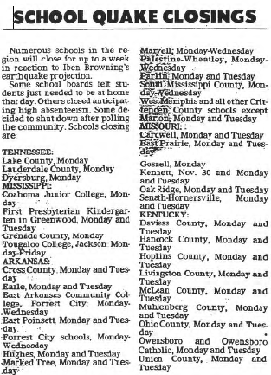
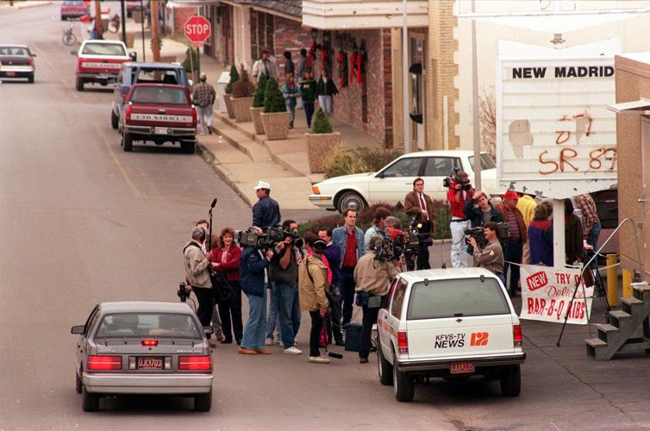
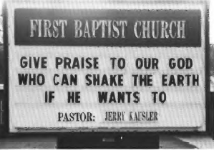
Schools are closed here, and elsewhere — although the girl’s volleyball game is going ahead, as scheduled. Residents have invested $22 million in earthquake insurance.

Slide 21
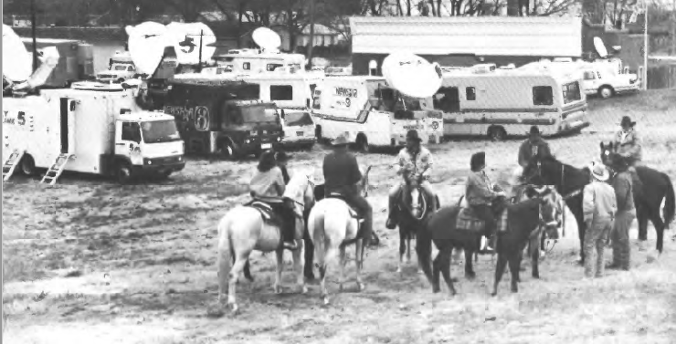
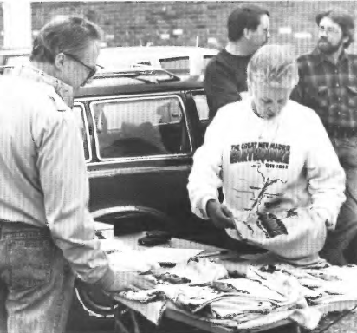
The National Guard is continuing a sample “earthquake preparedness” drill nearby.
In town, you can buy your “I Survived the Earthquake” t-shirt, or a hamburger with a torn faultline across it.

Slide 22
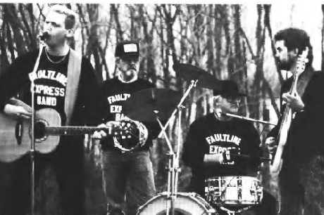
People are gathered, chatting, and waiting. And waiting and partying. No earthquake.
The experts at the USGS were right, it turns out. All that hype for nothing.

Slide 23
▶ How did Iben Browning’s spurious claim spiral out of control? What factors fostered misleading beliefs?
▶ Who withheld judgment at first, or wanted to seek more information? Where might you have gone to seek a reliable scientific perspective (using today’s technology, perhaps)?

Slide 24
What should we learn from the episode of Iben Browning & the New Madrid Earthquake of 1990?
about how misinformation spreads?
about expertise and credentials?
about reliable sources of information?
about plausibility and expert consensus?
about the role of scientific institutions?

Slide 25
Iben Browning was not an expert. He did not have appropriate credentials. His claims were presented outside the scientific literature. Thus, they were not even worthy of being entertained by an ordinary (non-expert) citizen.
Browning’s claims may have seemed plausible, appealing to the cause and effect of physical forces. But plausibility is not enough. Significant claims, especially incredible ones, need to be vetted by other experts, and a consensus developed. Nor should one be cowed by jargon of complex concepts.

Slide 26
David Stewart was consulted, in a journalistic tradition, as an “independent source.” But science demands more. Stewart’s own expertise mattered, too, and it had not been fully checked at first. Even when two isolated scientific experts may agree, however, the appropriate benchmark is the consensus of the relevant experts—as reflected, here, in the views of the USGS.
Browning’s earlier predictions—a factor in his alleged credibility—were unfounded. Yet at first, they were reported uncritically. Once traced, they proved to be without merit. Failure of due diligence in checking sources and second-hand claims can threaten effective science communication

Slide 27
The coverage on national television was largely on informal “talk” shows. One should recognize that such programs seek to both inform and entertain. One should be wary if the programs have not explicitly fact-checked any extraordinary scientific claim. We should expect them to be subjected to (and survive) the scrutiny of alternate or critical expert assessment.
The USGS’s reluctance to overtly refute Browning’s claims at the very outset may be seen by some as a failure of public science communication. Yet their decision not to engage with pseudoscience was itself a potent indicator. When they did finally address the issue, their expert consensus (from a respected scientific institution, with a long and broad track record) should have been definitive for public policy

Slide 28
The Precautionary Principle can be an effective policy tool in cases of uncertainty. However, in this case the scientific consensus was clear. Calling out the National Guard and closing schools was ill informed public policy, and may have contributed to fostering undue public anxiety and needless expense. Public agencies that distributed standard earthquake preparedness kits without disclaimers about Browning’s illegitimate prediction implicitly gave credence to them, validating any unschooled sense of impending danger.
The level of community concern was sustained largely by hearsay. It matters what people share with others. Individuals need to take personal responsibility in what they pass along.

Slide 29
Fear was a significant factor. The claims played on an inflammatory emotion. When such emotions swell, our discernment can falter. So one’s demand for evidence should (counterintuitively, perhaps) be on high alert. One may well want to escalate the normal standards for justifying alarming conclusions.
The commercial dimension might have been another clue. Sensationalism sells. But why should a citizen pay for a video on a matter of public safety? This was another indication that the messaging was occurring outside the realm of professional experts.

Slide 30
Ultimately (in retrospect), whose claims were trustworthy, whose were not, and why? How can this analysis inform our response in future episodes?

