Slide 1
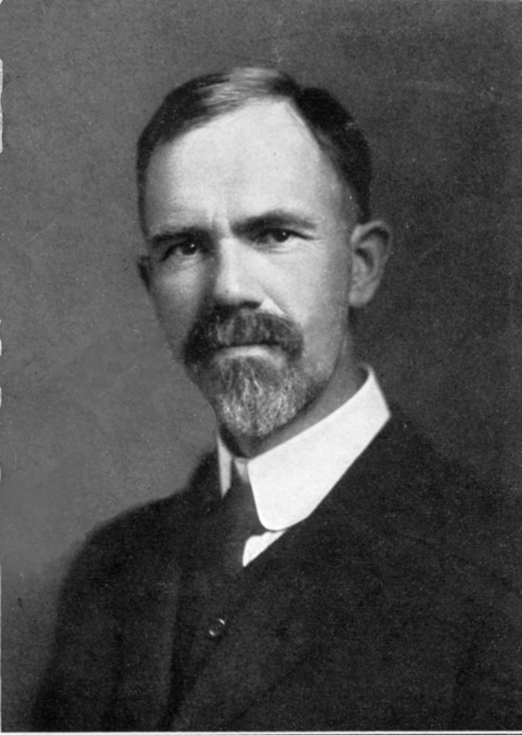
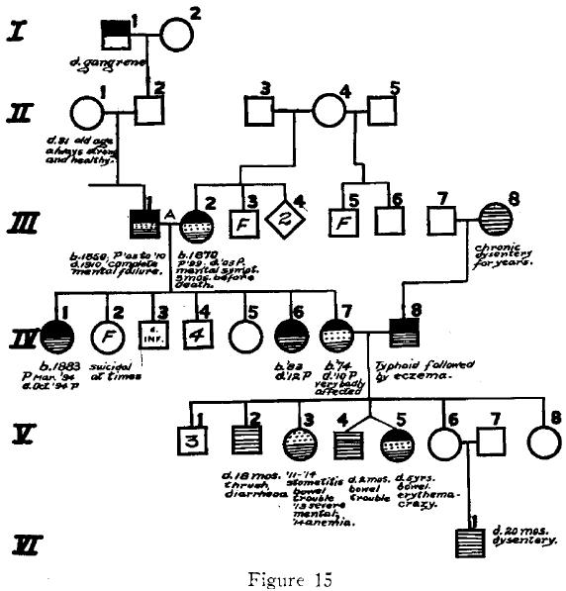
&
Charles Davenport
the Prospects of Genetics
© 2025 Douglas Allchin
http://shipseducation.net/misinfo/davenport

Slide 2
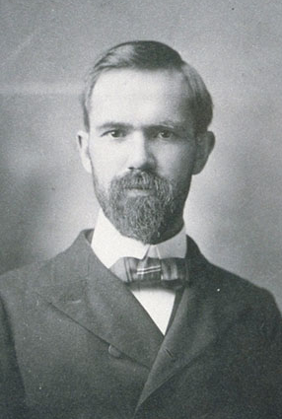
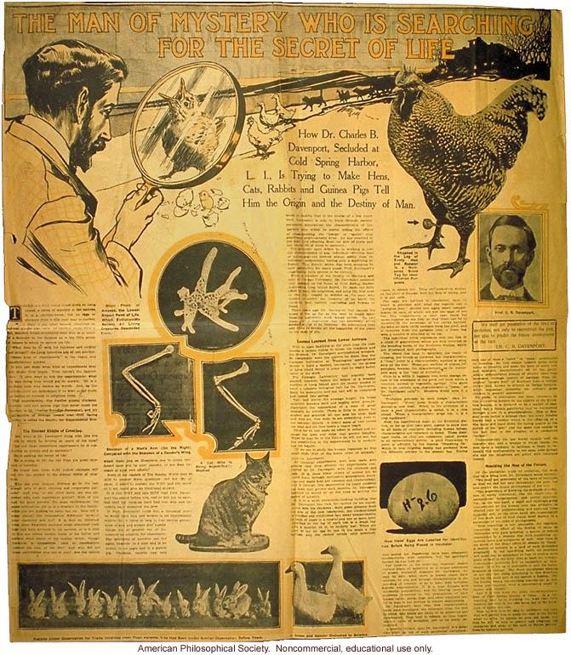
Meet Charles Davenport — a respected and enterprising biologist, described in a 1907 newspaper article as a "man of mystery," who hopes to decipher "the destiny of man" by studying the genetics of hens, cats, rabbits and guinea pigs.

Slide 3
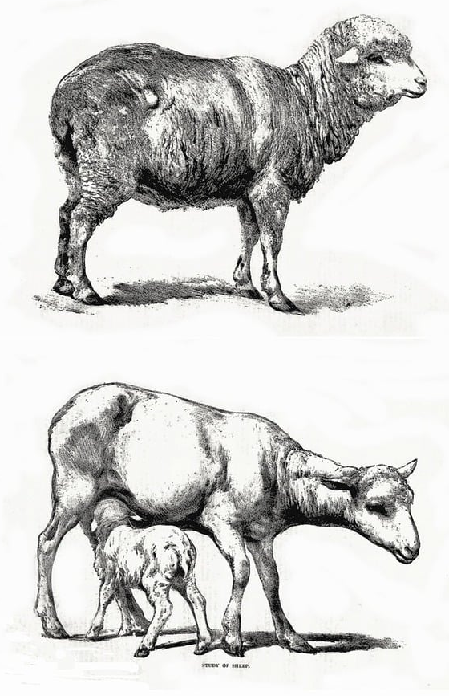
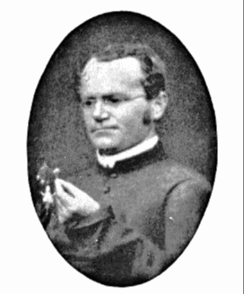
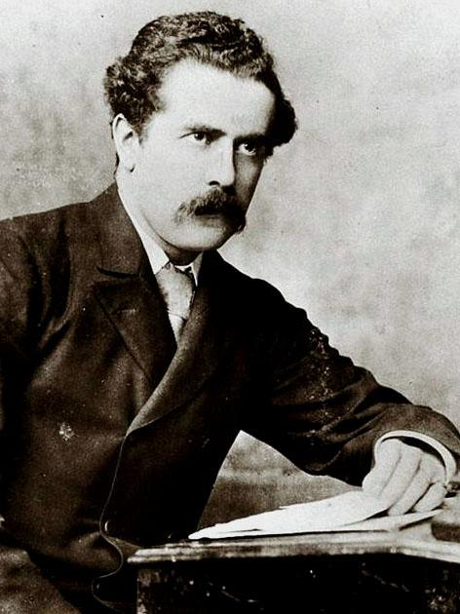
Farmers have long known that you can improve crop plants or animals through selective breeding.
Mendel's work on pea plants, rediscovered in 1900, seems to offer new prospects for research.
In 1911 Archibold Garrod shows that certain inborn errors of metabolism in humans follow a Mendelian pattern of inheritance.

Slide 4
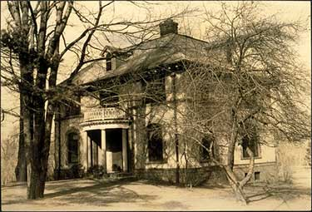
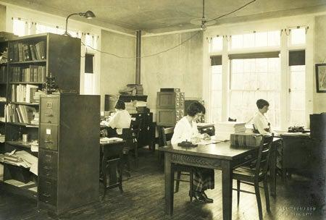
Davenport (among others) wants to apply that genetic knowledge to humans, with a vision of improving society.
They call it eugenics, meaning "good origins."
In 1910 Davenport becomes Director of a newly instituted Eugenics Record Office.

Slide 5
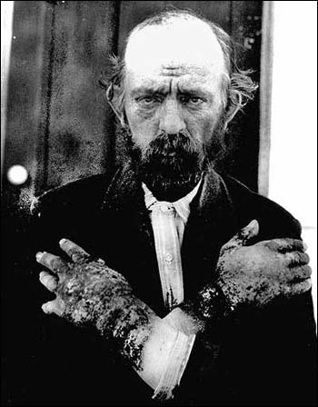
Davenport leads research on the genetics of many human conditions.
For example, in 1916, scientists debate whether the disease pellagra, prevalent in the poor rural South of the U.S., is caused by infection or an inadequate diet.
Davenport says it is neither(!).
He contends it is hereditary.

Slide 6
As evidence, he presents several sample pedigrees showing how pellagra had appeared through multliple generations of the same family.

Slide 7
Is a pedigree good evidence for Davenport's claim that pellagra is genetic?
What other factors might explain why a disease might appear to "run in families"?

Slide 8
Later (in 1927), doctors find
that dietary supplements of yeast can easily cure pellagra. So it is not genetic.
It is a vitamin deficiency. Its prevalence in the Southern U.S. could be explained by enduring disparities in wealth, meaning that over many generations poor farmers cannot afford a proper diet with enough meat and vegetables.

Slide 9
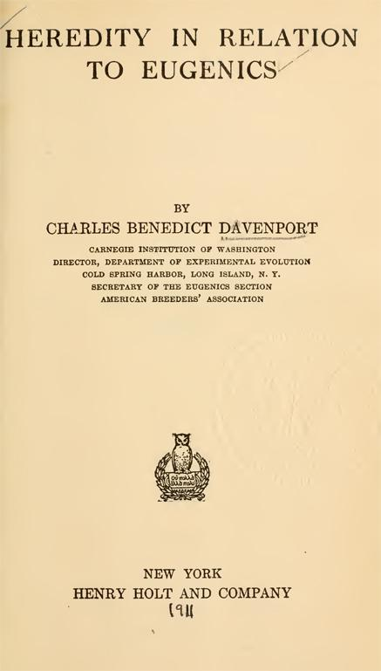
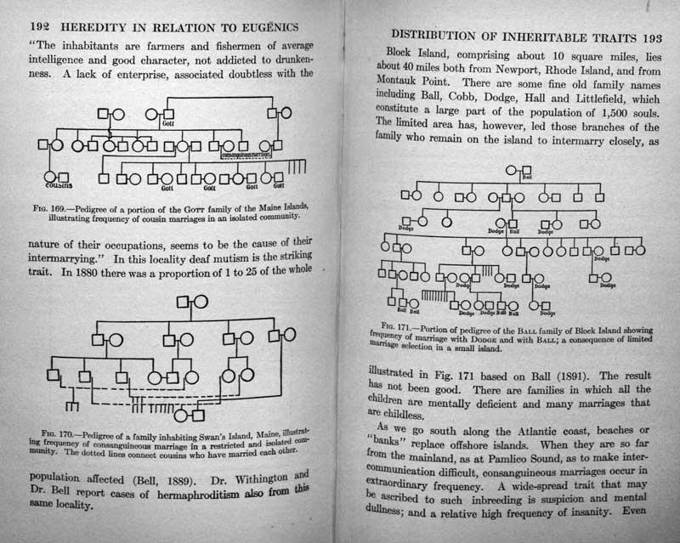
Let's return to 1911-12, when Davenport publishes an extensive report on Heredity in Relation to Eugenics and other studies.

Slide 10
Davenport has catalogued many human conditions as hereditary, with pedigrees for many of them. He presents a genetic basis for:
eye color
hair color
memory
epilepsy insanity
temperament
narcotism
hysteria
speech defects
calculating ability
musical ability
blood diseases
pauperism (poverty)
criminality
handwriting
general mental ability
cancer
polydactylism

Slide 11
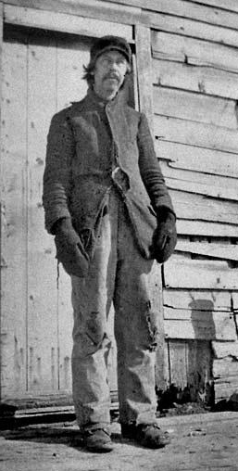
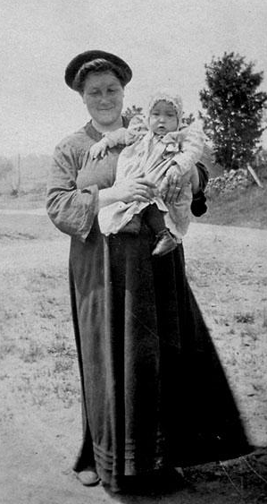
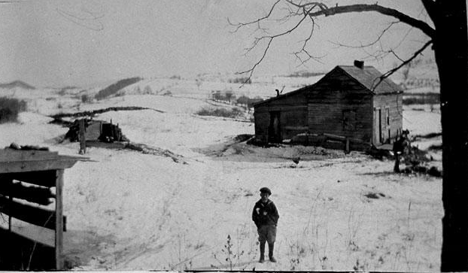
Let's focus just on feeble-mindedness, which Davenport describes as defective, abnormal, and inferior, and as presenting a "grave danger" to society.

Slide 12
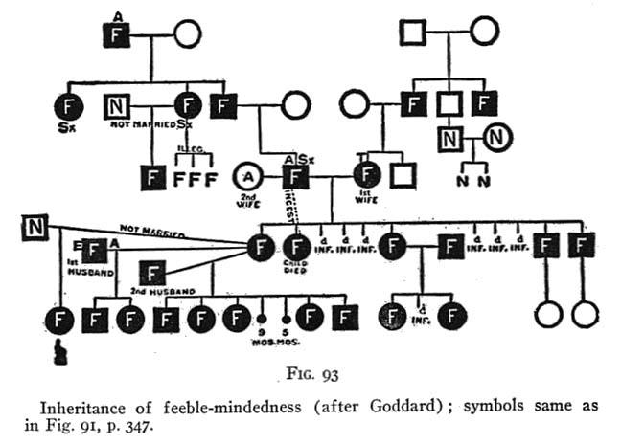
Here, too, he uses a pedigree – where F designates feeble-minded individuals – intending to show that the trait is genetic, although Davenport does not define the trait clearly.

Slide 13
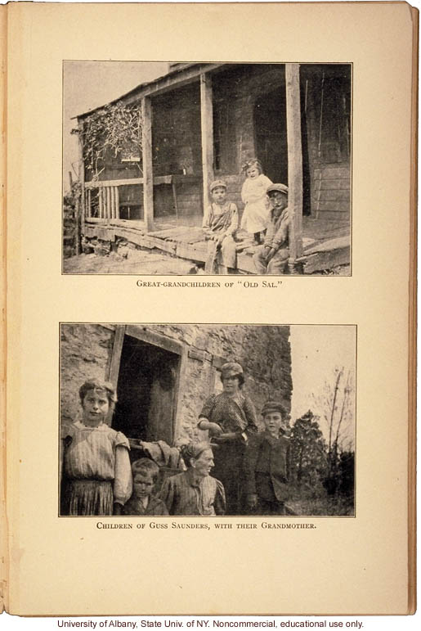
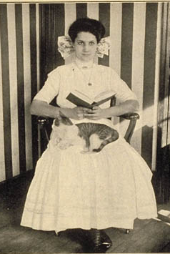
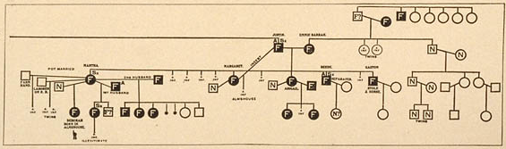
Here is another family, the Wolvertons, and their pedigree, presented by Henry Goddard.

Slide 14
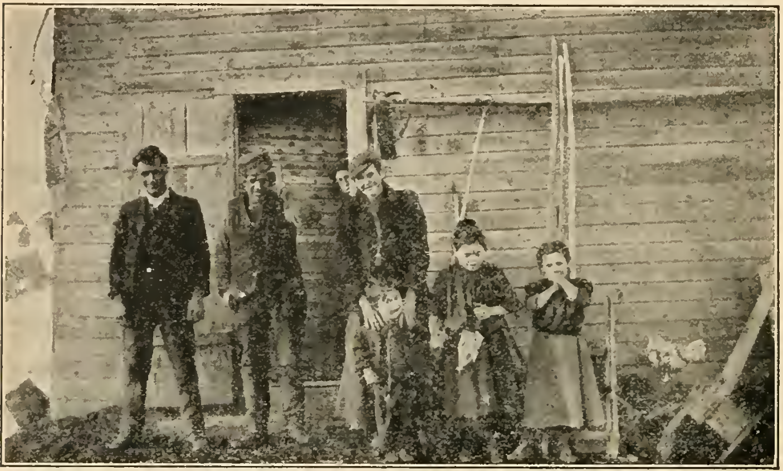
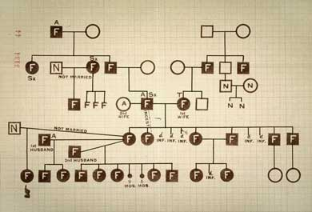
As a biologist at the time, how do you view Davenport's claims about the genetic basis for feeble-mindedness and other traits?
How will you respond?
What actions will you take?

Slide 15
In 1912, Davenport presents his findings on "Heredity in Nervous Disease and its Social Bearings" at a meeting of the prestigious American Association for the Advancement of Science. His remarks are reprinted in the equally renowned Journal of the American Medical Association.

Slide 16
At the end of the presentation, Dr. Woods Hutchinson of New York concurs:
As Dr. Davenport says, the more carefully these defectives are studied, the more the hereditary element comes out in them. ... the criminals, prostitutes, insane, epileptics, feeble-minded and inebriates.
He refers to his work with criminals in Indiana, his investigation of a notorious pair of labor activist saboteurs, and the study of feeble-minded at a school in Vineland, New Jersey.

Slide 17
Other attendees agree.
A reporter documents approving comments from:
Dr. L. Pierce Clark of New York,
Dr. William W. Graves of St. Louis,
Dr. E.E. Southard of Cambridge, Mass.,
Dr. Tom A. Williams of Washington, D.C.,
Dr. Warren Calvin, of Fort Wayne, Indiana
Dr. L. Grover Burnett of Kansas City, Missouri
They all endorse Davenport's views on feeble-mindedness as firmly grounded in personal experience and scientific data.

Slide 18
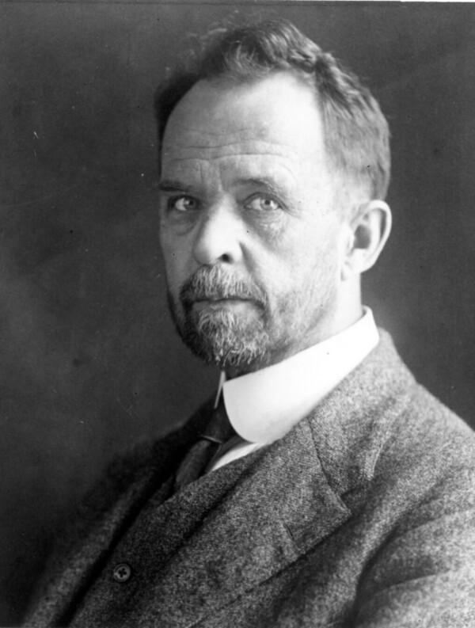
On the other hand, geneticist Thomas Hunt Morgan noted later:
Family pedigrees in which an unusual number of individuals [mentally] below par are present undoubtedly give the impression that something is inherited, but until all the social conditions surrounding the childhood of the individual are examined and given proper weight, serious doubts will arise as to what form of inheritances is producing the results. It is quite probable that there are extraneous factors involved in such pedigrees.
Morgan, Evolution and Genetics.(1925, p.201)

Slide 19
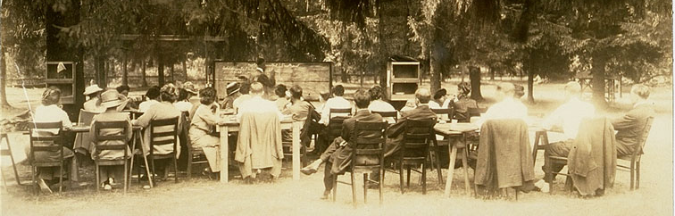
British geneticist David Heron observes that the mental ability of ancestors has often been attributed without evidence.
He also criticizes the data collection, noting that field workers were specifically instructed to search for instances that confirmed Mendelian patterns and to not record others. Namely, they “cherry-picked” an unrepresentative sample.
training field workers for
the Eugenics Record Office

Slide 20
As a fellow biologist – or as a citizen hearing these reports – how should you interpret this disagreement among apparent experts about the genetics of feeble-mindedness?
What justifies your view?

Slide 21
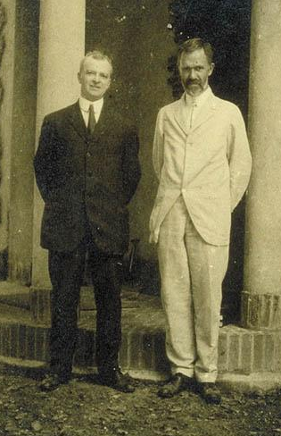
Harry Laughlin, Davenport's associate and Superintendent at the Eugenics Record Office, promotes the eugenics cause politically, although he is not trained as a scientist.
In 1922, he is appointed as an "expert eugenics agent" to Congress. He helps assemble legislation to limit immigration based on characterizing the undesirable genetic make-up of various nationalities, especially Eastern Europeans.

Slide 22
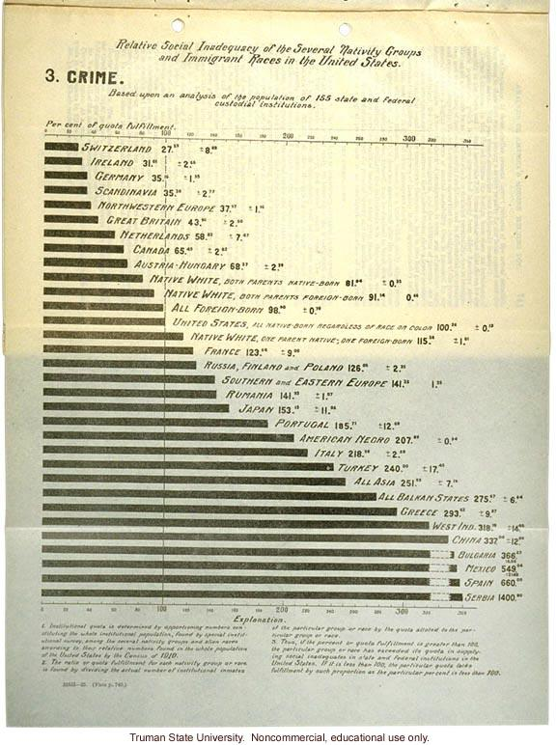
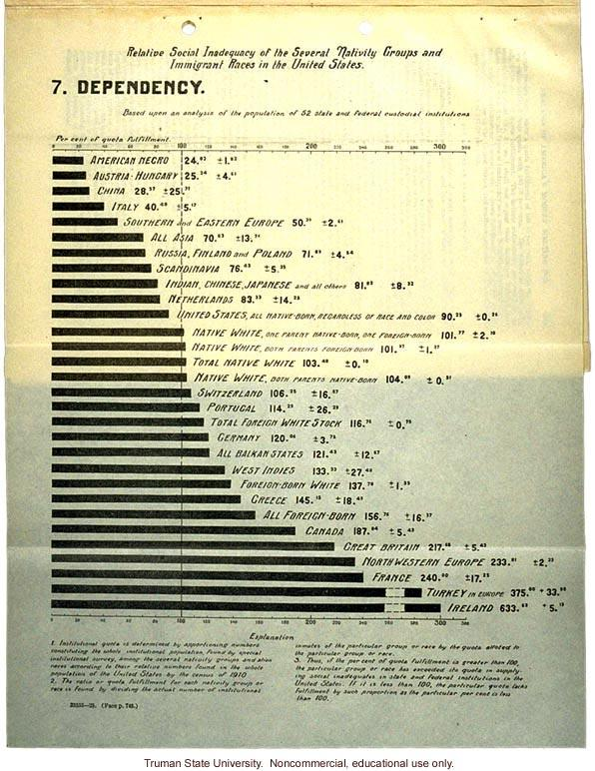
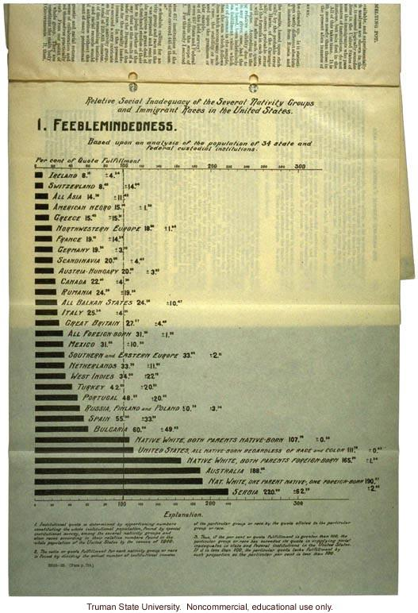
Laughlin surveys recent immigrants and presents their levels of "social inadequacy" – including crime, dependency, epilepsy, and tuberculosis – based on national origin, with high levels from new Slavic and Jewish immigrant populations.

Slide 23
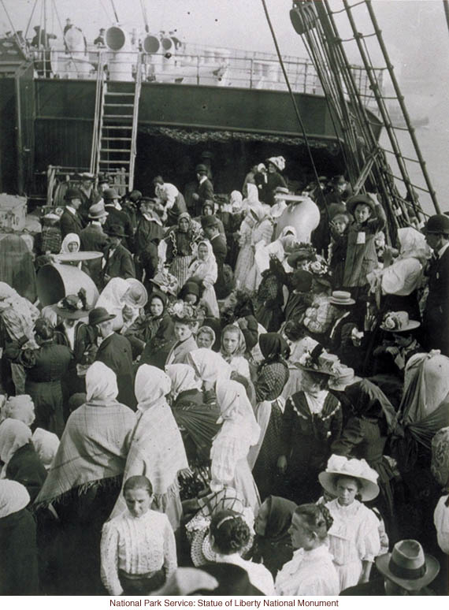
What is your view of this data as Congressional testimony, intended to inform public policy on immigration?

Slide 24
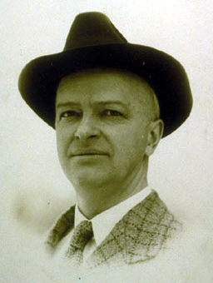
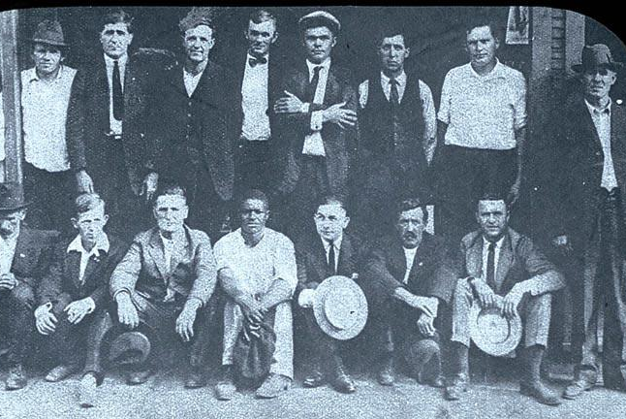
Laughlin has been presented an expert witness.
No others provide an alternative view.
As a member of Congress, how should you respond to Laughlin's testimony?
As a biologist at this time, how should you respond to Laughlin's testimony?
If you agree, should you endorse it publicly?
If you disagree, should you criticize it in public media?

Slide 25
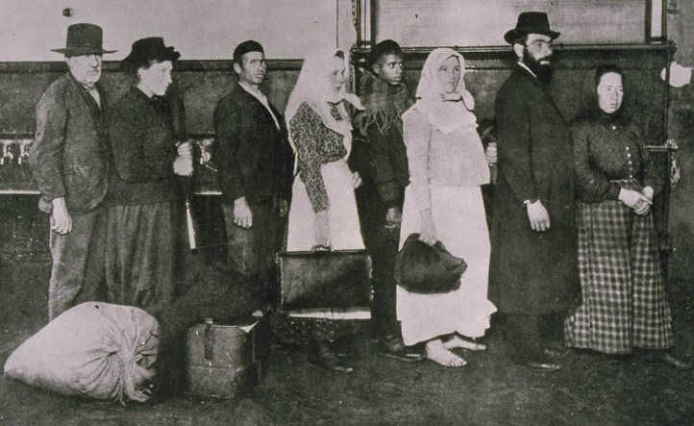
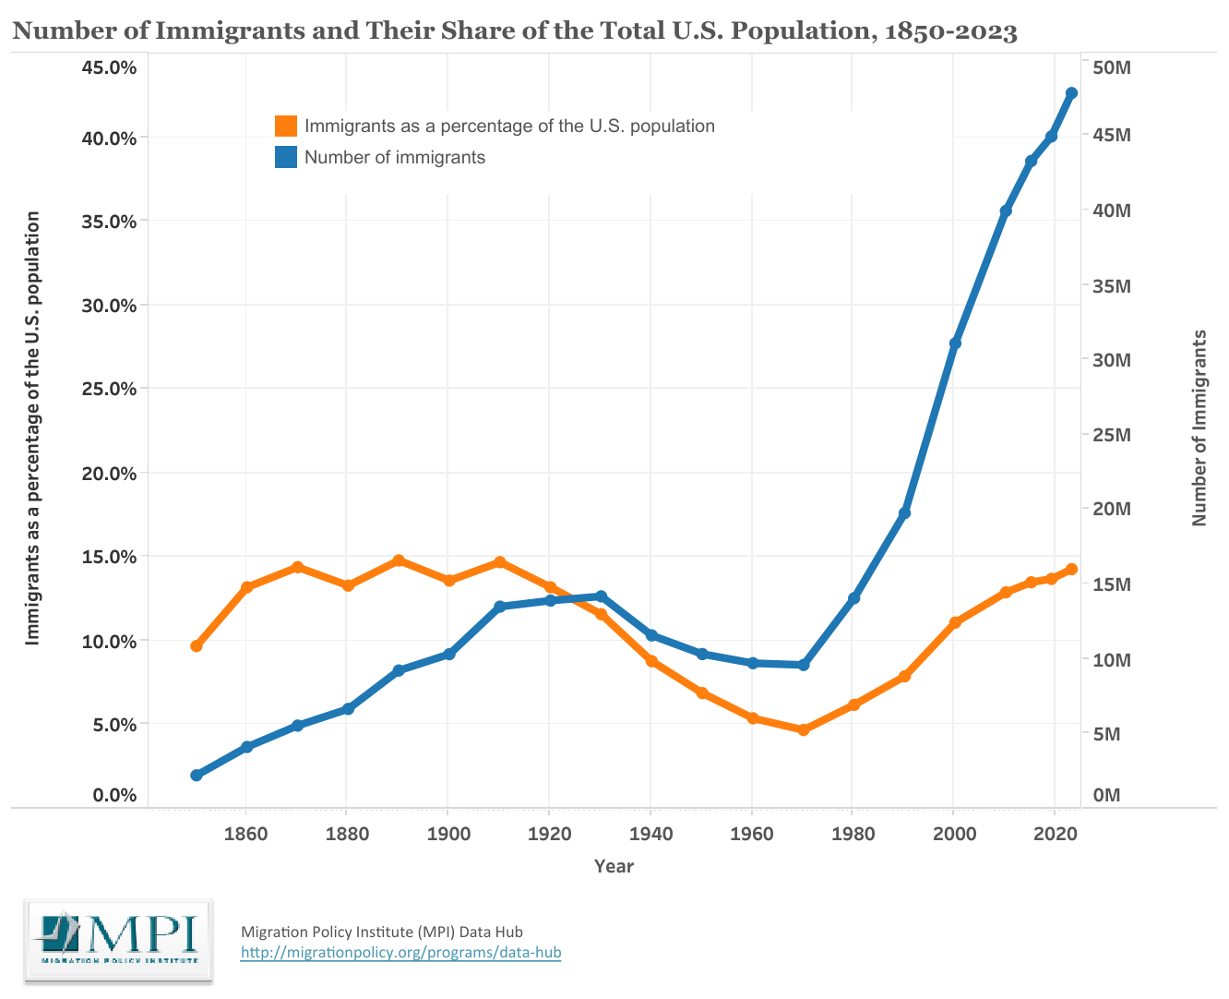

The Immigration Act is enacted in 1924.
Immigration of some groups is restricted by over 80% and remains at low levels for over a half-century.
1924
https://www.migrationpolicy.org/programs/data-hub/charts/immigrant-population-over-time

Slide 26
The pretensions of eugenics become more apparent in subsequent years. In 1935, the Carnegie Institute, a major funder of the Eugenics Record Office, concludes that the research has no scientific merit. Several years later, it withdraws funding completely and the ERO is forced to close.

Slide 27
We may now return to Davenport's early publications and reexamine them for clues about their scientific status.

Slide 28
First, recall that Davenport described pellagra as genetic. Tuberculosis, too. The first is a nutrient deficient; the other, a bacterial infection. However, both were prevalent among the impoverished and socially disadvantaged.
What does it mean to attribute these conditions to genetics, rather than (as many of Davenport's peers did) to other biological or social factors ?

Slide 29
Among other traits (such as eye color or stature), Davenport focused on:
insanity
temperament
narcotism
memory
hysteria
feeblemindedness
pauperism (poverty)
criminality
handwriting
general mental ability
Whose interests might be served by viewing these conditions as genetic, rather than as caused by an individual's developmental environment or by social context?

Slide 30
Davenport characterized the conditions to be "solved" by eugenics as:
desirable:
industry
ambition
foresight
abstinence
self-control
undesirable:
indolence
listlessness
licentiousness alcoholism
social burden
cost to the state
abnormal
defective, inferior
How would you describe Davenport's vision of an improved society? What does it mean to call these values scientific categories?

Slide 31
Why might others have found Davenport's (and others') claims about eugenics plausible or persuasive? (Or useful?) How would you frame a counterargument?
What was the role of appealing to science in passing the Immigration Act of 1924 or in supporting other measures to limit "undesirables"?

Slide 32
What do you think were Davenport's motives in studying genetics?
How should that assessment affect the analysis of his scientific claims?
How might an ordinary citizen or consumer at the time have developed an informed judgment of Davenport's eugenic claims?
Based on this case, what general recommendations do you have for someone assessing scientific claims in the media today?

Slide 33
&
Charles Davenport
the Prospects of Genetics
Summarize what you have learned from this historical case.

Slide 34

http://shipseducation.net/misinfo
©2025 Douglas Allchin
http://shipseducation.net/misinfo/davenport.htm

