Slide 1
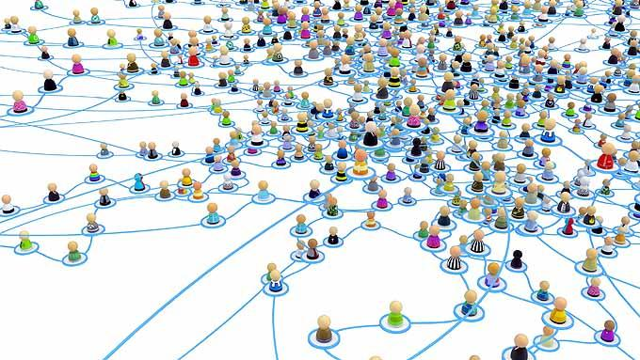
Inquiry into Expertise
© 2024. Gabor Zemplén and Douglas Allchin
http://shipseducation.net/expertise

Slide 2
From among your classmates, who can:
help you with your science homework?
find a good party this weekend?
help you negotiate the latest new app on your phone?
help in an emotional crisis?

Slide 3
Beyond your friends, who might:
reliably repair your cell phone?
help diagnose a possible pregnancy or sexually-transmitted disease?
help someone with suicidal thoughts or anxieties about gun violence?
fix your wifi network or internet connection?

Slide 4
List some other experts in our culture?

Slide 5
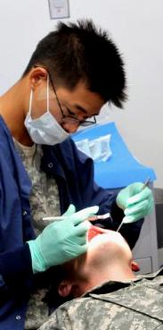
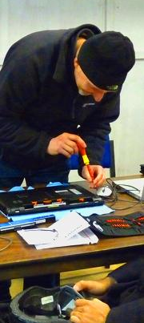
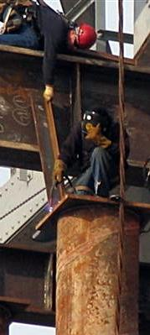
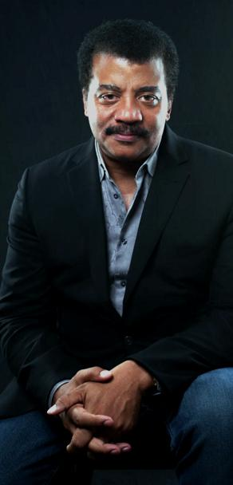
List some other experts in our culture?

Slide 6
List some other experts in our culture?
doctors, dentist
lawyers
accountants
airplane pilots
military intel
car/truck mechanics
plumbers, electricians, carpenters
appliance repairers
farmers
bridge welders

Slide 7
…and scientists as experts?

Slide 8
…and scientists as experts?
meteorologists
immunologists
chemists
astronomers
oceanographers
virologists
paleoclimatologists
biotech engineers
nuclear physicists
epidemiologists

Slide 9
When do these experts provide us with knowledge that is better and more reliable than everyday assumptions or other forms of expertise?

Slide 10
What makes an expert, an expert?
—---
(What differentiates someone with true expert knowledge from some self-professed, would-be know-it-all on YouTube?)

Slide 11
What makes an expert, an expert?
specialized knowledge or skills
professional training
extensive relevant experience
good memory (for their topic)
able to detect possible errors
keen perception (able to discern fine differences)
recognizes patterns in apparent chaos
efficient reasoning & judgment
avoids big mistakes

Slide 12
What makes a scientific expert,
a scientific expert?

Slide 13
What makes a scientific expert,
a scientific expert?
research experience
knowledge of investigative methods & statistics
knowledge of possible sources of investigative error
creative experimental design
extensive knowledge of previous research in their field
familiarity with current ideas and alternative theories

Slide 14
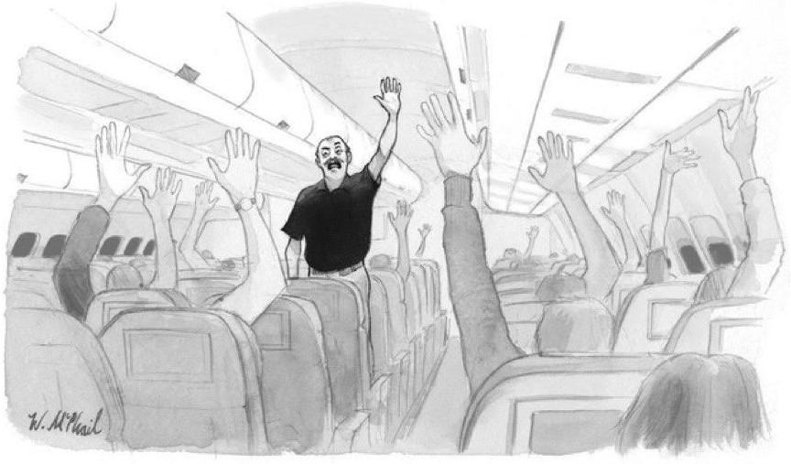
Well…
If we know what constitutes expertise, can’t we all be experts? Can’t we all become airplane pilots, chess masters, doctors, lawyers and pandemic experts, all at once?
Why or why not?
These smug pilots have lost touch with regular passengers like us. Who thinks I should fly the plane?

Slide 15
What types of expertise do you offer to others?
second or third language? some sport, musical instrument, or
art? some school subject? human relations? what instruments
or tools you have mastered?
What expertise do you hope to develop in the
future?
… Where does science fit?

Slide 16
When do others know more than you do?
When is it appropriate to make decisions based on your own knowledge and intuitions? When might it be more reasonable to trust someone else’s judgment instead of (or even against) your own “instincts”?

Slide 17
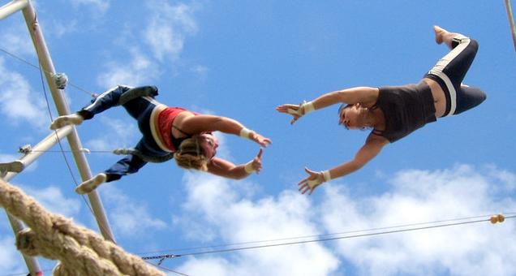
epistemic trust
in a social network

Slide 18
How do you know who is an expert?

Slide 19
How do you know who is an expert?
a documented track record, or portfolio
advanced degree/training
certification (testing)
licensing (accountability)
peer recommendations
professional awards or prizes
positions of leadership
(valid) user reviews
Which criteria are most important?
Which can be “gamed” or easily faked?

Slide 20
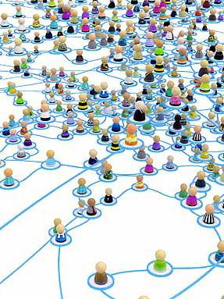
Summarize what you have learned about expertise, scientific expertise, epistemic trust and credentials.

