Slide 1
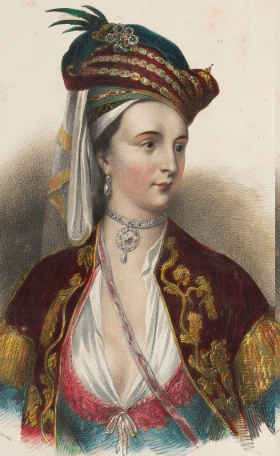
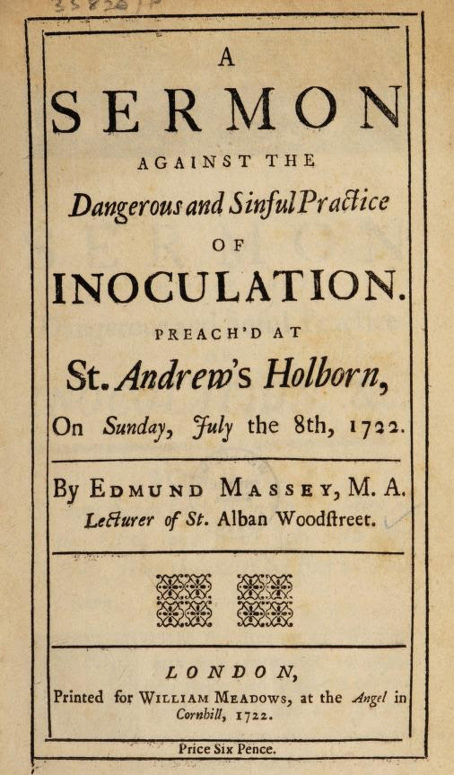
The Vaccines Skeptics of 1721
(C) 2022. Douglas Allchin
http://shipseducation.net/smallpox

Slide 2
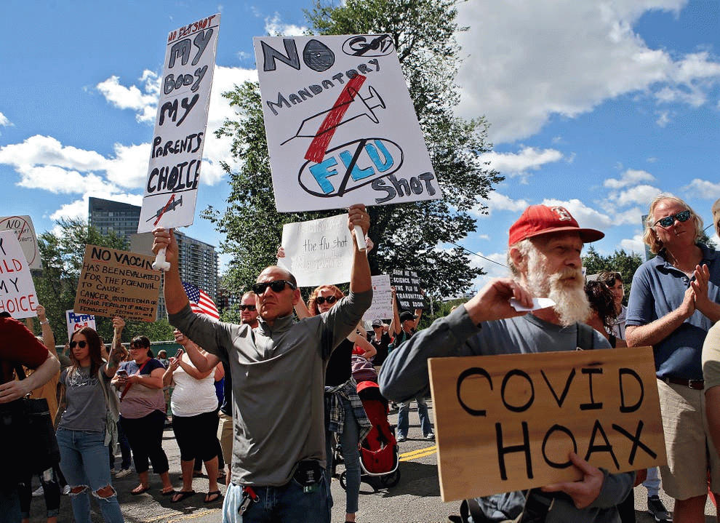

Slide 3
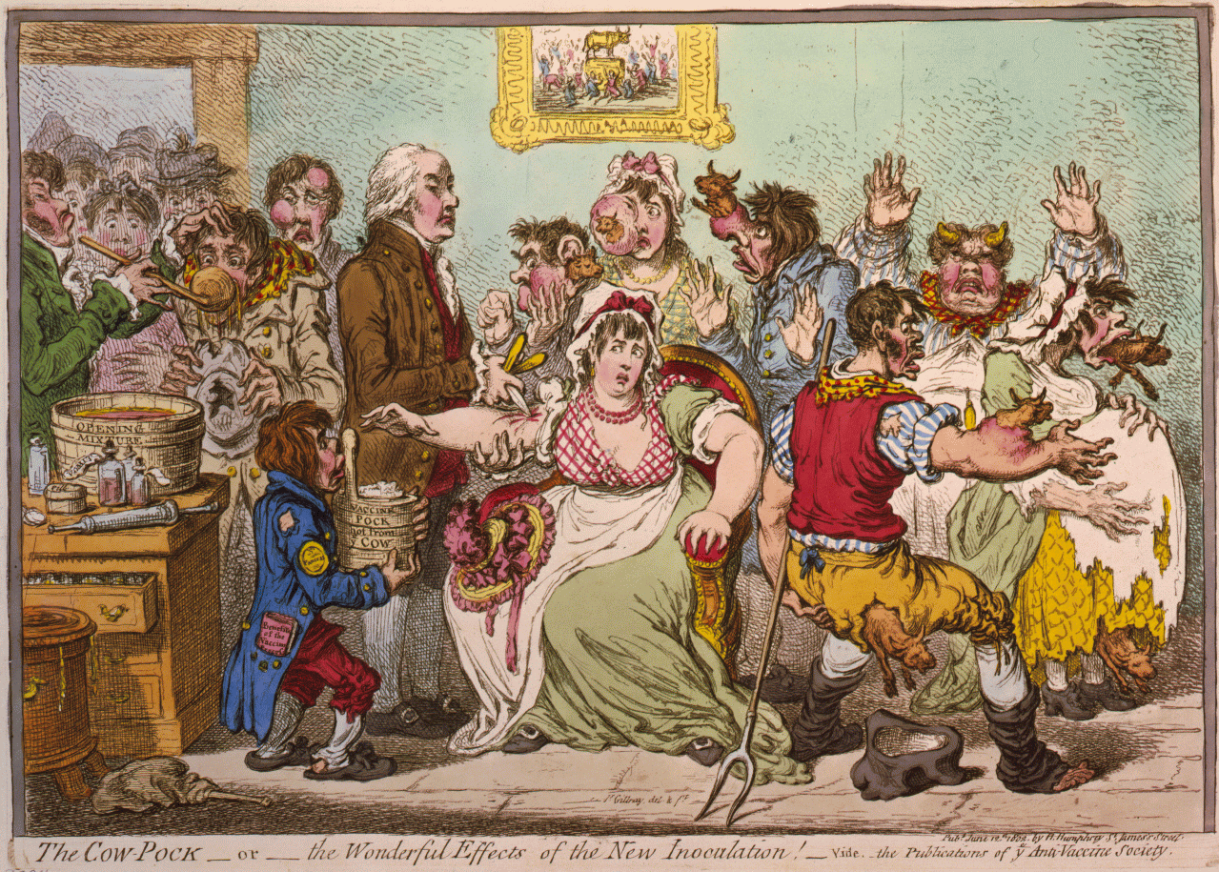
Anti-vaccination cartoon of 1802 (James Gillray)

Slide 4
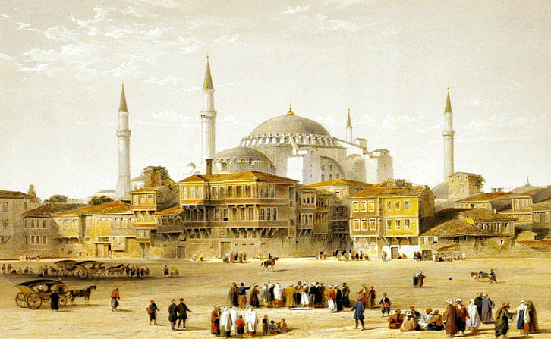
Constantinople (Istanbul, Turkey)

Slide 5
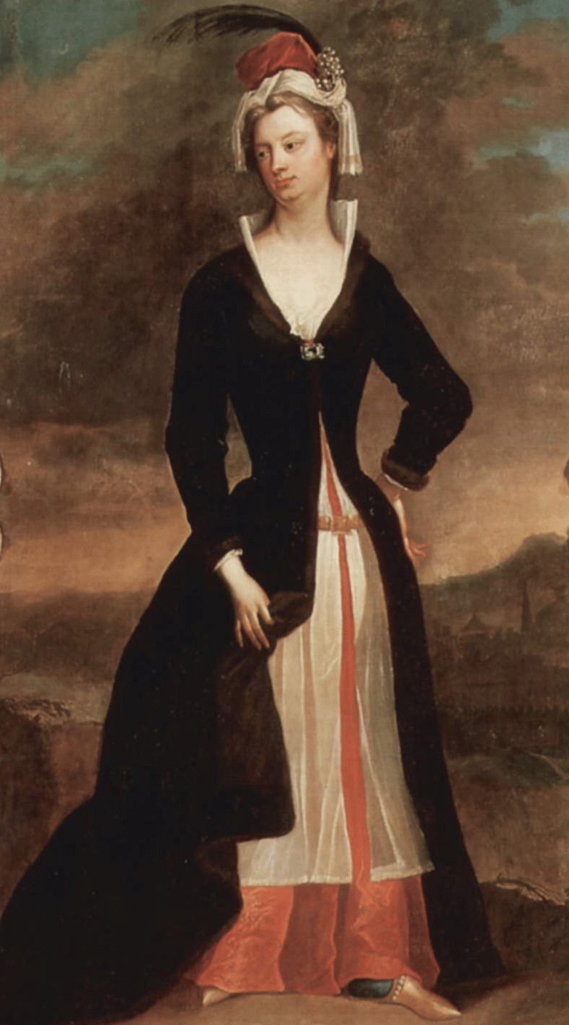
Lady Mary Wortley Montagu

Slide 6
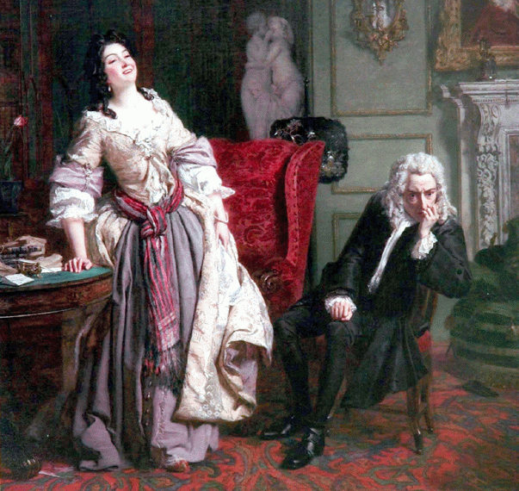
Lady Mary rejecting the advances of poet Alexander Pope
(reimagined by William Frith, 1852)

Slide 7
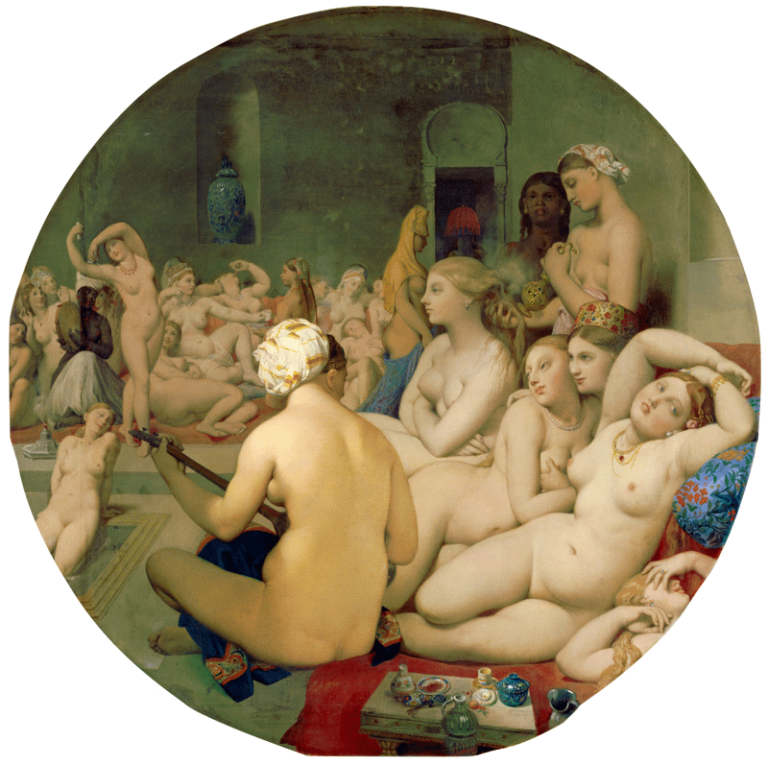
("The Turkish Bath," by Jean-Auguste-Dominique Ingres, 1862)

Slide 8
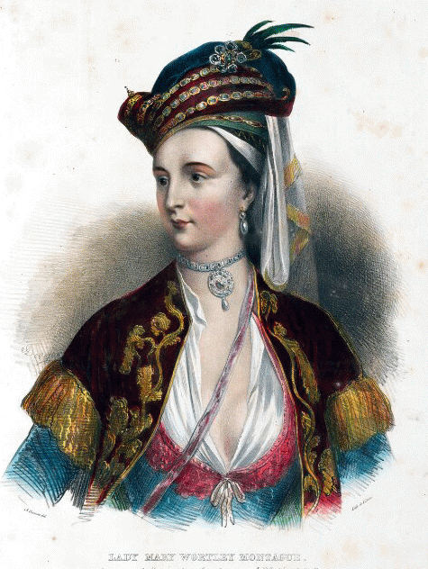

Slide 9
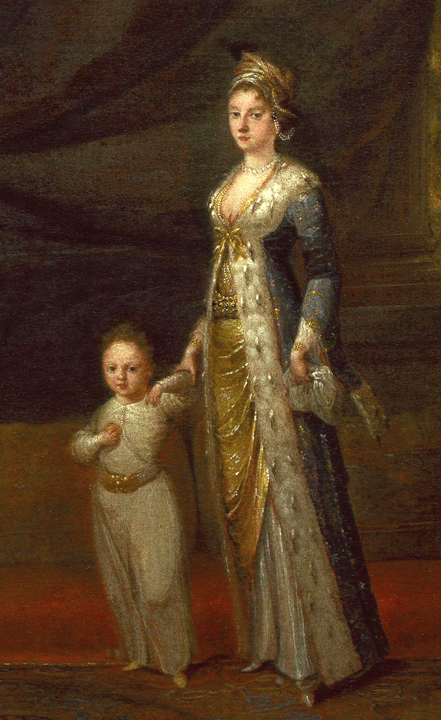
Lady Mary Wortley Montagu with her son (age 3)
(c. 1717, attributed to Jean Baptiste Vanmour)

Slide 10
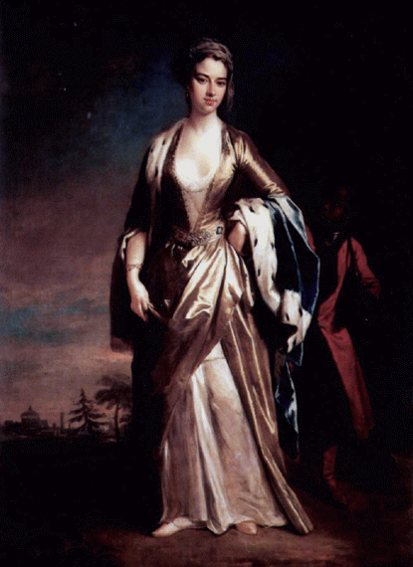
Lady Mary Wortley Montagu (1725)
(by Jonathan Richardson the Younger)

Slide 11
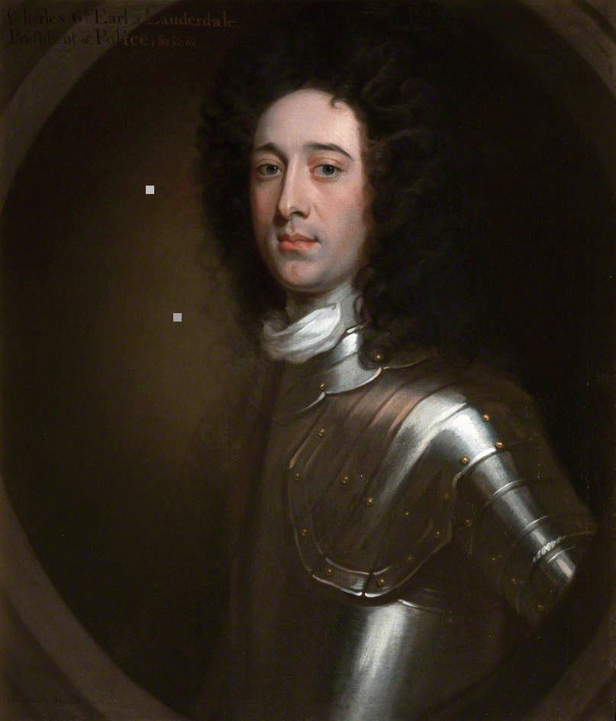
Charles Maitland
(by William Aikman)

Slide 12
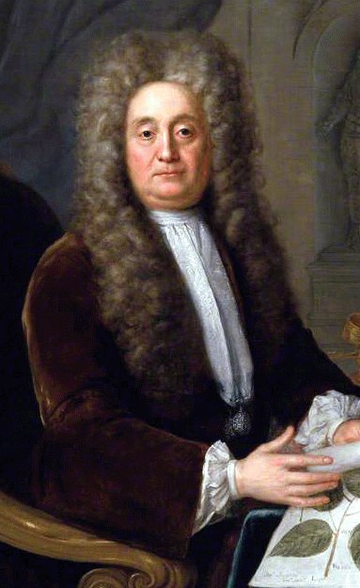
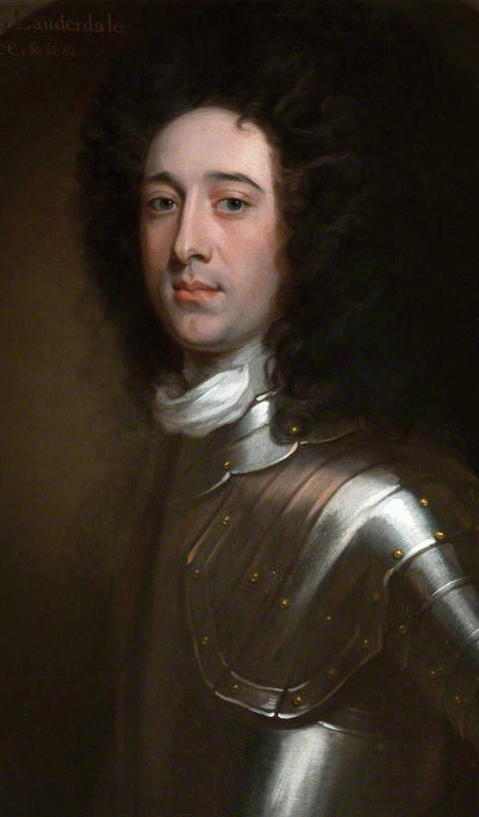
Hans Sloane (1726)
(by Stephen Slaughter)
Charles Maitland

Slide 13
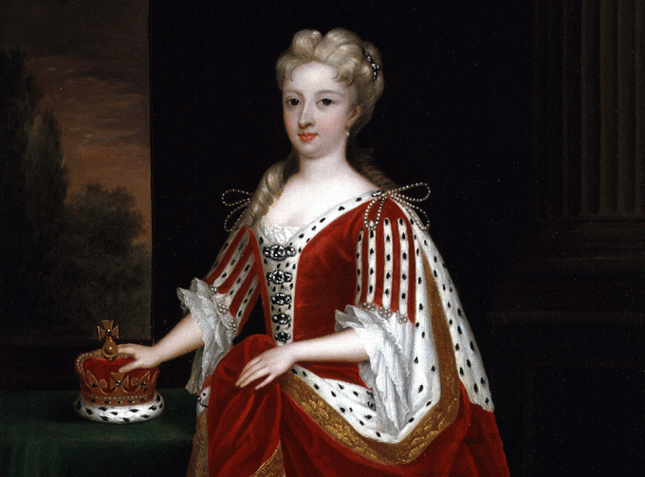
Caroline, Princess of Wales (1716)
(by Godfrey Kneller)

Slide 14
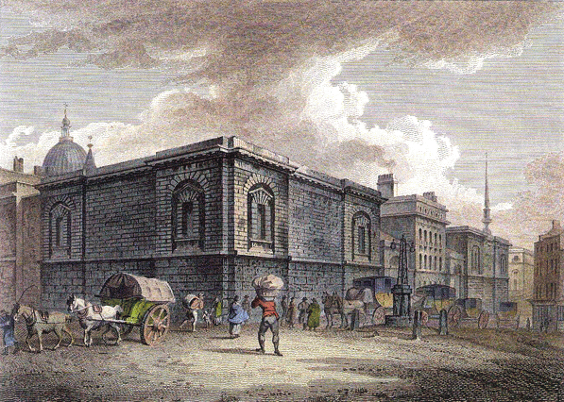
Newgate Prison (1800) (by Thomas Medland)

Slide 15
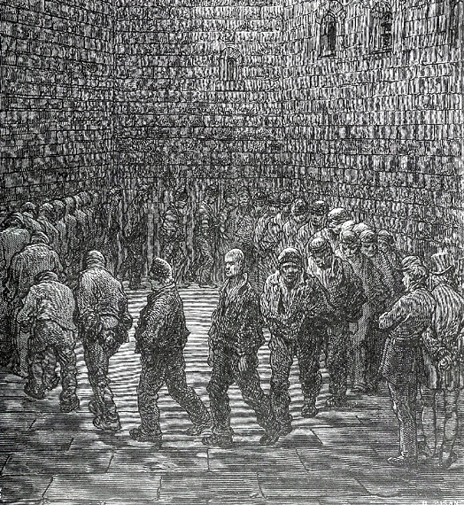
Hans Sloane

Slide 16
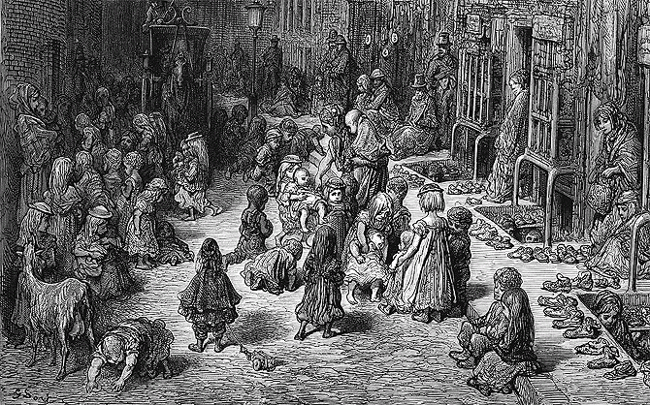
London orphange

Slide 17
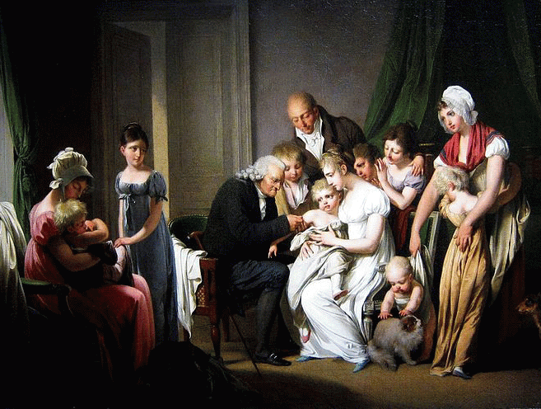

Slide 18
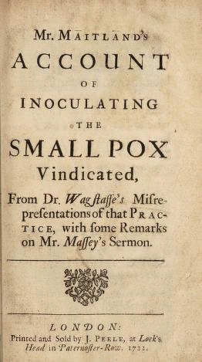
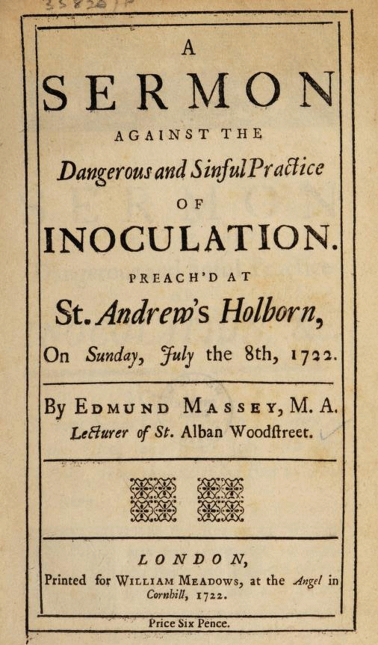
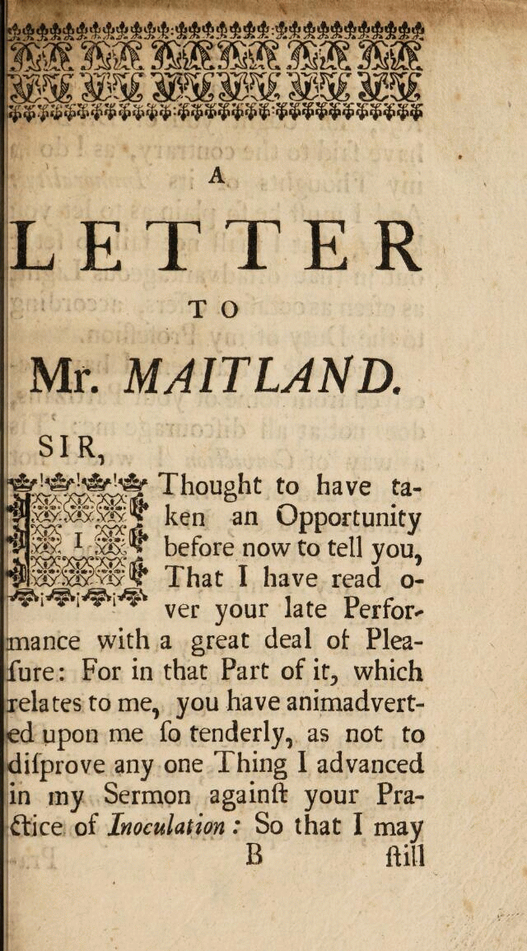
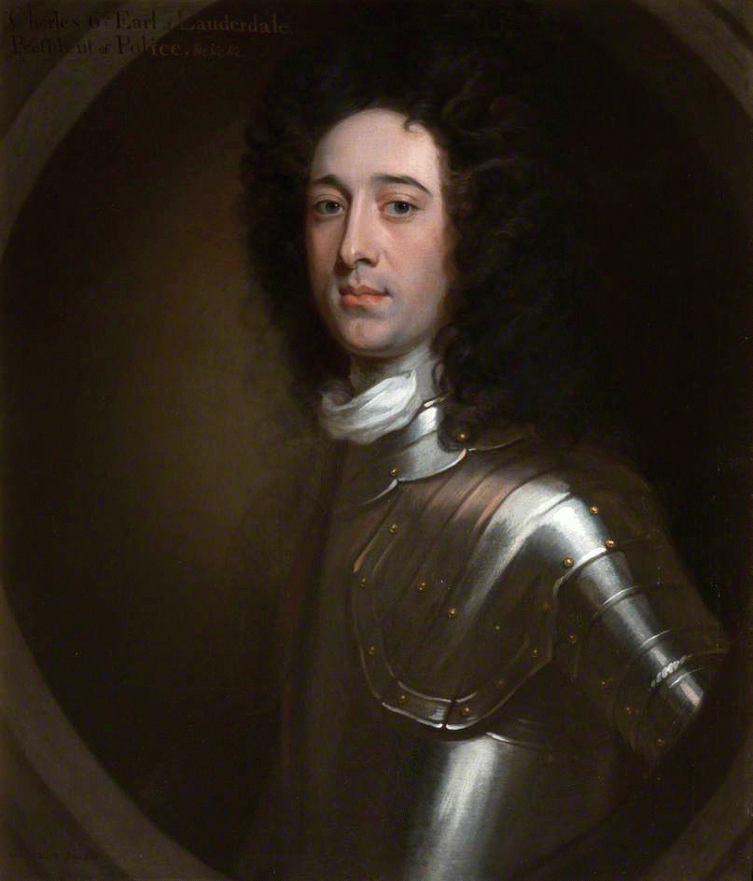

Slide 19
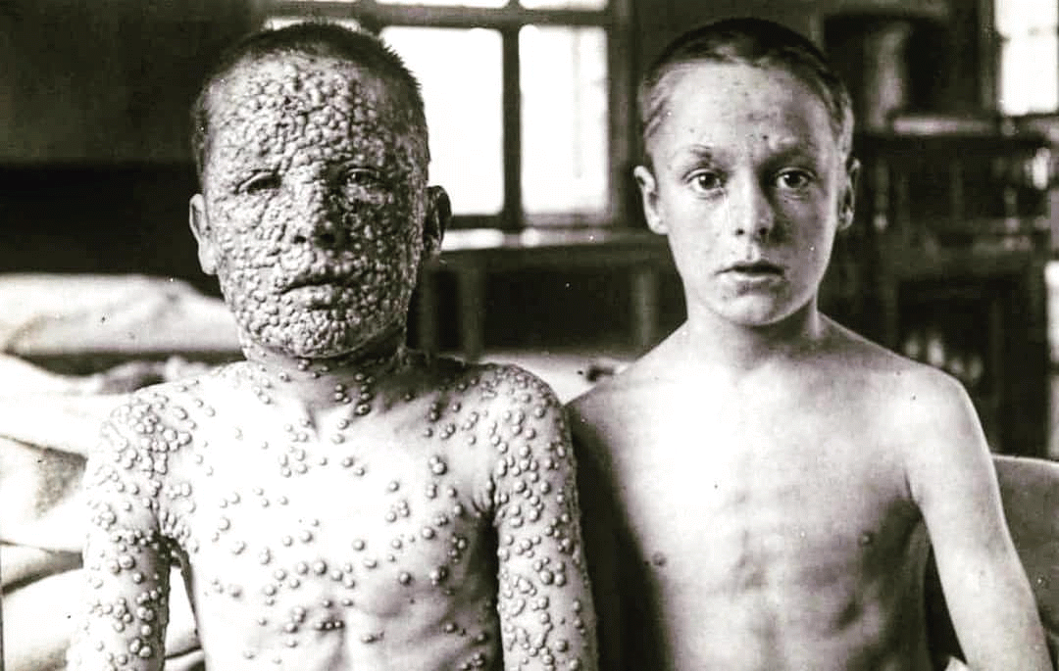
comparison of unvaccinated and vaccinated smallpox patients (c. 1900)

Slide 21
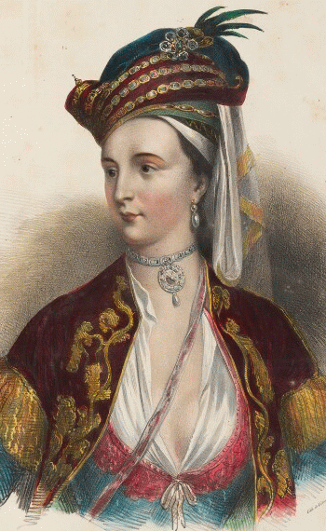
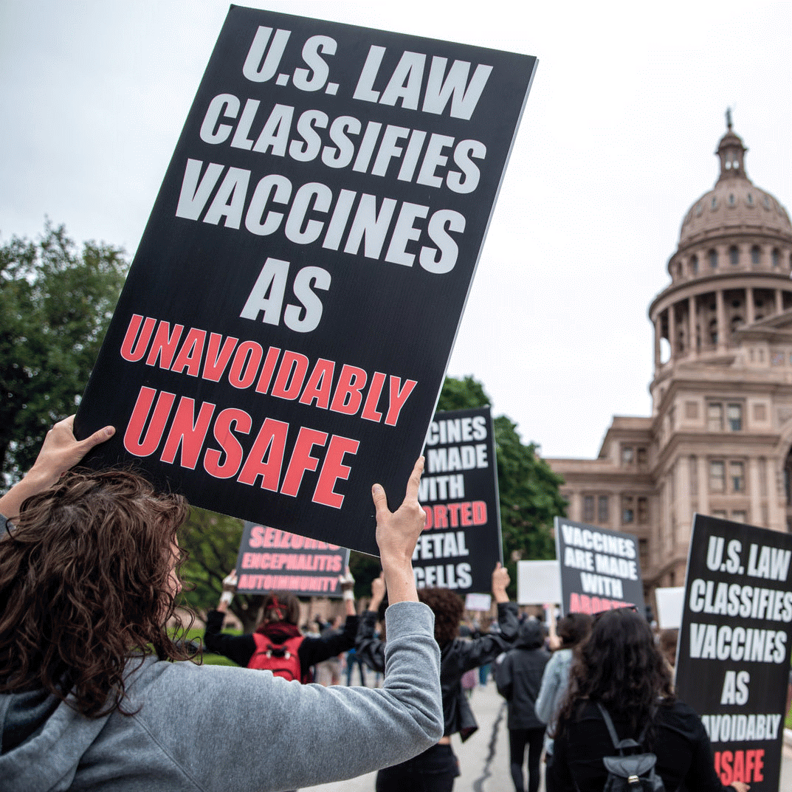
What lessons does the story of Lady Mary Montagu & smallpox variolation in the 1700s convey to us today?

Slide 22
What does the case of “The Vaccine Skeptics of 1721" demonstrate about:
Cultural bias in science?
Role of emotions vs. science in decision-making?
Experience vs. credentialed expertise?
Gender bias in science?
Systematic empirical evidence vs. experience/ testimony?
Ethics of scientific research?
Role of consensus & scientific institutions?
How we interpret the credibility of scientific
claims?

