Slide 1
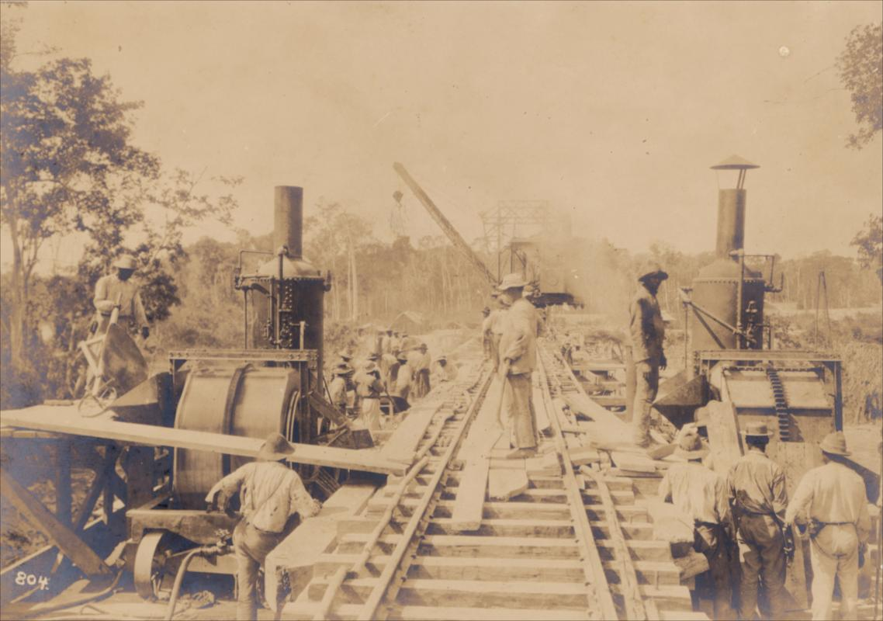
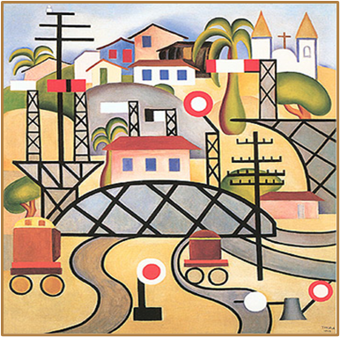
The railroad worker’s disease
Nathália Helena Azevedo & Thiago Marinho Del Corso

Slide 2
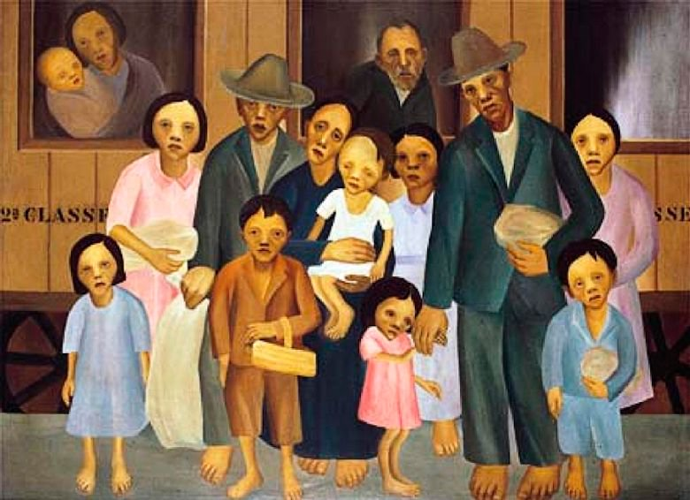
Prologue
Brazil, Railroads and Malaria

Slide 3
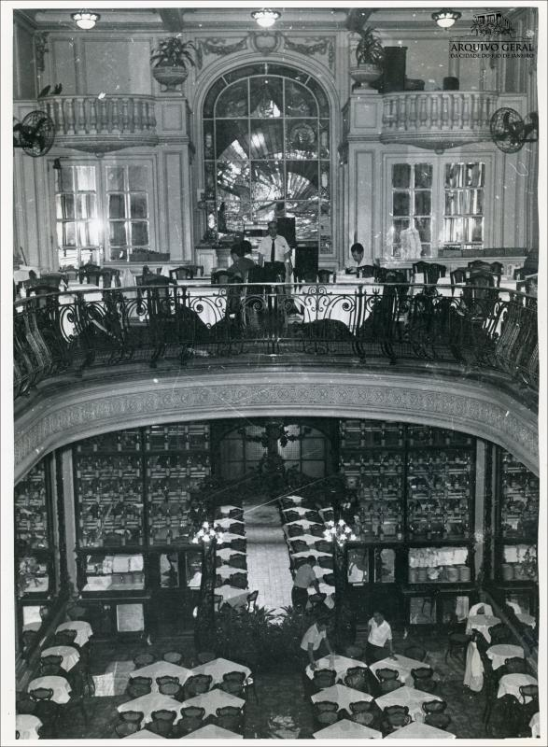
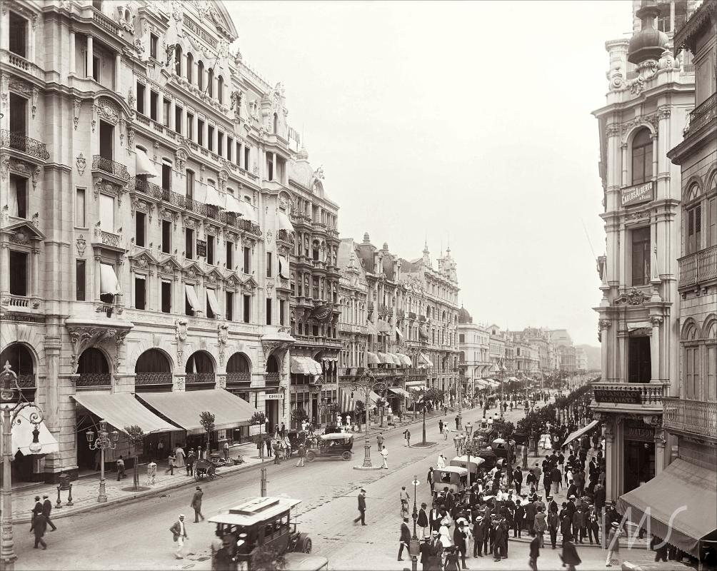
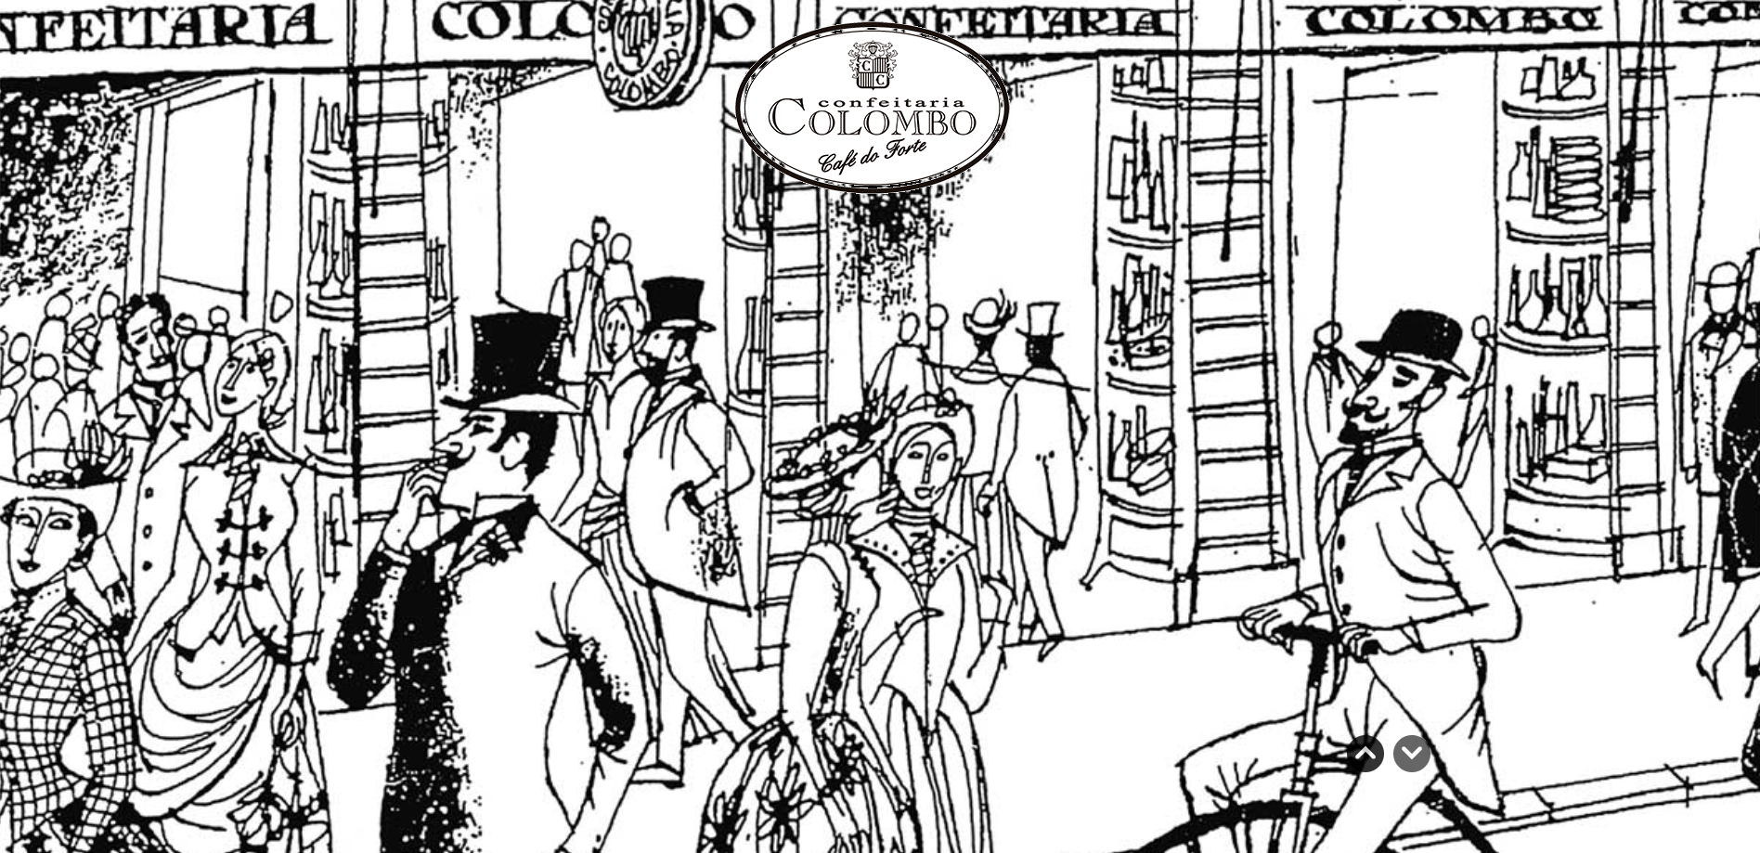
Aarão Reis
Rio de Janeiro, 1907

Slide 4
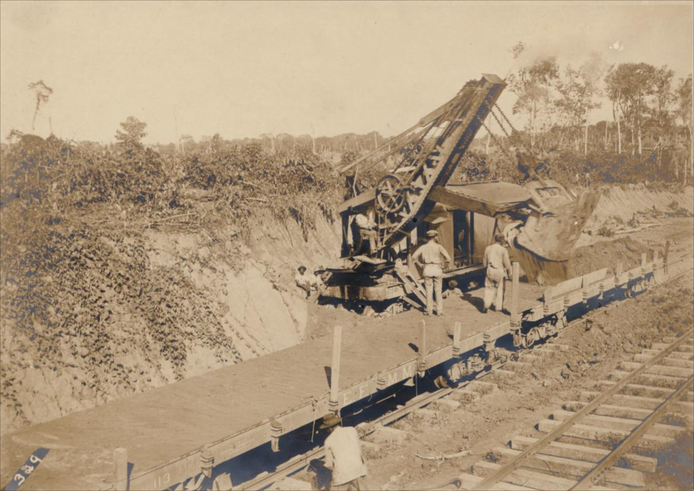

Slide 5
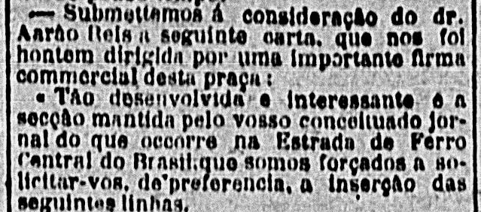
Pg. 7
Notes:
Letter from an unidentified reader published on 31.03.1907 (p. 07) in the newspaper “Correio da Manhã”.

Slide 6
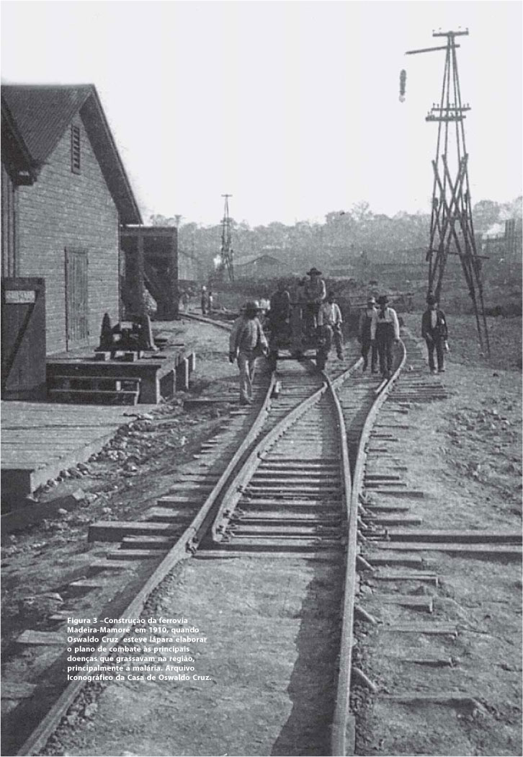
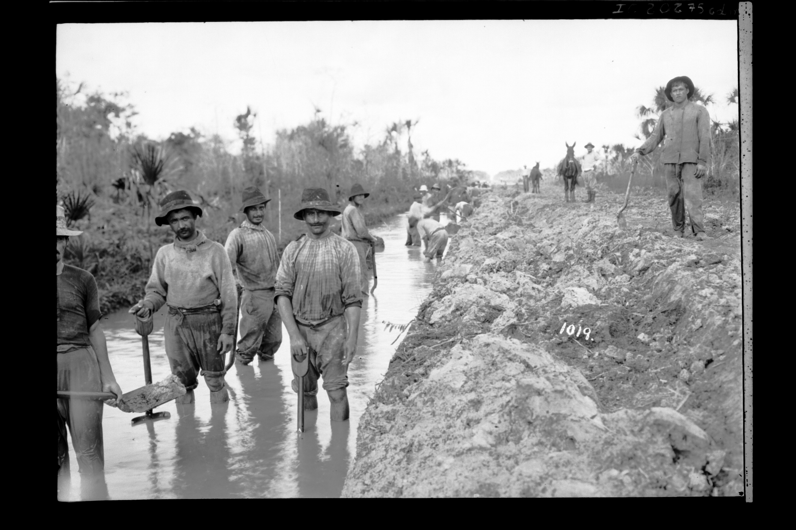

Slide 7
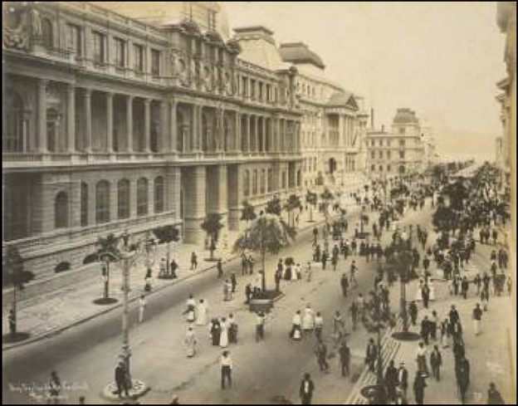
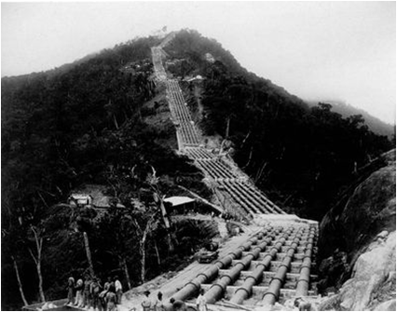
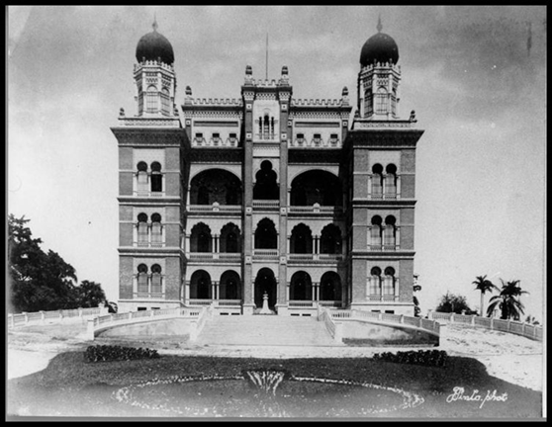
Hydroelectric project, São Paulo

Slide 8
[Think Question 1] As president of the railroad, what would be your response regarding the workers? What are your concerns, and what actions are available to you?

Slide 9
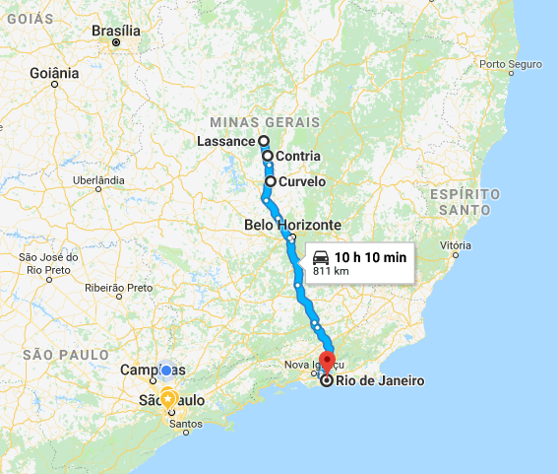
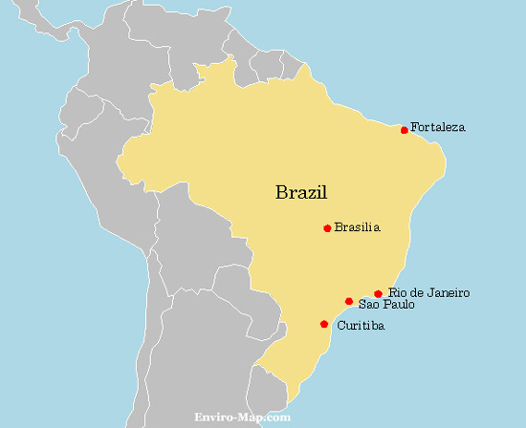
Cornélio Homem
Cantarino Motta, Chief Engineer, Lassance

Slide 10
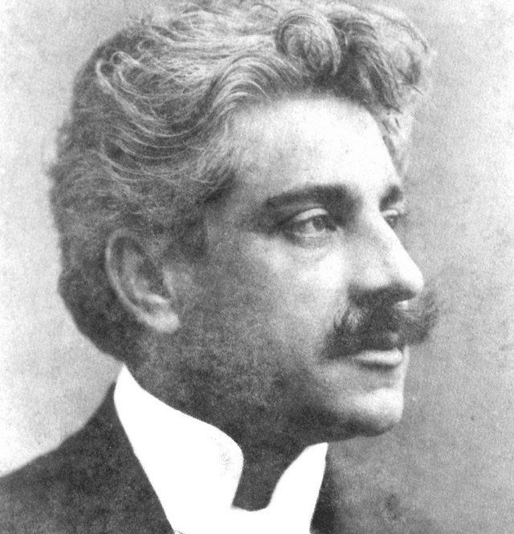
Manguinhos Institute, Rio de Janeiro
Oswaldo Cruz, Director
Cornélio Motta, Lassance

Slide 11
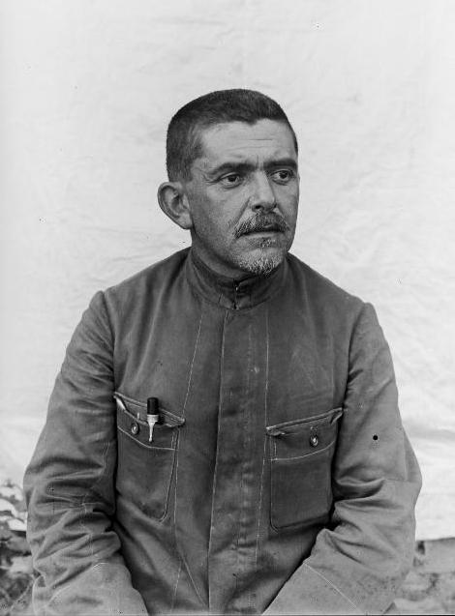
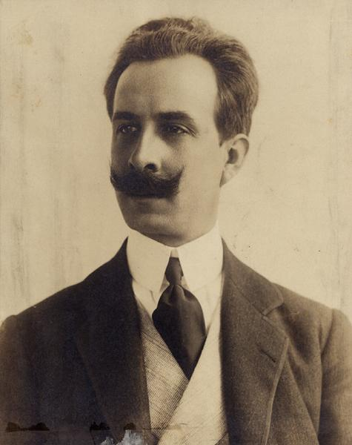
Belisário Penna
Carlos Ribeiro Justiniano

Slide 12
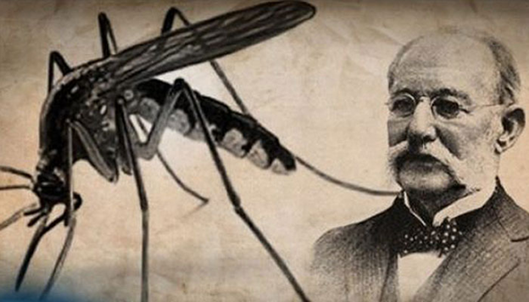

Slide 13
Chapter 1:
The Lassance Disease

Slide 14
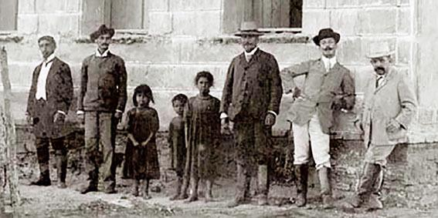
The physicians arrive in Lassance in June, 1907
At the far right, Belisário Penna and Carlos Ribeiro

Slide 15
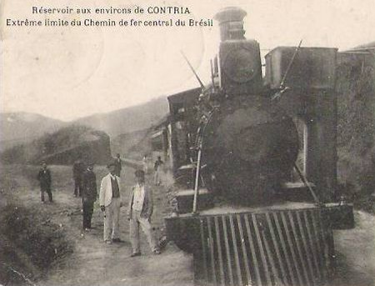
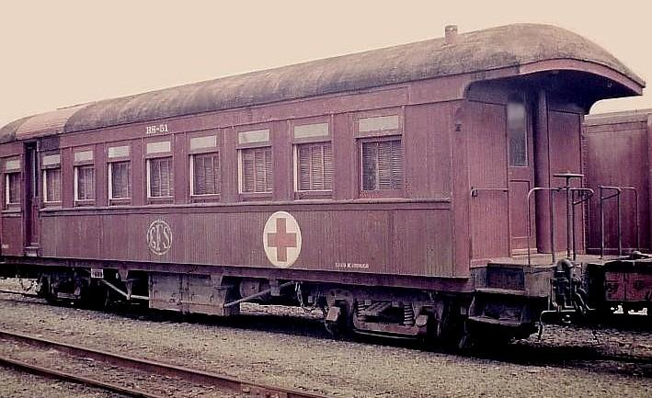
Carlos Ribeiro had his residence, office and laboratory in a train car

Slide 16
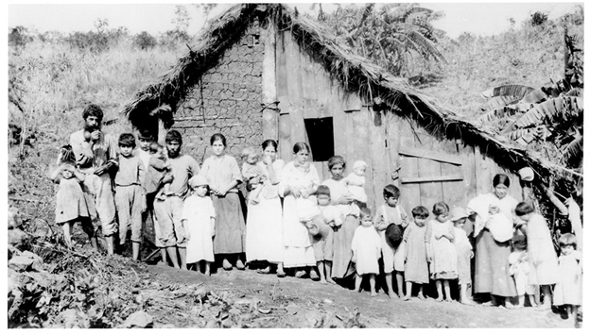
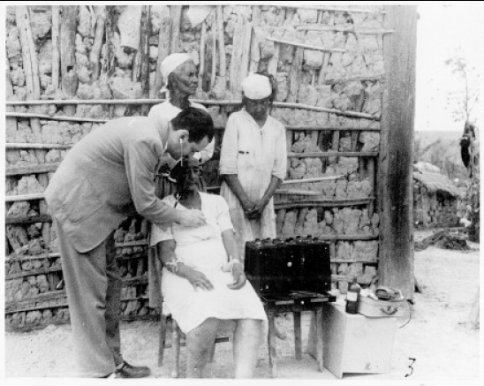
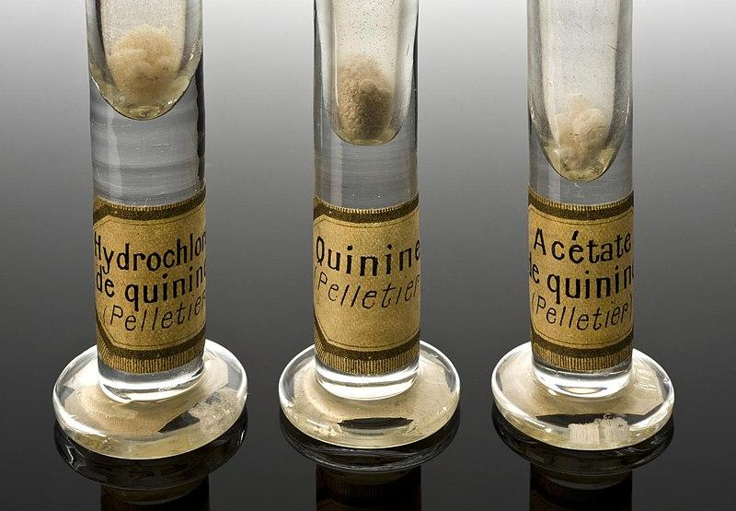
Lassance

Slide 17
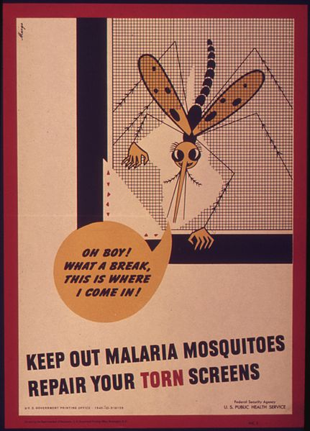
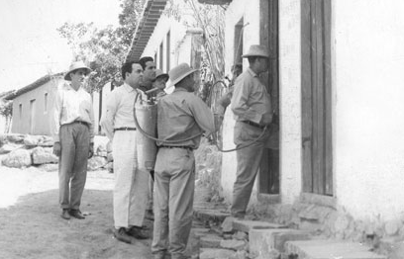
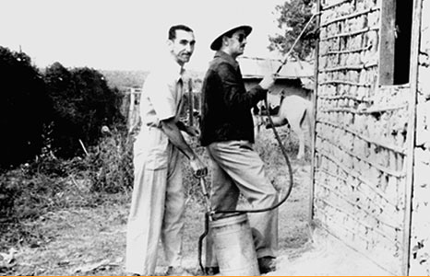
The anti-malaria work in Lassance

Slide 18
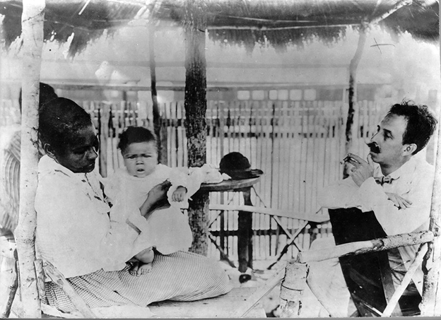

Slide 19
Symptoms found in the sick population of Lassance vs. malaria
Known Malaria Symptoms | 1. single bite, symptoms appear after 8 to 25 days 2. high fever, intense chills alternating with heat waves and profuse sweating (appears and disappears every 2 or 3 days) 3. head and body pain 4. appetite loss 5. anemia with yellowish skin (jaundice) and fatigue 6. liver and spleen enlargement 7. vomiting 8. encephalitis with retinal lesions (retinal bleaching) 9. can lead to death
Symptoms observed in Lassance | 1. swelling near bite (chagoma) 2. acute phase: symptoms usually go away within 3 to 8 weeks 3. low fever (goes away after a few days) 4. head and body pains (moderate) 5. appetite loss (moderate) 6. red spots on skin (exanthema) 7. liver and spleen enlargement 8. vomiting 9. meningitis and encephalitis (uncommon complications) 10. enlarged nerve ganglia 11. swelling (edema) 12. hardly leads to death

Slide 20
[Think Question 2] Given the list of symptoms, how would you determine if the railroad workers’ disease in Lassance is a variant form of malaria or a different disease entirely? What additional information would you like to collect? What criteria would you apply before seeking an alternative treatment or remedy?

Slide 21
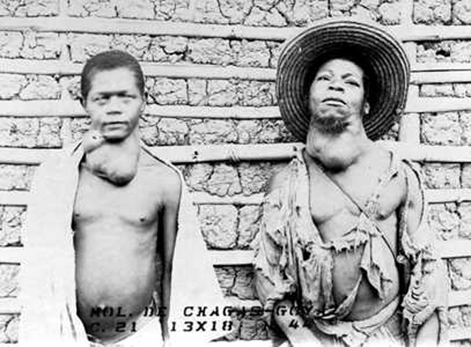
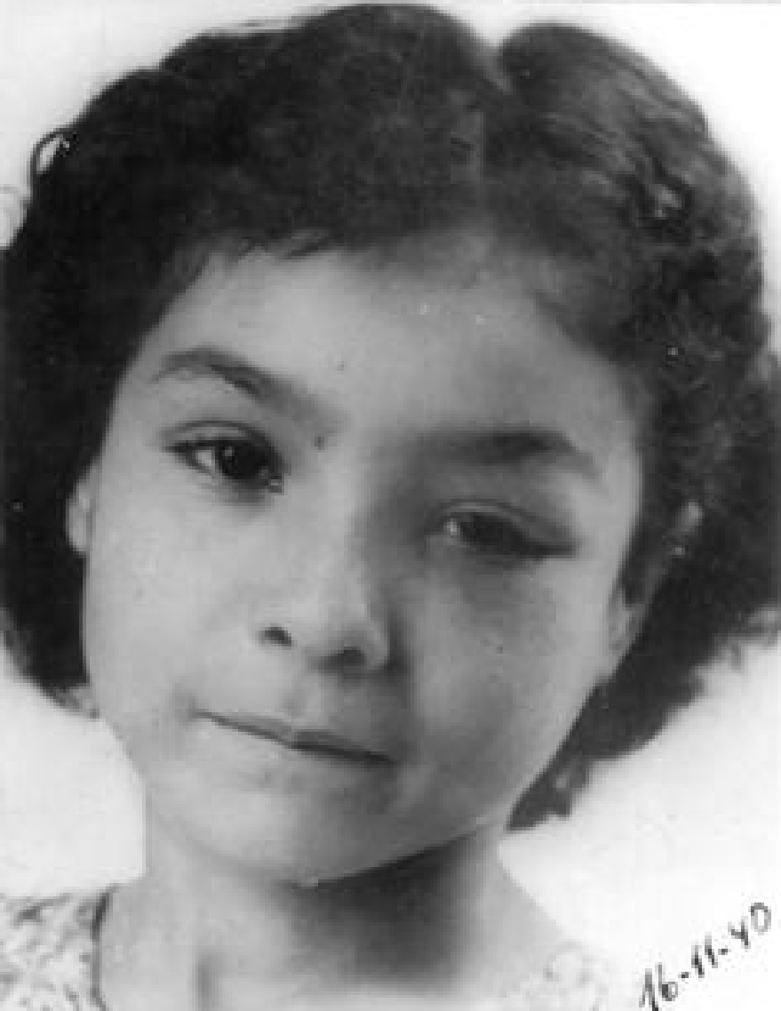
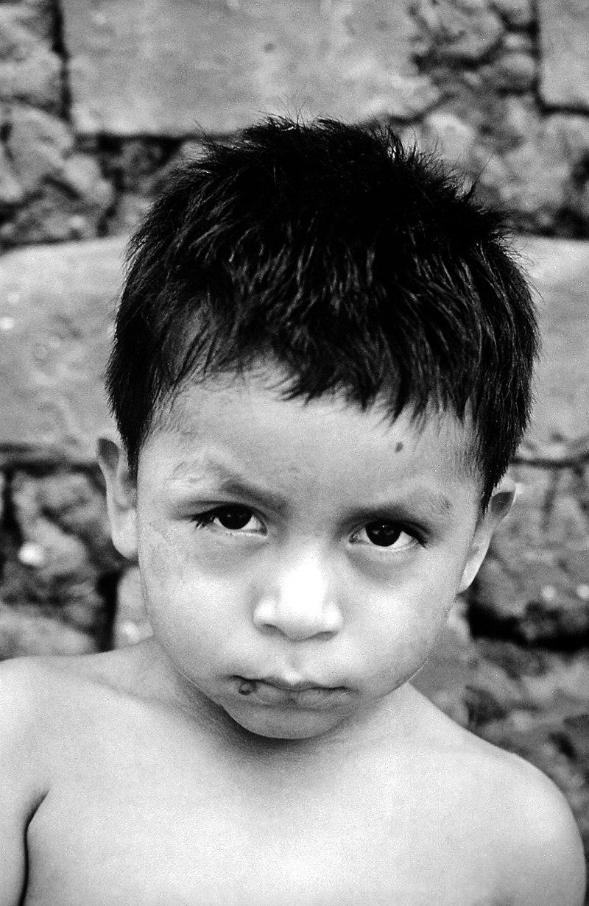
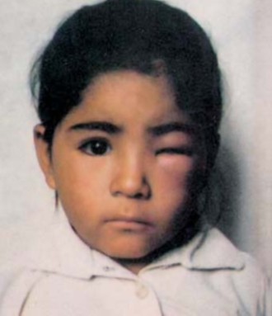
thyroid inflammation
eye condition, known as “Romaña's sign”

Slide 22
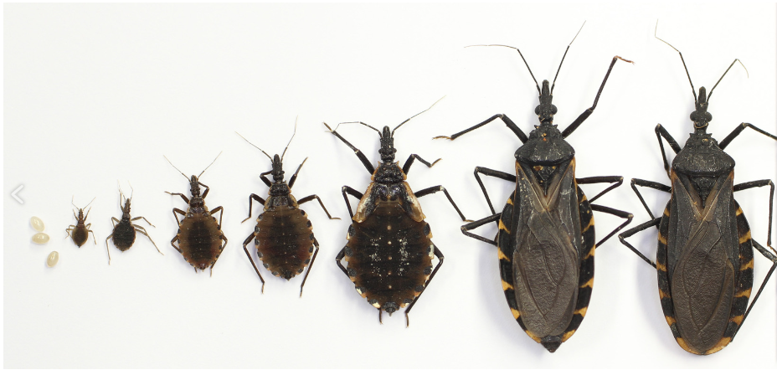
Chapter 2:
Of insects and men

Slide 23
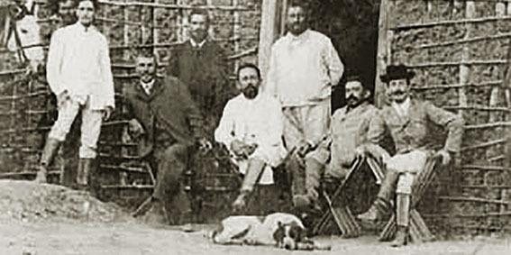
Cornélio Homem Cantarino Motta (center),
Carlos Ribeiro & Belisário Penna to the right

Slide 24
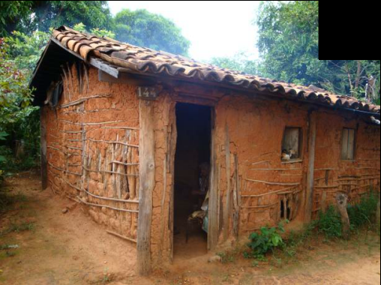
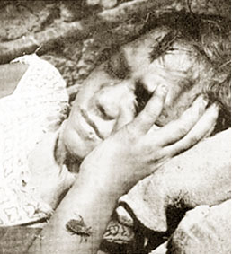

Slide 25
[Think Questions 3] Should Carlos take Cornélio’s suggestion seriously? Give at least one reason for heeding his advice, and at least one reason for doubting it. What could you do to investigate Cornélio's information further?

Slide 26
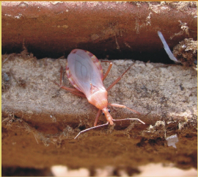
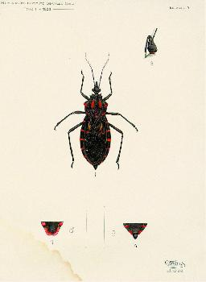
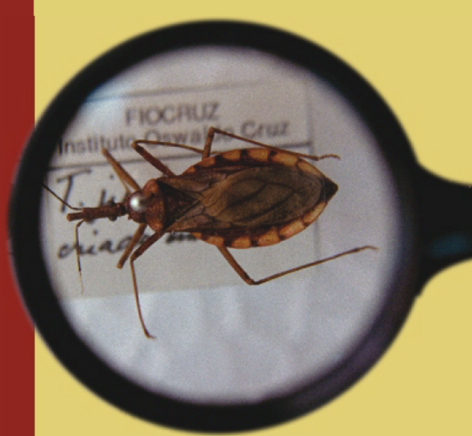
The insect stinging the residents of the region of Lassance
Belisário Penna
unknown Triatomina

Slide 27
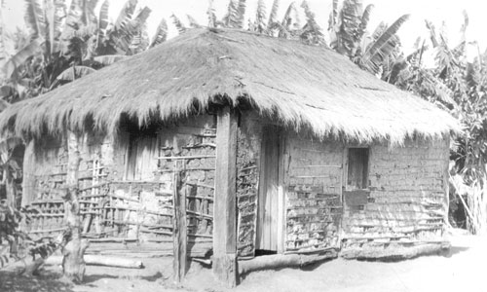
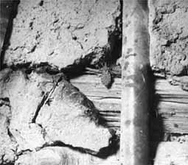
"the insect bites at night, hides in cracks, is common in unplastered and grass-covered houses where it reproduces freely, dislikes light, and disappears in the absence of people in the dwellings.”

Slide 28
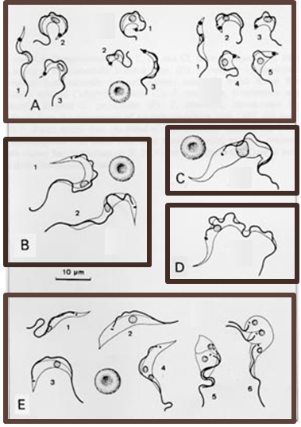
Chapter 3:
Protozoa and Diseases

Slide 29
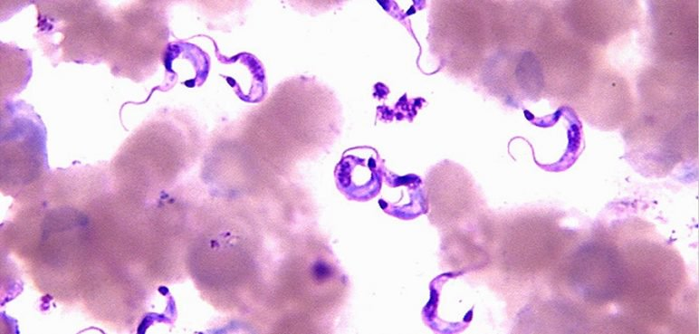
Protozoan Trypanosomide found in kissing bug stomach

Slide 30
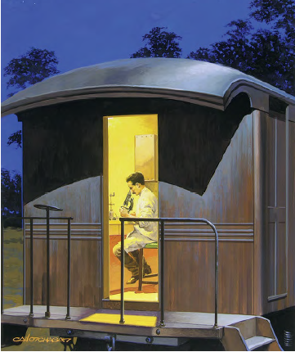
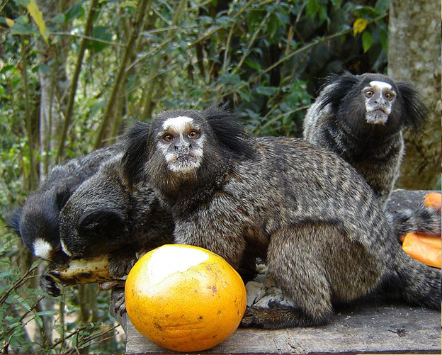
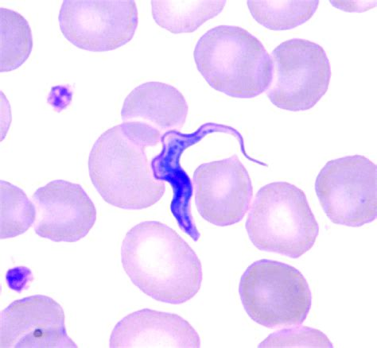
Marmoset (Callithrix penicillata)

Slide 31
[Think Questions 4] How might you determine if the trypanosome forms observed in the kissing bug and the marmoset are different species or variants of the same species? What expertise and resources do you need for this investigation? How will you secure them?

Slide 32
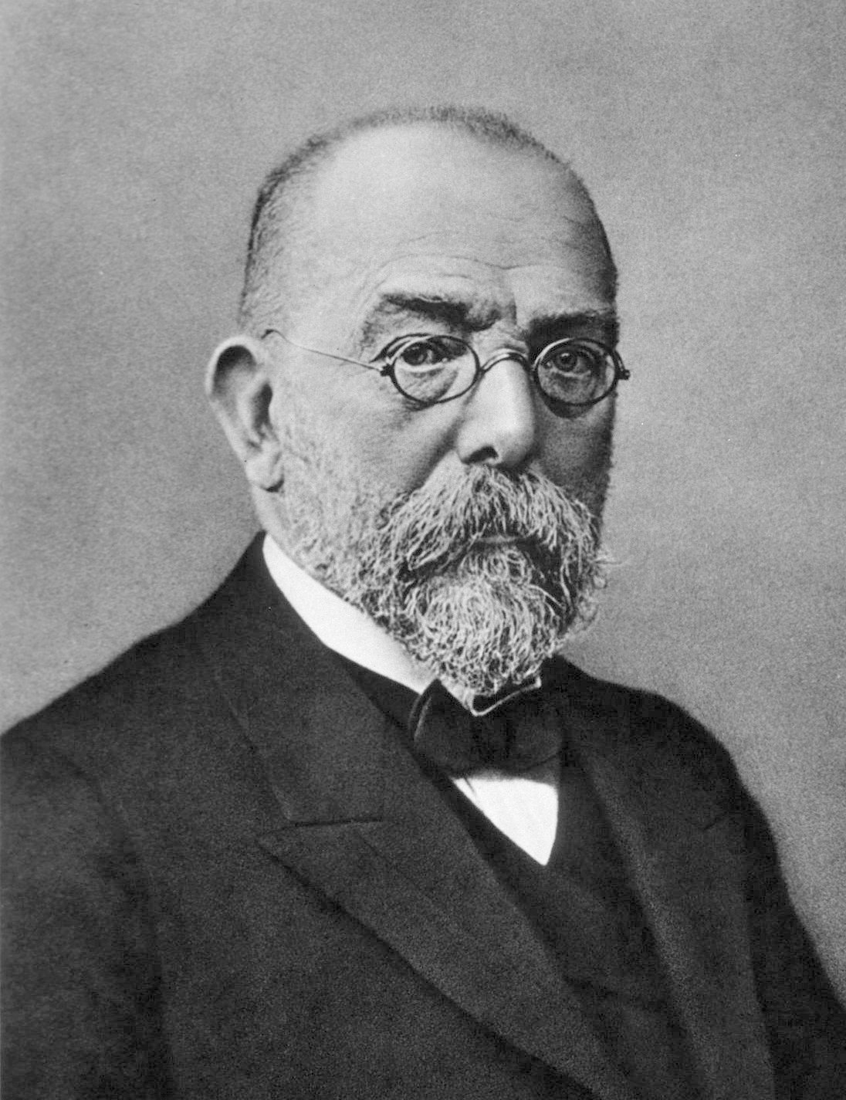
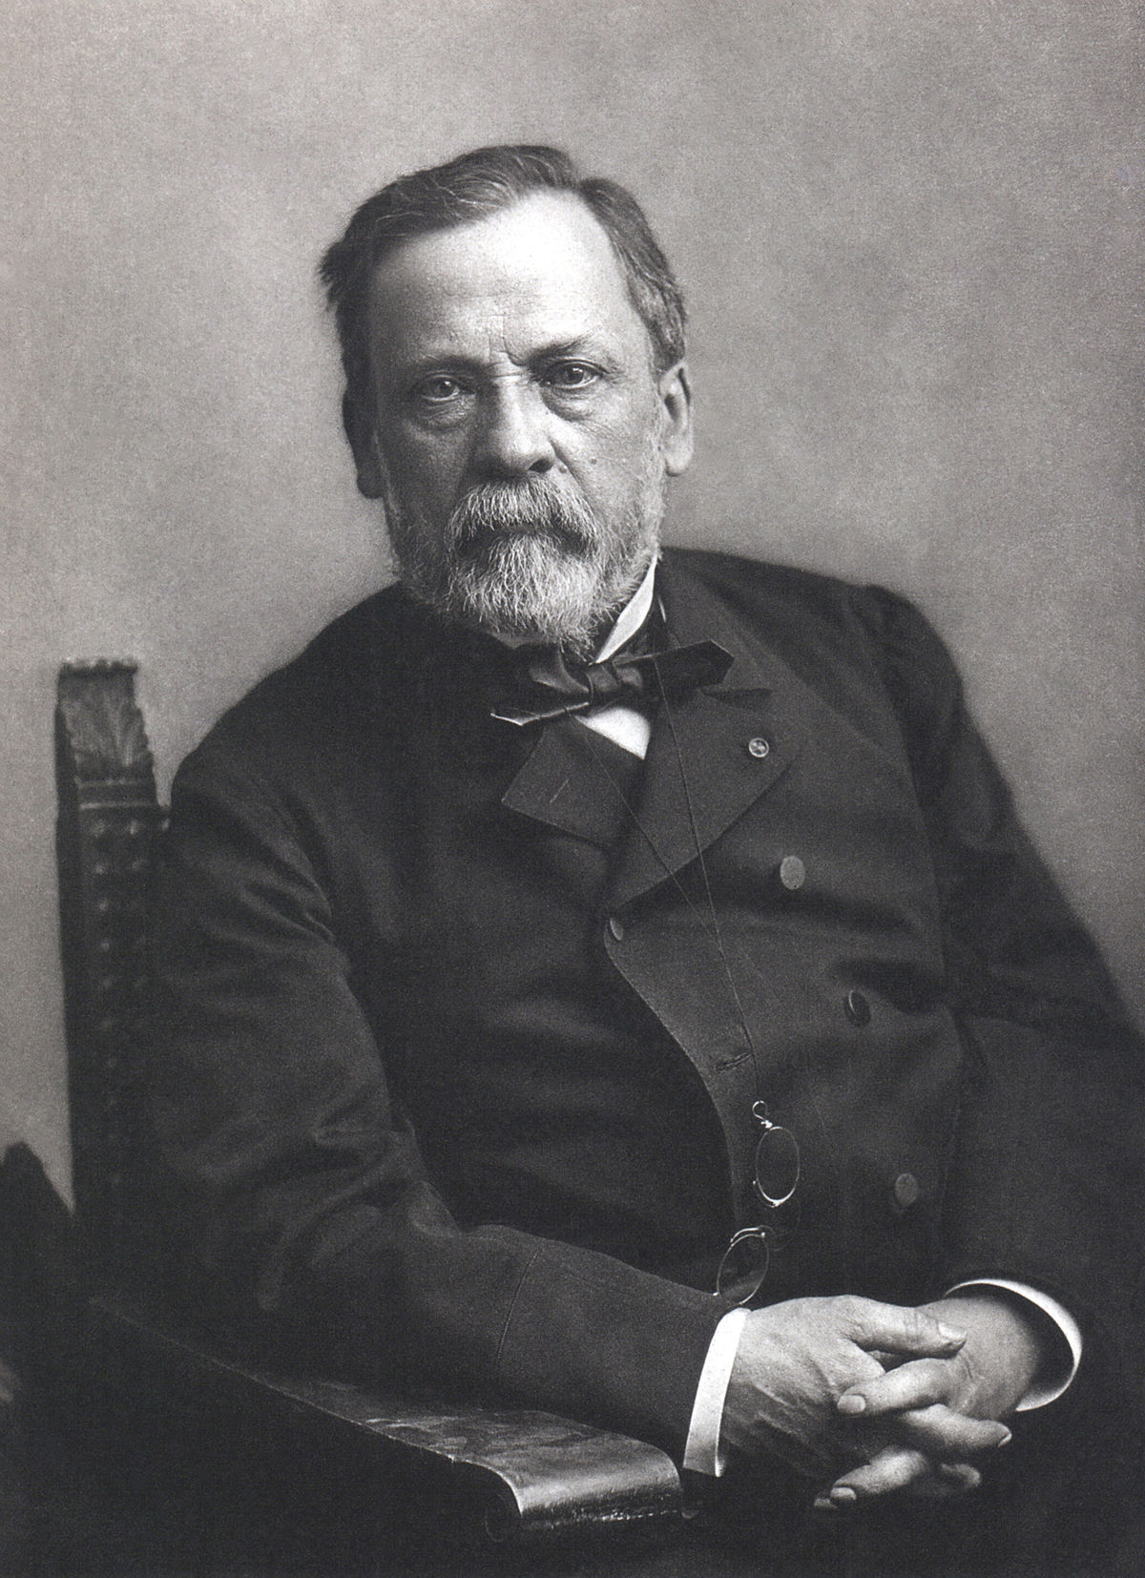
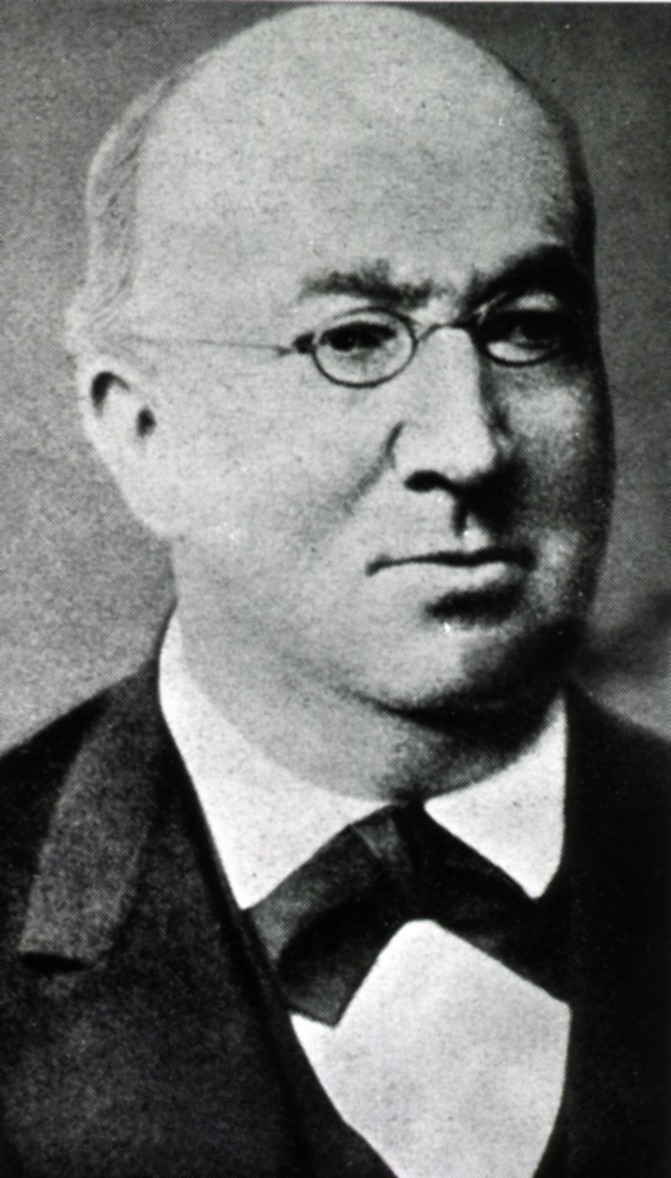
Robert Koch
Gabriel Gustav Valentin
Louis Pasteur
Patrick Manson
Carlos Finlay
Adolpho Lutz
Griffith Evans

Slide 33
Manguinhos Institute

Slide 34
After 30 days

Slide 35
Callithrix penicillata
Trypanosoma minasense
found in marmoset’s blood in the wild
Trypanosoma cruzi
found in the kissing bug and in marmosets infected by them

Slide 36
[Think Question 5] How can you confirm that the disease in the marmoset is the same as that in the Lassance group after ruling out one of the trypanosomes as pathogenic?

Slide 37
Trypanosoma cruzi

Slide 38
Blood sample
Stain: May-Grünwald Giemsa
Lymphocyte
Monocyte
Eosinophil
Neutrophil
Blood sample without protozoa, under a microscope

Slide 39
[Think Question 6] Should the blood investigations be abandoned or continued? If so, for how long? What factors guide your decision?

Slide 40
Berenice

Slide 41
[Think Question 7] In what ways does this finding change the course of the investigation? How might such unexpected events affect how you plan and conduct scientific investigations?

Slide 42
[Think Question 8] Is the presence of T. cruzi in the patient's blood in this one case sufficient to show that it causes the disease? If not, why not? How else might you link together the relevant evidence about the protozoa in kissing bugs, patients' blood, and other animals?

Slide 43
Manguinhos Institute
Manguinhos lab

Slide 45
Results of experiments performed by Carlos in mid-1909
Experiment | Origin of infected blood | Animals for inoculation of infected blood | Observations after inoculation | Interpretation of results by Carlos
A | Child A | 2 guinea pigs and 1 marmoset | The guinea pigs die 6 days after inoculation. The marmoset shows trypanosomes in the lung and peripheral circulation after 8 days. | (+) Guinea pigs die of the disease caused by the protozoa of the child’s blood. The marmoset is also contaminated with the disease.
B | Child B in severe condition and with many symptoms, but blood without visible T. cruzi. | 2 guinea pigs | One guinea pig dies and another has trypanosomes in the lung 9 days after inoculation, but has no parasites in the peripheral blood. | (+) One guinea pig dies accidentally and the other is in the early stage of the disease caused by the child’s blood.
C | Child C in severe condition and with many symptoms, but blood without T. cruzi. | guinea pigs | After 20 days, the guinea pigs show trypanosomes in the peripheral circulation. After 2 months of infection, some are alive and with intense infection. | (+) The guinea pigs are contaminated by the child's blood, but show differing degrees of infection and resistance.

Slide 46
[Think Question 9] What do you conclude from these experiments, combined with all the other evidence gathered through Carlos’s work?

Slide 48
[THINK Question 10] What types of scientific work were needed to generate this evidence, and how was each important?

Slide 50
Chapter 4.
Celebrating a triple discovery

Slide 51
Carlos Ribeiro Justiniano das Chagas's “Triple Discovery”

Slide 52
[Think Question 11] Imagine the impact of Chagas’s investigations and conclusions on the science of studying diseases. How might understanding the history of this one case shape public policy on funding science and using its results?

Slide 54
[Think Question 12] Why and how awards are important (and from whom)? What level of recognition does a discovery like this deserve?

Slide 55
?

Slide 56
Global Distribution of Chagas disease, based on 2018 estimates

Slide 57
Lassance today

Slide 58
[Think Question 13] Discuss how the case of Carlos Chagas & the Railroad Workers’ Disease illustrates various features about science and how it works:
A. The role of political and economic factors in supporting scientific research (THINK 1, 10, 11)
B. The role of personal background, motivations and skills (THINK 3, 10)
C. The role of analogy (e.g., comparisons between diseases) (THINK 2, 4, 8, 9, 10)
D. The role of local or anecdotal knowledge versus systematic investigation (THINK 3)
E. The role of chance or contingency (THINK 3, 7, 8, 10)
F. The role of patience and persistence (THINK 6, 7, 10)
G. The role of collaboration (THINK 8, 10, 12)
H. The relationship between laboratory studies and field studies (THINK 2, 4, 5, 6, 8, 9, 10)
I. The application of research knowledge to public health (THINK 11)
J. Incentives and rewards (THINK 12)

